Slide 1
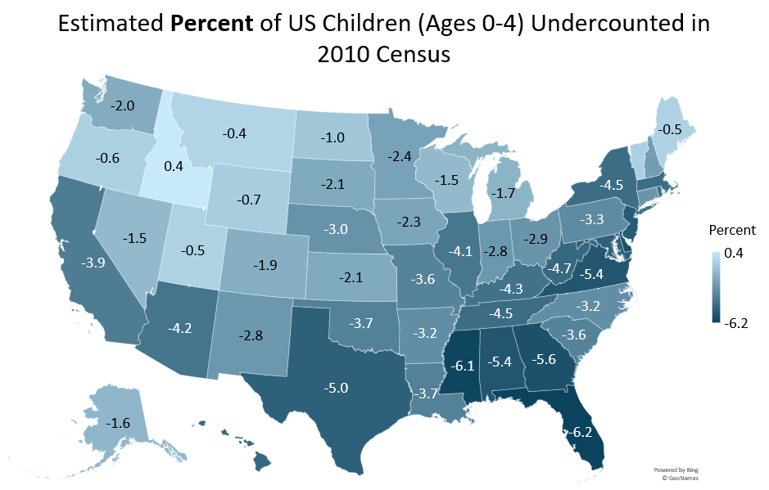
Source: King H, Ihrke, D, and Jensen, E. (2018). “Subnational Estimates of Net Coverage Error for the Population Aged 0 to 4 in the 2010 Census.” US Census Bureau. Paper presented at the Population Association of America Annual Conference in Denver, CO, April 2018.

Slide 2
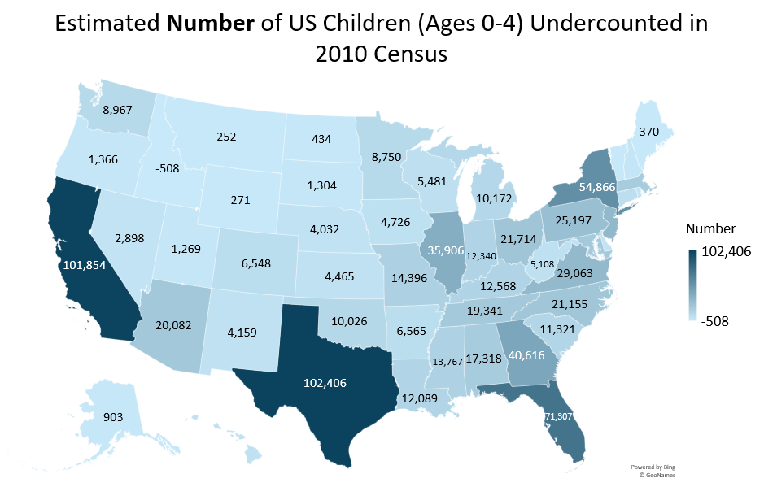
Source: King H, Ihrke, D, and Jensen, E. (2018). “Subnational Estimates of Net Coverage Error for the Population Aged 0 to 4 in the 2010 Census.” US Census Bureau. Paper presented at the Population Association of America Annual Conference in Denver, CO, April 2018.

