Slide 1
AAP Bright Futures National Center Bright Futures: Guidelines for Health Supervision of Infants, Children, and Adolescents
What’s New in the Fourth Edition?

Slide 2
Webinar Presenters
Joseph F. Hagan, Jr. MD, FAAP, Clinical Professor in Pediatrics, The Robert Larner, M.D. College of Medicine at the University of Vermont and The University of Vermont Children’s Hospital
Co-editor: Bright Futures Guidelines, Fourth Edition
Judith S. Shaw, EdD, MPH, RN, FAAP, Executive Director, Vermont Child Health Improvement Program; Executive Director, National Improvement Partnership Network; and Professor of Pediatrics & Nursing, The Robert Larner, M.D. College of Medicine at the University of Vermont
Co-editor: Bright Futures Guidelines, Fourth Edition

Slide 3
What is Bright Futures?
The mission of Bright Futures is to promote and improve the health, education, and well-being of infants, children, adolescents, families, and communities.
Bright Futures is the health promotion/disease prevention part of the medical home
At the heart of the medical home is the relationship between the clinician and the family or youth
Notes:
Bright Futures is a set of principles, strategies and tools that are theory-based, evidence-driven, and systems-oriented that can be used to improve the health and well-being of all children through culturally appropriate interventions that address the current and emerging health promotion needs at the family, clinical practice, community, health system and policy levels.

Slide 4
Who can use Bright Futures?
Notes:
In addition to clinicians, Bright Futures contains relevant information, tools and resources for a variety of audiences including:
state and local public health programs
policymakers
child health clinicians that directly provide primary care
home visiting staff
community mental health providers
school nurses
pediatric educators
medical residents
advocates and families who actively participate in well-child visits.
All of these audiences have important roles to play in keeping children healthy and safe. State and local government agencies and community organizations have the responsibility of helping families access care and resources that promote safe and healthful environments. For example, many state Medicaid agencies have adopted the Bright Futures Guidelines as the standard of care in the state, and most Early and Periodic Screening, Diagnosis, and Treatment (EPSDT) programs follow the Bright Futures/American Academy of Pediatrics (AAP) Periodicity Schedule and the Guidelines' pediatric screening recommendations, thus ensuring that children and teens obtaining care through government agencies receive quality and covered preventive services. The 2017 Periodicity Schedule is consistent with the Fourth Edition.

Slide 5
Bright Futures Guidelines: History and Timing of Release
1994: First edition, Morris Green, MD, Editor
2000: Second edition and Revised Edition in 2002, Morris Green, MD, and Judith S. Palfrey, MD, Editors
2008: Third edition Joseph F. Hagan, Jr, MD, FAAP, Judith S. Shaw, EdD, MPH, RN, FAAP, Paula M. Duncan, MD, FAAP, Editors
2017: Fourth edition Joseph F. Hagan, Jr, MD, FAAP, Judith S. Shaw, EdD, MPH, RN, FAAP, Paula M. Duncan, MD, FAAP, Editors
Notes:
From the beginning, the Bright Futures Guidelines have had a rich history with many tireless contributors.
The richness of the Fourth Edition reflects the combined wisdom of the multidisciplinary child and adolescent health care professionals and families who served on the 4 Bright Futures Expert Panels on Infancy, Early Childhood, Middle Childhood, and Adolescence.
Each Panel, and many expert reviewers, carefully considered the health supervision needs of an age group and developmental stage, as well as recommendations set forth in each of the 12 health promotion themes.
The Fourth Edition has also undergone Public Review receiving over 3500 comments from public external reviewers who represented AAP committees, councils, and sections; professional organizations; institutions; and individuals with expertise and interest in this project.

Slide 6
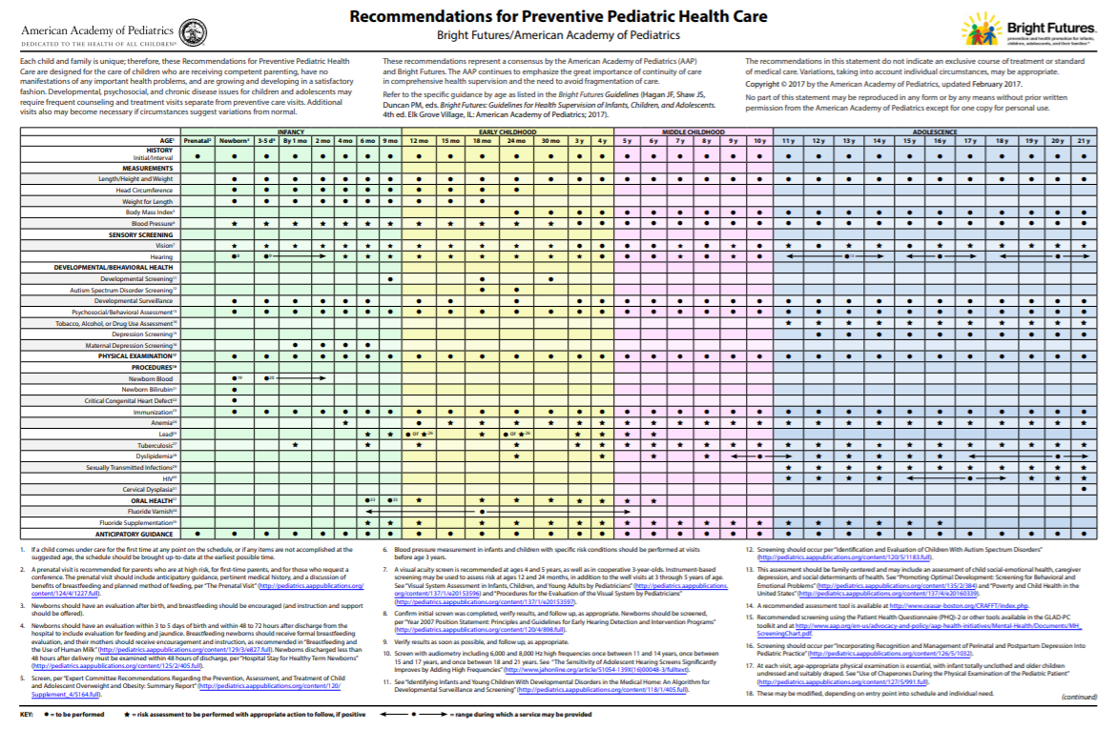
The Periodicity Schedule and the Bright Futures Guidelines
The Periodicity Schedule tells you what to do in well- child visits, while the Bright Futures Guidelines tell you how to do it—and how to do it well.
Notes:
The bottom line- the Bright Futures/AAP Periodicity Schedule recommends exactly what pediatric clinicians should screen for and do at every well-child visit to promote comprehensive health supervision, while the Bright Futures Guidelines provides clinicians with all-inclusive recommendations and tips to provide patients the best care. Within the public health arena, the Bright Futures/AAP Periodicity Schedule may be adopted as the standard of care for pediatric services. It can help identify health indicators and screenings and can be used by clinicians in health department clinics.
The AAP Recommendations for Preventive Pediatric Health Care, or Periodicity Schedule, is actually AAP Policy and is published annually in Pediatrics, the AAP peer reviewed journal.
The Periodicity Schedule is updated annually as new evidence emerges–you can find it on brightfutures.aap.org.
When linking to the Periodicity Schedule online, make sure to directly link to the Bright Futures website for the latest version.
The AAP updates the Periodicity Schedule annually, which is the reason the Schedule is not found in the book itself.

Slide 7
Evidence and Rationale Chapter
Rigorous Guidelines Review
Evidence and Rationale Described
Evidence Consultant: Alex Kemper, MD, FAAP
Recommendations interpreted with caution
Based in science
Consensus based
What Evidence grounds our Recommendations?
Notes:
As science has evolved, so, too, has the evidence-base for the health supervision recommendations as reflected in the Fourth Edition. The Evidence and Rationale chapter provides evidence-driven guidance for implementing the recommendations included in the Periodicity Schedule and also describes other preventive care services likely to be beneficial, but that are not supported by the same degree of evidence. The chapter reflects Bright Futures’ desire to be as transparent as possible about the evidence supporting its recommendations.
The Evidence and Rationale chapter presents each component of the Periodicity Schedule beginning with text that summarizes the supporting evidence. This summary is followed by tables that provide evidence citations, the rationale for the screening tasks, techniques, and risk assessment questions used in the Guidelines. The components are presented alphabetically by topic, unlike the Periodicity Schedule, which follows a different order.

Slide 8
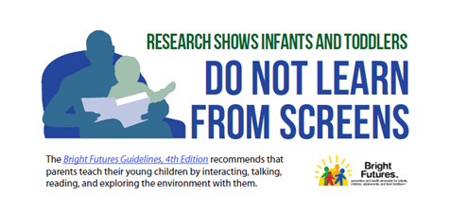
What’s new about the Fourth Edition?
Promoting Lifelong Health for Families and Communities
Provides greater focus on lifelong physical and mental health
Promoting the healthy and safe use of social media
Includes new screen time recommendations
Promoting health for children and youth with special health care needs
Expanded Evidence and Rationale Chapter
Notes:
A new team of experts was convened to develop a new health promotion theme: Promoting Lifelong Health for Families and Communities. The theme provides a current review of the science of development and insight for how this science might be applied in our practices and clinics. It helps health care professionals understand how the interplay of biological, behavioral, psychological, social, and environmental factors influence children’s capacity to reach their full potential for health and how to take the opportunity to positively influence the future health and wellness of patients and their families.
Bright Futures has always emphasized the importance of families and family engagement in care. We now have the data that prove what pediatricians have always believed to be correct--- early life experiences are important—and matter.

Slide 9
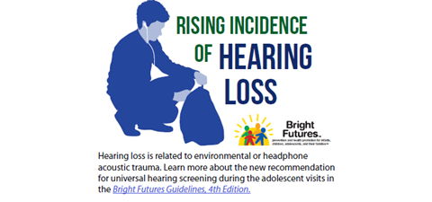
What’s new…(cont.)
Social determinants of health are embedded in many visits
Strengths and protective factors make a difference
Risk factors make a difference
Features updated milestones of development and developmental surveillance questions
Provides new clinical content about the latest recommendations and provides guidance on implementation
Includes updates to several adolescent screenings including cervical dysplasia; depression; dyslipidemia; hearing; vision; tobacco, alcohol, or drug use
Notes:
Social determinants of health are social and economic factors that affect the health of children and families. The Bright Futures Guidelines’ emphasis on social determinants reflects the importance of a broad view of health promotion–one that identifies ways to enhance social and physical environments in ways that promote quality of life and good health for all.
Contemporary health supervision looks beyond the office encounter to assess and address the risks, strengths and protective factors, which emerge from the family’s and community’s circumstances affecting health in both positive and negative ways. The AAP promotes a lifelong health model that encourages health care professionals to be guardians of healthy child development and to function as community leaders to help build strong foundations for positive social interactions, educational achievement, economic productivity, responsible citizenship, and lifelong health.
Although social factors are not new issues for health care professionals who care for children, adolescents and families, new science underpins their importance and provides evidence for effective interventions. In terms of screening for social determinants, Bright Futures suggests categories of social determinants that health care professionals may wish to address. It is best for local health departments and clinicians to determine which tools work best for their patient populations.
Understanding risks, strengths and protective factors makes a difference for the health and well-being of the child and family.
Note that developmental milestones are still important in care, even with enhanced screening tools available. The milestones in the Fourth Edition were developed with help from colleagues who are experts in developmental surveillance and screening.

Slide 10
New Screenings Since Third Edition
Bilirubin screening: Universal at the Newborn Visit.
Maternal depression screening: Universal at the 1 Month through 6 Month Visits.
Oral health: Universal fluoride varnish at the 6 Month (first tooth eruption) through 5 Year Visits, in addition to Selective fluoride supplementation at the 6 Months through 16 Year Visits.
Dyslipidemia screening: Universal once between the 9 Year and 11 Year Visits, in addition to the Universal dyslipidemia once between the 17 and 21 Year Visits carried over from the 3rd Edition.
Depression screening: Universal for adolescents, annually beginning at the 12 Year Visit.
Human immunodeficiency virus (HIV) screening: Universal once between the 15 Year and 18 Year Visits.
Notes:
Universal preventive services new to the Bright Futures Guidelines, Fourth Edition:
Newborn bilirubin screening
Maternal depression screening – Universal at the 1, 2, 4, and 6 Month visits
Oral health
Universal fluoride varnish for ages 6 months through 5 years
Universal fluoride supplementation for ages 6 months to 16 years (skipping the 15 month visit)
Dyslipidemia screening – has been updated to be a universal screening once between 9 and 11 year visits; and once between the 17 and 21 year visits
Depression screening for adolescents beginning at age 12
Human immunodeficiency virus (HIV) – universal screening once between the 15 and 18 year visits

Slide 11
Screenings Updated From Third Edition
Adolescent hearing screening:
3rd Edition: Selective audiometry based on risk assessment at all Adolescent Visits;
4th Edition: Universal audiometry (once during the Early, the Middle, and Late Adolescence Visits).
Adolescent tobacco, alcohol, or drug use assessment:
3rd Edition: Selective based on risk assessment for Alcohol and drugs.
4th Edition: Tobacco, alcohol, or drugs Universal administration of an assessment tool at all Adolescent Visits.
Cervical dysplasia:
3rd Edition: Selective based on risk assessment at all Adolescent Visits.
4th Edition: Universal beginning at the 21 Year Visit in the 4th Edition.
Notes:
Other updated screenings include:
Adolescent hearing screening – was changed from selective screening based on risk assessment to universal screen once in the early, middle and late adolescent visits.
Tobacco, alcohol or drug use assessment is universally recommended at all adolescent visits.
Annual pelvic examinations for cervical dysplasia for sexually active adolescent and young adult females is now recommended to begin at the 21 year visit.

Slide 12
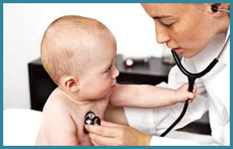
Well-Child Visits
The Four Tasks of a Well-Child Visit:
Disease detection
Disease prevention
Health promotion
Anticipatory guidance
Notes:
The four tasks of a well-child visit include disease detection, disease prevention, health promotion, and anticipatory guidance.
Disease detection most commonly refers to screening, surveillance, and the physical examination. Disease prevention includes both primary prevention activities applied to a whole population (i.e. immunizations or “back to sleep” recommendation) and secondary prevention activities aimed at patients with specific risk factors.
Health promotion activities focus the visits on wellness. And anticipatory guidance presents families with advice that is developmentally consistent. All of these activities work together for a successful visit.

Slide 13
Components of a Bright Futures Visit
History
Surveillance of development
Review of systems
Observation of interaction
Physical examination
Screening
Immunizations
Anticipatory guidance
Notes:
The information on this slide outlines the important components of a Bright Futures visit.
History is defined as information clinicians gather from families and children
Surveillance are the observations about certain aspects of health made by an experienced clinician throughout the visit;
The physical exam begins with height and weight (BMI calculation) and then Bright Futures recommends a comprehensive exam for each age and developmental stage visit
Screening includes using validated tools to detect certain short and long term conditions and health risks
Immunizations protect us from disease. For example, more people die from flu every year in the US than from any other vaccine-preventable disease
Anticipatory guidance refers to unique conversations between the clinician and family that recognize there are specific topics to discuss about health promotion at any age and point in development.

Slide 14
How does Bright Futures help you?
For public health professionals Bright Futures provides:
Clinicians with specific information for age-related health supervision visits
Educational content to home-visitors, school nurses, WIC staff, and others to use and share with children and families
Recommended standardized developmental assessments and screening tools
Engagement with community partners to develop a comprehensive referral network to support children and families
Standards of pediatric preventive care
Measures of Quality Improvement
Training resources for local clinics
Notes:
Health departments have utilized the Bright Futures/AAP Periodicity Schedule and Bright Futures in a variety of ways. For example, many health departments have trained home visiting staff to use Bright Futures resources to engage families in conversations about health promotion in the home setting. Pediatricians who champion Bright Futures in their communities can access Bright Futures resources via the Bright Futures website for use in presentations to families and other health care professionals. Resources include the Bright Futures video, tip sheets, sample PowerPoint presentations and many others.

Slide 15
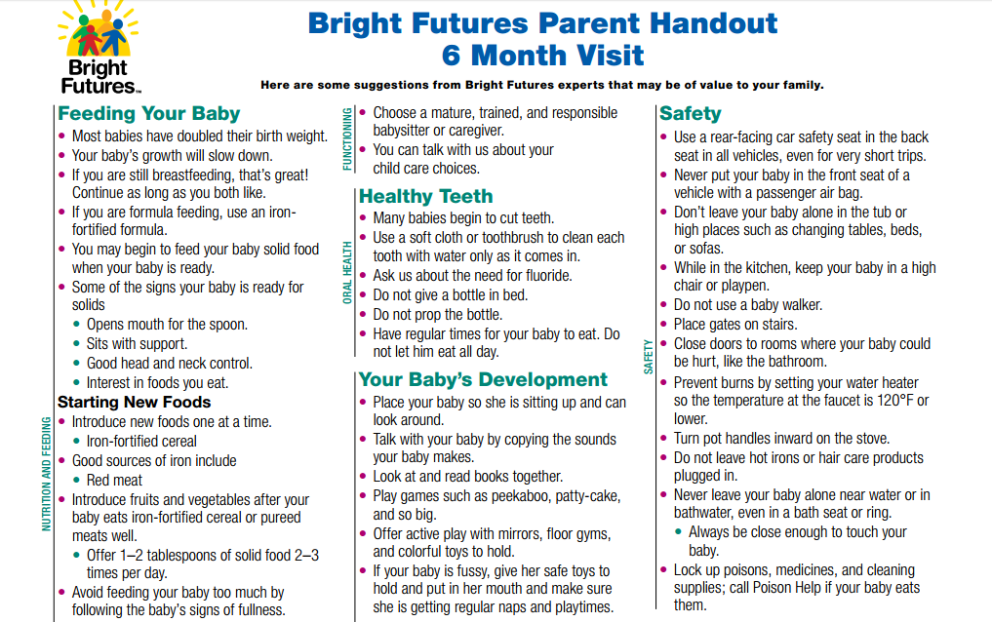
How does Bright Futures help you?
For families:
Provides resources and educational materials specific to each well-child visit. Bright Futures recognizes the strengths that families and parents bring to the health care partnership.
Notes:
For families: Bright Futures helps promote credible and reliable health information resources to patients and their families and involves the entire family in the health and wellness of the child. When families and professionals work together, sharing their knowledge and experience, children—and their families—thrive.
Bright Futures has resources for families. For example, the Bright Futures Activity Book is a coloring book for parents to share with young children that highlight the Bright Futures’ themes. This resource also includes parent handouts for every visit. The Family Pocket Guide is an abbreviated, plain language version that details what to expect for each visit. For example, it includes tips such as encouraging families to speak up and take active roles in their children’s care. It also includes links to resources for further information for children’s good health.

Slide 16
EPSDT and Bright Futures
In most states the EPSDT schedules/programs and the Bright Futures/AAP Periodicity Schedule are closely aligned
Many states’ Medicaid programs have adopted the Bright Futures Guidelines as the standard of care for the states’ EPSDT programs
Check your state’s website to see whether the EPSDT schedule aligns to the Bright Futures/AAP Periodicity Schedule
Notes:
In a study conducted this year, researchers found that most states do align with the Bright Futures/AAP Periodicity Schedule. Many states’ Medicaid programs have adopted the Bright Futures Guidelines as the standard of care for the states’ EPSDT programs and have aligned the programs to the Bright Futures/AAP Periodicity Schedule.
Be sure to visit the States and Communities section of the Bright Futures Website to view 10 new stories of how various EPSDT programs are using the Bright Futures Guidelines. For example, Pennsylvania’s EPSDT staff has implemented the Bright Futures Guidelines by improving oral health throughout the state by increasing access to and use of routine pediatric dental care. They have done so by collaborating with managed care organizations in the state.
Note the new state stories are: California, Colorado, Kentucky, Minnesota, Montana, Nevada, North Dakota, Pennsylvania, Rhode Island, South Dakota, Utah, Wyoming.
You can check your state’s website to see whether the state’s EPSDT schedule aligns to the Bright Futures/AAP Periodicity Schedule and follows the Bright Futures Guidelines.

Slide 17
States and Communities
Notes:
Visit the State and Communities section of the Bright Futures Website for implementation assistance, materials, and state stories that may be helpful during provider-focused implementation efforts.

Slide 18
States Agencies and Bright Futures A Strong Partnership
State agencies are in a unique position to:
Update/revise provider manuals or Periodicity Schedules
Recommend standardized developmental assessments
Promote Bright Futures tools and resources
Use data-driven strategies to improve preventive services
Educate the public and train providers/home-visiting professionals about Bright Futures content
Change billing and payment policies
Implement Bright Futures Guidelines in public health clinics
Notes:
Medicaid providers, departments of public health, and Title V, child care, child welfare, and other local agencies that work with family health, education, and well-being are key drivers of state health promotion and disease prevention initiatives. This slide provides examples of ways state agencies and Bright Futures can partner together.

Slide 19
Implementation Strategies/Models
Trainings/Learning Collaboratives
Home Visiting Programs
Improvement Partnerships
Quality Improvement Projects
Family Engagement
Adapting or Promoting Bright Futures Tools
Notes:
There are many ways –using a variety of models--in which state and local agencies can integrate and implement the Bright Futures Guidelines. For example, some state health departments are working alongside local health department staff to train home-visiting representatives and home-based care managers in developmental screening. Using the Bright Futures/AAP Periodicity Schedule as a road map, the trainings focus on common developmental screening tools by educating the representatives on how and when to use the tools, and how to refer families to specialized treatment.
For example, the Tennessee Governor’s Children’s Cabinet partnership, comprised of 6 state agencies, is charged with coordinating and enhancing state efforts to provide resources and services to children in TN. Such efforts include providing detailed online information on screenings, well-child visits, developmental milestones, and more.
In terms of Quality Improvement, the Bright Futures Guidelines serve as an excellent roadmap to identify core indicators and measures that may be improved. Examples include maternal depression screening, autism spectrum disorder screening, and immunization rates.
Finally, family engagement is an area many practices and organizations struggle with. A South Carolina program has made family engagement a priority and now offers webinars to participating practices/clinics on how best to involve families in improvement processes. Successful strategies include creating Patient Advisory Committees and developing and implementing parent evaluation forms after visits.
These are just a few example of projects in certain states and communities. However, use Bright Futures and its resources in any way that may benefit children and families in your area. For more information and examples of tried and true Bright Futures implementation efforts, visit the State and Communities page of the Bright Futures website.

Slide 20
Preliminary Implementation Steps for Public Health Professionals
Start gradually and replicate successful projects
Include families and the communities at all stages of implementation
Work with existing initiatives
Create provider buy-in and understand their barriers
Encourage providers to engage their offices/clinics
Adapt Bright Futures tools
Use measures to evaluate
Notes:
Many health departments and state agencies find that integrating the Bright Futures Guidelines into health promotion and prevention programs helps them accomplish their goals of improving the health of children. There are many ways you can begin to implement Bright Futures at the state and community levels. Here are some tips to get started.
Start gradually, so you can modify activities as you go along. Replicate successful projects and scale up implementation efforts, when appropriate.
Focusing on individual elements of the Guidelines will feel less overwhelming, and will allow a project’s efficacy to be evaluated effectively.
Include families and community partners at all stages of implementation. They are integral stakeholders that help refine goals, provide feedback, and establish valuable relationships.
Working with existing initiatives leverages and synchronizes efforts, which may lead to a greater positive impact.
Obtain clinician buy-in and tailor implementation projects and Bright Futures tools to the needs of local practices/clinics. Understand the clinician’s barriers and work together to leverage existing resources to address their concerns.
Ensure that participating clinics/practices gather data to monitor progress and evaluate the effectiveness of the intervention.
Finally, update your organization or agency’s website to make it easy for clinicians and others to access the Bright Futures materials.

Slide 21
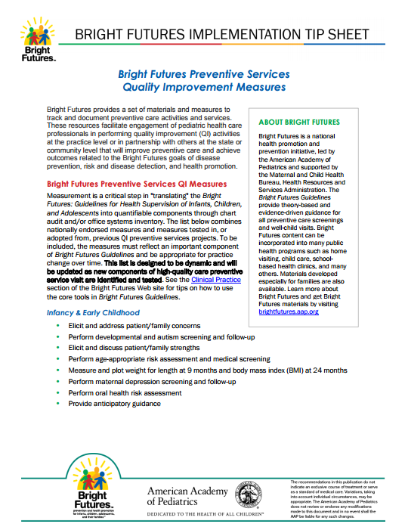
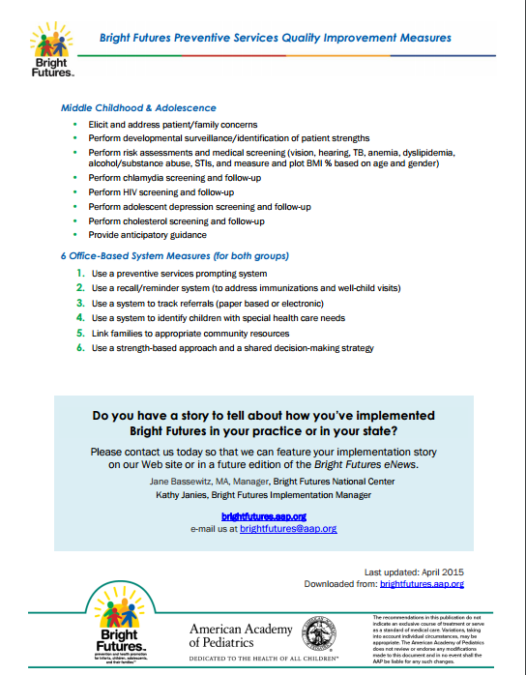
Highlighting an Implementation Step: Using Measures
The list of Bright Futures Quality Improvement Measures is dynamic and is updated as new components of high-quality care preventive service visits are identified. They are grouped under the following categories:
Infancy & Early Childhood
Middle Childhood & Adolescence
Office-Based System Measures
Available at: https://brightfutures.aap.org/Bright%20Futures%20Documents/AAP_BF_Tipsheet_PreventiveServices_revFINAL.pdf
Notes:
Bright Futures provides a set of materials and measures to track and document preventive care activities and services. These resources facilitate engagement of pediatric health care professionals in performing Quality Improvement (QI) activities at the practice level or in partnership with others at the state or community level They will improve preventive care and achieve outcomes related to the Bright Futures tasks of disease prevention, risk and disease detection, and health promotion. The measures are grouped under the following categories: Infancy & Early Childhood, Middle Childhood & Adolescence, and Office-Based System Measures.
Measurement is a critical step in "translating" the Guidelines into quantifiable components through chart audit and/or office systems inventory. The Bright Futures QI measures combine nationally endorsed measures and measures tested in, or adopted from, previous QI preventive services projects. To be included, the measures must reflect an important component of Bright Futures Guidelines and be appropriate for practice change over time.
The QI Measures can be found under the Quality Improvement tab in the Bright Futures website.

Slide 22
Using Bright Futures Resources for Implementation Models
The Bright Futures standards, tools and resources can be used and adopted “as-is” and/or adapted by a broad audience to meet state-specific pediatric preventive care requirements.
Notes:
The Bright Futures Website provides access to the Bright Futures resources including the Bright Futures Guidelines, the Pocket Guide, the Bright Futures Tool and Resource Kit, the Performing Preventive Services Manual, the Bright Futures: Nutrition and Pocket Guide, the Bright Futures Activity Book, and the Family Pocket Guide.
Other Bright Futures materials, aimed at specific target audiences such as health care professionals or families have been developed including a Tool and Resource Kit. This Kit is currently being updated to align with the Fourth Edition.

Slide 23
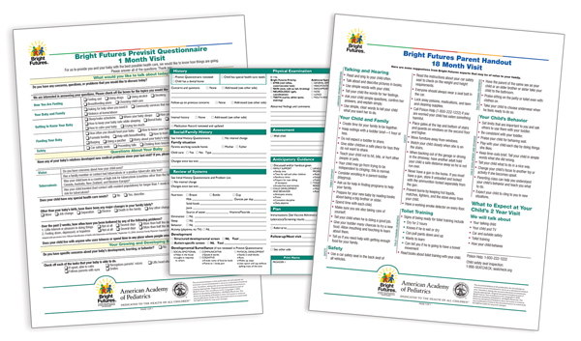
Bright Futures Tool and Resource Kit
Previsit Questionnaires
Visit Documentation Forms
Patient/Parent Education Handouts
Core Bright Futures Tools: Previsit Questionnaires, Documentation Forms, Parent/Patient Education Handouts
The revised Kit is anticipated in late 2018 and will include these core tools
Notes:
The Core Tools are an integral component of the suite of Bright Futures resources. Different audiences use the toolkit differently. For example, a public health clinician might use the Previsit Questionnaires in a local clinic, whereas a school nurse might also distribute education handouts to adolescent students.
The new Tool and Resource Kit is currently under development and is anticipated to be released in early 2018. This Kit will help health care professionals support and implement the recommendations provided in the Fourth Edition.

Slide 24
Bright Futures Tool and Resource Kit
Below are some tools and resources currently under development that will soon be available to assist with implementation of the Fourth Edition:
• Screening and Priorities for each age/stage
Available on: brightfutures.aap.org/materials-and-tools/Pages/Presentations-and-Handouts.aspx
Medical Screening Reference Tables
Include risk assessment questions
Revised Infancy Parent Education Handouts with updated food allergy and oral health information
4, 6, 9, and 12 Month visits
Notes:
These resources are currently under development and will be available in the near future to assist with implementation of the Fourth Edition.
Please note that the risk assessment questions will be posted soon on the Bright Futures website. The Bright Futures Tool and Resource Kit, which will contain the risk assessment questions, patient and parent handouts, and other materials, is currently under development and is anticipated to be released in early 2018.

Slide 25
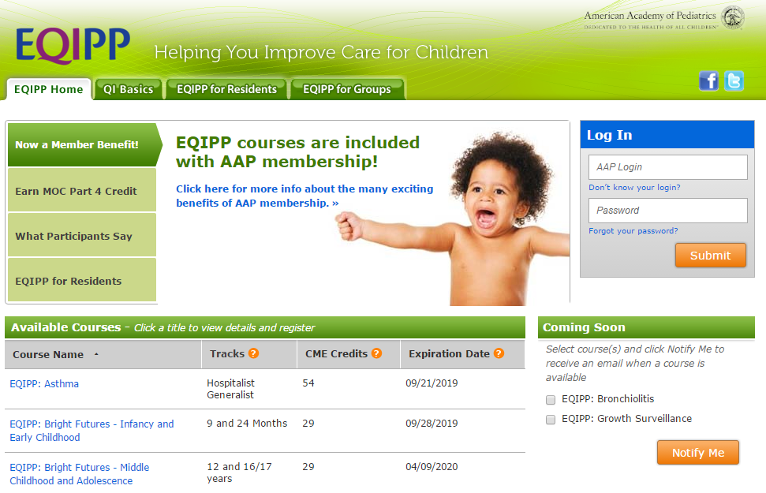
Additional Resources
Coding for Pediatric Preventive Care 2018 booklet
EQIPP courses help identify and close gaps in your practice using practice tools.
Bright Futures - Infancy and Early Childhood Course
Bright Futures - Middle Childhood and Adolescence Course
Notes:
The Coding for Pediatric Preventive Care booklet includes the Current Procedural Terminology, known as CPT, Healthcare Common Procedure Coding System Level II, and ICD-10-CM codes most commonly reported by pediatricians in providing preventive care services.
Education in Quality Improvement for Pediatric Practice or EQIPP is a self-directed, online learning program that weaves measurement-based improvement principles and concepts with pediatric-specific clinical content to improve children’s health and wellness. EQIPP courses help identify and close the gaps in practices using practical tools. With these online courses, users learn to document improved quality care on a continuous basis, earn continuing medical education credits, and meet MOC Part 4 (Performance in Practice) requirements all at once.
Both of the Bright Futures EQIPP courses are available on the EQIPP web site.

Slide 26
How to Obtain Bright Futures Materials
Visit the Bright Futures Web site: brightfutures.aap.org
For a preview of the book go to shopAAP.org
Sign up for our eNews and other alerts at brightfutures.aap.org
Notes:
For more information check out the Bright Futures website. For a preview of the book go to: https://shop.aap.org/bright-futures-guidelines-for-health-supervision-of-infants-children-and-adolescents-4th-edition-1/

Slide 27
American Academy of Pediatrics Bright Future National Center
Jane Bassewitz, MA
Manager, Bright Futures National Center
Kathy Janies
Manager, Bright Futures Implementation
Phone
630-626-6223
E-mail brightfutures@aap.org
Web site brightfutures.aap.org
Notes:
Please contact us if you are interested in learning more about how to implement Bright Futures in your state or if you have any experiences and/or lessons learned to share.

