Slide 1
AAP Bright Futures National Center Bright Futures Tool & Resource Kit, 2nd Edition
Notes:
I’m delighted to be with you today to tell you about the new and improved, 2nd edition of the Bright Futures Tool & Resource Kit.

Slide 2
Agenda for Today
What is Bright Futures?
What is the Toolkit and why you should use it
A tour through the Toolkit’s Core Tools and supplementary materials
Notes:
Here’s our agenda for today’s talk.
I’ll spend a few minutes reviewing what Bright Futures is and the two major Bright Futures products—the Bright Futures Guidelines and the related Periodicity Schedule.
I’ll then spend the bulk of my time talking about the Toolkit—what it is and why it can be an indispensable tool to help make your practice more efficient and your relationship with the families in your care more satisfying and productive.
I’ll provide a tour of the Core Tools and some of the additional tools that are provided in this 2nd edition.

Slide 3
What is Bright Futures?
The mission of Bright Futures is to promote and improve the health, education, and well-being of infants, children, adolescents, families, and communities.
Bright Futures is the health promotion/disease prevention part of the medical home
About Bright Futures video
Notes:
So, what is Bright Futures?
The mission of Bright Futures is to promote and improve the health, education, and well-being of infants, children, adolescents, families, and communities. Bright Futures is the health promotion/disease prevention part of the medical home.
This video gives you more information.
This video is available on the Bright Futures Web site and here:
https://www.youtube.com/watch?v=UvzL6C23ppc&t=1s

Slide 4
Routine Preventive Care is a Personal Relationship
At the heart of the medical home is the relationship between the health care professional and the family
Bright Futures’ guidance and tools helps health care professionals and families make the most of their time together during each visit
Notes:
The relationship between the health care professional and the family is at the heart of the medical home. And it’s at the preventive care visits—from the Prenatal to the 21 Year visit—where that relationship with the child and family grows and develops.
Bright Futures guidelines and tools help health care professionals and families make the most of their time together during each visit and support the development of that all-important relationship at the heart of the medical home.

Slide 5
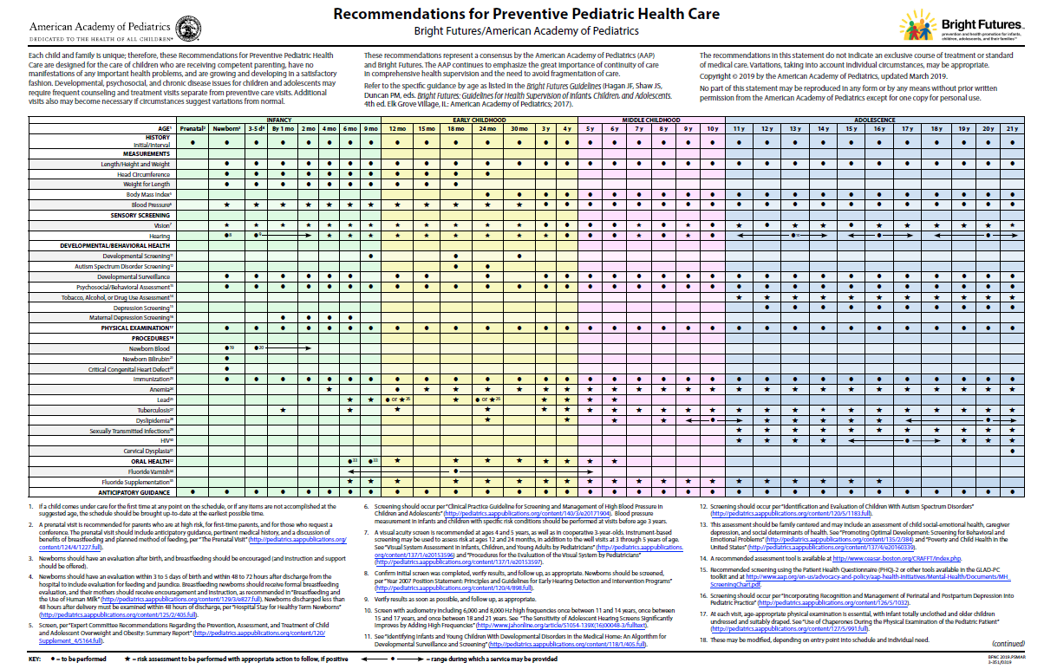
Bright Futures Recommendations
Periodicity Schedule Guidelines
The Periodicity Schedule tells you what to do in well-child visits, while the Bright Futures Guidelines tell you how to do it—and how to do it well. Find both at brightfutures.aap.org
Notes:
Bright Futures recommendations are embodied in two primary documents—The AAP Recommendations for Preventive Pediatric Health Care, better known as the Periodicity Schedule, and the Bright Futures Guidelines.
In a nutshell: The Periodicity Schedule is the what of the well-child visit, while the Bright Futures Guidelines is the how.
In a chart format, the Periodicity Schedule summarizes what to do in well-child visits and sets the expectations for preventive care. The Periodicity Schedule is published annually in Pediatrics, the AAP peer reviewed journal. It is AAP Policy and is updated annually by AAP as new evidence emerges.
The Guidelines tell you how to do the visit—and how to do it well. The Guidelines include the rationale and evidence for the recommendations as well as strategies for implementation.
You can find both at brightfutures.aap.org.

Slide 6
Components of a Bright Futures Visit
History
Surveillance of Development
Review of Systems
Observation of Interaction
Physical Examination
Screening
Immunizations
HEALTH SUPERVISION
Anticipatory guidance
ANTICIPATORY GUIDANCE
Notes:
The components of a preventive services visit, commonly referred to as well-child care, haven’t changed over time. They can be divided into two parts—health supervision and anticipatory guidance.
The health supervision components are the standard activities that happen in each visit. The anticipatory guidance is the vital communication that occurs between health care professional and family—where you provide guidance and education, discuss issues of concern, and help the family anticipate the developmental changes that will occur. Anticipatory guidance is the yeast that helps the relationship between health care professional and family grow over time.
This is a lot to cover in one visit!

Slide 7
NOTE: The new Toolkit is an online access product. For more information about the Toolkit and licensing options, visit https://shop.aap.org/bright-futures-tool-and-resource-kit-2nd-edition. ​
Notes:
The Bright Futures Tool & Resource Kit, 2nd edition, can help. It has been completely revised and updated to match the 4th edition of the Guidelines.

Slide 8
Why Should You Use the Bright Futures Tool & Resource Kit?
Toolkit helps you provide standardized care
All the forms are closely linked to Bright Futures visit components and recommendations, making clinical activities and messages consistent throughout
Completed visit documentation forms help you track care over time, ensuring that all patients receive recommended exams, screenings, immunizations, and anticipatory guidance
AND it helps you provide individualized care
Forms allow parent/patient priorities and concerns to surface, giving you opportunities to tailor care and anticipatory guidance
Notes:
8
The Toolkit helps you provide standardized care. All of the forms in the Toolkit are anchored to the Guidelines visit components and recommendations, which makes clinical activities and messages consistent throughout.
In addition, by using the visit documentation forms, you can track care over time, ensuring that all patients receive recommended exams, screenings, immunizations, and anticipatory guidance.
The Toolkit also helps you provide individualized care. Its forms allow priorities and concerns to surface, giving you opportunities to tailor care and anticipatory guidance.

Slide 9
What does the Toolkit Offer?
Core Tools that guide you and the family through all phases of the visit: BEFORE, DURING, and AFTER
Supporting Materials, including additional documentation forms and educational materials
Toolkit tools and resources are intended for ALL children, recognizing that they should be adapted depending on the needs and circumstances of the child and family
Notes:
The Toolkit provides three Core Tools that guide you and the family through all phases of the visit: BEFORE, DURING, and AFTER. These tools are closely linked and are intended to be used in tandem.
It also offers a variety of Supporting Materials, including additional documentation forms and educational materials.
It’s important to note that the information in the tools are an exact reflection of the Guidelines, with no adaptation or interpretation.
The Toolkit materials are intended to be used with ALL families, but we recognize that you will want to tailor them to suit the needs and circumstances of the children and families in your clinical setting. For example, safety counseling will differ depending on your area of the country. In Arizona, you’ll focus on pool safety, whereas safety around farm equipment will be important in the rural Midwest, and traffic safety counseling will be key in urban areas.

Slide 10
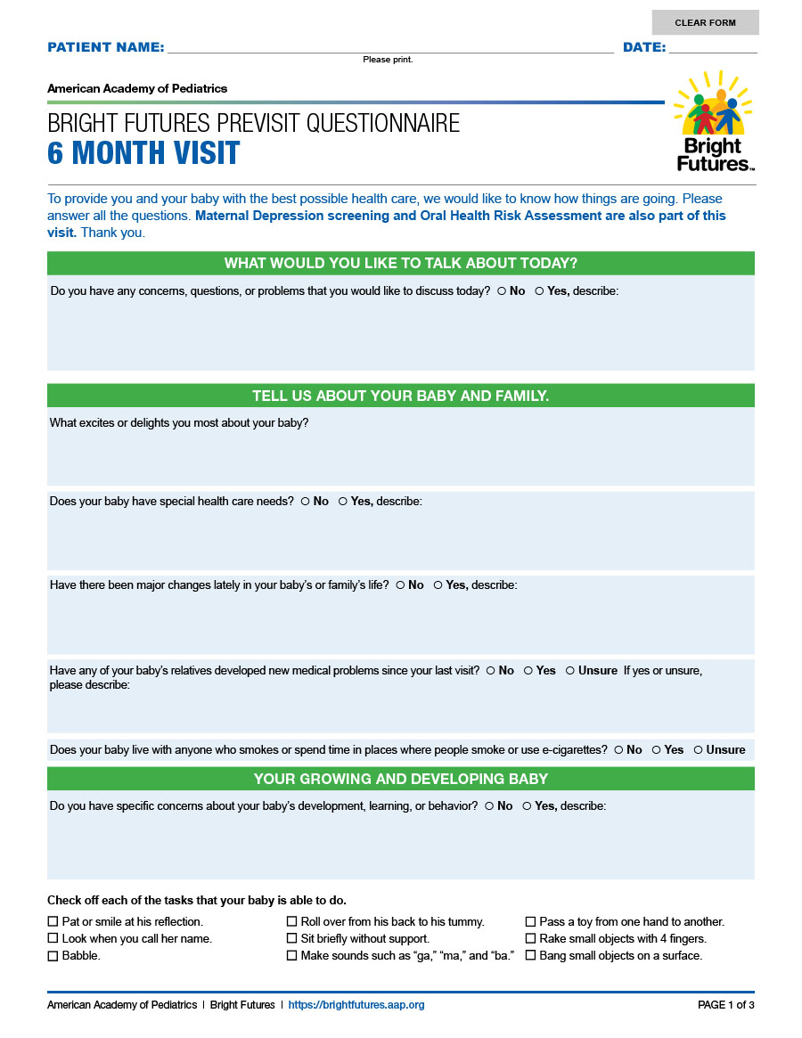
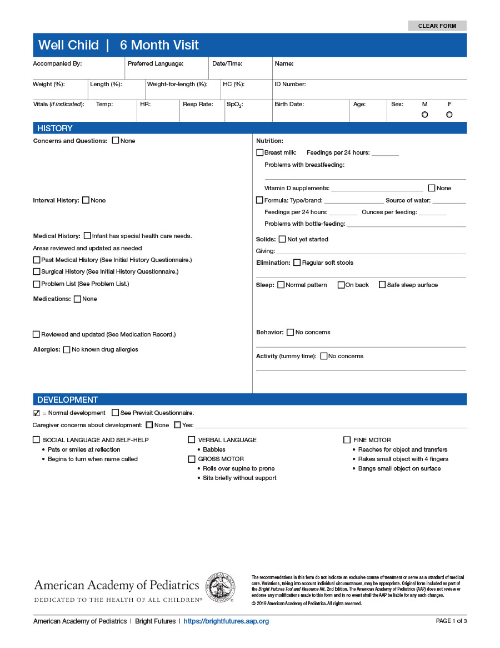
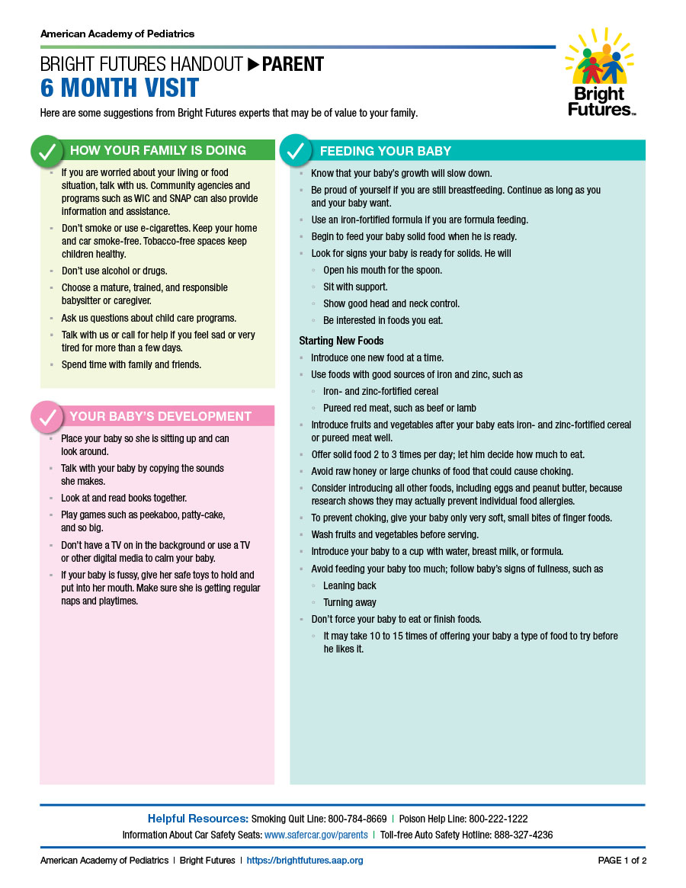
Core Tools in the Bright Futures Tool & Resource Kit, 2nd Edition
Parent/Patient Educational Handout
Reinforces anticipatory guidance AFTER the visit
Previsit Questionnaire
Gathers pertinent information BEFORE the visit
Visit Documentation Form
Records activities DURING the visit
Notes:
Let’s open up the Toolkit and see what’s inside. We’ll start with the Core Tools. Throughout this presentation, I’ll use the 6 Month Visit to illustrate.
The three Core Tools are the Previsit Questionnaire, the Visit Documentation Form, and the Parent/Patient Educational Handout. They bring the Guidelines off the shelf and into your practice.
The Previsit Questionnaire gathers pertinent information that sets the stage for what you can focus on during the visit.
The Visit Documentation Form records the activities of a visit, allowing you track the child’s development over time. It also allows you to fulfill regulatory requirements.
The Parent/Patient Educational Handout summarizes and reinforces the anticipatory guidance you’ve provided during the visit.
In the next few slides, we’ll look at each of the Core Tools in more detail.

Slide 11
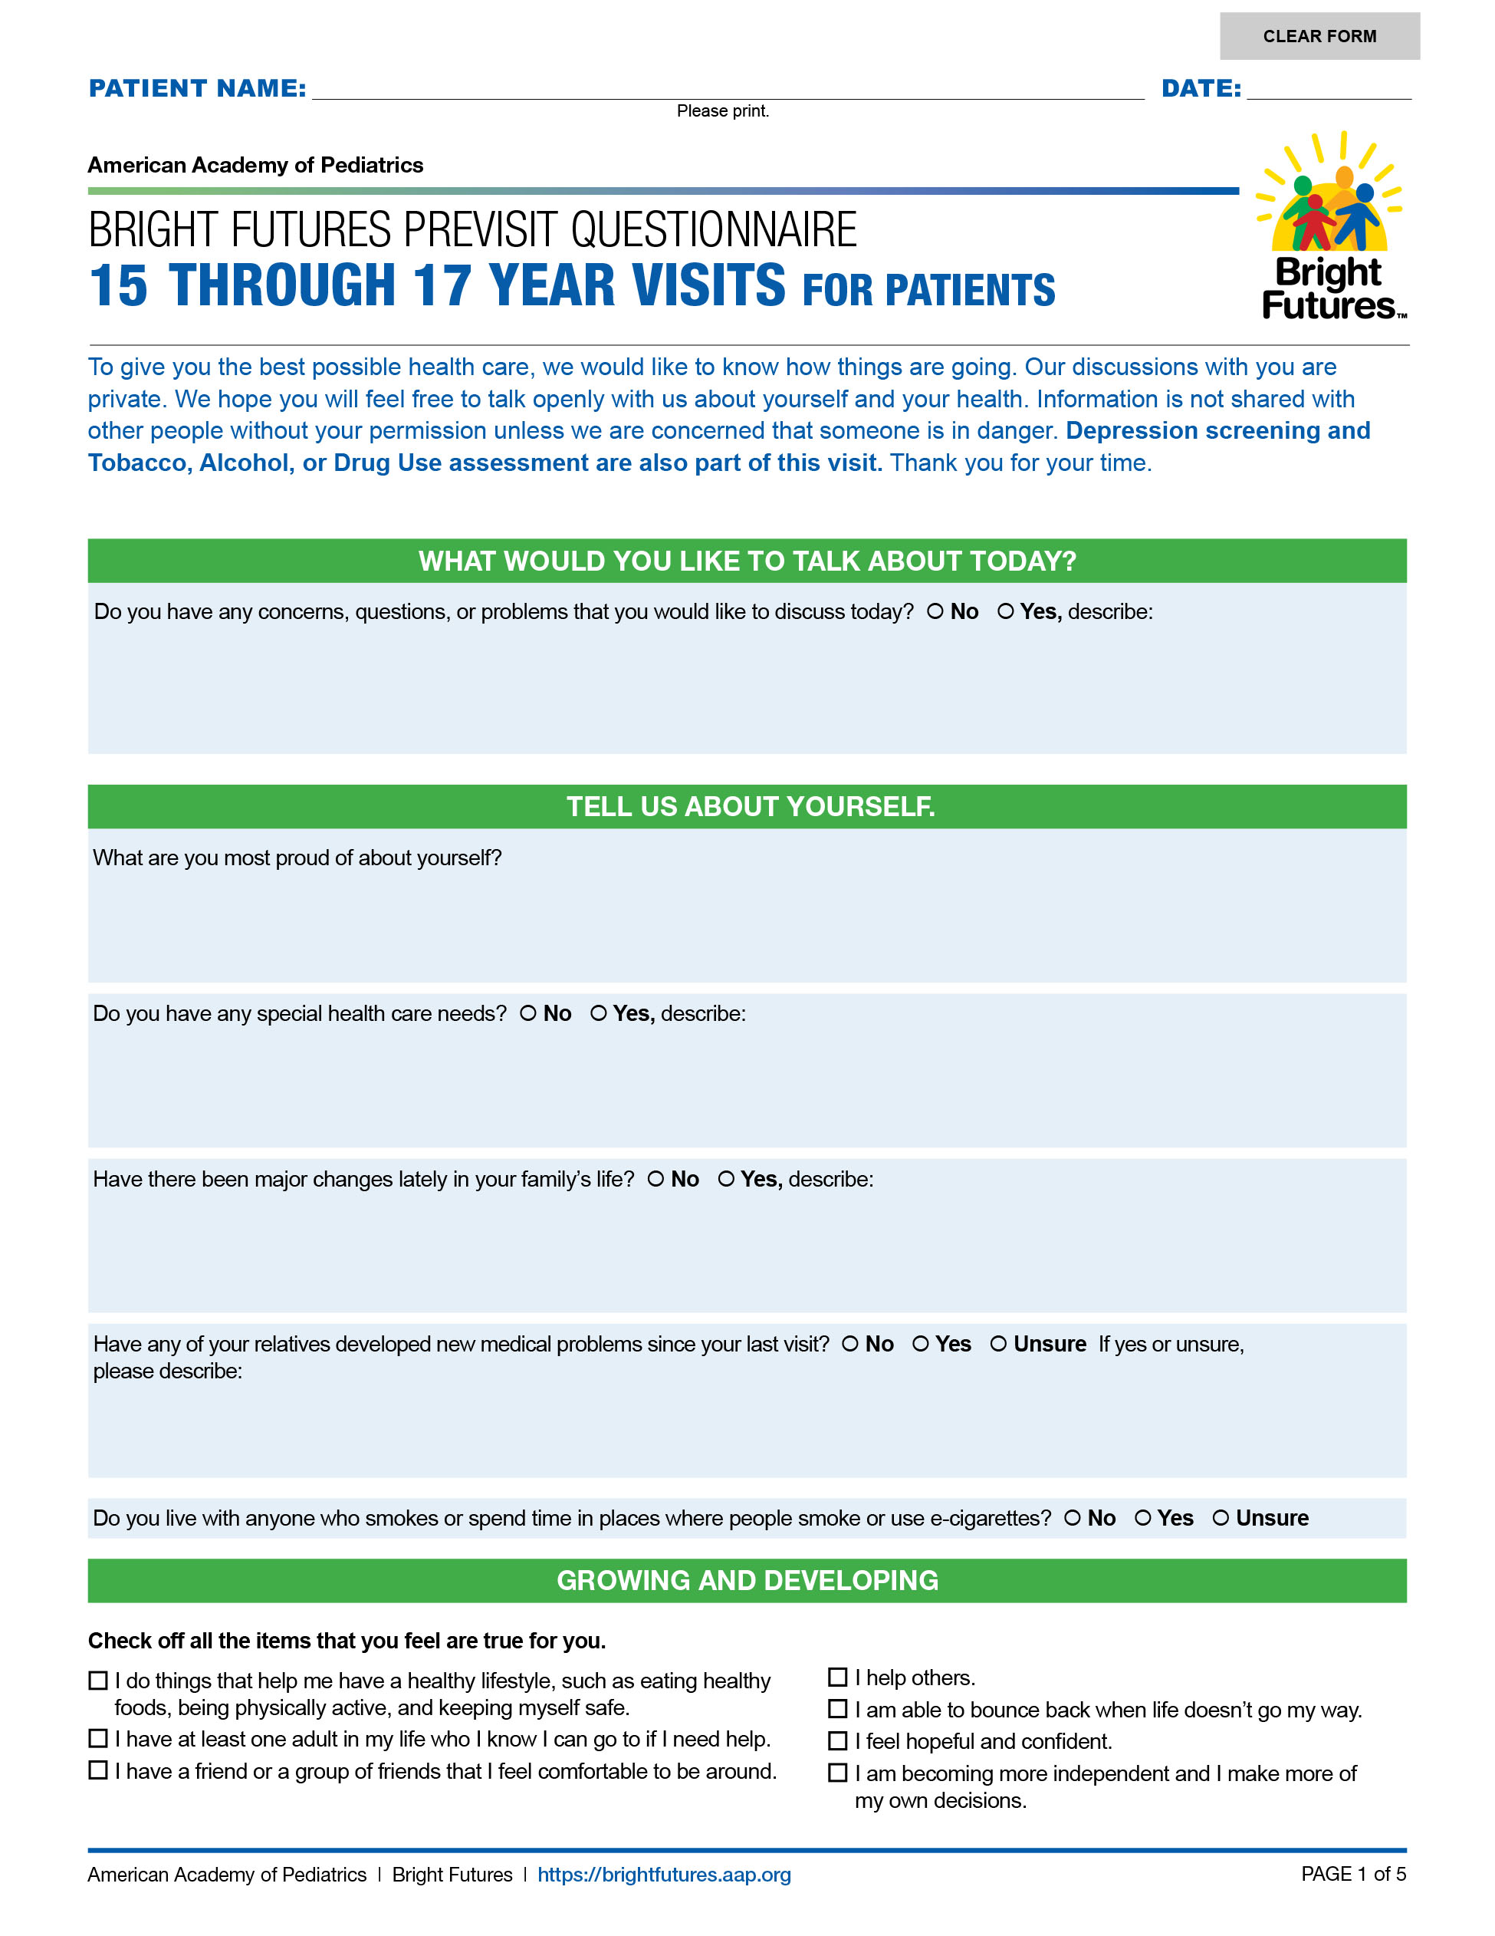
Core Tools: Previsit Questionnaire
Parent fills out before seeing the health care professional.
Written in plain language
Beginning at age 11, youth are asked to fill out their own form
The questionnaire:
provides space to note special concerns, describe changes since the previous visit
gathers information about development
contains risk assessment questions that may lead to recommended medical screening
gathers information that sets the stage for focused anticipatory guidance
Notes:
Here’s the Previsit Questionnaire.
Parents fill it out before seeing the health care professional, and it’s written in plain language to facilitate understanding and use. Beginning at age 11, youth are asked to fill out their own form before they see the health care professional.
The Previsit Questionnaire accomplishes two important objectives. First, it gathers valuable information, making the visit more efficient and allowing the health care professional to provide individualized care. Second, it helps parents identify the issues and concerns they want to discuss during the visit and it gives them a preview of the topics that will be covered during the visit.
The questionnaire:
provides space to note special concerns and describe changes since the previous visit
gathers information about development
contains risk assessment questions that may lead to recommended medical screening, and
gathers information that sets the stage for focused anticipatory guidance

Slide 12
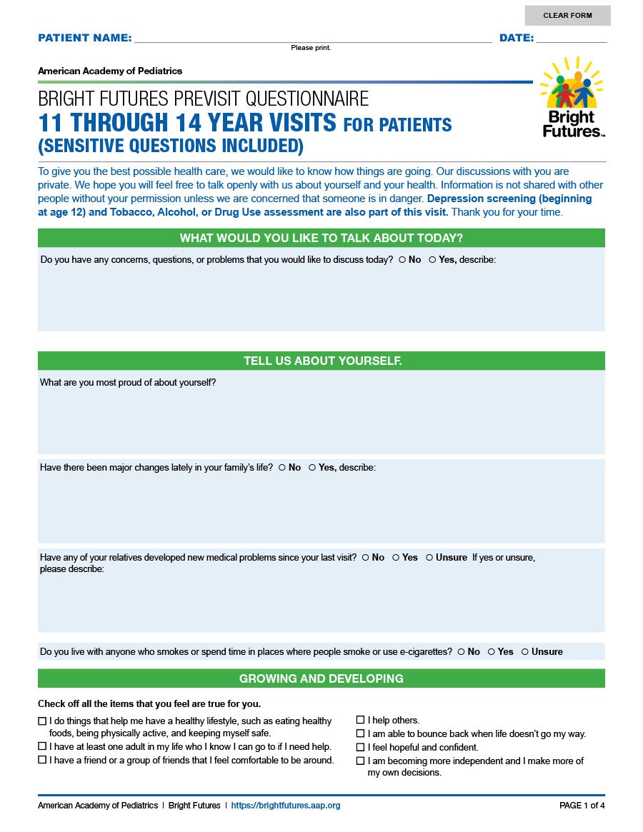
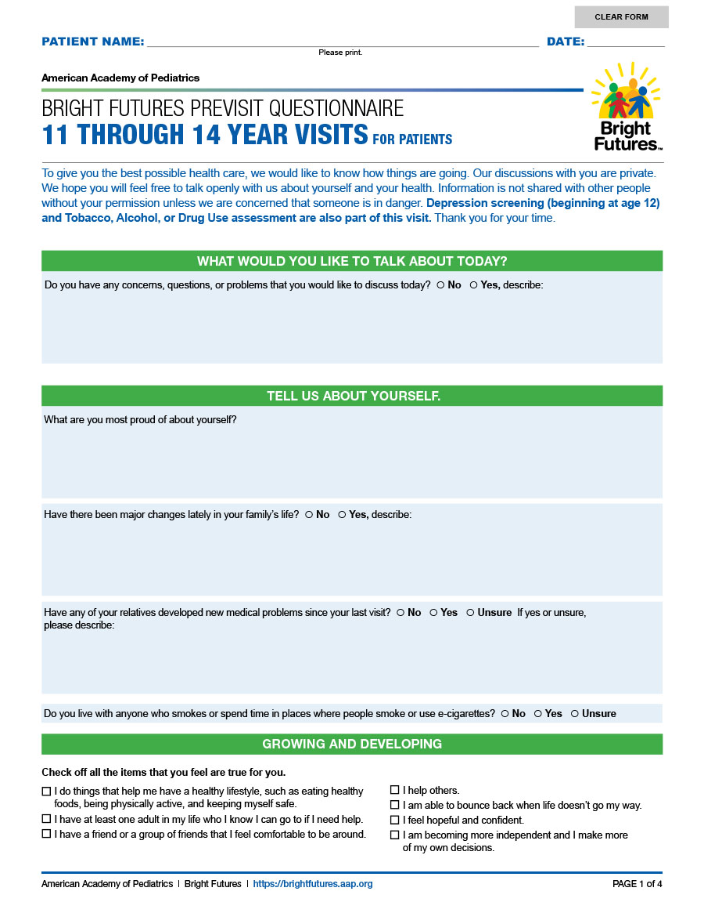
Adolescent Previsit Questionnaire
Provides opportunity for adolescents to think about their own health, behaviors, activities, growth/development,
Two versions of 11-14 Year PVQ: with and without sensitive questions
Notes:
The Adolescent Previsit Questionnaire provides a wonderful opportunity for adolescents to think about their own health, behaviors, and activities and to reflect on how they are feeling about their growth and development.
Because the Questionnaires for the 11-14 Year visits must accommodate children and youth at very different developmental stages—prepuberty, early puberty, and late puberty, the Toolkit contains two versions. One version has "Sensitive Questions Included“ and the other does not. Health care professionals can use the questionnaire that is most appropriate for their patients.

Slide 13
Additional Screenings
What would you like to talk about today?
Tell us about your baby and family.
Your growing and developing baby - Developmental Surveillance
Notes:
Let’s look in more detail at the sections in the Previsit Questionnaire.
The top of each Questionnaire notes whether additional screenings [CLICK] should be administered at this visit. These screenings are listed separately because multiple tools for that screening may be available and this allows the practice to choose their preferred tool. For example, Maternal Depression screening and Oral Health Risk Assessment are additional screenings that should be completed at the 6 Month Visit.
The Previsit Questionnaire helps set the agenda for the visit. This happens in the first section of the Questionnaire, where it asks parents to note issues [CLICK] they want to discuss. In the next section, [CLICK] it asks general questions about the child and family. In keeping with Bright Futures’ strengths-based approach, this section also asks parents what delights and excites them most about their child.
The next section of the Previsit Questionnaire [CLICK] focuses on surveillance of development. Checkboxes provide the opportunity to document developmental tasks achieved. Note that this is surveillance and does not replace the administration of a standardized developmental screen, which occurs at specified intervals during Infancy and Early Childhood.

Slide 14
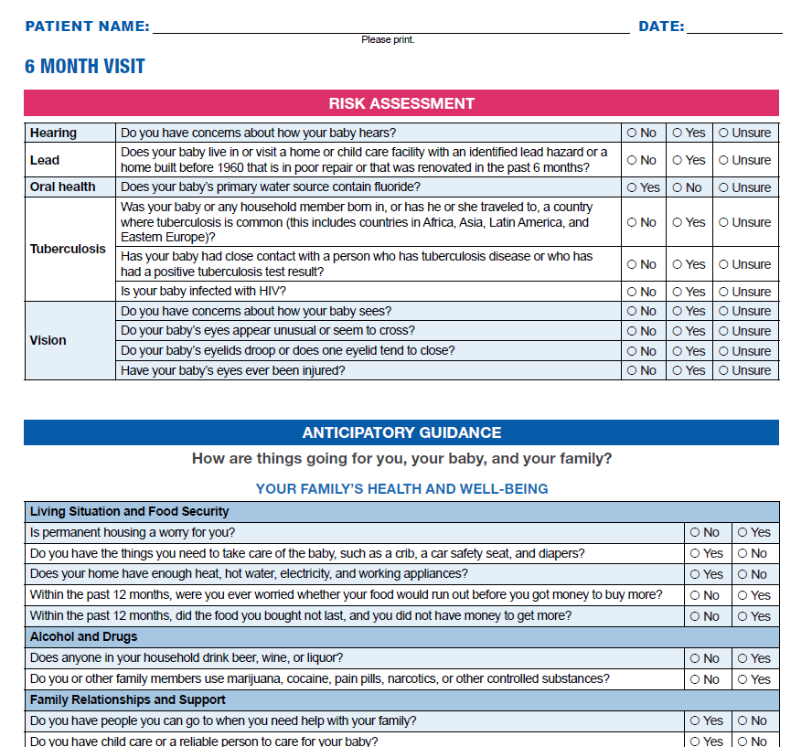
Medical Screening –
Risk Assessment Questions
Notes:
Turning to the second page of the Previsit Questionnaire, we come to the medical screening section.
At each visit, the Guidelines include Universal and Selective screening. Universal screening is performed on all children or youth and Selective Screening is performed on those for whom a risk assessment [CLICK] suggests concern. This section of the Previsit Questionnaire is the place where risk is ascertained. For example, this visit assesses risk for hearing, [CLICK] lead, oral health, TB, and vision.
If you look closely at the responses in the right-hand columns, [CLICK] you’ll see that the “yes” and “no” answers appear to be inconsistent. That’s actually intentional. To make it easier for health care professionals to spot the issues that need special attention, the responses that would trigger a “let’s talk about this” moment are always on the right. An “unsure” response [CLICK] also may get focused attention from the health care professional.

Slide 15
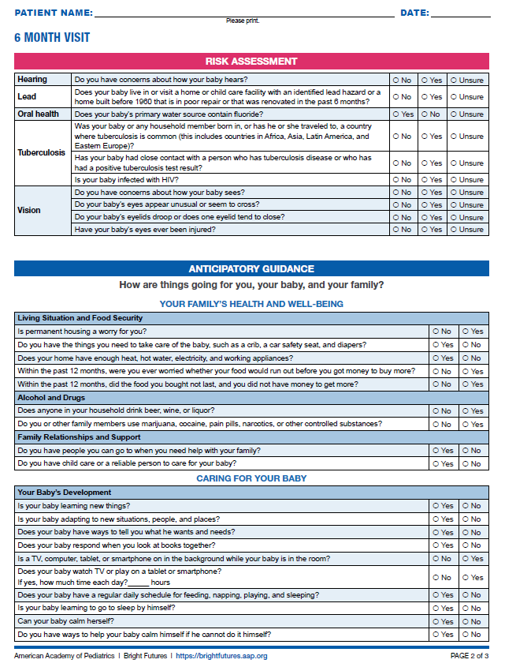
Anticipatory Guidance
Visit Priorities
Notes:
The final portion of the Previsit Questionnaire focuses on anticipatory guidance [CLICK]. A few things to point out here:
Each visit has 5 priority areas for anticipatory guidance, and these are reflected in the separate sections [CLICK] of the anticipatory guidance questions.
Social determinants of health are a special focus of the 4th edition, and the “Your Family’s Health and Well-Being” section [CLICK], which is the first topic in this section for most visits, includes the social determinants questions. Often when we think about the social factors that affect health, we immediately go to the risk factors, such as poor housing, lack of adequate food, or interpersonal violence.
Yet we know, as our co-editor Paula Duncan used to say, it’s just as important to learn what is going well. Therefore, Bright Futures includes questions that assess for risk AND assess for strengths and protective factors. For example, in this visit, that’s shown by answers indicating the parent has the necessary resources to care for the child, doesn’t have problems with family alcohol or drug use, and has strong supportive relationships and access to good quality child care.
Like the Risk Assessment questions, any responses in the right-hand column [CLICK] highlight the “let’s talk about this” issues—the health topics and concerns that require focused discussion.
The Adolescent Previsit Questionnaires have a third anticipatory guidance response column—”sometimes.” This is because the answers to questions like “Do you eat meals together as a family?” can require a more nuanced answer than just “yes” or “no.”

Slide 16
Core Tools: Visit Documentation Form
Health care professional uses DURING visit to document activities
Conforms to evaluation and management (E/M) documentation guidelines
Includes sections for each component of visit with space for results, concerns, and observations:
History
Development
Social and Family History
Review of systems
Physical examination
Assessment
Anticipatory guidance
Plan
Notes:
The second Core Tool is the Visit Documentation Form. The health care professional uses this form during the visit to document all the activities that occur during the visit. The form covers all the components of a Bright Futures visit and links directly to the Previsit Questionnaire.
On the next slide, I’ll highlight a few aspects of this form.

Slide 17
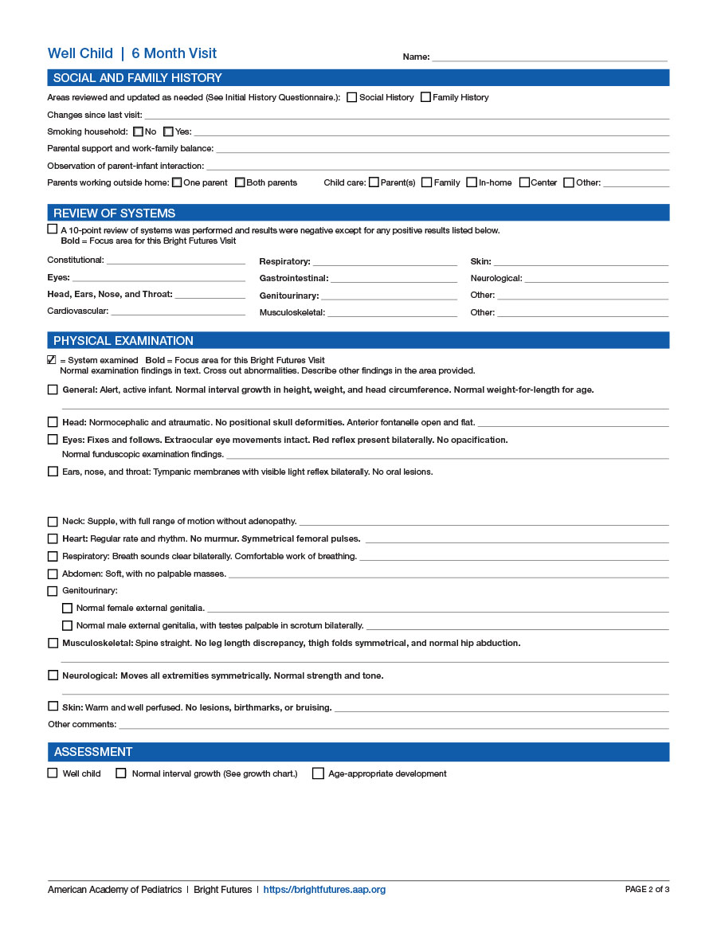
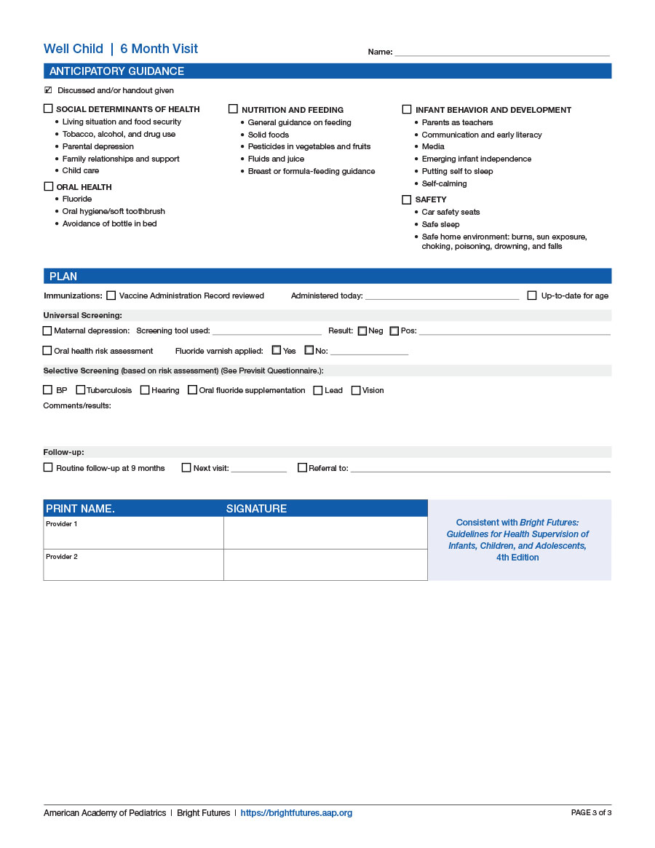
Notes:
Let’s walk through the Visit Documentation Form for the 6 Month Visit.
On this first page, it includes a History [CLICK] and Development section.
On the second page, the Social and Family [CLICK] section emphasizes the psychosocial aspects of the patient’s social and family history, with space for results, concerns, and observations.
The Review of Systems [CLICK] is new with this edition, and bolded systems are a focus for that visit.
A complete Physical Examination [CLICK] is part of every health supervision visit. The bolded areas highlight the components of the exam that are important for a child or youth at that visit.
An Assessment [CLICK] section allows for an open-ended summary of the child’s health status.
The third page includes the Anticipatory Guidance, [CLICK] which is anchored in the 5 priorities the visit.
The Plan [CLICK] is the final section for documenting screening results, immunizations given, and follow-up plans.

Slide 18
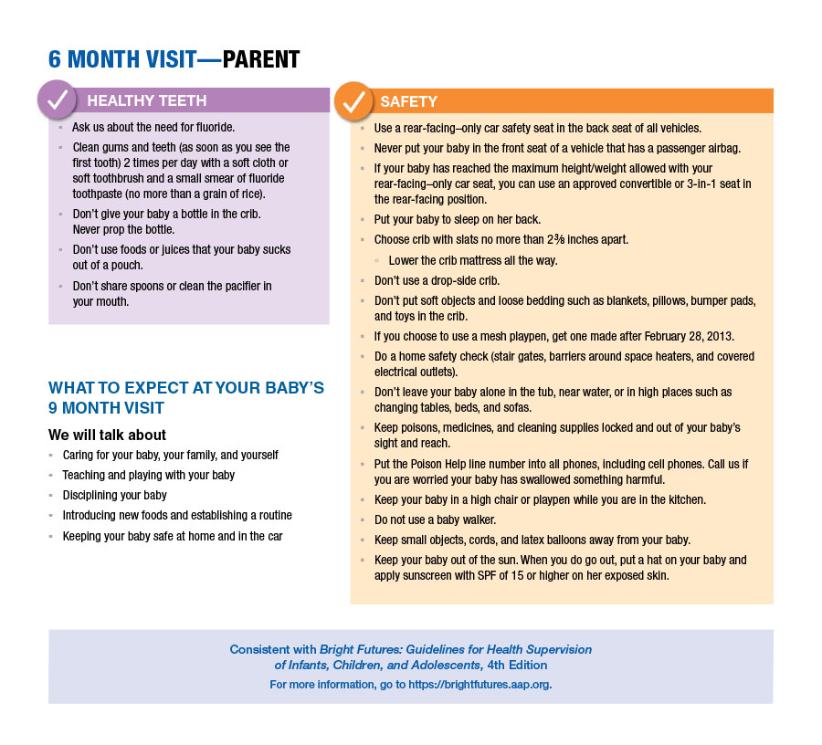
Core Tools: Educational Handouts
Parent handouts for 1st Week to 17 Year Visits
Patient handouts for the 7 Year to 21 Year Visits
Summarize anticipatory guidance for the visit
Tied to the 5 priorities for that visit
Written in plain language
Notes:
Finally, let’s round out our tour through the Core Tools with a look at the Parent-Patient Educational Handouts.
The first two tools that we just reviewed—the Previsit Questionnaire and the Visit Documentation Form—have guided you and your patients BEFORE and DURING the visit. The Handouts take care of the AFTER part.
The Toolkit has handouts designed for parents for the 1st Week through 17 Year Visits and handouts for patients for the 7 Year to 21 Year Visits.
The Handouts are tied to the 5 priorities for each visit and summarize the anticipatory guidance. They’re a great way to reinforce the education and counseling you provide during the visit, and they’re written in plain language to facilitate understanding.
The Handouts for all the Infancy and Early Childhood visits also include a preview of the next visit [CLICK]. This is a great way to get parents excited about bringing their young child in for the next visit.
Both the Previsit Questionnaire and Handouts are in English and Spanish.

Slide 19
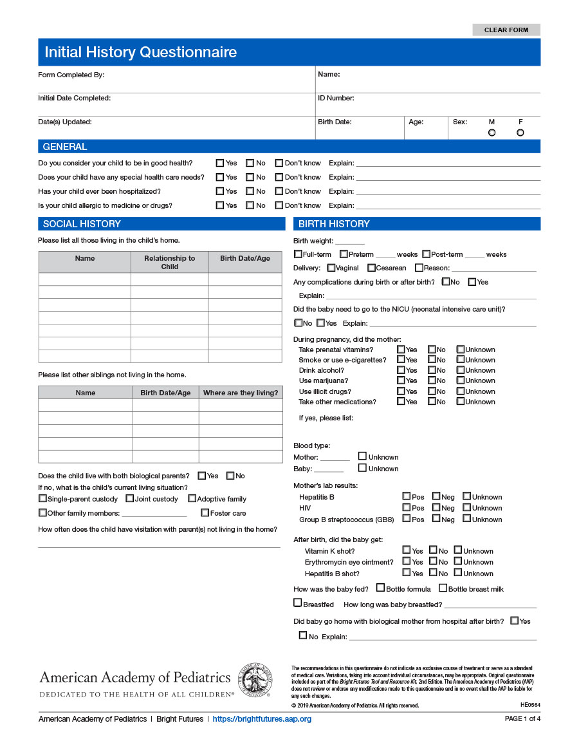
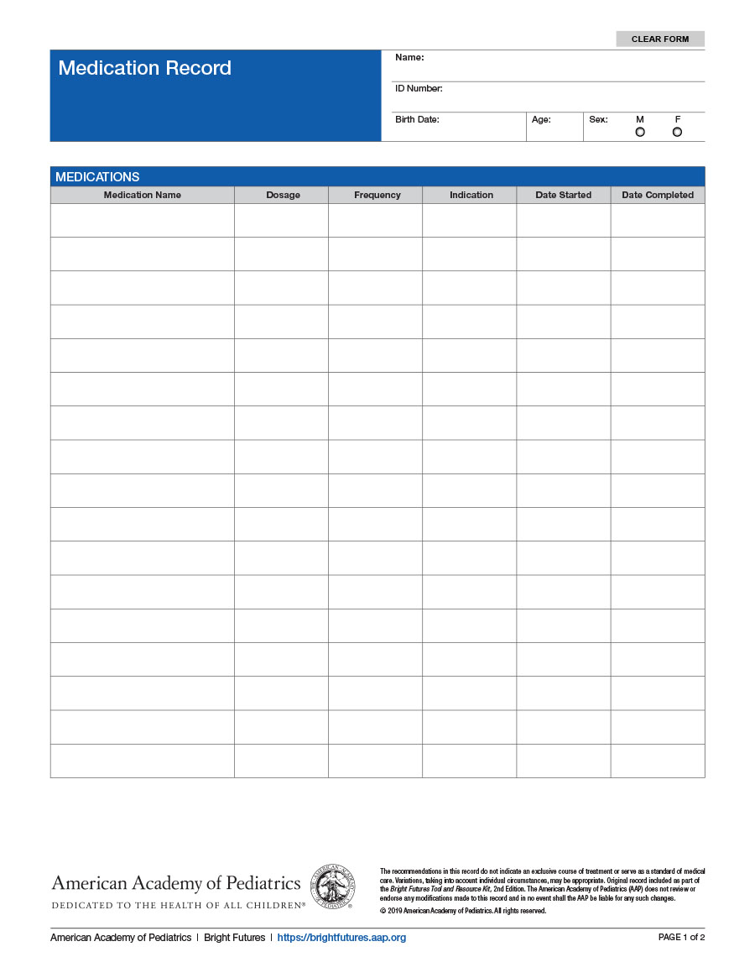
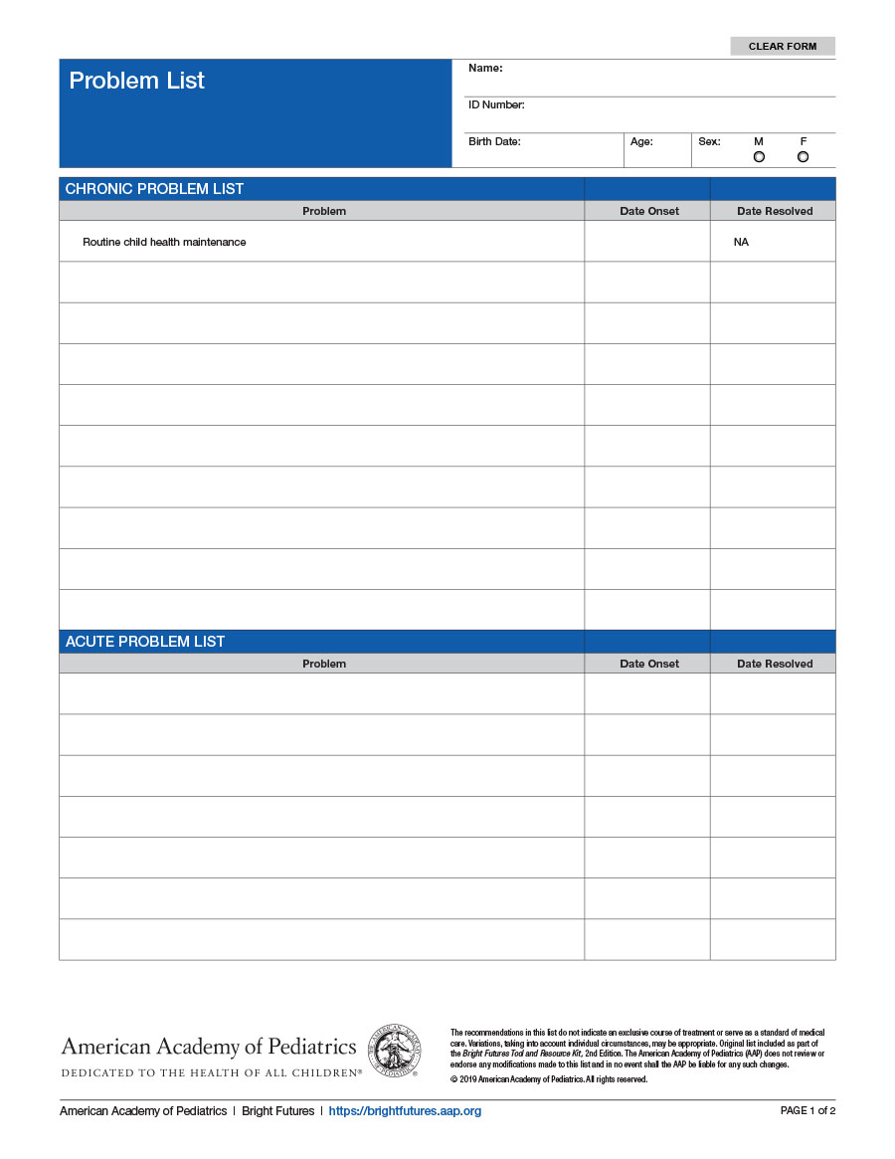
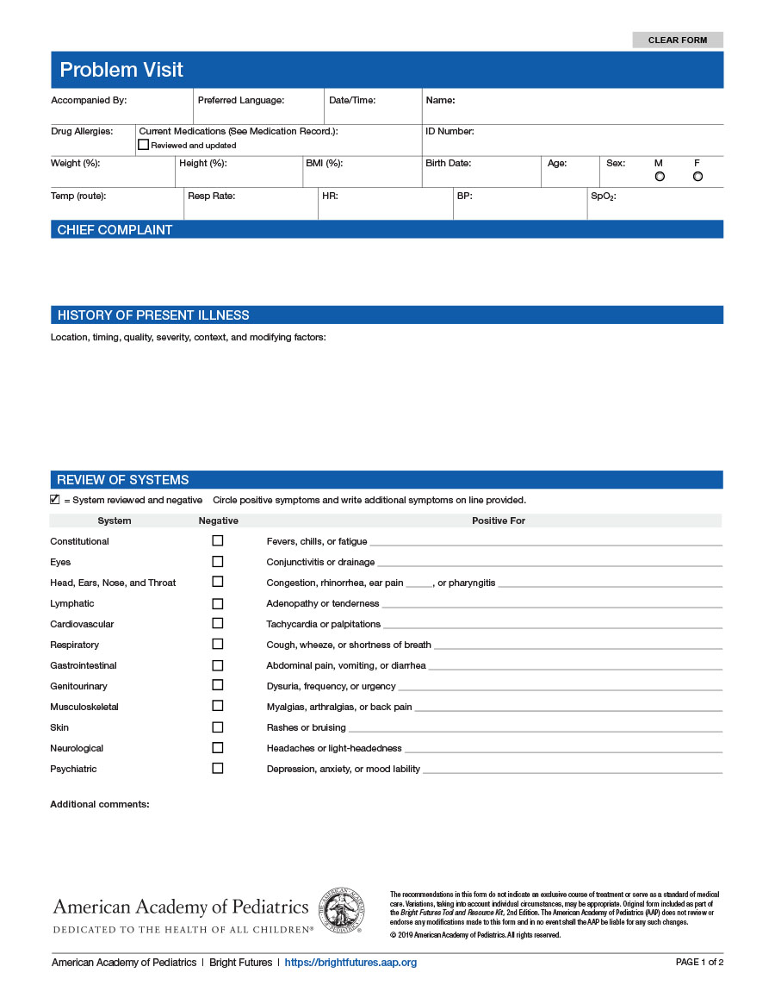
Supporting Materials
Notes:
The Toolkit also contains other useful forms to help you document important information, including the Bright Futures:
[CLICK] Initial History Questionnaire
[CLICK] Medication Record
[CLICK] Problem List
[CLICK] Problem Visit

Slide 20
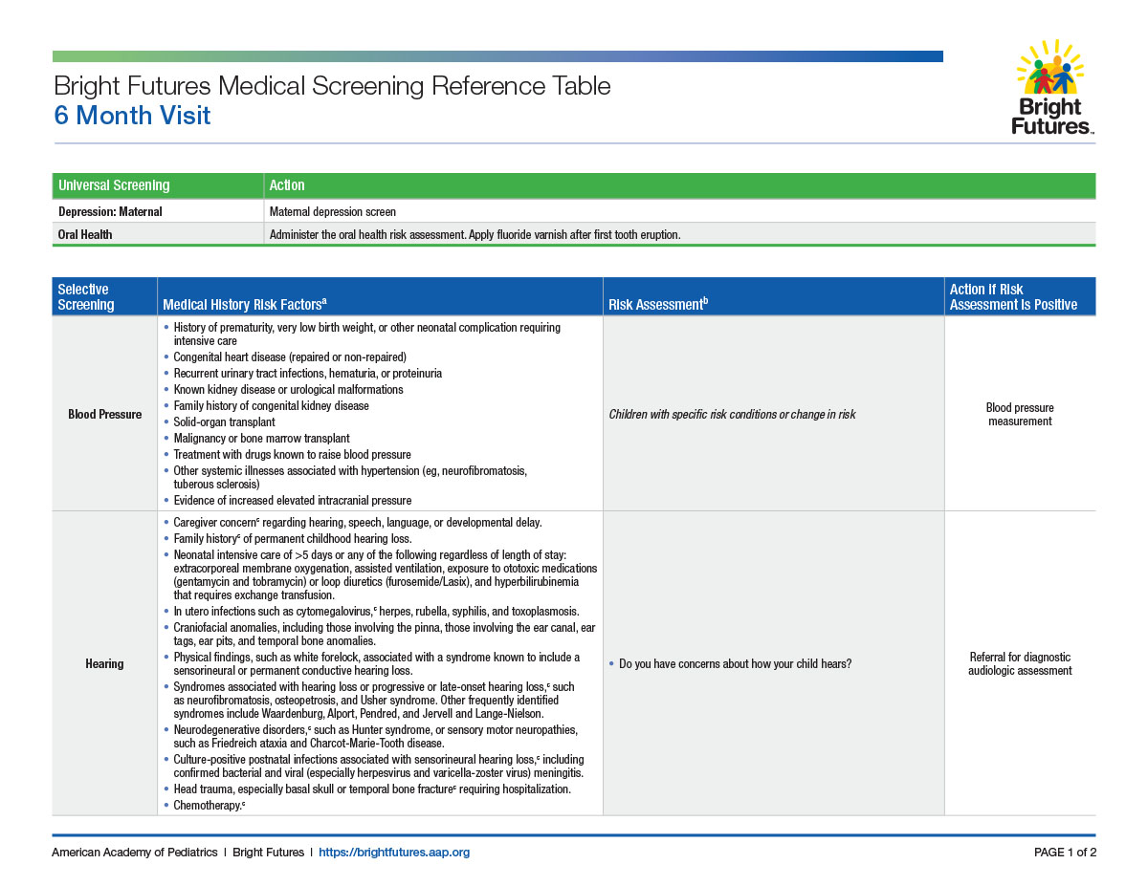
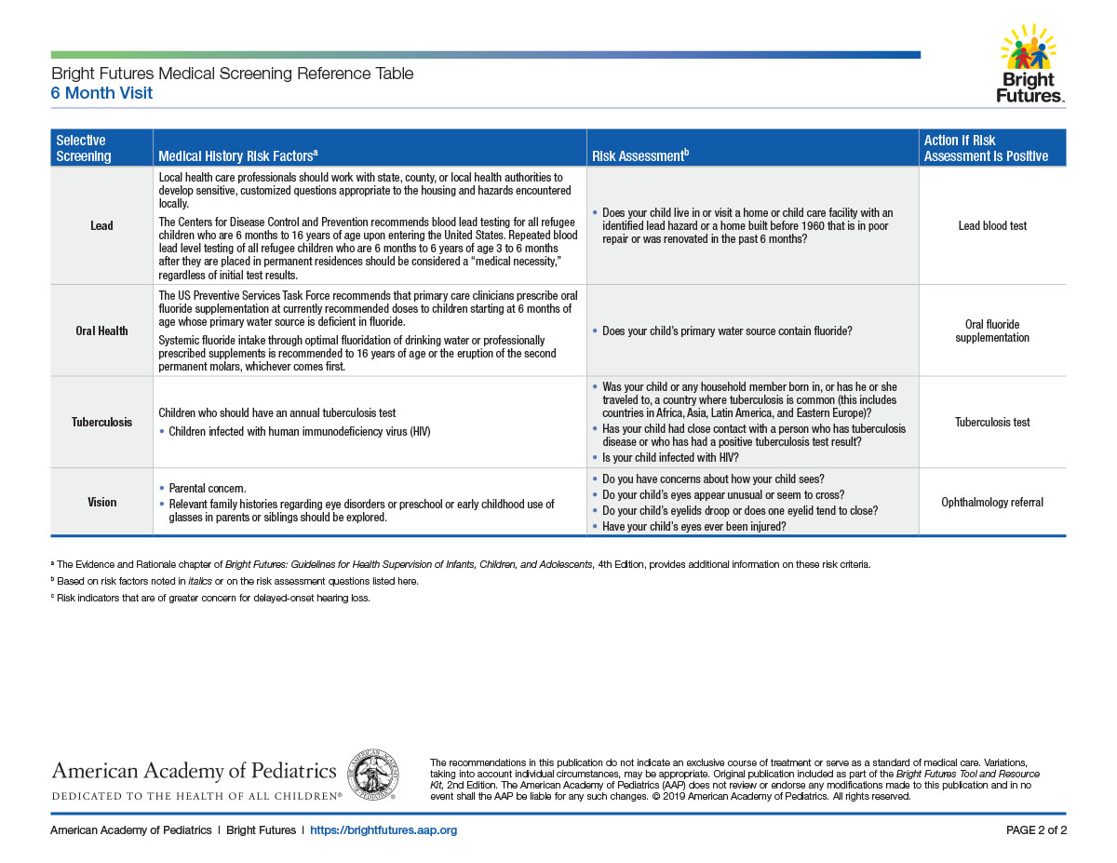
Bright Futures Medical Screening Reference Tables
Notes:
The Bright Futures Medical Screening Reference Tables summarize the universal and selective screening recommended for each visit. Each table provides the relevant medical history risk factors for a screening, risk assessment questions to ask for selective screening, and the action to take if the risk assessment shows a positive result.

Slide 21
Bright Futures and the Electronic Health Record (EHR)
The templates, questionnaires, handouts, and forms from the Bright Futures Resource and Tool Kit form a structured knowledge base that can be used in EHRs.
Depending on your specific EHR system, you can import the documents or use them as a guide in setting up customized health supervision visit templates and Previsit Questionnaires.
Notes:
I expect you’re wondering about electronic health records at this point. We often get questions about whether, and how, these materials can be adapted to EHRs. The good news is that they can be.
Depending on your specific EHR system, you can import the documents or use them as a guide in setting up customized health supervision visit templates and Previsit Questionnaires.

Slide 22
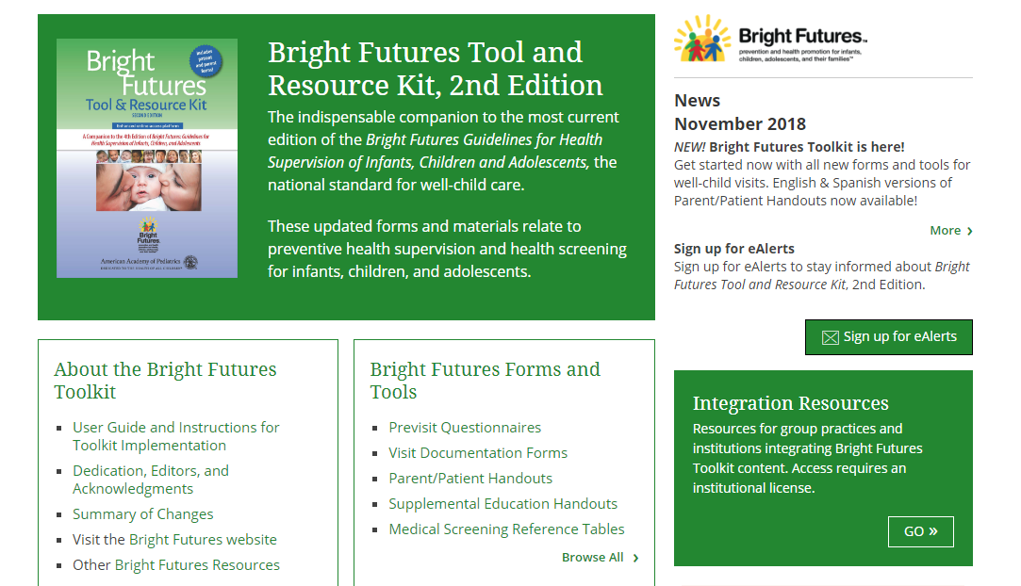
Licensing the Toolkit
NOTE: To license the Toolkit to use the forms in practice and/or incorporate them into an Electronic Medical Record System, please contact AAP Licensing at http://go.aap.org/brightfuturesform. ​
Integration Resources Center
Integration guides and tools are intended to aid overall integration of Toolkit resources into an EHR or system.
Key Features:
EHR visit documentation guidance
Permanent-linked HTML form display
Downloadable forms in PDF, HTML, xml, rtf, docx, and plain-text versions
Summary of major changes from the original Toolkit
Updates center to alert and feed updated forms/links
https://toolkits.solutions.aap.org/bright-futures
Notes:
This slide shows you how you can obtain the Bright Futures Tool & Resource Kit, 2nd edition and highlights some key features.

Slide 23
American Academy of Pediatrics Bright Futures National Center
Jane Bassewitz, MA
Senior Manager, Bright Futures National Center
Kathy Janies
Manager, Bright Futures Implementation
Phone
630-626-6783
E-mail brightfutures@aap.org
Web site brightfutures.aap.org
Notes:
For more information, you can contact the Bright Futures National Center.
Thank you.

Slide 24
Bright Futures in Action
Notes:
This concludes our tour of the Toolkit. I hope I’ve shown you how these tools can not only make your health supervision visits more efficient and productive but contribute to that all-important relationship that is at the heart of the medical home.

