Slide 1
Recognition & Intervention for Human Trafficking in the Pediatric Healthcare Setting

Slide 2
Objectives
Define human trafficking and explain the intersection of human trafficking with health care
Learn how to screen and intervene for human trafficking in the clinical setting
Define how trauma informed care can be utilized with the trafficked population, and in a human trafficking clinic
Understand board relevant human trafficking content
Notes:
At the end of this presentation, we hope that you will be able to do the following:

Slide 3
Human Trafficking Myths
Human Trafficking is the same as kidnapping
Human trafficking is only sex trafficking
Only females are trafficked
Human Trafficking increases near highways and during major events
Notes:
Explain to your audience you will debunk these myths as you progress through the slides.

Slide 4
What is human trafficking
Human Trafficking:
The recruitment, harboring, transportation, provision, or obtaining of a person for labor or services, including sex acts, through the use of force, fraud or coercion [1].
The Commercial Sexual Exploitation of Children (CSEC):
Any person under 18 years of age who has been subject to sexual exploitation as a result of their loitering for the purpose of prostitution or their engagement in an offer to exchange sexual conduct in return for food, clothing, a place to stay, drugs, or a fee [2].
Notes:
Definitions of human trafficking that are currently accepted. Human trafficking in simplicity is modern day slavery.

Slide 5
What is human trafficking
Shared Hope International. (2019). Protected Innocence Challenge Toolkit 2019. https://doi.org/10.1017/CBO9781107415324.004
Notes:
Add your own state’s report card in comparison to previous years via the link at the bottom of the slide.

Slide 6
Child maltreatment
Sexual Assault/Rape
Neglect
Human Trafficking/CSEC
Child Abuse
Domestic Violence
Notes:
Human trafficking is a subsection of overall child maltreatment.

Slide 7
Sex and labor trafficking statistics
40.3 million Victims of Modern Day Slavery
Trafficked Individuals
24.9 Million: Forced Labor
15.4 Million: Forced Marriage
20 Million Labor Trafficking
4.8 Million Sex Trafficking
3.3 Million Children
1 Million Children
ILO, & Walk Free Foundation. (2017). Global estimates of modern slavery: Forced labour and forced marriage.
Retrieved from http://www.ilo.org/wcmsp5/groups/public/---dgreports/---dcomm/documents/publication/wcms_575479.pdf
Notes:
The International Labour Organization estimated that 24.9 million people were victims of forced labor in 2016 (including forced labor in the private economy, state-imposed forced labor, and forced sexual exploitation of adults/child commercial sexual exploitation). Of this group, 18% were children (4.5 million)

Slide 8
WHO CAN BE AFFECTED?
Males
Females
LGBT
Gender
Peak age of entry 15-17
Range generally 8 to 18
Age
All racial backgrounds
Race
affects those above and below the poverty line
those below are disproportionately affected
SES
Sex trafficked individuals: majority are US citizens
Labor trafficked individuals: greater number of foreign born nationals
Citizenship
Polaris Project. (2015). Sex Trafficking in the US: A Closer Look at U.S. Citizen Victims. Retrieved from https://polarisproject.org/sites/default/files/us-citizen-sex-trafficking.pdf
Counter-Trafficking Data Collaborative (CTDC), [February, 2020].
Notes:
Who can be affected by human trafficking? Truthfully, any individual can be affected by human trafficking, however there is a predominance of females who are trafficked for sex trafficking. Largely, numbers are under-reported given the clandestine nature of human trafficking, and thus we truly cannot estimately how many males vs females are trafficking. The average age of entry is between 15 to 17 years old, with a range between 8 to 18. This age of entry really emphasizes why this education is so important to us as pediatricians. Additionally, those below the poverty line are disproportionately affected, and the majority of sex trafficking victims have found to be domestic citizens.

Slide 9
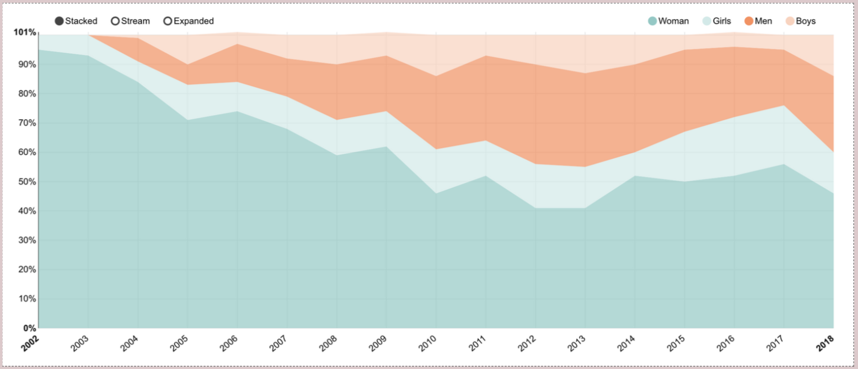
WHO CAN BE AFFECTED?
Counter-Trafficking Data Collaborative (CTDC), [February, 2020].
Notes:
Since 2002, the number of men and boys that are being trafficked has increased due to an increase in reporting of men and boys that are being trafficked. This is most likely reflective more of the increase in awareness throughout the years of human trafficking, and less of an actual increase in trafficking of this set of individuals.

Slide 10
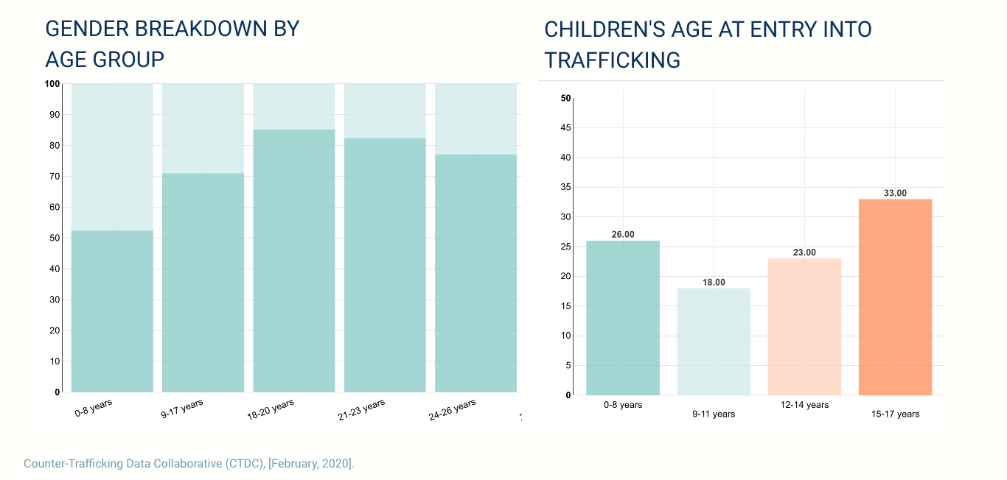
WHO CAN BE AFFECTED?
Notes:
This slide emphasizes that children of all ages can be trafficked, but the predominant age of entry is ages 15 to 17.

Slide 11
At Risk Populations
SOAR to health and Wellness, Department of HHS
Notes:
These 8 sections of the population are at high risk for being trafficked, but children in foster care/juvenile justice, homeless youth, and survivors of physical and sexual abuse are especially at risk. these children should be screened for trafficking at least once during their care.

Slide 12
At Risk Populations
In the US
~ 1.6 million children run away from home and ~3 million cases of child abuse reported each year
Our Community
2,800 homeless youth and 2,000 substantiated claims of child abuse
Cuyahoga DCFS Statistical Report. 2018. http://cfs.cuyahogacounty.us/pdf_cfs/en-US/reports/2018StatisticalReport.pdf
Notes:
The latter stat is based on Ohio. Please change based on your state.

Slide 13
Who are the traffickers?
WHO ARE THE TRAFFICKERS? | HOW ARE CHILDREN RECRUITED? | WHY DO THEY STAY?
“PIMPS” ROMANTIC PARTNERS GANGS FAMILY MEMBERS FRIENDS EMPLOYERS | PSYCHOLOGICAL MANIPULATION RELATIONSHIP TRAP DEBT BONDAGE PHYSICAL VIOLENCE OR THREAT OF HARM BEFRIENDING JOB AD | TRAUMA BONDING STOCKHOLM SYNDROME DRUG ADDICTION ALTERNATIVES
Notes:
Traffickers are usually known to the individual being trafficked in some way. A boyfriend or romantic partners who promises love and care, a family member such as a parent or cousin or aunt/uncle, or a friend/colleague. These relationships can provide a trap for children who have built a bond with their trafficker. This bond is often what makes it so difficult for that child to leave. Additionally, the concept of stockholm syndrome can explain why a child might stay because of their feelings of trust that they have placed in their trafficker. Some children are not aware that the situation that they are in is akin to trafficking.

Slide 14
WHO ARE THE TRAFFICKERS
Notes:
This slide is present to emphasize that psychological abuse is the largest means of control used on children.

Slide 15
Notes:
A John is the purchaser of sex. Anecdotally they are thought to be middle aged men who are married and professionals. In the literature, Johns are 90% men but 10% can be women. Additionally, its important to know in a study, 100% of trafficked children reported violence at the hands of their Johns indicating that the physical and emotional abuse they are afflicted with can come from the John and the trafficker.

Slide 16
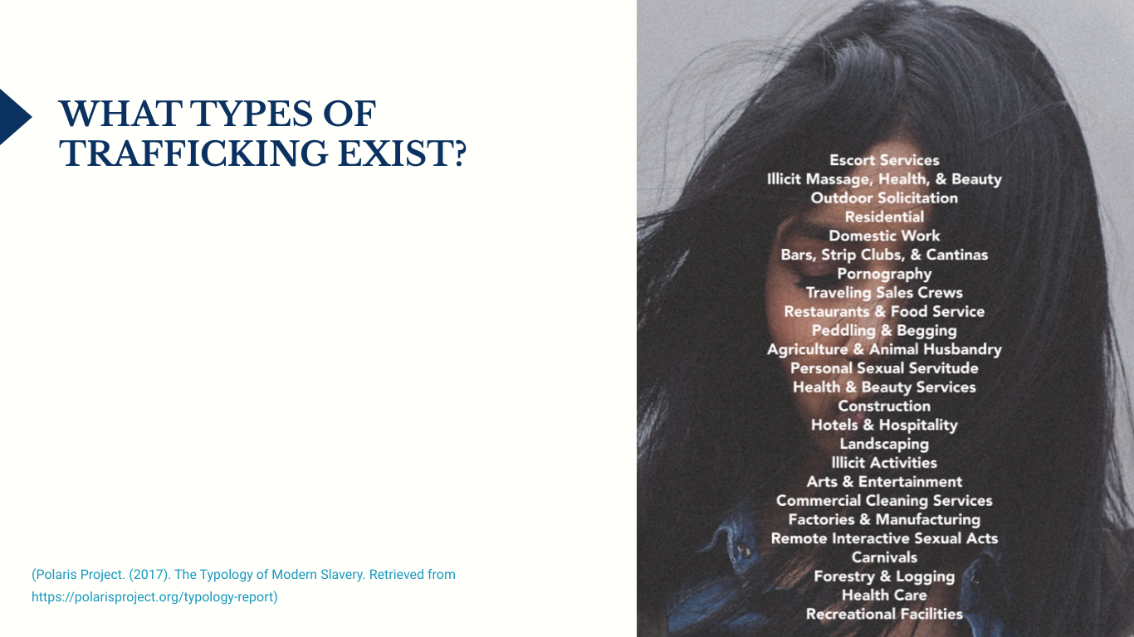
Notes:
Trafficking can occur in areas that are least expected such as agriculture, animal husbandry, forestry/logging, and healthcare.

Slide 17
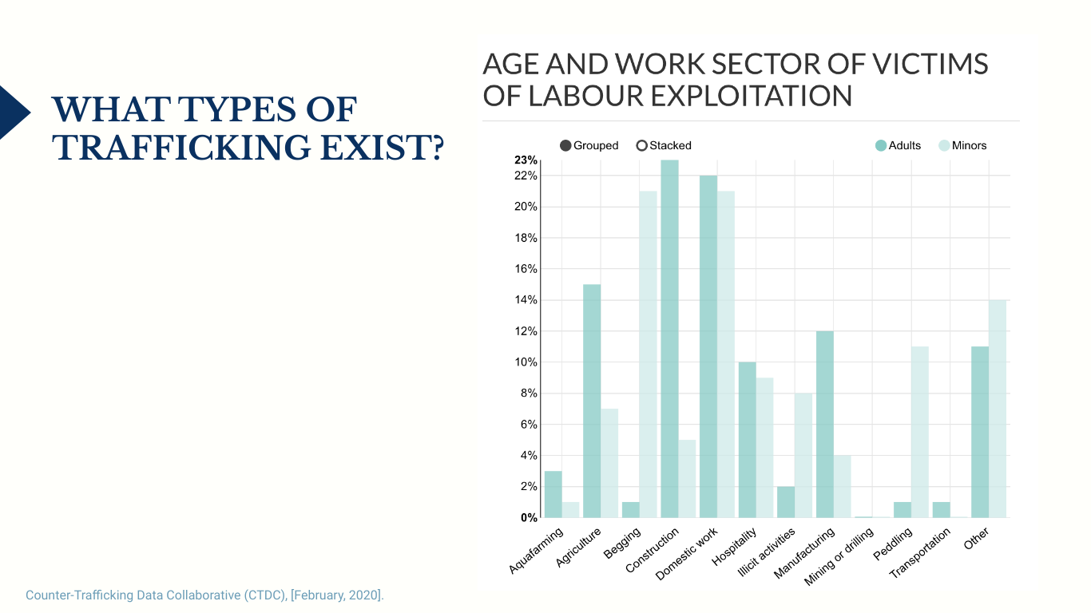
Notes:
From data from the counter-trafficking data collective, begging and domestic work were the most frequently reported types of trafficking for minors.

Slide 18
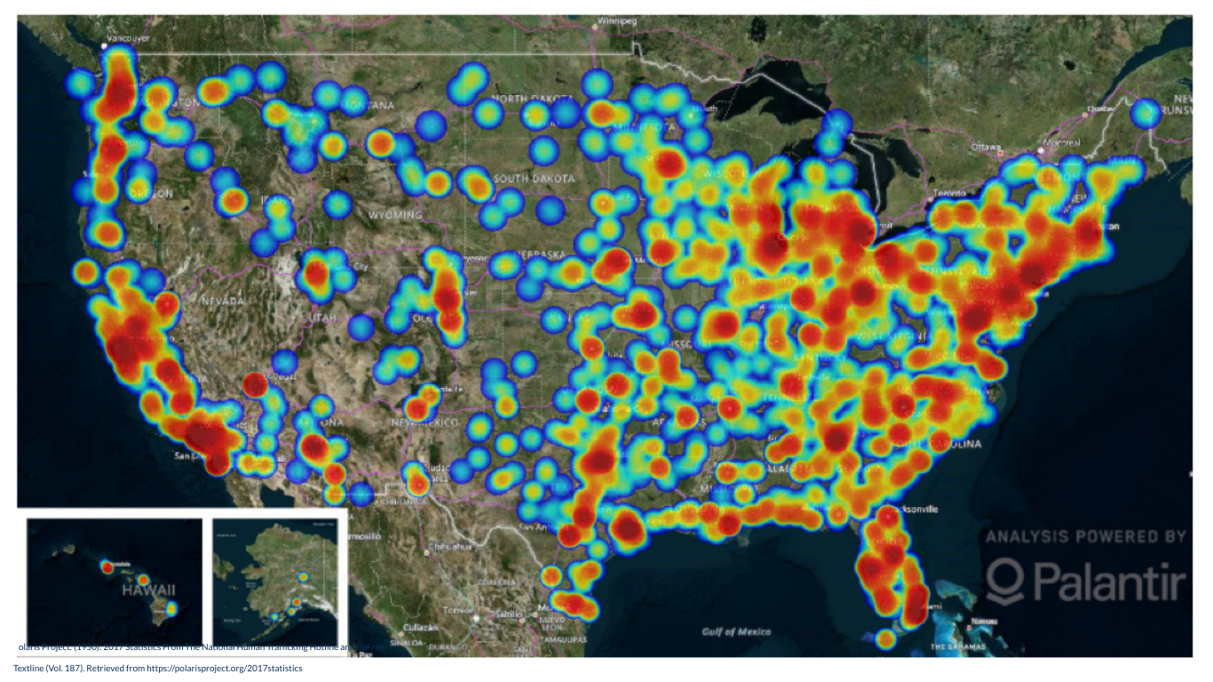
Notes:
This heat map is from the National human trafficking hotline and indicates that trafficking can occur anywhere in the US.

Slide 19
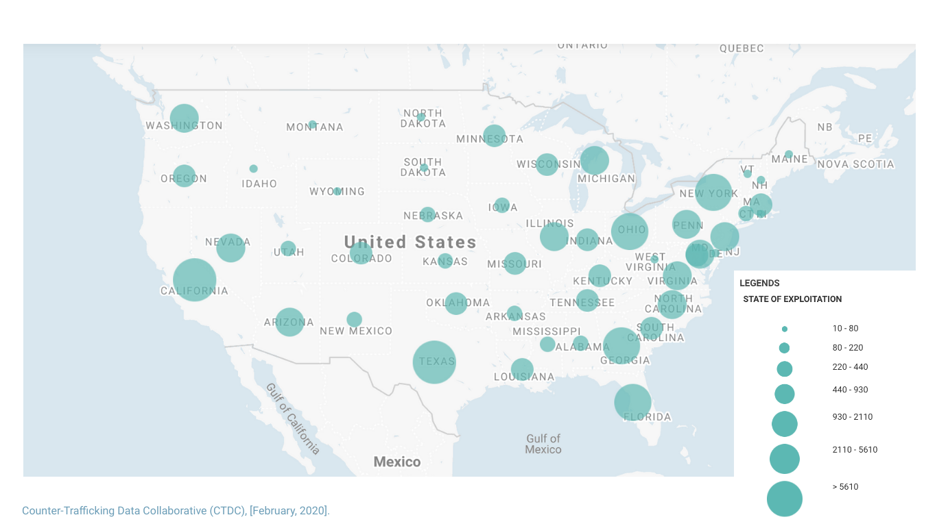
Notes:
These stats are updated every year. Please adjust based on the time of your presentation.

Slide 20
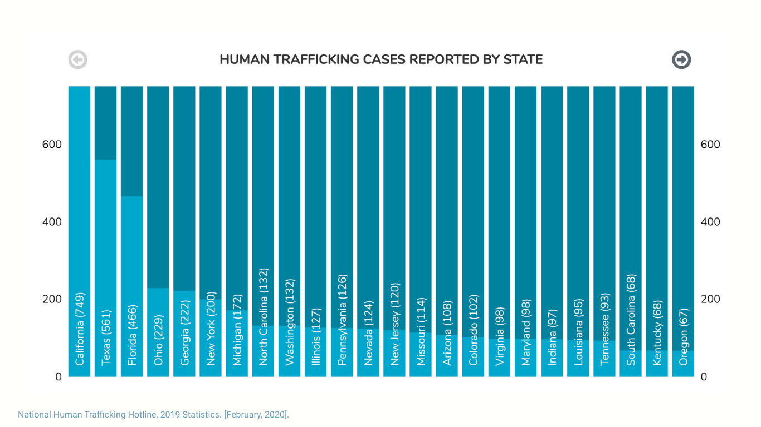
Notes:
These stats are updated every year. Please adjust based on the time of your presentation.

Slide 21
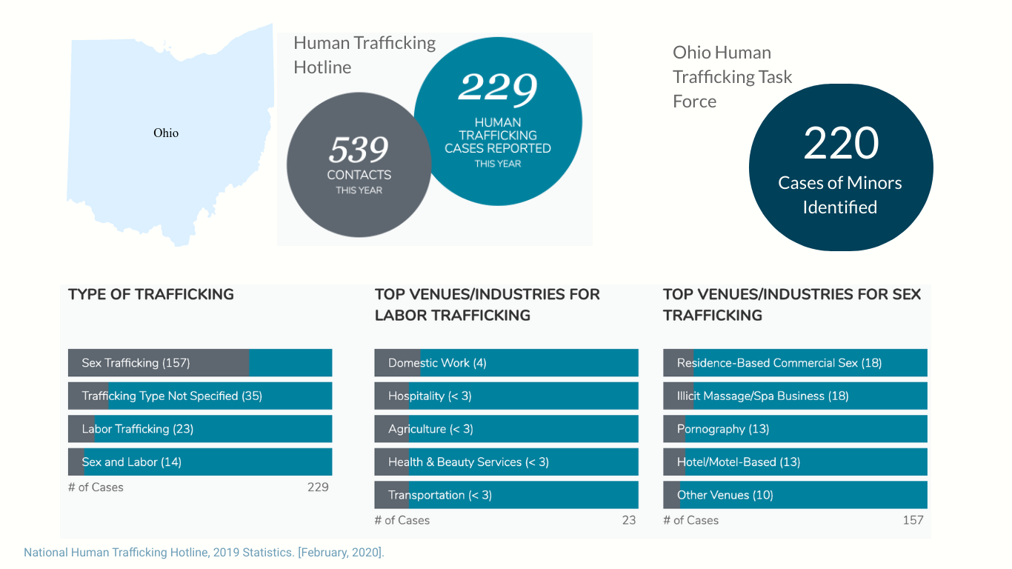
Notes:
This slide was specifically formulated for a Pediatric Program in Ohio. Please make adjustments to this slide as you see fit for your location/area. Stats can be found here: https://humantraffickinghotline.org/states

Slide 22
Notes:
Human trafficking is thought to occur only during large events such as the Super Bowl, World Series, or the Republican National Convention. However, trafficking is happening all the time, even when these events are not occuring.

Slide 23
Notes:
Human trafficking occurs because it is a profitable industry. Unlike weapons and drugs, in human trafficking, the “product” comes back to the trafficker every night. Unfortunately, it has been shown to be more profitable than either of these industries and labor trafficking has shown to increase the product margin and profitability of a company.

Slide 24
Health Consequences of Human Trafficking

Slide 25
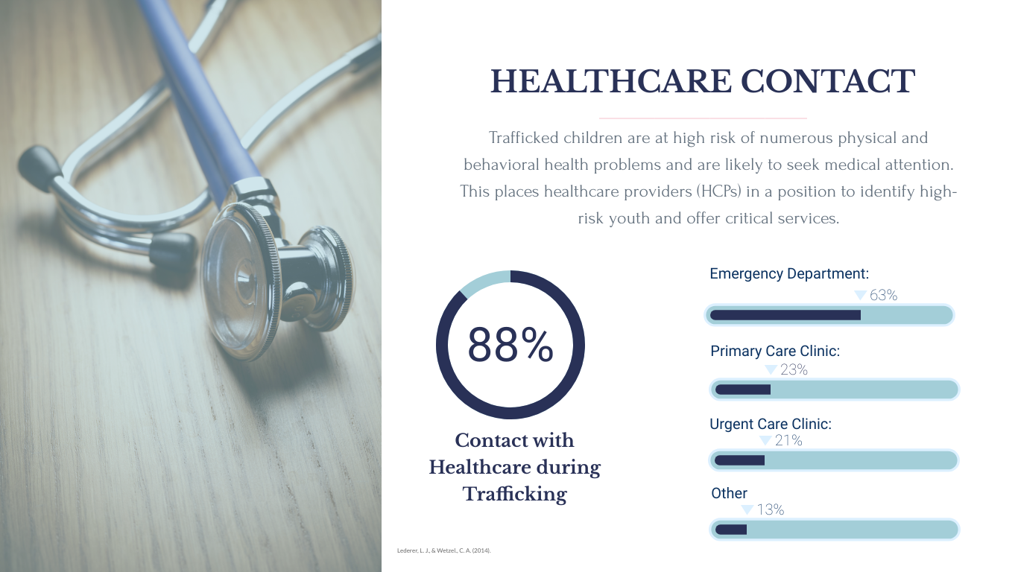
Notes:
Trafficked children are at high risk of numerous physical and behavioral health problems and are likely to seek medical attention. In a study by Lederer et al, 88% of children noted that they had some form of contact with the healthcare field during their trafficking period. This encompassed many different sections of healthcare. A healthcare provider is in a unique position to identify high risk youth and offer services.

Slide 26
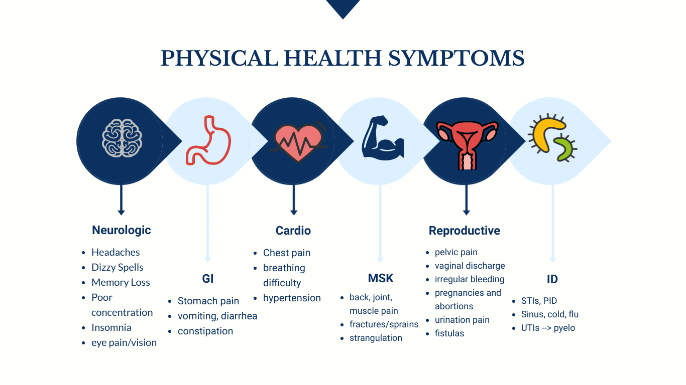
Notes:
Health consequences of human trafficking encompasses all organ systems and trafficked children can present with a seemingly disconnect set of symptoms that would not point to trafficking unless you have a high index of suspicion. For example, a child presenting several times for an asthma exacerbation despite repeated health education could not have proper access to their life saving medications. A child with headaches, weight loss, and poor concentration could be trafficked as well. Additionally, trafficked individuals may experience malnutrition as a result of an inadequate diet, and be forced to live in substandard conditions.⁶ Given the varied and potentially severe health implications of human trafficking, it is imperative that pediatricians be equipped to recognize and respond to suspected labor and sexual exploitation.

Slide 27
Notes:
More examples of health consequences of human trafficking. Psychological issues are one of the most common presenting symptoms for an individual who is trafficked.

Slide 28
Notes:
Please ask your audience to read the case vignette aloud. the next slide points out the red flags and consequences of human trafficking.

Slide 30
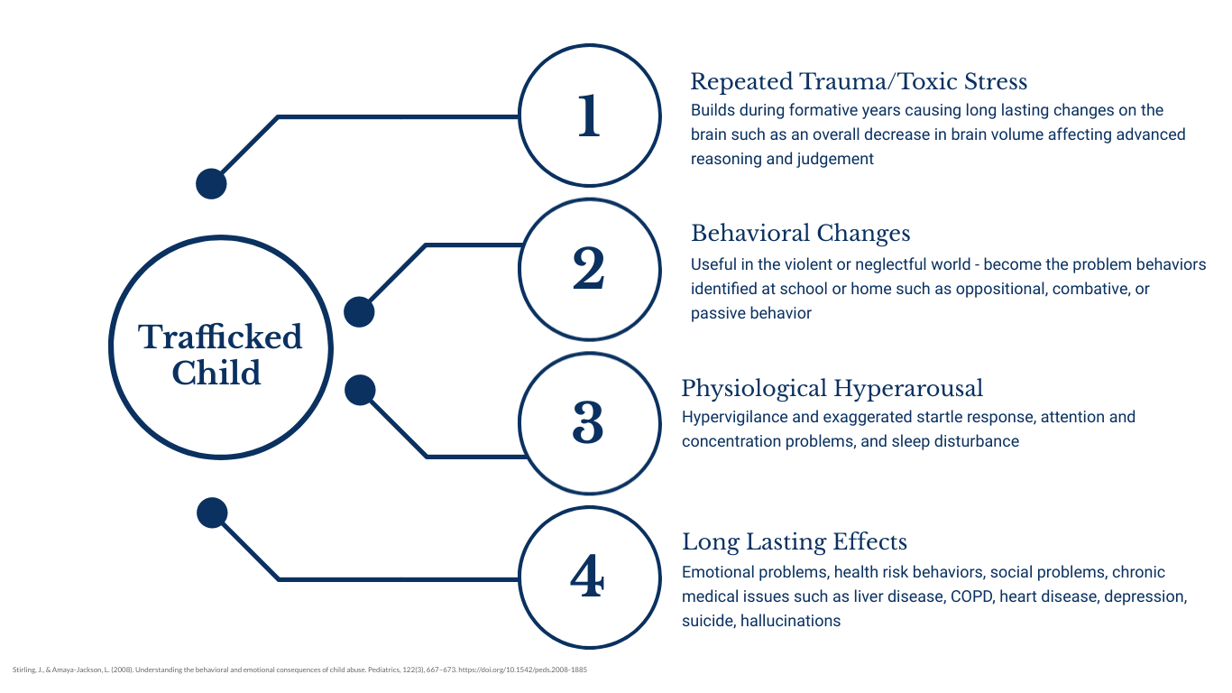
Notes:
Repeated trauma and toxic stress during a child’s formative years can cause cause long lasting changes on the brain such as an overall decrease in brain volume. A child’s advanced reasoning and judgement is affected through this change. Additionally, children learn to adapt to their violent/neglectful world and learn behaviors that are seen to be problematic in school or home. They can be perceived as oppositional, combative, or passive in their behavior when that's their learned response to their complex trauma. A known consequence is physiological hyperarousal where hypervigilance and an exaggerated startle response are increased along with concentration problems and sleep disturbance. These trauma sequelae can have long lasting effects such as emotional problems, health risk behaviors, social problems, and chronic medical issues such as COPD, heart disease, depression, suicide, and hallucinations.

Slide 31
Notes:
Please ask your audience to read the case vignette aloud. the next slide points out the red flags and consequences of human trafficking.

Slide 33
Algorithm to Aiding a Trafficked Child

Slide 34
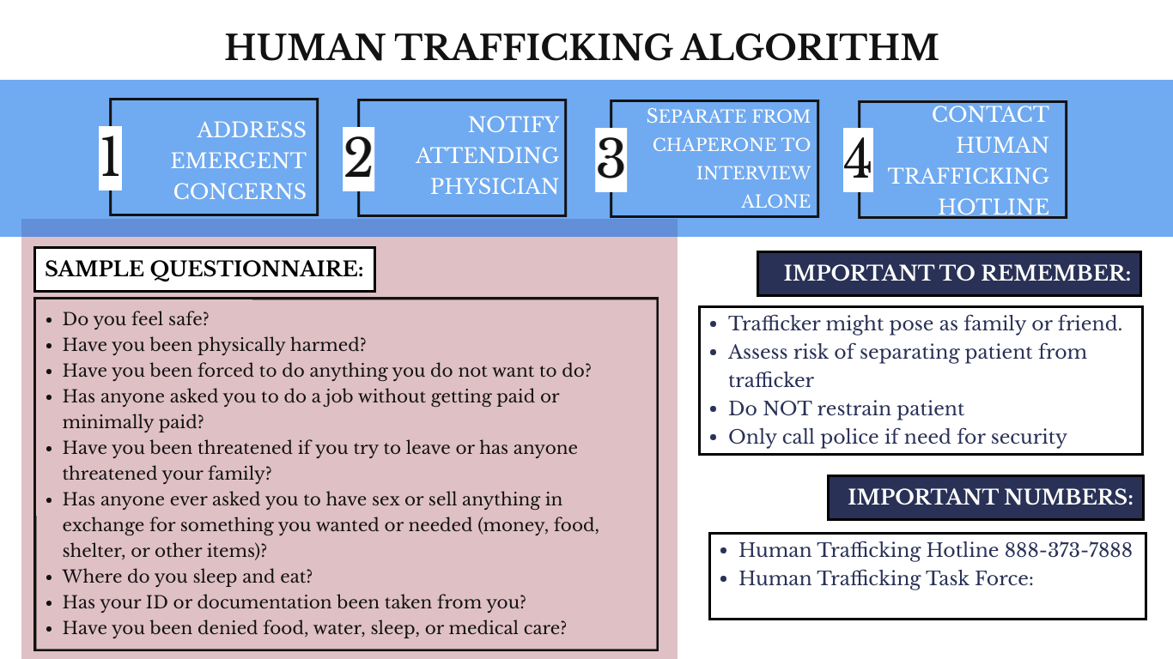
Notes:
This algorithm is designed to help aide you if you come across a child who you are worried about being trafficked.
This is the front of the card. (Proceed to the next slide. Please distribute the algorithm cards to your participants.)

Slide 35
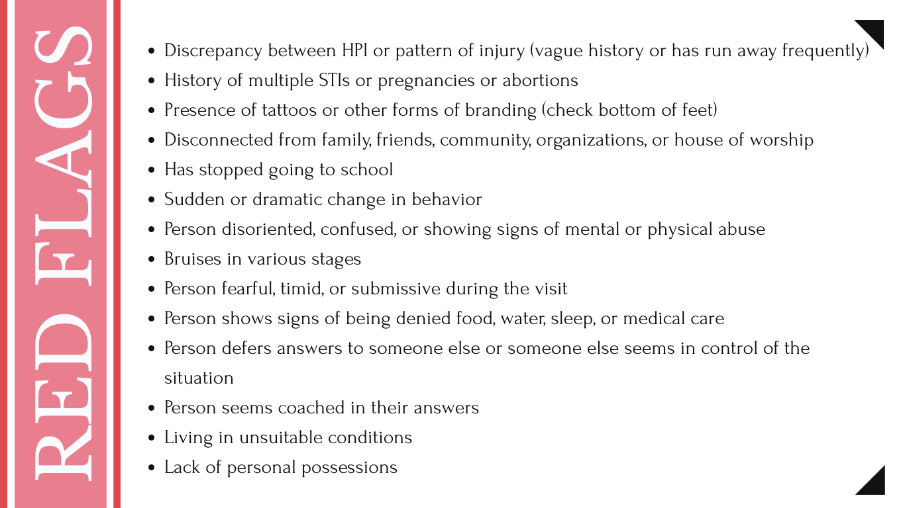
Notes:
This is the back of the back. and we will go through the sections in detail.

Slide 36
Notes:
Say you have a child who comes in to your clinic or the ED. Through your initial intake process, there many be red flags that you have picked up on that alert you to trafficking. (next slide)

Slide 37
Notes:
These are potential red flags that may alert you to a child that has been trafficked.

Slide 38
Notes:
The first step after you have identified a red flag or concern for trafficking is to treat any emergent medical concerns. Assess these three areas.

Slide 40
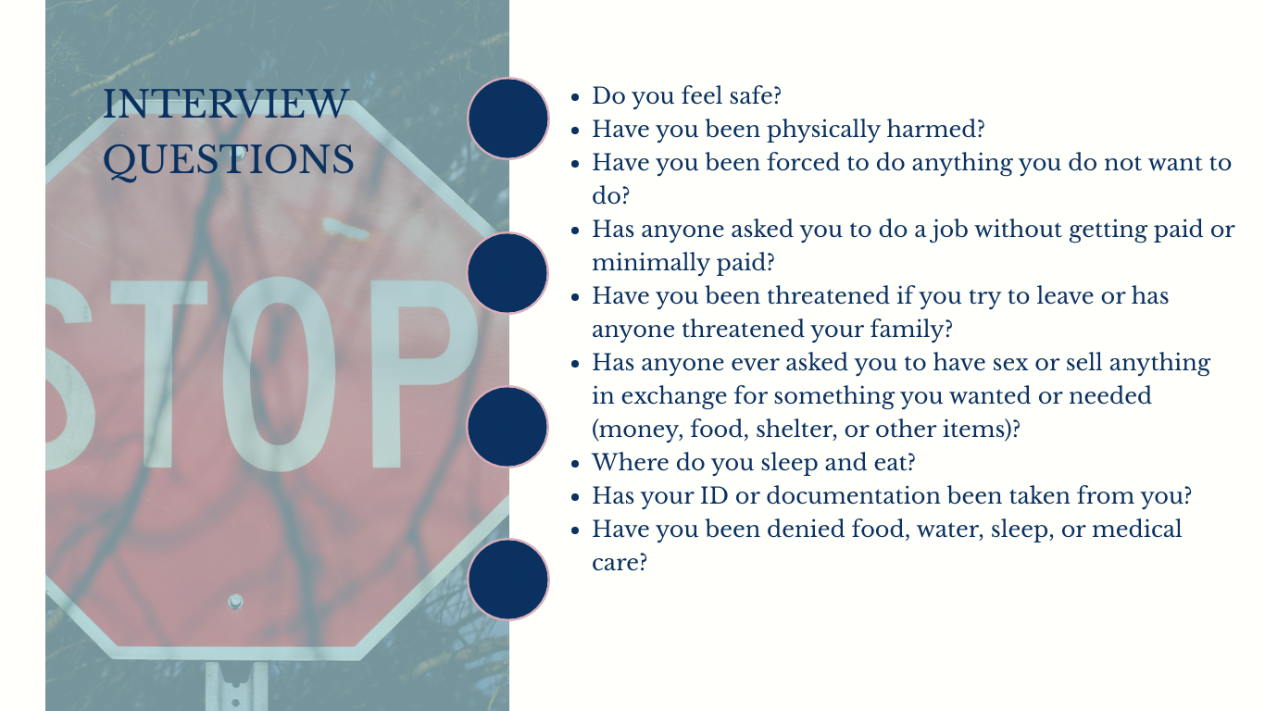
Notes:
Once you have addressed emergent concerns, then attempt to separate the child and the guardian to question the child alone. These interview questions are a guide to your questioning. Being open, non-accusatory, and kind with your words will help engage the individual’s trust. Asking about safety should always be the initial question asked.

Slide 41
Notes:
Sometimes separating the child and the chaperone requires some creativity. Involve members of your medical team to aide you. Whether that is asking the parent to help with paperwork while you stay in the room, or assisting the patient to the bathroom to collect a specimen. Sometimes it might mean asking them to go examine if their car is being towed. Safety for your team and the patient is always the most important, but if you can separate the child and guardian in a safe manner, you could be aiding a child in a dangerous situation.

Slide 43
Notes:
If you are able to identify trafficking in your patient or even if you have not been able to question the child on your own, you can still call the human trafficking hotline for guidance. they are a free resource that is present to help with next steps and triage. If you are concerned about your own anonymity or safety, they will use the level of confidentiality that is important to you. They respond to the child’s concerning quickly within 2 to 24 hours.

Slide 44
Documentation
Exam findings/suspicion
Document tattoos, branding, injuries
Document red flags for future providers
Documenting acute/remote injuries, genital and extragenital (cutaneous, oral, closed head, neck, thoracoabdominal injuries, and skeletal fractures)
Safe documentation
Document concerns where providers only have access (Including for survivors, who are at risk of re-victimization)
Notes:
Documentation is very important in cases of trafficking. Make sure to document your exam findings and your suspicions about trafficking. Documentation should be placed in a safe area that does not have access to the parent or guardian or cannot be printed on home going documents. If documentation is not placed in a safe and protected area, this can be dangerous to the child in question. Additionally, documentation can be re-victimizing for the child/survivor themself so making sure the documentation is only visible to providers will aide in stopping re-victimization.

Slide 45
Trauma Informed Care

Slide 46
Notes:
Trauma infomed care is a key aspect to the long term care and rehabilitation for survivors. It recognizes signs and symptoms of trafficking/trauma in clients and focuses on recovery. It responds by fully integrating knowledge about trauma into policies, procedures, and practices and seeks to actively resist re-victimization and re-traumatization.

Slide 47
Notes:
Trauma informed care can explain how trafficked children can be inadvertently re-traumatized through their encounters with healthcare professionals. A maneuver as simple as a thyroid exam can trigger memories of strangulation and lead to anxiety and distress. Venipuncture may prompt recollection of the pain and helplessness associated with prior forced drug use; a genital exam may elicit feelings of fear associated with past sexual assault. A pediatrician’s use of a trauma-informed approach may minimize re-traumatization and facilitate patient feelings of trust and self-agency

