Slide 1
AAP Bright Futures National Center Bright Futures: Guidelines for Health Supervision of Infants, Children, and Adolescents, 4th Edition
Promoting Healthy Growth During Early Infancy
Author: Jayne Barr, MD , MPH
Notes:
This topic focuses on Promoting Healthy Growth During Early Infancy, primarily focusing on the nutrition (breastfeeding) and promoting healthy growth following birth.

Slide 2
Author & Disclosure Information
Jayne Barr, MD, MPH
Associate Professor Internal Medicine and Pediatrics, APD Primary Care, Metrohealth Case Western Reserve University, Cleveland, Ohio
I have nothing to disclose
Note: The recommendations in this presentation/training do not indicate an exclusive course of treatment or serve as a standard of care. Variations, taking into account individual circumstances, may be appropriate.
Citation: If you plan to use this resource, please cite or credit as: Barr, J. (2022) Bright Futures: Promoting Healthy Growth During Early Infancy [PowerPoint Slides]. 2022. Accessed <date>. http://www.aap.org/en/practice-management/bright-futures/bright-futures-in-clinical-practice/bright-futures-educational-resources
This program is supported by the Health Resources and Services Administration (HRSA) of the US Department of Health and Human Services (HHS) as part of an award totaling $5,000,000 with 10 percent financed with non-governmental sources. The contents are those of the author(s) and do not necessarily represent the official views of, nor an endorsement, by HRSA, HHS, or the US Government. For more information, please visit HRSA.gov.
Notes:
Please read and review the author & disclosure information before you continue.

Slide 3
Pre-test
Evaluate your knowledge about the topic before the mini training. Please click on the pre-test link below.
Please click on link to be routed to the pre-test
Note: This is for learning purposes only and is NOT approved for CME.
Notes:
Please complete the pre-test prior to reviewing the presentation.

Slide 4
Main Objectives
As a result of completing this module, the participant will be able to:
Promote healthy eating and growth starting in the newborn period.
Identify important aspects of the maternal history.
Develop an approach to assess parent responsiveness to infant hunger and satiety cues, breastfeeding in the absences of hunger, sleep duration and quality.
Provide on overview of sociocultural, economic, or other barriers to food and nutritional needs.
Notes:
As a result of completing this module, the participant will be able to:
Promote healthy eating and growth starting in the newborn period.
Identify important aspects of the maternal history.
Develop an approach to assess parent responsiveness to infant hunger and safety cues, breastfeeding in the absences of hunger, sleep duration and quality.
Address sociocultural, economic, or other barriers to food and nutritional needs.

Slide 5
Scope in Pediatrics
Adequate nutrition during infancy is essential in order to ensure the health, growth and development of infants and children.
The pediatric health care professional will be able to:
Identify the role of the pediatric health care professional in promoting and protecting breastfeeding.
Describe the benefits of breastfeeding.
Identify reasons a mother may decide not to breastfeed.
Use best practices to promote healthy growth beginning in the newborn period and address the barriers that may be present.
Notes:
It is important that health care professionals are assuring that infants are being provided adequate nutrition during infancy in order to ensure the health, growth and development of infants and children.
The pediatric health care professional will be able to:
Identify the role of the pediatric health care professional in promoting and protecting breastfeeding.
Describe the benefits of breastfeeding.
Identify reasons a mother may decide not to breastfeed.
Use best practices to promote healthy growth beginning in the newborn period and address the barriers that may be present. This includes the importance of responsive feeding and healthy habits in infancy on healthy growth.

Slide 6
Disparities Related to Breastfeeding
There are disparities in breastfeeding.^{5,6}
Hispanic women have higher rates to initiate breastfeeding. They are also more likely to supplement formula earlier and to introduce solids earlier.^{5,7}
Fewer Black infants and Native American infants were exclusively breastfed the first 6 months of life as compared to White infants and a national average.⁵
This disparity is especially true for low-income Black women who return to work earlier and are faced with various challenges.^{5,7}
To hear the optional narrated guidance, click the icon .
Notes:
As there are disparities noted in infant mortality, there are similar disparities in breastfeeding.
According to the CDC, demographic characteristics and family breastfeeding history play a role in Hispanic mothers having a higher rate of breastfeeding. While this research suggests Hispanic women have higher rate to initiate breastfeeding, the group is also more likely to supplement formula earlier and to introduce solids earlier.
From data available from the CDC, 21.2% of Black infants and 19.6% of Native American infants were exclusively breastfed for the first 6 months of life. The CDC also reports 21.5% Hispanic and 26.8% Non-Hispanic Asian rate for exclusive breastfeeding through 6 months.
This is in comparison to 28.7% White infants and a national average of 25.6%.
The low rate for breastfeeding infants through the first 6 months of life is especially true for low-income Black women who return to work earlier in comparison to other racial or ethnic groups. There are also challenges with work schedules, support for breastfeeding or expressing breast milk.

Slide 7
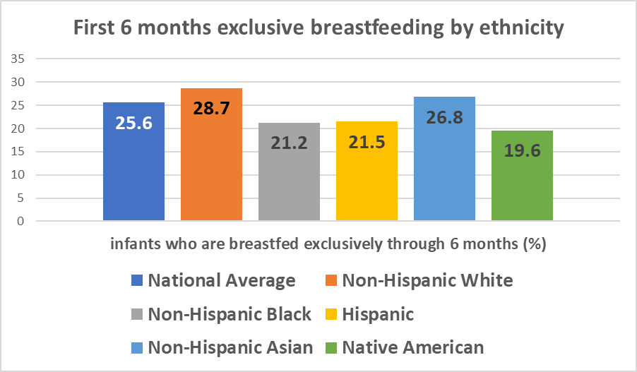
Source: Data derived from United States, 2019. MMWR Morb Mortal Wkly Rep 2021
Notes:
Data available from the CDC, 21.2% of Black infants and 19.6% of Native American infants were exclusively breastfed the first 6 months of life. The CDC also reports that 21.5% Hispanic and 26.8% Non-Hispanic Asian rate for exclusive breastfeeding through 6 months.
This is in comparison to 28.7% White infants and a national average of 25.6%.

Slide 8
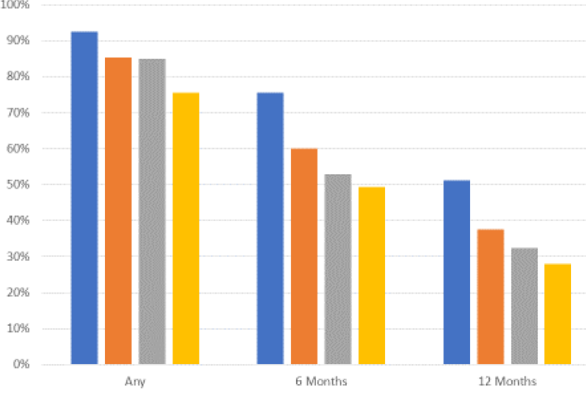
Any Breastfeeding Initiation
Source: Data derived from United States, 2019. MMWR Morb Mortal Wkly Rep 2021
Notes:
Compared to exclusive breastfeeding as shown in the previous slide, the national average for ANY breastfeeding initiation rate is 83.9% per the CDC data. The breastfeeding initiation rate is highest for non-Hispanic and Asian population; the breastfeeding initiation rate is higher for non-Hispanic white and Hispanic populations as compared to non-Hispanic black or African-American populations.

Slide 9
Disparities Related to Breastfeeding
The disparities in breastfeeding are associated with differences in health outcomes for Black infants, as compared to White infants.^{5,7}
Barriers to initiating breastfeeding^{6,7}
Absence of lactation support
Maternal health complications
Lack of trust
Implicit biases
To hear the optional narrated guidance, click the icon .
Notes:
The disparities in breastfeeding are associated with differences in health outcomes for Black infants, as compared to White infants, with increased cases of necrotizing enterocolitis, acute otitis media and death associated with insufficient breastfeeding.
Recent research by Mieso and by Kirksey offer insights to the barriers to initiating breastfeeding. Barriers to initiating breastfeeding included absence of lactation support when lactating issues occurred, prenatal and postpartum health complications such as mental health problems, stress related to challenges at home or at work, poverty, and lack of trust in the health care professionals. It was also noted that the implicit biases of health care professionals and/or institution discrimination have an impact with discussions of breastfeeding and the decision for lactation referral.

Slide 10
Overview: What Pediatric Health Care Professionals Can Do
Ensure hospitalized mothers have access to support and education concerning breastfeeding immediately after birth through discharge.^{6,7}
Assess internal implicit biases that may impact breastfeeding support.^{6,7}
Understand cultural, societal, and familial influences that may impact a woman’s decision to breastfeed.^{6,7}
Need to be able to communicate and discuss the health benefits of breastfeeding^{6,7}
To have awareness of the alternatives to breastfeeding.
To hear the optional narrated guidance, click the icon .
Notes:
As discussed in the previous slide, just as there are disparities noted in infant mortality, there are similar disparities in breastfeeding.
Narration:
It is important for health care professionals, including residents and trainees, to minimize the disparities in breastfeeding.
First, professionals need to ensure that there is access to mothers in the hospital for support and education with breastfeeding immediately after birth through discharge.
Professionals, including residents and trainees, need to assess internal implicit biases that may impact breastfeeding support.
Professionals, including residents and trainees, have to be trained and educated to understand the cultural, societal, and familial influences that may impact a woman’s decision to breastfeed.
Health care professionals, including residents and trainees, need to be able to communicate and discuss the health benefits of breastfeeding – such as reduction in respiratory infections, decreased incidence of obesity and diabetes, decreased atopic disease, and decreased infant mortality.
There is also a need to have an awareness of the alternatives to breastfeeding.

Slide 11
Discussing Alternatives to Breastfeeding
While the AAP recommends exclusive breastfeeding for approximately 6 months and supports continued breastfeeding until 2 years (or beyond), there are considerations which health care professionals should have awareness¹⁴
Contraindications to breastfeeding
Classis galactosemia
Maternal infections (brucellosis, active herpetic lesions)
Marijuana use
Maternal medications
Medical necessity of supplementation
Parental preference
Adoption, gender-diverse families
Notes:
Approximately 19% of breastfed infants receive supplemental commercial infant formula within the first 48 hours after birth.
While the AAP recommends exclusive breastfeeding for approximately 6 months and supports continued breastfeeding until 2 years (or beyond), there are considerations which health care professionals should have awareness.
Contraindications to breastfeeding include:
Classic galactosemia is an absolute contraindication to breastfeeding
Maternal infections – untreated brucellosis, active herpetic lesions on the breast
Maternal marijuana use while breastfeeding is discouraged since there is insufficient data to assess the effects of the infant
Some medications are contraindicated with breastfeeding
Supplementation may be medically necessary if breastfeeding technique and frequency is not optimal.
Families may have preference for commercial formula.
Breastfeeding may not be possible in cases of adoption.
Gender-diverse parents have less access to human milk due to social and biological constraints.

Slide 12
Case Study
Mom is 30-year-old female
Delivered first child, a boy
No complications ,vaginal delivery
Infant weighs 7lbs 8oz, 19” long
Apgar scores: 7 at 1-min., 9 at 5-min.
Mom indicates she will breastfeed
Inquiring about feeding and what to expect
Plans to return to work full-time
Has received many conflicting information about breastfeeding
Notes:
Mom is a 30-year-old female who delivered her first child, a boy. There were no complications with the vaginal delivery. The infant weighs 7 pounds 8 ounces and length is 19 inches. Apgar scores are: 7 at 1 minute, 9 at 5 minutes.
During the prenatal visit, the mother had indicated that she would breastfeed. The mother is inquiring information about feeding her newborn and what to expect.
She plans on returning to work full-time in about 8 weeks.
She has asked other family members (including her mother) and friends who have had children. She has received conflicting information about breastfeeding, expressed breast milk, formula feeding, and introducing infant cereal and fruits.

Slide 13
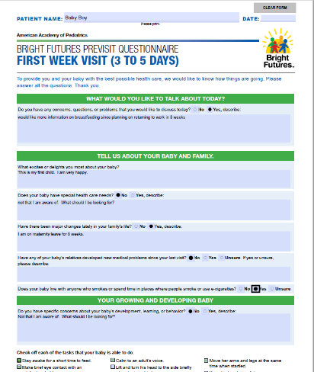
Self-Assessment
What does the Bright Futures Previsit Questionnaire reveal about the mom and infant?
Parent would like more information on breastfeeding as they will be returning to work.
First child and parent is very happy.
Parent is not aware if child has special health care needs. Wants to know what to look for.
Is on maternity leave for 8 weeks.
Parent does not have specific concerns today. Wants to know what to be aware of.
Notes:
What does the Bright Futures Previsit Questionnaire reveal about the mother and infant?

Slide 14
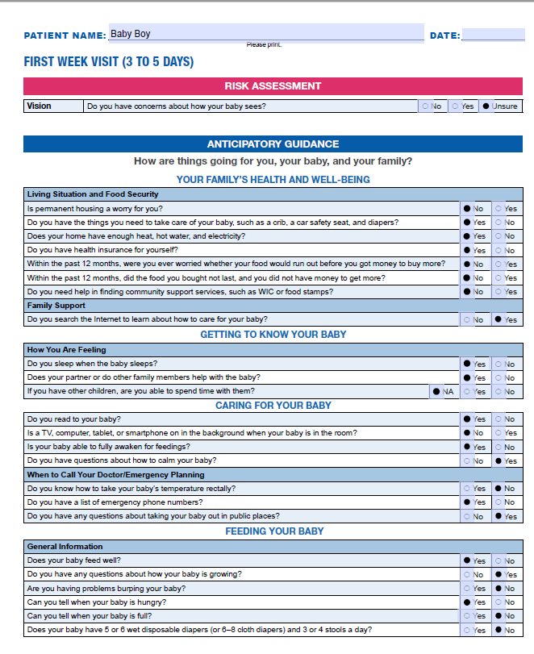
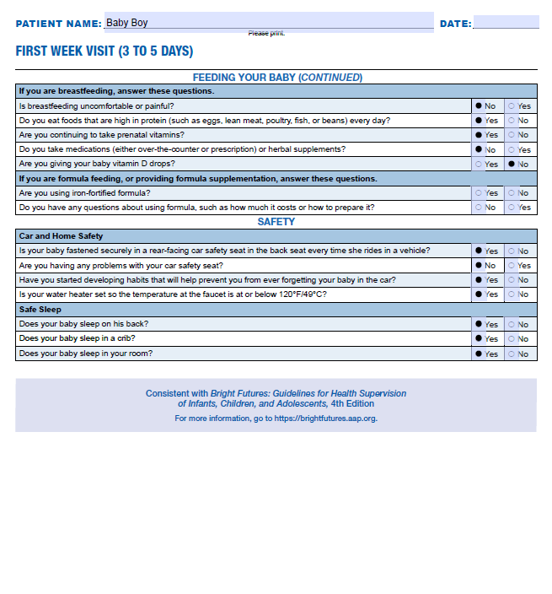
Self-Assessment
What does the self-assessment reveal about the mom and infant?
Notes:
What does the self-assessment reveal about the mother and infant?

Slide 15
Self-Assessment Questions
What are important aspects of the previsit questionnaire?
While examining the infant during this visit, what would you focus on?
What other maternal history would you need to know? (mental health, medical history and medications, perceptions of breastfeeding, etc.)?
What would you want staff to document and discuss with the mother?
What would be the focus on subsequent visits in regard to nutrition and promoting healthy growth? Any other areas that the clinician should discuss or review?
1 Month Visit
2 Month Visit
Click next to view responses.
To hear the optional narrated guidance, click the icon .
Notes:
Narration: Let’s discuss some important aspects of this case as we go through the self-assessment questions.

Slide 16
Self-Assessment Feedback #1:
Based on this Previsit Questionnaire, what are some priorities to address during this visit?
Feeding practices
Health care and food disparities
Psychosocial concerns
Financial concerns
Family member smoking
To hear the optional narrated guidance, click the icon .
Notes:
Narration: Let's talk about the first question. What are some priorities to address during this visit? In general, we would want to discuss feeding practices, food disparities, psychosocial concerns, financial concerns, and household smoking. The mother has questions regarding breastfeeding. She remarked that it is sometimes painful or uncomfortable. We should review the mother’s breastfeeding technique.
It is also reported that there were not a lot of wet diapers or bowel movements. We will want to have more information regarding the feeding pattern.
She was also not giving vitamin D for the infant. We will want to review the importance of prescribing vitamin D drops for breastfed infants. She did note that she is searching the internet to learn how to care for her baby and she is unsure about normal infant development and developmental milestones. This is important to review during this visit.
There may also be some underlying financial concerns so we may want to have some follow up with WIC or food stamps. We want to remind the mother about household smoking since the grandparent does smoke a pipe.
Facilitator Notes:
To screen for questions, health care disparities, psychosocial concerns.
The mother has questions regarding breastfeeding
Remarked that it was sometimes painful or uncomfortable
Review the mom’s breastfeeding technique
Reported there not a lot of wet diapers or bowel movements
Provide more information regarding feeding
She was not given vitamin D drops for the infant.
Review importance and prescribe drops
She is searching the Internet to learn about how to care for her baby
She is unsure about normal infant development and developmental milestones
There may be some underlying financial concerns
Follow up on “maybe” needing WIC or food stamps
Grandparent smokes a pipe
Remind limiting the infant’s smoke exposure

Slide 17
Self-Assessment Feedback #2:
While examining the infant during this visit, what would you focus on?
Summarize the information and the mother’s concerns
Discuss benefits of breastfeeding (eg, healthy growth)
Review physical exam and highlight developmental milestones
To hear the optional narrated guidance, click the icon .
Notes:
Narration: Let’s talk about question 2. While examining the infant during this visit, what would you focus on? It’s important to summarize the information during the visit and your findings during the exam.
We also want to make sure we address the mother’s concerns. We will want to discuss the benefits of breastfeeding and noting any weight gain and address any of her concerns.
We should also review the physical exam and, finally, we should highlight the developmental milestones.

Slide 18
Self-Assessment Feedback #3:
What other maternal history would you need to know?
Mental health (remind mom to ask for help, rest/sleep when baby sleeps, voice any mental health concerns)
Medical and family history
Perceptions of breastfeeding
To hear the optional narrated guidance, click the icon .
Notes:
Narration: The third question-What other maternal history would you need to know? It’s important to gather a complete medical and family history.
The mother does not indicate mental health issues or depression, but we should take time to remind the mom to ask for help from family/friends; rest and/or sleep when the baby sleeps and voice any mental health concerns to her health care professionals. Finally, we want to have an idea of the mother’s perception of breastfeeding and to understand if there are any barriers to breastfeeding.

Slide 19
Self-Assessment Feedback #4:
What would you want staff to document and discuss with the mother?
Address mother’s concerns about breastfeeding and development
Refer to lactation counseling
To hear the optional narrated guidance, click the icon .
Notes:
Narration: Let’s discuss what we want the staff to document and discuss with the mother. The staff should document and discuss the following: addressing mother’s concerns about breastfeeding and development and making referrals to lactation counseling, and also addressing any of the mother’s questions on breastfeeding and development.
We should always offer lactation counseling and review of milestones of the infant development during each office visit.
The staff may notice that there are some possible financial concerns and therefore want to be able to provide any local resources.
We also want to make sure that there is education provided on limiting smoke exposure especially as, in this case, the grandparent does smoke a pipe.
Facilitator’s Notes:
The staff should document and could discuss the following:
- Address mother’s concerns about breastfeeding and development
-Refer to lactation counseling
-The mother has a lot of questions on breastfeeding and development
- Offer lactation counseling and review milestones of infant development
- Possible financial concerns, therefore, provide local resources
- Discuss importance of limiting smoke exposure (grandparent smokes a pipe)

Slide 20
Self-Assessment Feedback #5:
What would be the focus of subsequent visits regarding nutrition/promoting healthy growth?
1 Month Visit
Feeding strategies, hunger and satiety cues
Discussion on preparing to return to work
Ask about parent and family health and well-being
Ask about social determinants (food insecurity, environmental tobacco exposure)
To hear the optional narrated guidance, click the icon .
Notes:
Narration: What do we want to focus on subsequent visits particularly the 4 week visit as well as the 2-month visit - regarding nutrition, promoting healthy weight, and what other areas should we, as pediatric health care professionals, discuss or review? We should focus on feeding strategies, healthy growth, tracking weight for length, holding, burping, and understanding hunger and satiety cues.
We also want to discuss about preparing for returning to work either breast pumping, feeding plans and choices, and general guidance on feeding, childcare alternatives and we also want to look at surveilling the parent and family health as well as well-being such as postpartum checkups, perinatal depression screenings, and family relationships.
We should be assessing feeding and also looking at postpartum concerns such as the need for any areas of counseling to provide to the family and other caregivers.
In terms of assessing of feeding, we want to know and have the parent understand that there are cues of when the baby is hungry such as putting their hands to their mouth, sucking, rooting, or fussing.
We also want them to understand cues to knowing when the baby is full such as turning away, closing their mouth, relaxing arms and hands. Now, we want to review and discuss the newborn assessment and newborn behavior.
Spending time with the child, holding them, cuddling them, reading, singing, playing, and learning what things the child and baby likes is really important for the pediatric health care professional to discuss.
We want to ask about the social determinants such as food insecurity, environmental tobacco exposure, and making them aware of any community resources and family support.
Facilitator Notes:
Feedback for question 5.
Focus on feeding strategies, weight gain, holding, burping, hunger and satiation cues
Discuss preparing for returning to work – breast pumping, feeding plans and choices, general guidance on feeding, childcare alternatives
Surveil parent and family health and well-being (postpartum checkup, perinatal depression screen, family relationships), feeding assessment
Postpartum concerns; Assess areas of counseling to provide to the family and other caregivers.
Assessment of feeding
Cues to knowing when baby is hungry (putting hand to mouth, sucking, rooting, fussing)
Cues to knowing when baby is full (turning away, closing the mouth, relaxed arms and hands)
Review and discuss the Newborn assessment and newborn behavior
Spending time with child holding taking, cuddling, reading, singing, playing; learning what things your baby likes
Ask about social determinants (food security, environmental and tobacco exposure)
Provide community resources and family support

Slide 21
Self-Assessment 5 Continued:
What would be the focus of subsequent visits regarding nutrition/promoting healthy growth?
2 Month Visit
General guidance on feeding
Ask about parent and family health and well-being
Ask about social determinants (food insecurity, environmental tobacco exposure)
Notes:
At the 2-month visit:
Provide general guidance on feeding, breast pumping, feeding plans and choices, avoid feeding your baby solid foods or juice.
Ask about parent and family health and well-being (postpartum checkup, perinatal depression screen, family relationships); assess areas of counseling to provide to the family and other caregivers.
Ask about social determinants (such as food insecurity, environmental tobacco exposure).
Provide community resources and family support.

Slide 22
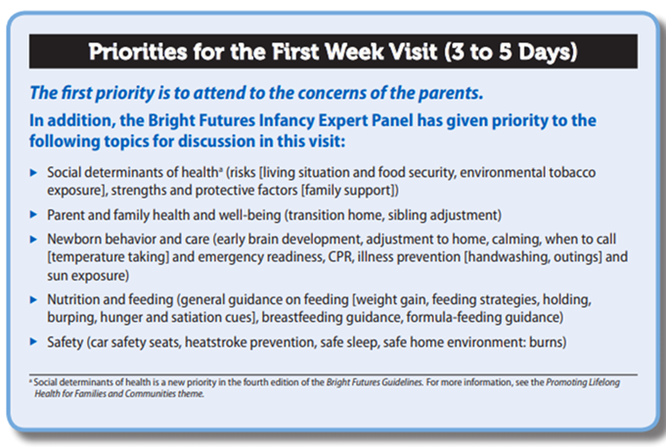
Priorities for the First Week Visit
To hear the optional narrated guidance, click on the icon.
Notes:
The first priority of every Bright Futures visit is to attend to the concerns of the parents.
This is a visual of the First Week Visit priorities which you can refer to in the Bright Futures Guidelines, 4th Edition.
Note: one of the priorities includes addressing nutrition and feeding issues, including breastfeeding guidance

Slide 23
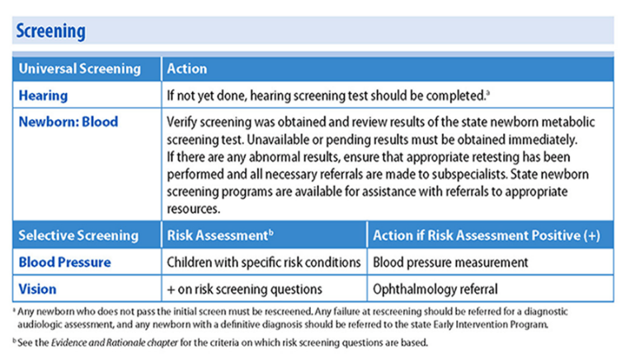
Recommended Screenings: First Week Visit
Source: Bright Futures Guidelines, 4th Edition: Infancy Newborn Visit
Notes:
Universal screening means you conduct the screening on every patient, no matter if they are at risk or not.
At this visit, confirm that both the newborn hearing and blood screening has been completed. Follow-up, as needed, based on results.
If the infant has specific risk conditions, measure the infant’s blood pressure.
If the infant is positive on risk screening questions regarding their vision, or if a parent has a concern, refer to an ophthalmologist for further evaluation.

Slide 24
Anticipatory Guidance
What the “experts” would focus on…
Nutrition and feeding
Recognize signs of hunger, fullness; develop feeding routine
Exclusive breastfeeding for about the first 6 months provides ideal nutrition, supports best growth and development
Iron-fortified formula is a recommended substitute, if needed
Social Determinants of Health
Programs like WIC and SNAP are available to help you if you have concerns about your food situation
Parent and family health and well-being
Make sure to ask for help from family or friends
Rest and sleep when baby sleeps
Notes:
Anticipatory Guidance:
What the “experts” would focus on…
Nutrition and feeding
Recognize signs of hunger, fullness; develop feeding routine
Exclusive breastfeeding for about the first 6 months provides ideal nutrition, supports best growth and development
Iron-fortified formula is a recommended substitute, if needed
Social Determinants of Health
Programs like WIC and SNAP are available to help you if you have concerns about your food situation
Parent and family health and well-being
Make sure to ask for help from family or friends
Rest and sleep when baby sleeps

Slide 25
Use of Visit Documentation Form
Source: Bright Futures Tool & Resource Kit, 2nd Edition
Notes:
Here is a mocked-up documentation form based on the case study. Some information that can be documented are:
Concerns and questions: questions about breastfeeding and weight.
Language: English/Spanish
Birth history: full-term 39 weeks vaginal delivery. Apgars 7, 9. Birth weight 7.5 pounds (3.5kg). length 19 inches. Hearing screen passed. Newborn blood screening not back yet. Maternal blood type A+. Maternal serologies negative.
Vitamin K given. Hep B vaccine given.
Newborn Screen pending.
Weight today 7.2 pounds (3.27 kg).
Nutrition: Breastfeeding 10 minutes on each breast every 3 hours.
Did not receive vitamin D prescription.
4 wet diapers; 1-2 stools.
Sleeps on his back.
Development: typical.

Slide 26
What Else Can You Discuss?
Discuss the infant’s weight and ways to promote continual breastfeeding.
Explore any barriers to breastfeeding.
Source: Bright Futures Tool & Resource Kit, 2nd Edition
Notes:
What else can you discuss?
Discuss the infant’s weight and ways to promote continual breastfeeding. This can include exclusive breastfeeding for 6 months and continued breastfeeding for as long as mutually desired.
Explore any barriers to breastfeeding.

Slide 27
Reinforcing the Anticipatory Guidance
Notes:
With the parent educational handout, reinforce the information discussed during the visit around nutrition and feeding, as well as other health and safety topics for this infant and family.

Slide 28
Summary: Teaching Points
Remember to use the Previsit Questionnaires and Visit Documentation templates
Assessment of infant development, as well as growth parameters, must be done at each visit
Pediatric health care professionals can provide counseling and reassurance regarding breastfeeding
Notes:
Summary: Teaching Points
Remember to use of Previsit Questionnaires and Visit Documentation templates that are useful for consistency and to provide areas for discussion.
Assessment of infant development as well as growth parameters must be done at each visit.
Pediatric health care professionals can provide counseling and reassurance regarding breastfeeding.

Slide 29
Summary: Teaching Points
Understand the benefits of breastfeeding
Educational handouts are helpful for teach back
Think about disparities in breastfeeding and why
they exist
Identify and address barriers to breastfeeding
Solids should not be introduced until the infant is 6 months old and is developmentally ready for introduction to solids
Notes:
Summary: Teaching Points
Understand the benefits of breastfeeding.
Breastfeeding exclusively for the first 6 months is beneficial for growth and development.
Health care professionals should identify reasons or barriers a mother may decide not to breastfeed and to know resources to assist a mother to continue to breastfeed.
Educational handouts are helpful for teach back.
Disparities in breastfeeding exist due to socioeconomic factors such as income and earlier return to work.
Solids should not be introduced until the infant is 6 months old and is developmentally ready for introduction to solids.

Slide 30
Post-test
Test your knowledge on the topic and review feedback on your responses. Please complete the post-test, link below.
Please click on link to be routed to the post-test.
Note: This is for learning purposes only and is NOT approved for CME.
Notes:
Please complete the post-test prior to ending the presentation.

Slide 31
Clinical Resources
AAP Institute for Healthy Childhood Weight (IHCW)
Building a Foundation for Healthy Active Living – provides numerous clinical resou​rces to support better integration​ of early nutrition, healthy active living and obesity prevention into clinical care during the critical first 5 years of life.
Food Insecurity Webinar
Conversations About Care Podcast
AAP Breastfeeding Residency Curriculum: Faculty Implementation Guide
AAP Breastfeeding Overview
Notes:
Here are some clinical resources to support your learning and practice to promote healthy growth in early infancy.

Slide 32
Clinical Resources
Related AAP Policy/Guidelines/Reports/Resources
AAP Breastfeeding and the Use of Human Milk
IHCW Collection – Obesity guidelines, policy statements and reports
Bright Futures Guidelines, 4th Edition
Joint Bright Futures/IHCW/Maternal & Child Health Bureau Webinars
Using Bright Futures to Achieve Excellence in Well-Child Care
Building a Foundation for Healthy Living: A Focus on Child Obesity Prevention During the First Five Years
Laying the Foundation for Obesity Assessment and Management: An Introduction to the AAP Obesity Prevention, Assessment, and Treatment Algorithm
Notes:
Here are clinical resources to support your learning and practice to promote health growth in early infancy.

Slide 33
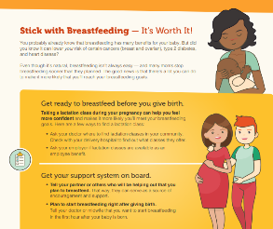
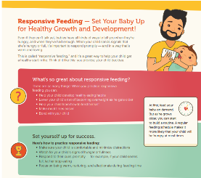
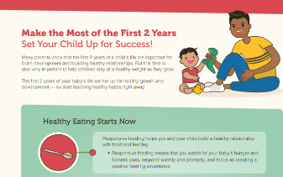
Resources for Families
USDA Dietary Guidelines for Americans
AAP HealthyChildren.org – includes numerous articles and resources about the importance of breastfeeding and promotes healthy growth and development.
Bright Futures Guidelines, 4th Edition – Parent and Patient Education
AAP IHCW Healthy Active Living for Families
AAP IHCW Building a Foundation for Healthy Active Living – includes a series of resources (English and Spanish) developed to increase awareness and knowledge around key healthy active living behaviors.
Notes:
Here are some family-focused resources to support and promote healthy growth in early infancy.

Slide 34
References
American Academy of Pediatrics Institute for Health Childhood Weight. Professional Education. AAP.org. Accessed November 3, 2022. https://www.aap.org/en/patient-care/institute-for-healthy-childhood-weight
American Academy Pediatrics. Breastfeeding Curriculum. AAP.org. Accessed November 3, 2022. https://www.aap.org/en/learning/breastfeeding-curriculum/
Meek JY, Noble L; Section on Breastfeeding. Policy statement: breastfeeding and the use of human milk. Pediatrics. 2022;150(1):e2022057988
Beauregard JL, Hamner HC, Chen J, Avila-Rodriguez W, Elam-Evans LD, Perrine CG. Racial disparities in breastfeeding initiation and duration among US infants born in 2012. MMWR Morb Mortal Wkly Rep. 2019;68:745-748
Chiang KV, Li R, Anstey EH, Perrine CG. Racial and ethnic disparities in breastfeeding initiation. 2019. MMWR Morb Mortal Wkly Rep 2021;70:769–774
Kirksey, K. A social history of racial disparities in breastfeeding in the United States. Social Science & Medicine. 2021;289(5),114365
Mieso, BR, Burrow, H, & Lam, SK. Beyond Statistics: Uncovering the roots of racial disparities in breastfeeding. Pediatrics. 2021;147(5) e2020037887

Slide 35
References
Jones KM, Power ML, Queenan JT, Schulkin J. Racial and ethnic disparities in breastfeeding. Breastfeed Med. 2015;10(4):186-196
Hagan JF, Shaw JS, Duncan PM, Bright Futures: Guidelines for Health Supervision of Infants, Children, and Adolescents. 4th Edition, American Academy of Pediatrics; 2017
US Department of Agriculture and US Department of Health and Human Services. Dietary Guidelines for Americans, 2020-2025. 9th Edition. Accessed November 3, 2022. https://www.dietaryguidelines.gov/
American Academy of Pediatrics. Nutrition. HealthyChildren.org. Accessed November 3, 2022. https://www.healthychildren.org/English/ages-stages/baby/feeding-nutrition/Pages/default.aspx
American Academy of Pediatrics. Breastfeeding. HealthyChildren.org. Accessed November 3, 2022. https://www.healthychildren.org/English/ages-stages/baby/breastfeeding/Pages/default.aspx
American Academy of Pediatrics. Well-Child Visits: Parent and Patient Education. aap.org/brightfutures. Accessed November 3, 2022. https://www.aap.org/en/practice-management/bright-futures/bright-futures-family-centered-care/well-child-visits-parent-and-patient-education/
Meek JY and Noble L. Policy Statement: Breastfeeding and the Use of Human Milk. Pediatrics. 2022; 150(1):e2022057988.

