Slide 1
AAP Bright Futures National Center Bright Futures: Guidelines for Health Supervision of Infants, Children, and Adolescents, 4th Edition
Promoting Social-Emotional Health in Infancy
Author: Robert C. Lee, DO, MS, FAAP
Notes:
Facilitator Guide:
Welcome to this Bright Futures mini training learning activity on Promoting Social-Emotional .Health in Infancy.

Slide 2
Author & Disclosure Information
Robert C. Lee, DO, MS, FAAP
Assistant Professor of Pediatrics
Associate Residency Program Director
NYU Long Island School of Medicine
I have nothing to disclose
Note: The recommendations in this presentation/training do not indicate an exclusive course of treatment or serve as a standard of care. Variations, taking into account individual circumstances, may be appropriate.
Citation: If you plan to use this resource, please cite or credit as: Lee, RC (2022) Bright Futures: Promoting Social-Emotional Health In Infancy [PowerPoint Slides]. 2022. Accessed <date>. https://www.aap.org/en/practice-management/bright-futures/bright-futures-in-clinical-practice/bright-futures-educational-resources/
This program is supported by the Health Resources and Services Administration (HRSA) of the US Department of Health and Human Services (HHS) as part of an award totaling $5,000,000 with 10 percent financed with non-governmental sources. The contents are those of the author(s) and do not necessarily represent the official views of, nor an endorsement, by HRSA, HHS, or the US Government. For more information, please visit HRSA.gov.
Notes:
Facilitator Guide:
The author has no disclosures.

Slide 3
Pre-test
Evaluate your knowledge about the topic before the mini training. Please click on the pre-test link below.
Please click on link to be routed to the pre-test
NOTE: This is for learning purposes only and is NOT approved for CME.
Notes:
Facilitator Guide:
Please complete the pretest prior to reviewing the presentation

Slide 4
Main Objectives
Recognize and address behaviors that can be clinical clues of social-emotional development delays and disabilities in infants (0-12 months)
Identify the role of pediatric health care professionals in promoting social-emotional health during infancy
Describe the use of Bright Futures core tools in the screening of parents and infants at risk for social-emotional dysfunction
Use best practices to promote social-emotional health during infancy
NOTE: We use the term “parent” to refer to all parents, caregivers, and legal guardians.
Notes:
Facilitator Guide:
Establishing social-emotional health and well-being is a core task for the developing infant and those who care for them. Infant social-emotional health, or infant mental health, can be compromised at many critical times in development beginning prenatally with maternal mental health and throughout infancy. Pediatric health care professionals are challenged to promote infant mental health through activities that are aimed at prevention, risk assessment, diagnosis, and appropriate interventions.
The main objectives of this module are:
Recognize and address infant behaviors that can be clinical clues to social-emotional developmental delays and disabilities
Identify the role of pediatric health care professionals in promoting social-emotional health during health supervision visit
Describe the use of Bright Futures tools in the screening of both parent and infant at risk for social-emotional dysfunction
Use best practice to promote social-emotional health during health supervision visits in infancy

Slide 5
Scope of Pediatrics
“Infant mental health” is the infant’s capacity to experience, regulate, and express emotions; to form safe, stable, nurturing relationships; and to explore the environment and learn.
The interaction between primary caregiver and infant is central to the infant’s physical, cognitive, social, and emotional development and self-regulation abilities.
Infant’s social-emotional health may be affected by the emotional and physical health of the primary caregiver.
Every Bright Futures health supervision visit must include monitoring the emotional health of the primary caregiver.
Notes:
Facilitator Guide:
Infant mental health is the infant’s capacity to experience, regulate, and express emotions; to form close relationships; and to explore the environment and learn.
The interaction between primary caregiver and infant is central to the infant’s physical, cognitive social, and emotional development and self-regulation abilities.
The infant’s social-emotional health may be affected by the emotional and physical health of the primary caregiver.
Every Bright Future health supervision visit must therefore include monitoring of the emotional health of the primary caregiver.

Slide 6
Equity & Disparities
Maternal and infant mental health disparities exist among historically marginalized and oppressed people and people with low socioeconomic status.
Socioeconomic status and race are factors that influence rates of adverse outcomes/status including pregnancy-related depression, post-traumatic stress disorder, toxic stress in children, and parenting stress.¹
Historically marginalized and oppressed women with low socioeconomic status are less likely to seek behavioral support than White, more affluent women.
When they do seek behavioral support, health care professionals are less likely to follow up and less likely to fill relevant prescriptions.²
In community-based screening initiative, historically marginalized and oppressed women with low socioeconomic status who have higher risk for postpartum depression were not routinely screened.³
Notes:
Facilitator Guide:
Maternal and infant mental health disparities exist among historically marginalized and oppressed people and people with low socioeconomic status in the United States. Research strongly points to both socioeconomic status and race as factors that influence rate of adverse maternal and infant mental health outcomes. Klawetter and Frankel report disparities in pregnancy-related depression, post-traumatic stress disorder, toxic stress in children and parenting stress.
For example, historically marginalized and oppressed women with low socioeconomic status are less likely to seek behavioral support than White, more affluent women. When they do seek behavioral support, health care professionals are less likely to follow up and less likely to fill relevant prescriptions compared to when White, more affluent women seek behavioral health services.
In a published report of implementing community-based screening initiative, historically marginalized and oppressed women with low socioeconomic status, who have higher risk of postpartum depression, were not routinely screened.

Slide 7
Equity – Practice Considerations
Residents/trainees should engage in reflection aimed at increasing self-awareness, acknowledging privilege, and fighting bias and discrimination.
Resident/trainees should honor native languages and respect cultural norms as they relate to parental and infant social-emotional health.
Notes:
Facilitator Guide:
Residents/trainees should engage in self-reflection aimed at increasing self-awareness, acknowledging privilege, and fighting own bias and discrimination.
Residents/trainees should honor native languages and respect cultural norms as they relate to parental and infant social-emotional health.

Slide 8
Case Study
6-month-old male with feeding difficulties and failure to thrive presents
for a health supervision visit
Infant was born at 38 weeks GA with birth weight of 2.9 kg (25%)
Now, at 6 months and 9 days, he weighs 5.18 kg (<2%)
Mother reports that she had no formula at home, and she has not been able to get her WIC EBT card
Hospitalized at 5 months of age for dehydration and weight loss. He was vomiting after each feeding
Social History
Mother is 27 years old with 3 children under the age of 7
Father works as a TSA agent at the airport
Mother reports that she has no family support and that they live in a one-bedroom apartment near the airport
Notes:
Facilitator Guide:
The case study is a 6-month-old infant brought in by mother for a routine health supervision visit. Mother has concerns regarding his feeding and weight.
You review the birth history which reveals that infant was born at 38 weeks gestational age (full term) with a birth weight of 2.9 kg which was 25% on the growth chart. His current age is 6 months and 9 days, and he weighs 5.18 kg which is <2% on the growth chart. Mother reports that she has no formula at home because she has not been able to get her WIC EBT card and has been giving the infant pureed food. Infant was admitted to hospital at 5 months of age for vomiting after feeding. Infant was discharged after 3 days when he tolerated feeding and gained weight.
Review of family social history reveals that mother is 27 years of age with 2 other children (6 years old and 4 years old). Father works the late afternoon shift as TSA agent at the airport. Mother reports that both parents don’t have family around and they live in a one-bedroom apartment near the airport.

Slide 9
Case Study
During the Physical Examination
When mother tries feeding, seems hungry and ready to drink, but then gives up and turns away from his mother
Patient starts to cry, and mother has difficulty in calming
Seems curious when offered a small toy rattle, reaches for it and transfers to other hand
Patient's arms and legs appear thin
Belly is distended
Does not sit with support and often slides to one side
Notes:
Facilitator Guide:
During the visit, you notice that when the mother tries to feed him formula that you have provided in the office, the infant seems hungry and ready to drink, but then gives up and turns away from the mother. When he starts to cry, the mother has difficulty in calming him. When you try to help to calm him down by offering a toy rattle, he reaches for it and transfers it to the other hand.
During your physical examination, you notice that both arms and legs appear thin. His abdomen appears distended. When you try to sit him up on the examination table, he slides to one side and has difficulty sitting independently with support.

Slide 10
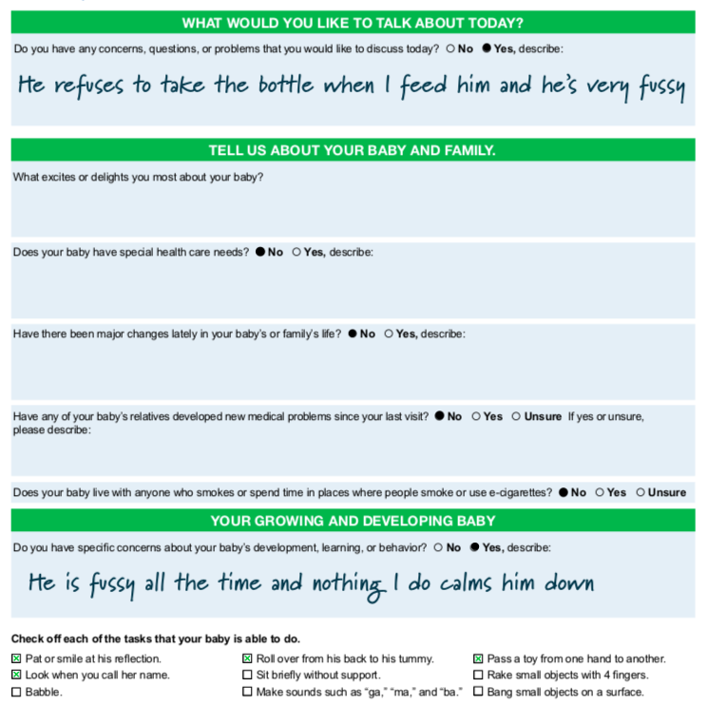
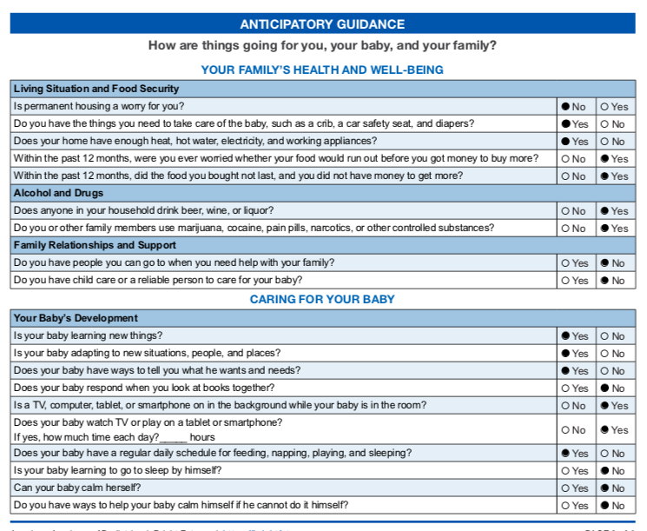
Bright Futures Previsit Questionnaire⁴
Notes:
Facilitator Guide:
Consider giving the mother the Bright Futures Previsit Questionnaire (PVQ) and postpartum screening tool before the visit begins.
The PVQ helps set the agenda - what the parent wants to talk about-, look for what’s going right with the child and family relationship, and obtain developmental surveillance information. While you are reviewing the PVQ, you note that the parent has concerns that “he refuses to take the bottle when I feed him and he’s very fussy.” Parent focuses on the negative and can’t find a positive. During the visit, you should acknowledge and reinforce positive parent-infant interactions and discuss concerns.
In the questions about Living Situation and Food Security, the parent answered “yes” to food insecurity. The parent also answered “yes” to Alcohol and Drugs. In terms of Your Baby’s Development, the parent checks that baby does not sleep by himself and cannot calm himself.

Slide 11
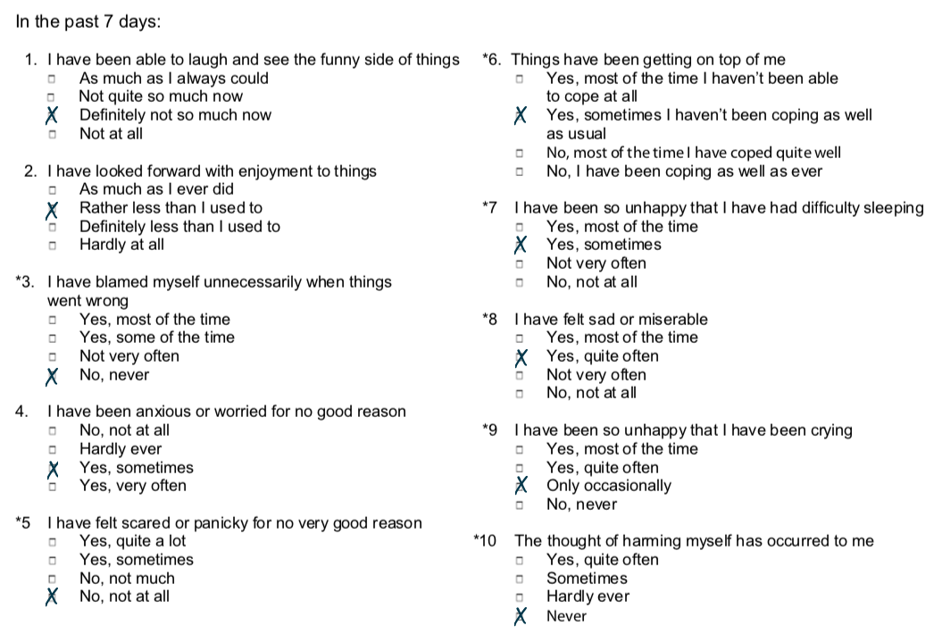
Edinburgh Postnatal Depression Scale
NOTE: The AAP does not approve nor endorse any specific tool for screening purposes.
Notes:
Facilitator Guide:
You review the Edinburgh Postnatal Depression Scale (postpartum depression screening tool). Responses are scored 0, 1, 2 and 3 based on the seriousness of the symptoms. Items 3, 5 to 10 are reverse scored (ie, 3, 2, 1, and 0).
The total score is found by adding together the scores for each of the 10 items. Mothers scoring above (12 or 13) are likely to be suffering from depression and should seek medical attention.
The mother’s postpartum depression screening tool has a score of 12 which indicates she may likely be suffering from postpartum depression.

Slide 12
Observation of Parent-Child Interaction⁵
Are the parent and infant responsive to one another?
Is the parent aware of, responsive to, and effective in responding to the infant?
Does the parent express and show comfort and confidence with their infant?
Does the parent-­infant relationship demonstrate comfort, adequate feeding/eating, and response to the infant’s cues?
If the infant is given a book, what is the parent’s response?
Does the parent appear to be happy, content, at ease, depressed, tearful, angry, anxious, fatigued, over­whelmed, or uncomfortable?
Notes:
Facilitator Guide:
It is important to observe the parent and child interaction during the health supervision visit.
Observation focuses on:
Are the parent and infant responsive to one another (eg, holding, talking, smiling, providing toys for play and distraction, especially during the examination)?
Is the parent aware of, responsive to, and effective in responding to the infant?
Does the parent express and show comfort and confidence with their infant?
Does the parent-­infant relationship demonstrate comfort, adequate feeding/eating, and response to the infant’s cues?
If the infant is given a book, what is the parent’s response (eg, react with pleasure, show puzzlement, put book away)?
Does the parent appear to be happy, content, at ease, depressed, tearful, angry, anxious, fatigued, over­whelmed, or uncomfortable?

Slide 13
Observation of Parent-Child Interaction⁵
Source: Bright Futures Guidelines, 4th Edition: Promoting Mental Health
Notes:
Facilitator Guide:
Pediatric health care professionals should observe the attachment style and pattern during clinical encounters with infants and parents. They should give anticipatory guidance to assist families in enhancing secure development. Three patterns of attachment have been described by Bowlby (see reference).

Slide 14
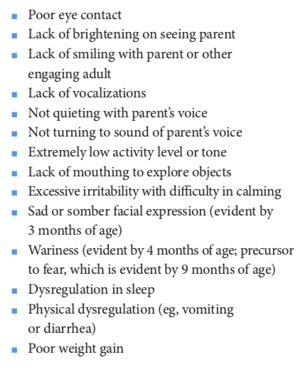
Observation of Parent-Child Interaction⁵
Signs of possible problems in emotional well-being in infants:
Source: Bright Futures Guidelines, 4th Edition: Promoting Mental Health
Notes:
Facilitator Guide:
Signs of possible problems in emotional well-being in infants are described. If the infant appears to have problems with emotional development, the pediatric health care professional should determine the degree with the primary caregiver as they may be experiencing mental health issues.

Slide 15
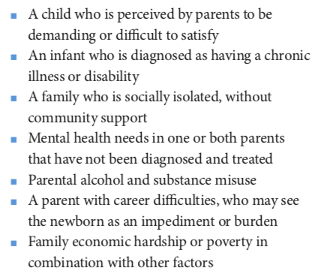
Observation of Parent-Child Interaction⁵
Factors associated with child maltreatment include:
Source: Bright Futures Guidelines, 4th Edition: Promoting Mental Health
Notes:
Facilitator Guide:
Child maltreatment or abuse can occur in any family. Without identification and intervention, unchecked stressors in a household can lead to neglect or abuse.

Slide 16
Self-Assessment
Based on the infant’s history, physical exam, previsit questionnaire, and postpartum depression screening responses, what red flags should the clinician focus on and why?
?
Notes:
Facilitator Guide:
Having gone through the infant’s history, physical exam, Bright Futures Previsit Questionnaire, and Edinburgh Postnatal Depression Scale responses, what red flags should be considered and why?

Slide 17
Self-Assessment Feedback
Excessive irritability and difficulty in calming
Feeding difficulty
Developmental delay
Postpartum depression
The next slide will remind you of the Bright Futures priorities for this visit.
!
Click the icon to hear narrated guidance.
Notes:
Narration:
What are the red flags and why? The first red flag is:
The first red flag is: Excessive irritability and difficulty in calming - The persistence of crying and irritability beyond the first 3 months in this patient predicts a higher risk of social-emotional delay. It is therefore important to offer timely help through counseling and therapy. The parent exhibits all the signs of chronic exhaustion and overload as a consequence of persistent alarm and sleep deficit. The repeated daily experience of excessive irritability causes feelings of failure, diminished self-esteem, powerlessness, and depression.
Second red flag: Feeding difficulty - Physical dysregulation such as vomiting, and diarrhea and poor weight gain are signs of possible problems in the social-emotional health of this patient. His feeding difficulties are a red flag regarding secure attachment child-parent relationship.
Third red flag: Developmental delay - The attachment relationship between infant and parent are crucial to healthy development. A secure, warm, responsive, and predictable relationship with parent influences the formation of neural structures in the brain that lead to positive infant well-being. His developmental delay is a sign of a stressful environment.
The fourth and final red flag: Postpartum depression – The parents’ depression is a concern because the infant’s development and emotional well-being are affected and compromised. Parents need to be attuned to her own mental health and seek help when needed.

Slide 18
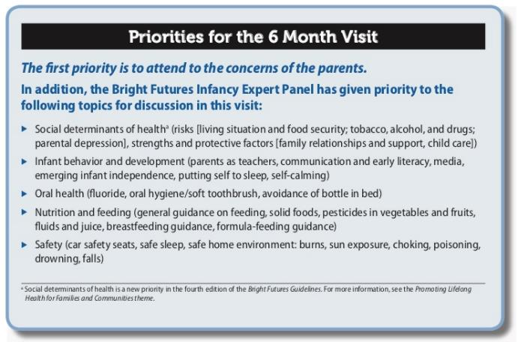
Source: Bright Futures Guidelines, 4th Edition: Infancy Visits
Notes:
Facilitator Guide:
Bright Futures Priorities for the 6-month visit include discussions on social determinants of health (food security, parental depression, strengths, and protective factors) and infant behaviors and development.

Slide 19
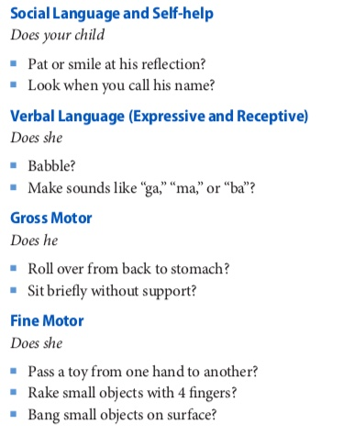
Developmental Surveillance⁵
Source: Bright Futures Guidelines, 4th Edition: Infancy Visits
Notes:
Facilitator Guide:
Using the age-based development checklist in the Bright Futures Visit Documentation Form, the pediatric health care professional is able to monitor development during infancy.
Key developmental milestones for the 6-month-old includes:
Pat or smile at his reflection
Look when you call his name
Babble
Makes sound like “ga,” “ma,” or “ba”
Roll over from back to stomach
Sit briefly without support
Pass a toy from one hand to another
Rake small objects with 4 fingers
Bang small objects on surface

Slide 20
Anticipatory Guidance
Knowledge Questions
Based on the parent’s concerns and your assessment, what aspects of anticipatory guidance for this family would you highlight?
What developmental milestones would you encourage the family to expect over the next several months?
Notes:
Facilitator Guide:
Based on the parent’s concern and your assessment, what aspects of anticipatory guidance for this family would you highlight?
What development milestone would you encourage the family to expect over the next several months?

Slide 21
Anticipatory Guidance Feedback
Discuss living situation and food security
Discuss postpartum depression
Discuss infant behavior and development
Sample questions for each topic can be found in: Bright Futures Guidelines, 4th Edition: Infancy Visits
Notes:
Facilitator Guide:
Discuss living situation and food security
Discuss postpartum depression
Discuss infant behavior and development

Slide 22
Anticipatory Guidance⁵
Source: Bright Futures Guidelines, 4th Edition: Infancy Visits
Click the icon to hear narrated guidance.
Notes:
Narration:
Using sample questions listed in the Bright Futures Guidelines to invite discussion, gather information, address the needs, and build partnership.
Anticipatory guidance geared to this case study should include:
Food security - The family is eligible for the WIC program. You should stress the importance on making WIC appointments so that she can nutritious food for her family. You can also advise the mother to apply for the SNAP if the family qualifies.
Parental depression - The mother in our case study feels tired and overwhelmed with the baby. Her postpartum depression screening is positive. She should be referred for help. Resources such as Postpartum Progress provides a list of providers by state and Postpartum Support International offers multilingual chat and hotline resources.
Infant behavior and development. You can help mother understand the developmental next steps and provide concrete examples. Examples such as:
Play on the floor with the baby every day.
Learn how to read the baby’s mood. If he’s happy, keep doing what you’re doing. If he’s upset, take a break and comfort the baby.
Show the baby how to comfort himself when upset. He may suck on his fingers to self soothe.
Use “reciprocal” play (eg, when he smiles, you smile; when he makes sound, you copy them).
Repeat baby’s sound and say simple words with these sounds.
Read books to baby daily
When your baby looks at something, point to it and talk about it.

Slide 23
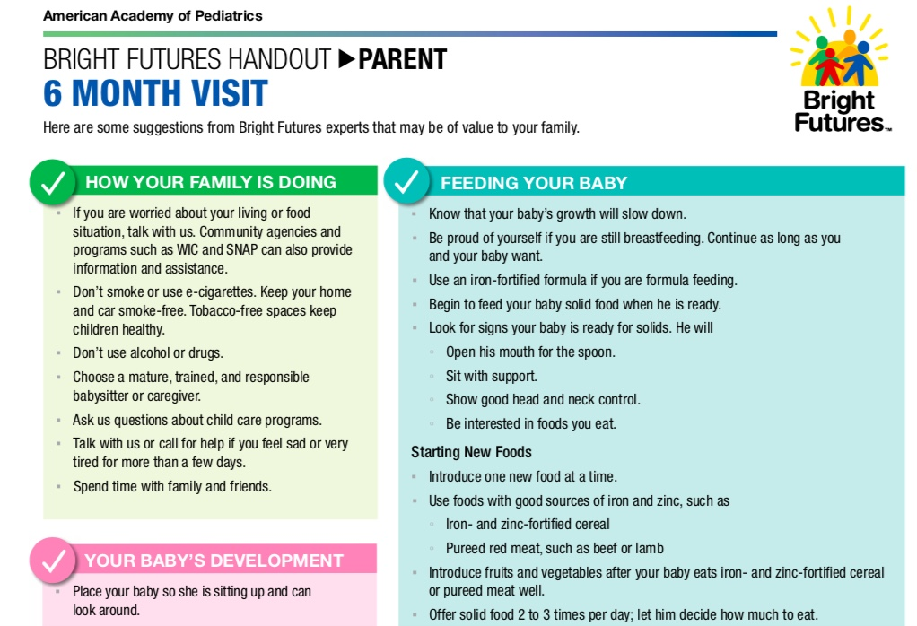
Reinforce Anticipatory Guidance⁴
Online version of Parent Education can be found here: https://www.aap.org/en/practice-management/bright-futures/bright-futures-family-centered-care/well-child-visits-parent-and-patient-education/bright-futures-information-for-parents-6-month-visit/
Notes:
Facilitator Guide:
Consider giving the parent the Bright Futures Parent Educational Handout to reinforce anticipatory guidance topics pertinent to this case.
Encourage mother to use the WIC Program and Supplemental Nutrition Assistance Program (SNAP) to help with food security for both parent and infant.
Reinforce non-use of alcohol or drugs in the household.
Refer mother for help with postpartum depression.

Slide 24
Teaching Points
Promoting family support during a health supervision visit should included a screening for postpartum depression
The interaction between primary caregiver and infant is central to the infant’s physical, cognitive, social, and emotional development and self-regulation abilities
Developmental delays and infant behavioral problems should be addressed using a strength-based approach.
Notes:
Facilitator Guide:
Teaching point for this mini module include:
Pediatric health care professionals should promote family support during the Bright Futures health supervision visit by including postpartum depression screening.
Observation of the interaction between primary caregiver and infant is central to assessing the infant’s physical, cognitive, social, and emotional development and self-regulation abilities.
When an infant has developmental delays and behavioral problems, pediatric health care professionals should recognize social-emotional dysregulation and address them using a strength-based approach. Pediatric health care professionals can advocate for positive behavioral interventions. Referring parents to home visiting programs, early care and education programs, or parent support groups.

Slide 25
Post-test
Test your knowledge about the topic and review feedback on your responses. Please click the post-test link below.
Please click on link to be routed to the post-test
NOTE: This is for learning purposes only and is NOT approved for CME.
Notes:
Facilitator Guide:
Please complete the post-test to check your knowledge before exiting the program

Slide 26
Resources
Clinician Resources
AAP Early Relational Health
AAP Perinatal Mental Health and Social Support
SCREEN and INTERVENE: A Toolkit for Pediatricians to Address Food Insecurity
The Center on the Developing Child
Center for the Study of Social Policy: Strengthening Families
AAP Policy Statements
Preventing Childhood Toxic Stress: Partnering with Families and Communities to Promote Relational Health

Slide 27
Resources
Bright Futures Resources
Bright Futures Guidelines and Pocket Guide
Integrating Social Determinants of Health Into Health Supervision Visits
Bright Futures – Building Positive Parenting Skills Across Ages PediaLink course
Resources for Families
Feeding America
HealthyChildren.org
Postpartum Progress
Postpartum Support International
Zero to Three

Slide 28
References
Klawetter S , Frankel K, Infant mental health: A lens for maternal and child mental health disparities. J Hum Behav Soc Environ. 2018;28(5):557-569
Kozhimannil KB, Trinacty CM, Busch AB, et al. Racial and ethnic disparities in postpartum depression care among low-income women. Psychiatric Services.2011;62(6):619-625
Perry DF, Le HN, Villamil CA, et al. Integrating perinatal depression screening into WIC at federally qualified health center. Prog Community Health Partersh. 2015;9(2):253-259
Shaw JS, Hagan JF Jr, Shepard MT, Curry ES, Swanson JT, Janies KM, eds. Bright Futures Tool and Resource Kit. 2nd ed. American Academy of Pediatrics; 2019
Hagan JF, Shaw JS, Duncan PM: American Academy of Pediatrics. Bright Futures Guidelines for Health Supervision of Infants, Children, and Adolescents, 4th edition;2017

