Slide 1
Community Partnerships: Improving Student Oral Health in Schools
Learning Burst
This resource was supported by Cooperative Agreement Number NU38OT000282, funded by the Healthy Schools Branch - Centers for Disease Control and Prevention. Its contents are solely the responsibility of the American Academy of Pediatrics and do not necessarily represent the official views of the Centers for Disease Control and Prevention of the Department of Health and Human Services.
Notes:
Welcome to this Learning Burst on Community Partnerships Improving Student’s Oral Health in Schools.
This resource was developed by the American Academy of Pediatrics through a Cooperative Agreement funded by the Centers for Disease Control and Prevention Healthy Schools Branch. Its contents are solely the responsibility of the American Academy of Pediatrics and do not necessarily represent the official views of the Centers for Disease Control and Prevention.
This learning burst is intended to provide basic information about engaging various community partners in order to improve student oral health in schools.

Slide 2
Learning Outcomes
By the end of this learning burst, participants will be able to:
Understand the existing pediatric oral health disparities
List potential community partners to improve pediatric oral health outcomes
List 2-3 simple steps that school health staff can consistently do to improve oral health of their students
Notes:
By the end of this learning burst, participants will be able to:
Understand the existing pediatric oral health disparities
List possible partners to improve pediatric oral health outcomes
List 2-3 simple step that school health staff can consistently do to improve oral health of their students

Slide 3
Oral Health Disparities
Low-income children have higher rates of unmet oral health needs
About half of children enrolled in Medicaid did not see a dentist in 2019
The prevalence of treated and untreated tooth decay among American Indian, Alaska Native, Native Hawaiian, Hispanic and Black 3rd graders is considerably higher than White children while use of dental sealants is lower
https://www.cdc.gov/oralhealth/oral_health_disparities/index.htm
https://www.pewtrusts.org/en/research-and-analysis/articles/2022/03/11/inequitable-access-to-oral-health-care-continues-to-harm-children-of-color
Notes:
Building community partnerships is a great way to address oral health inequities that currently exist. For example, low-income children have higher rates of unmet oral health needs and about half of children enrolled in Medicaid did not see a dentist in 2019. For context, about 40 million children in 2022 were insured through Medicaid or CHIP. Additionally, the prevalence of treated and untreated tooth decay among American Indian, Alaska Native, Native Hawaiian, Hispanic and Black 3rd graders is considerably higher that White children while use of dental sealants is lower.

Slide 4
Barriers to Accessing Dental Care
More than 64 million people in the US – including millions of children – live in areas with dental provider shortages
Access to care is limited for millions of children who rely on Medicaid and CHIP
Fewer than a third of US dental practices treated patients on public insurance in 2020
Children living in rural communities are likely to experience barriers to oral care
https://www.pewtrusts.org/en/research-and-analysis/articles/2022/03/11/inequitable-access-to-oral-health-care-continues-to-harm-children-of-color
Notes:
In addition to the previously mentioned disparities, there are barriers to accessing dental care that only increase these disparities. For example, more than 64 million people in the US – including millions of children – live in areas with dental provider shortages. Particularly, access to care is limited for millions of children who rely on Medicaid and CHIP. Fewer than a third of US dental practices treated patients on public insurance in 2020.
Barriers to accessing dental care for those living in rural areas can be even more difficult. For example, children living in rural communities are less likely to receive preventive dental visits than urban children, and oral health literacy is lower among rural populations resulting in poor oral hygiene and trouble navigating the oral health system. Lastly, a higher proportion of homes in rural communities do not have community water fluoridation system.

Slide 5
Oral Health and Educational Outcomes
Children who have poor oral health often miss more school and receive lower grades than children who have good oral health.
Health inequity can create educational inequity.
Notes:
When there is health inequity and barriers to accessing care, there is often also educational inequity. For example, children who have poor oral health often miss more school and receive lower grades than children who have good oral health. For these reasons, it is important to address oral health inequity and barriers to accessing care.

Slide 6
Community Partners to Impact Oral Health
Possible partners to consider:
Community Health Clinics
Dental Providers
Universities and Colleges
Dental Insurance Companies/Foundations
State Health Departments
State Oral Health Coalitions
Notes:
One way to begin addressing barriers to accessing oral health care and to generally improve the provision of oral health services is to collaborate with local community partners. There are several community partners you can consider to help schools and communities positively impact oral health. On the following slides we will talk about the possible partners to consider, ways to engage with them, and why it is helpful to engage them in school health activities. These partners include community health clinics, dental providers, university and community colleges, dental insurance companies/foundations, state health departments, state oral health coalitions, and more.

Slide 7
Community Health Clinics (CHC)
Identify CHC in your community
Ask about their various clinic services
Ask specifics about dental services
Provided by dental providers
Provided by primary care providers
Ask about existing CHC partnerships in schools
Ask about CHC interest in supporting oral health in schools
Notes:
The first partnership we’ll discuss is Community Health Clinics, or CHCs for short.
To collaborate with CHCs, school health professionals can:
Get to know the CHC in their area and the various types of services and staff that are available to support oral and overall school health. CHCs are ideal partners to help in improving access to care among children and families, particularly those living in medically underserved areas.
Second, ask specifically about what dental services the CHCs provide. Do their services include preventive and restorative care? Do they see children and adults? Are there primary care providers (PCPs) involved in providing any preventive dental services such as oral health risk assessments, fluoride varnish application, education, etc.?
Some CHCs may already have existing relationships with schools and/or may be providing services for students in schools either onsite or mobile through telehealth (ie: School-Based Health Centers (SBHC), adolescent clinics, mobile clinics). If you’re unsure about current partnerships, reach out to a local CHC to ask if the clinic provides any community services in oral health, whether the clinic is connected to schools for any other health services or education, and whether there is any interest in supporting oral health in schools. Be sure to ask what they think would be helpful and how they can contribute.

Slide 8
Dental Providers
Get to know your dental community
Know which dental practices are taking new patients
Know the type of insurances that each practice accepts
Ask about provider interest in supporting oral health in schools
Dental assessments
Dental education
Dental sealants
Notes:
Dental Providers are another ideal partner to help in reducing oral health disparities among children and often are willing and eager to become part of the school team.
To collaborate with dental providers, school health professionals can:
Get to know their dental community. For example, where are they located? What providers are present? Are those providers pediatric or general practice dentists?
Find out which dental practices are taking new patients. It is not helpful to refer a child with an urgent dental need to a provider that has a wait time of a month or greater or isn’t currently accepting new patients.
Ask about the type of insurance that the practice takes and whether they have a sliding scale for those that may not have existing insurance.
Ask about the providers interest in supporting oral health in schools. For example, what do they think would be helpful? How can they contribute? Are they able to provide dental assessments, education, and/or dental sealants in schools?

Slide 9
Universities and Colleges
Identify local or state dental schools
Dentist, Dental Hygienist and/or Assistants
Identify opportunities to partner
Dental assessments
Dental education
Fluoride varnish
Dental sealants
Cleanings
Notes:
The next potential partner to reach out to are schools of higher education (universities or colleges) that have dental education programs. This can include dental schools, dental hygiene, and dental assistance programs.
To collaborate with universities and/or colleges, school health professionals can:
Connect with these partners by reaching out to the program director and gauging their interest in partnering with local schools. Opportunities for students/faculty engagement in schools could include, providing dental assessments, dental education, application of a fluoride varnish, dental sealants, and cleanings.
In these types of partnerships, families and students benefit because they are able to receive preventative services that they otherwise may not have, but it also provides an opportunity to connect students to a dental home in the community.
Finally, you do not have to limit yourself to the dental programs in universities and/or colleges. Nursing, medicine, and other allied health programs may also be interested in and capable of delivering oral health education in the school setting.

Slide 10
Dental Insurance Companies/Foundations
Grants for oral health initiatives
Provide free dental supplies for schools
Provide educational materials for students
Provide information for parents on accessing insurance for students and family members
Provide list of local dentists currently accepting Medicaid
Notes:
Now, we’ll discuss partnering with dental insurance companies and foundations.
To collaborate with dental insurance companies and foundations, school health professionals can reach out to dental insurance companies and foundations to ask if they are:
Offering grant opportunities for oral health initiatives in schools,
Providing free dental supplies for schools,
Providing educational materials for students and families,
Providing information for parents on accessing dental insurance,
As well as providing a list of local dentists currently accepting Medicaid or those that provide sliding scale for those uninsured.

Slide 11
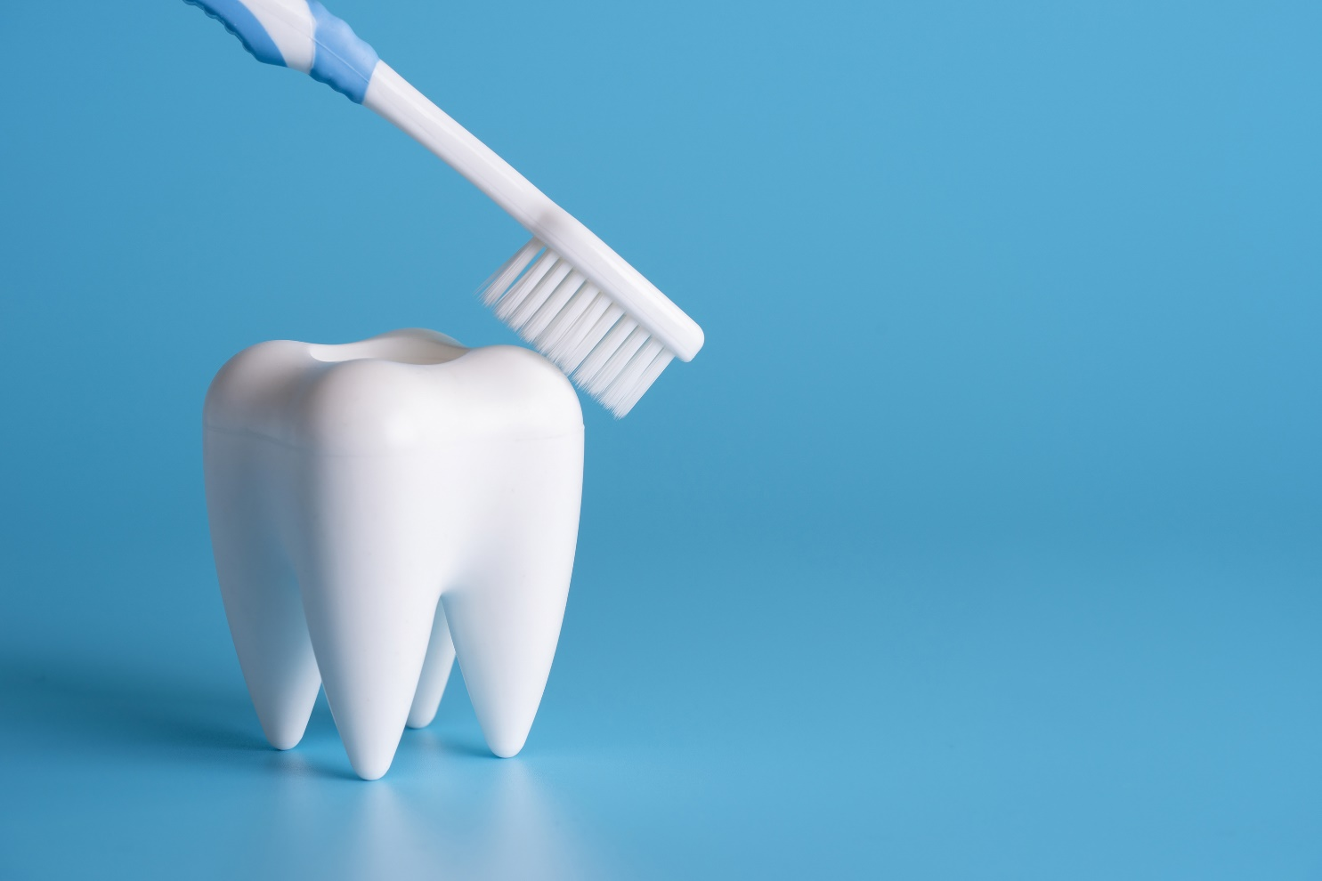
State Oral Health Programs
State Oral Public Health Division (DOH)
Oral health data
Strategic planning
Current school initiatives
Funding for new projects
State Oral Health Coalitions
Department of Human Services (DHS) Dental Coordinator/Officer
Notes:
The last partner we’ll discuss are the state oral health programs. These can include the state oral public health division within your state department of health, the state oral health coalition, as well as the Department of Human Services (DHS) dental coordinator.
To collaborate with state oral health programs, school health professionals can:
Contact your oral public health division or department within the state department of health. They can assist with providing oral health data, strategic planning, and information on current state school initiatives related to oral health, and they may have funding for new projects related to oral health in schools. State oral health coalitions are also helpful since they often have access to additional oral health resources as well as information about oral health workforces that may be interested in school health and oral health.
Get to know your Department of Human Services dental coordinator or dental officer. They can assist with providing state resources and can offer resources for families to locate dental providers in their area.
Building these relationships in your community and state can go beyond oral health and serve to also increase the number of people that can and are willing to advocate for student health services in schools.

Slide 12
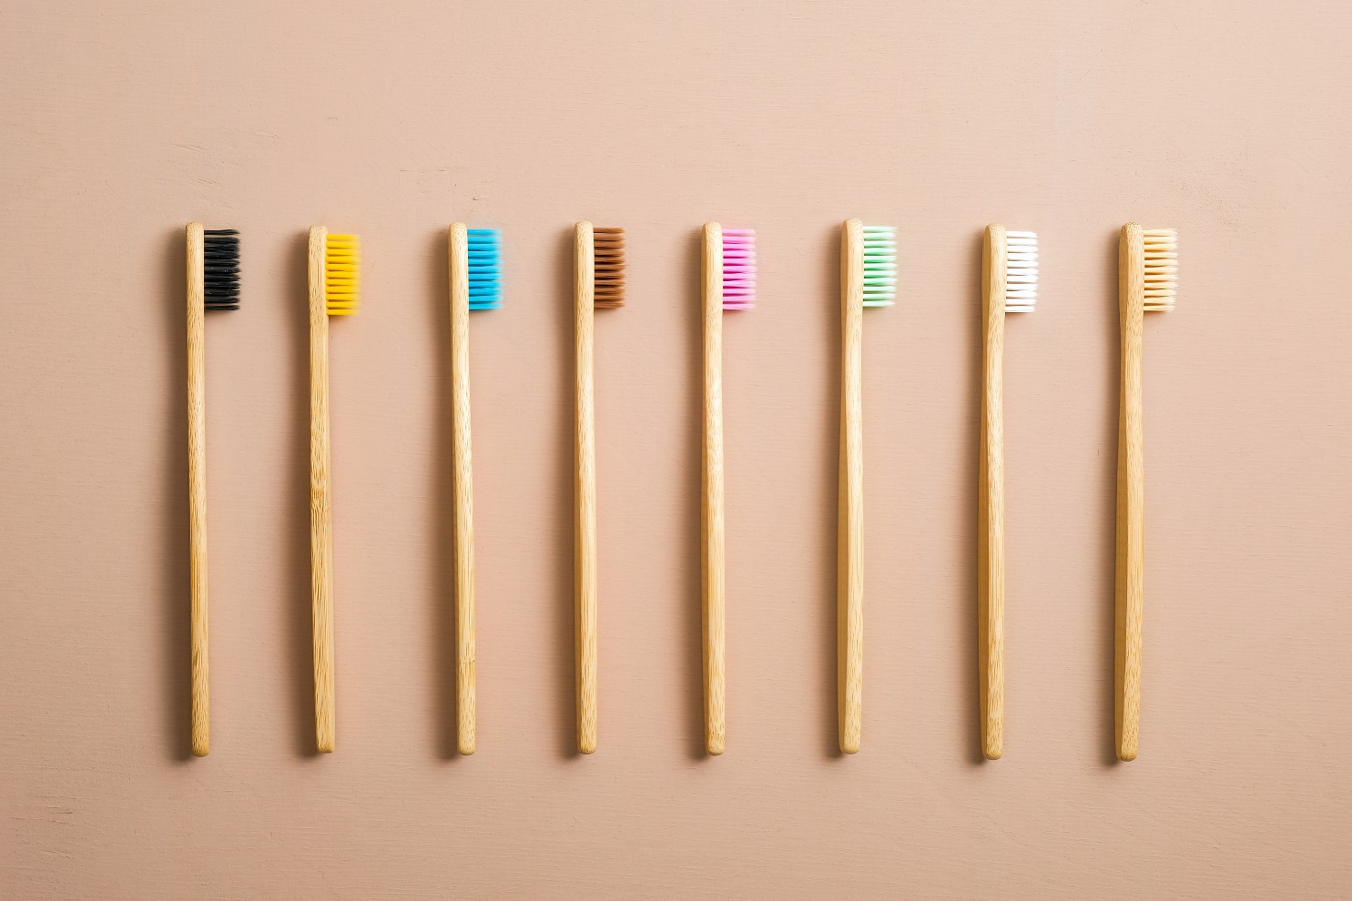
Steps for School Staff to Improve Oral Health
Talk about oral health at each encounter
Identify risk factors for poor oral health
Include a dental hygienist on your team
Learn to perform an oral assessment
Learn to differentiate between normal and abnormal findings
Educate…educate…educate
Notes:
While community engagement and partnerships are important, school health providers in schools can assist daily in improving oral health of their students through the following steps.
Talk about oral health and identify and discuss risk factors with students. For example:
What foods are accessible at school and what should be avoided (vending machines with soda, candy, etc.)?
What are healthy choices at schools (readily available water, healthy lunches with fresh fruits and vegetables)?
What are the student's current oral hygiene habits?
When was the student’s last dental visit?
Where possible, consider including a dental hygienist on your school health team. However, even without a dental hygienist, staff can learn to perform an oral assessment, learn to differentiate between normal and abnormal findings, and educate, educate, educate.
The Smiles for Life Curriculum is one way to educate yourself on child oral health, caries risk assessment, fluoride varnish and counseling, and the oral examination. The curriculum is freely available at: https://www.smilesforlifeoralhealth.org/all-courses/

Slide 13
Oral Health Education
Provide students with simple dental tips to improve outcomes
Brush
Floss
Avoid sugary foods and drinks
Avoid sharing saliva
Visit a dentist
Send home information for families
Notes:
Oral health education is simple but impactful if provided by a known and trusted person such as a school nurse or school health assistant. Simple dental tips to improve oral health outcomes that school health professionals can share include, brushing, flossing, avoiding sugary foods and drinks, avoiding sharing saliva, and visiting a dentist for regular check ups when possible.
Additionally, sending home education to families about oral health and community resources can be helpful. When sending information to families, be sure to consider any language barriers, make it simple, and connect in various ways including by phone, at school events, etc. in order to reach people where they are.

Slide 14
Case Scenario(s)
Notes:
[Use this slide to share a local case scenario related to the topic.]

Slide 15
Recap
Oral health education, assessments, and referrals are important strategies for improving health and decreasing absenteeism
Partnerships can increase access to dental care, education, and the availability of preventive services
School health staff can play a role in improving health outcomes for children
Providing services in school increases health equity, which can improve attendance in school and educational success
Notes:
Let’s review what we learned about community partnerships to improve oral health in schools.
Providing oral health education, assessments, and referrals in schools is an important strategy for improving oral health and overall health and decreasing absenteeism due to dental problems.
Developing partnerships with community partners is critical for increasing access to dental care, education, and the availability of preventive services.
While these partnerships are important, school health staff can also play a role in improving health outcomes for children daily.
Improving oral health outcomes by providing services in school increases health equity which can improve attendance in school and educational success for students.

Slide 16
Make a list of potential community partners
Reach out to key contact(s)
Consider developing an oral health advisory group
Start small, grow your partners over time
Have patience and persistence and success will come
Notes:
What are your next steps?
One of the first steps you can do is to begin making a list of your local community health clinics, dental providers, university and community colleges, state health department, state oral health coalitions, and others that you could potentially collaborate with and that may be interested in improving oral health outcomes for children.
Next, reach out to these organizations and find out who are the key players that might want to join your efforts.
You may consider creating an oral health advisory group for your school which can include school staff, community partners, parents, etc. This way you can ask the school and community what they need the most related to oral health.
Remember, success does not happen overnight so start with small steps and grow your partners, oral health school program/interventions, and education and before you know it you will see the reward by having students with better oral health outcomes. So be patient and persistent and have fun while doing it.

Slide 17
Resources
Bureau of Health Workforce, Health Resources and Services Administration (HRSA), U.S. Department of Health & Human Services, Designated Health Professional Shortage Areas Statistics: Designated HPSA Quarterly Summary, as of September 30, 2022 available at https://data.hrsa.gov/topics/health-workforce/shortage-areas.
Buerlein J. (2010). Promoting children's oral health. A role for school nurses in prevention, education, and coordination. NASN school nurse (Print), 25(1), 26–29. https://doi.org/10.1177/1942602X09353053
Centers for Disease Control and Prevention. Oral Health Surveillance Report: Trends in Dental Caries and Sealants, Tooth Retention, and Edentulism, United States, 1999–2004 to 2011–2016. US Dept of Health and Human Services; 2019.
Devlin, D., & Henshaw, M. (2011). Improving Access to Preventive Dental Services through a School–Based Dental Sealant Program. American Dental Hygienists' Association, 85(3), 211-219.
Griffin SO, Thornton-Evans G, Wei L, Griffin PM. Disparities in dental use and untreated caries prevalence by income. JDR Clin Trans Res. 2020:2380084420934746. doi:10.1177/2380084420934746
Griffin, S., Naavaal, S., Scherrer, C., Griffin, P. M., Harris, K., & Chattopadhyay, S. (2016). School-based dental sealant programs prevent cavities and are cost-effective. Health affairs, 35(12), 2233-2240.
Griffin SO, Wei L, Gooch BF, Weno K, Espinoza L. Vital Signs: Dental Sealant Use and Untreated Tooth Decay Among U.S. School-Aged Children. MMWR Morb Mortal Wkly Rep 2016;65:1141-1145. DOI: http://dx.doi.org/10.15585/mmwr.mm6541e1external icon
Notes:
Please see the following articles and useful resources on oral health.

Slide 18
Resources
Holmes, B. W., Sheetz, A., Allison, M., Ancona, R., Attisha, E., Beers, N., ... & Young, T. (2016). Role of the school nurse in providing school health services. Pediatrics, 137(6).
Inequitable Access to Oral Health Care Continue to Harm Children of Color. The Pew Charitable Trusts Dental Campaign. Available at: https://www.pewtrusts.org/en/research-and-analysis/articles/2022/03/11/inequitable-access-to-oral-health-care-continues-to-harm-children-of-color
Krol, D. M., Whelan, K., & SECTION ON ORAL HEALTH. (2023). Maintaining and improving the oral health of young children. Pediatrics, 151(1), e2022060417.
Naavaal S, Kelekar U. School hours lost due to acute/unplanned dental care. Health Behav Policy Rev. 2018;5(2);66–73.
OHRC: National Maternal and Child Oral Health Resources Center. Available at: https://www.mchoralhealth.org/
Pew Charitable Trust. Inequitable Access to Oral Health Care Continues to Harm Children of Color. March 11, 2022. https://www.pewtrusts.org/en/research-and-analysis/articles/2022/03/11/inequitable-access-to-oral-health-care-continues-to-harm-children-of-color
Smiles for Life Curriculum. Available at: https://www.smilesforlifeoralhealth.org/all-courses/
Young D﻿, Brown ZM﻿, Somers S﻿. Perkins J﻿. Children’s Health Under Medicaid: A National Review of Early and Periodic Screening, Diagnostic, and Treatment Services 2015-2019. 4th ed. National Health Law Program; 2021. Accessed April 27, 2022. https://healthlaw.org/wp- content/uploads/2021/06/2021.07-EPSDT-Chart-Book.pdf
Notes:
Please see the following articles and useful resources on oral health.

Slide 19
Additional Questions
Contact Agency
Contact Person and Title
Contact Email Address
Contact Phone Number
Notes:
[Use this slide to customize contact information]
If there are further questions, please feel free to reach out to [person named above].

