Slide 1
Toxic Stress:
Why Environment Matters
Name of Presenter
Material developed by the American Academy of Pediatrics
Revised: August 2018
Notes:
This is the second in five modules. During this session, you will gain a deeper understanding of toxic stress and its impact on brain development in young children as well as some of the things you can do to promote children’s health and well-being.

Slide 2
Objectives
Participant will be able to:
Define adversity or stress
Describe 4 key concepts that help explain how environment-brain interaction changes the brain
Identify strategies for reducing toxic stress in order to promote healthy development
Notes:
This presentation looks at advances in our understanding of health and disease and how early experiences and environments, especially toxic stress, affect brain development and long-term health. Recent findings as reported in the report, “Balancing Adverse Childhood Experiences (ACES) with Hope” (2017) demonstrate the critical importance of positive experiences for children and within families in shaping healthy brain development. The research shows, the critical importance of mitigating toxic stress and promoting positive, nurturing environments and relationships for young children.

Slide 3
Why Does Environment Matter?
Notes:
Environment matters because stress in the environment can change the brain. Although all stress is not necessarily a bad thing, toxic stress that is excessive or unremitting can interfere with healthy brain development. An environment where stress is toxic has the potential to make permanent changes in:
Gene expression (epigenetics)
Brain development or neuroscience
And behavior or allostatis
Note to the trainer: Consider sharing the video: Brain Builders: https://www.youtube.com/watch?v=OQTfmnYB7I0 (3:19)

Slide 4
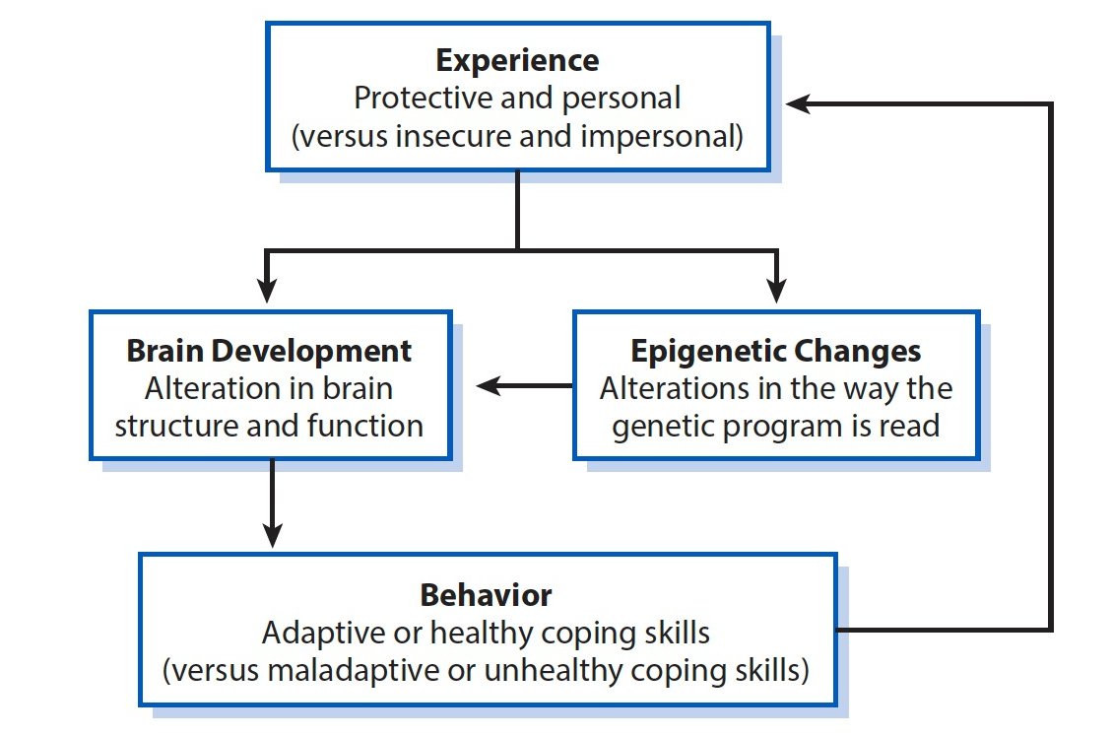
Development is a Dance Between Nature and Nurture
From Bright Futures Guidelines for Health Supervision of Infants, Children and Adolescents, 4th ed.: Modified with permission from Garner A, Forkey H, Stirling J, Nalven L, Schilling S; American Academy of Pediatrics, Dave Thomas Foundation for Adoption. Helping Foster and Adoptive Families Cope With Trauma. Elk Grove Village, IL: American Academy of Pediatrics; 2015. https://www.aap.org/traumaguide. Accessed July 19, 2018.
Notes:
The interaction between nurture and nature make the importance of positive intervention even more critical during the period from pregnancy through the first few years of life. It is during this time that emphasis on improved health and well-being can have the most impact on brain development and, consequentially, a child’s behavior.
Examples from Bright Futures, 4th Edition include:
Supporting the nutrition and health of women before and during pregnancy
Promoting positive parenting skills
Ensuring families have access to critical health, education, and social services
Focusing on protective factors to instill resiliency
Simple interactions between caregivers and children can make significant impact on brain development.
Note to the trainer: Consider showing the Still Face Experiment by Dr. Edward Tronick: https://www.youtube.com/watch?v=apzXGEbZht0 and discussing the impact of relationships from birth.

Slide 5
Seeing the Environment Through an Ecobiodevelopmental (EBD) Framework
Promotes understanding of the environment and brain development
Shows why early support is important
Highlights psychosocial protective factors and stressors as every bit as biological as nutrition
Emphasizes the dimension of time
Notes:
The diagram on the last slide showed an ecobiodevelopmental (EBD) framework for looking at toxic stress and its role in brain development
EBD is grounded in developmental science. The simplicity of the EBD framework may promote understanding as well as support for translation (early investments are the right thing to do biologically)
It also highlights the pivotal role of toxic stress and looks not just at the need for enrichment in early childhood but the need to treat, mitigate and immunize against toxic stress
Psychosocial protective factors and stressors and other salient features of the ecology are every bit as biological as nutrition or lead (no distinction between mental and physical health, just healthy vs. unhealthy development)
Emphasizes the dimension of time – to reflect the on-going, cumulative nature of benefits and threats to health and wellness

Slide 6
How Do You Define Adversity or Stress?
Stress is not necessarily a bad thing
Based on the perception and reaction (objective physiologic responses):
  Positive stress response
  Tolerable stress response
  Toxic stress response
Source: Toxic Stress. Center on the Developing Child at Harvard University Website. https://developingchild.harvard.edu/science/key-concepts/toxic-stress/. Accessed on July 16, 2018.
Notes:
How do you define/measure adversity? There’s no one measure, but there are ways to classify the effects of adversity. The National Scientific Council on the Developing Child created the categories of positive, tolerable and toxic stress to describe the body’s stress response and its effects on health, disease learning and behavior.
Stress is not necessarily a bad thing
Huge individual variability
Perception of adversity or stress (subjective)
Reaction to adversity or stress (objective)
The National Scientific Council on the Developing Child has developed a conceptual taxonomy that is comprised of 3 types of stress responses:
Positive Stress
Tolerable Stress
Toxic Stress
Source: Toxic Stress. Center on the Developing Child at Harvard University Website. https://developingchild.harvard.edu/science/key-concepts/toxic-stress/. Accessed on July 16, 2018.

Slide 7
Positive Stress Response
Brief, infrequent, mild to moderate intensity
Most normative childhood stress
  2 year-old stumbles while running
  Beginning school or child care
Social emotional buffers allow a return to baseline
Builds motivation and resiliency
Positive Stress is not the absence of stress
SourceToxic Stress. Center on the Developing Child at Harvard University Website. https://developingchild.harvard.edu/science/key-concepts/toxic-stress/. Accessed on July 16, 2018.
Notes:
Positive Stress
Brief, infrequent, mild to moderate intensity
Most normative childhood stress
Inability of the 15 month old to express their desires
The 2 year old who stumbles while running
Beginning school or daycare
The big project in middle school
Social-emotional buffers allow a return to baseline (responding to non-verbal clues, consolation, reassurance, assistance in planning)
Builds motivation and resiliency
Positive Stress is NOT the ABSENCE of stress. It builds a child’s ability to gain confidence and competence from experiences, especially when a child has a nurturing caregiver who helps them learn how to cope with stress and build skills. The availability of caring and responsive adult provides a protective effect that allows the child to return to baseline. Positive stresses are a growth-promoting element of normal development

Slide 8
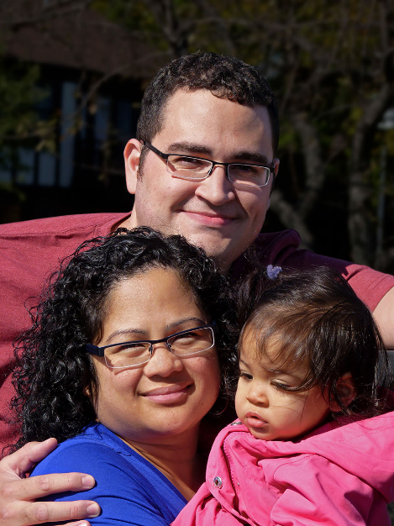
Tolerable Stress Response
Exposure to non-normative experiences
  Death in family
  Natural disaster
Social emotional buffers can provide protection and promote a return to baseline
A single major negative event does not necessarily mean long-lasting problems
SourceToxic Stress. Center on the Developing Child at Harvard University Website. https://developingchild.harvard.edu/science/key-concepts/toxic-stress/. Accessed on July 16, 2018.
Notes:
Tolerable stress in contrast to positive stress is associated with non-normative (not “every day” or “common”) experiences that present a greater risk for adversity or threat. These are things like a death in the family, a natural disaster, a serious illness, or tragic event. When there are social-emotional buffers like responsive parents and caregivers the risk that the experience will produce excessive activation of the stress response system that lead to harm and long-term consequences for health and learning is greatly reduced.
Tolerable stress can support a child in building skills for handling stressors. They need support in seeking and building relationships that can support them through the stressor. The protective adult relationships allow for adaptive coping and a sense of control that promotes returning back to baseline status.

Slide 9
Toxic Stress Response
Long lasting, unremitting stress, not a “single bad stressor”
Adverse child experiences
  Abuse
  Household dysfunction
Insufficient social-emotional buffering
Potentially permanent changes and long-term effects
Epigenetics
Brain architecture
Source Toxic Stress. Center on the Developing Child at Harvard University Website. https://developingchild.harvard.edu/science/key-concepts/toxic-stress/. Accessed on July 16, 2018.
Notes:
Long lasting, frequent, or strong intensity: It is not a “single bad stressor”
Adverse experiences: More extreme precipitants of childhood stress (adverse childhood experiences or ACEs)
Physical, sexual, emotional abuse
Physical, emotional neglect
Household dysfunction
Insufficient social-emotional buffering (Deficient levels of emotion coaching, re-processing, reassurance and support)
Potentially permanent changes and long-term effects
Epigenetics (there are life long / intergenerational changes in how the genetic program is turned ON or OFF)
Brain architecture (the mediators of stress impact upon the mechanisms of brain development / connectivity)
In a practical sense, toxic stress can impact a child’s sleep, eating, and toileting – creating problems like insomnia, night waking, nightmares, overeating, hoarding food, lass of apetite, constipation, encopresis, and enuresis.
The impact of toxic stress on executive function, the critical system which helps us manage all of the complexities of our lives, is also significant. Young children experience a slow acquisition of milestones, skillsl; and learning. Impacts to working memory can lead to confabulation which adults see as lying. Children may not be able to control their inhibitions leading to tantrums, aggression, fighting, and disrupting school. Finally, children may become easily frustrated, have difficulty with transitions, and lack organizational skills. They may appear as though they have ADHD or LD rather than trauma.

Slide 10

“Social-emotional buffering is the primary factor distinguishing tolerable from toxic level of stress.”
Andrew Garner, MD, PhD, FAAP
Chair, AAP EBCD Leadership Work Group (2012-2014)
Notes:
It is important to remember that some level of stress is normal and growth-promoting, but that toxic stress can hinder healthy development especially when social-emotional buffering is lacking. It is the response to stress that matters and what is in place to mitigate its effects. These protective factors can mediate the effects of toxic stress.

Slide 11
Desired Protective Factors
For Families
Concrete support in times of need
Social connections
Knowledge of parenting and child development
Personal resilience
The ability to enhance social and emotional competence in children
The ability to foster nurturing and attachment
Strengthening Families: A Protective Factors Framework. Center for the Study of Social Policy. https://www.cssp.org/young-children-their-families/strengtheningfamilies/about#protective-factors-framework. Accessed July 26, 2018.
Notes:
These desired protective factors are the things public health professionals can consider when thinking about early brain and child development. When families do not have these elements in their lives, they may need referrals to community agencies who can help build these protective factors.

Slide 12
Desired Protective Factors
For Communities
Safe neighborhoods
Safe, high quality schools
Stable and safe housing
Access to nutritious food
Access to job opportunities
Access to medical care (including behavioral health and wellness care)
Access to transportation
Access to safe, high quality, affordable child care
Inclusion and equity related to race, ethnicity, and disability
Strengthening Families: A Protective Factors Framework. Center for the Study of Social Policy. https://www.cssp.org/young-children-their-families/strengtheningfamilies/about#protective-factors-framework. Accessed July 26, 2018.
Notes:
Note to the trainer: consider sharing Community Resilience from the Assistant Secretary for Emergency Preparedness and Response available at: https://www.phe.gov/Preparedness/planning/abc/Pages/community-resilience.aspx

Slide 13
Eco-Bio-Developmental
Model of Human Health and Disease
Ecology becomes biology,
And together they drive development across the lifespan
Shonkoﬀ JP, Garner AS, American Academy of Pediatrics Committee on Psychosocial Aspects of Child and Family Health, Committee on Early Childhood, Adoption, and Dependent Care, Section on Developmental and Behavioral Pediatrics. The lifelong eﬀects of early childhood adversity and toxic stress. Pediatrics. 2012;129(1):e232-e246. doi: 10.1542/peds.2011-2663.
Notes:
As this diagram illustrates, ecology, or the social and physical environment including the stressors that come with it becomes biology as the brain develops and together they drive development across the lifespan. Without mediating protective factors, toxic stress in young children can lead to permanent changes in the brain structure and how it function.
Source:Shonkoﬀ JP, Garner AS, American Academy of Pediatrics Committee on Psychosocial Aspects of Child and Family Health, Committee on Early Childhood, Adoption, and Dependent Care, Section on Developmental and Behavioral Pediatrics. The lifelong eﬀects of early childhood adversity and toxic stress. Pediatrics. 2012;129(1):e232-e246. doi: 10.1542/peds.2011-2663.
Note to the trainer: This diagram was developed based on a number of sources including:
Bronfenbrenner U. The Ecology of Human Development: Experiments by Nature and Design. Cambridge, MA: Harvard University Press; 1979.
Sameroff A. A unified theory of development: a dialectic integration of nature and nurture. Child Dev. 2010;81(1):6–22.
National Research Council, Institute of Medicine, Committee on Integrating the Science of Early Childhood Development; Shonkoff JP, Phillips D, eds. From Neurons to Neighborhoods: The Science of Early Childhood Development. Washington DC, National Academies Press; 2000.

Slide 14
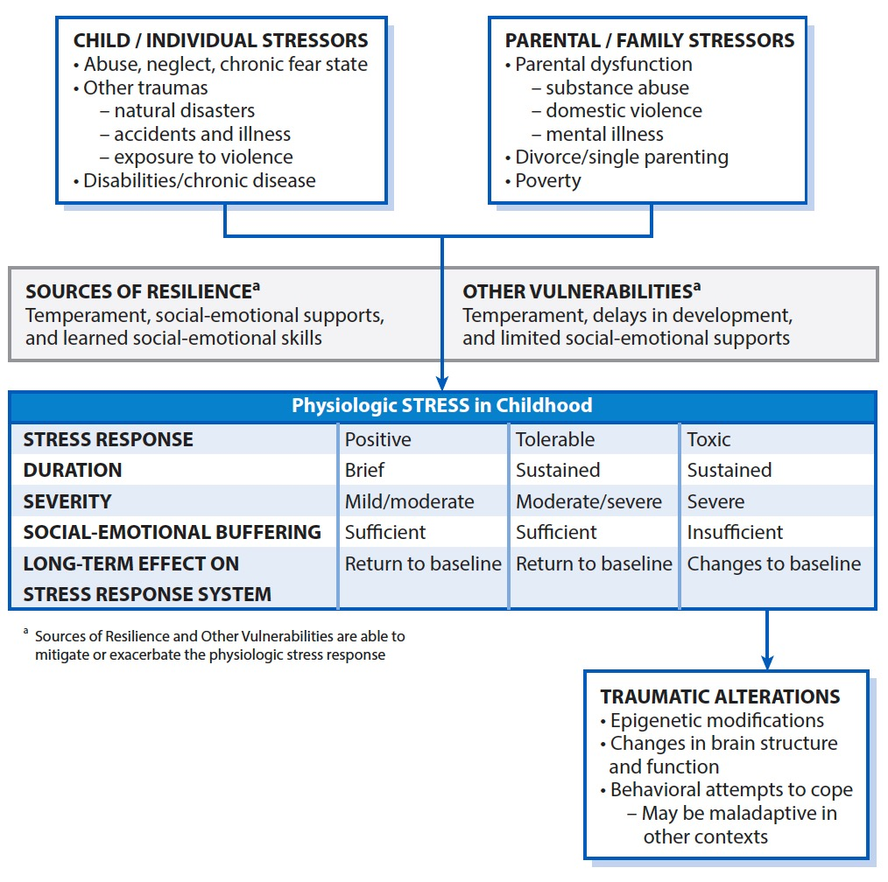
Precipitants and Consequences of Stress in Childhood
Bright Futures Guidelines for Health Supervision of Infants, Children and Adolescents, 4th ed.: Reproduced with permission from Garner A, Forkey H, Stirling J, Nalven L, Schilling S; American Academy of Pediatrics, Dave Thomas Foundation for Adoption. Helping Foster and Adoptive Families Cope With Trauma. Elk Grove Village, IL: American Academy of Pediatrics; 2015. https://www.aap.org/traumaguide. Accessed July 2018.
Notes:
This chart shows how child and family stressors can impact a child’s development. Note the impact of toxic stress and the traumatic alterations that result. You can see how individual and family stressors come through both sources of resilience and other vulnerabilities to create each level of stress on a child. Most importantly, note that only toxic stress creates traumatic alterations that create epigenetic modifications, changes in brain structure, and behavioral coping mechanisms that may, at times, be maladaptive.
Source: From Bright Futures: Reproduced with permission from Garner A, Forkey H, Stirling J, Nalven L, Schilling S; American Academy of Pediatrics, Dave Thomas Foundation for Adoption. Helping Foster and Adoptive Families Cope With Trauma. Elk Grove Village, IL: American Academy of Pediatrics; 2015. https://www.aap.org/traumaguide.

Slide 15
Key Concept 1
Childhood adversity has lifelong consequences
Notes:
Let’s talk through some key concepts of toxic stress.
First, childhood adversity has lifelong consequences. Significant adversity in childhood is strongly associated with unhealthy lifestyles and poor health decades later.
Brain architecture is built from the bottom up. Is the foundation strong or weak?
Early experiences are foundational for later health and well-being.

Slide 16
Adverse Childhood
Experiences (ACE) Study
One the largest studies to assess associations between childhood maltreatment and later health and well-being
Findings suggest that certain experiences are major risk factors for illnesses and poor quality of life
Violence Prevention: Adverse Childhood Experiences (ACEs). Centers for Disease Control and Prevention Website. https://www.cdc.gov/violenceprevention/acestudy/. Updated April 1, 2016. Accessed July 16, 2018.
Notes:
The ACE study is one of the largest studies that has assessed associations between childhood maltreatment and later health and well-being.
Findings suggest that certain experiences are major risk factors for illnesses and poor quality of life.
Notably, this study was NOT done on an impoverished population, but an upper-middle class, college-educated population.

Slide 17
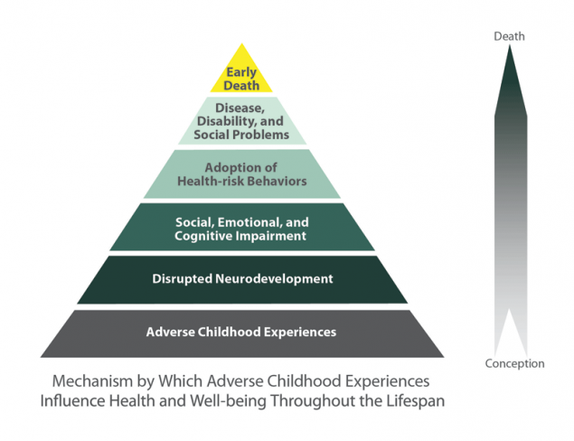
Adverse Childhood
Experiences (ACE) Study
The Ace Pyramid. Centers for Disease Control and Prevention Website. https://www.cdc.gov/violenceprevention/acestudy/about.html. Updated June 14, 2016. Accessed July 13, 2018.
Notes:
Childhood abuse, neglect, or exposure to other toxic stressors, or prolonged unremitting exposure to stress or adverse childhood experiences are common. Almost 2/3 of participants reported at least one ACE and more than 1 in 5 reported 3 or more ACE. The short- and long-term outcomes of these childhood exposures include a multitude of health and social consequences.
The next session on Adverse Childhood Experiences will offer more details about this study, the impacts of adverse experiences on early brain and child development, and the efforts you can make to minimize it.

Slide 18
Key Concept 2
Epigenetics
Which genes are turned on/off, when and where
Ecology (environment/experiences)
Stress-induced changes in gene expression
Notes:
Epigenetics
Which genes are turned on or off, when and where
Ecology or environment/experience influences how the genetic blueprint is read and utilized
Ecological effects at the molecular level
Stress-induced changes in gene expression
Through epigenetic mechanisms the early childhood ecology becomes biologically embedded, influencing how the genome functions
Note to the Trainer: consider sharing Moshe Szyf’s Ted Talk, How Early Life Experience is Written into DNA https://www.ted.com/talks/moshe_szyf_how_early_life_experience_is_written_into_dna/transcript?language=en (16:36 minutes).This shares Michael Meaney’s experiment with Mice.

Slide 19
Parental Stress and Children’s Genes
Parents’ stress leaves lasting marks on children’s genes
Higher stress levels reported by mothers during their child’s first year correlated with methylation levels on 139 DNA sites in adolescents
Parent' stress leaves lasting marks on children's genes: UBC-CFRI research. The University of British Columbia Website. https://news.ubc.ca/2011/08/30/parents-stress-leaves-lasting-marks-on-childrens-genes-ubc-cfri-research/. Published August 20, 2011. Accessed July 17, 2018.
Notes:
Michael Kober and colleagues’ research focused on a central part of epigenetics, called methylation, in which a chemical group attaches to parts of the DNA, a process that acts like a dimmer switch on gene function in response to social and physical environments. The study showed that parental stress during their child’s early years can leave an imprint on a child’s genes that can last into adolescence and may affect how genes are expressed later in life.
Through epigenetic mechanisms the early childhood ecology becomes biologically embedded, influencing how the genome functions

Slide 20
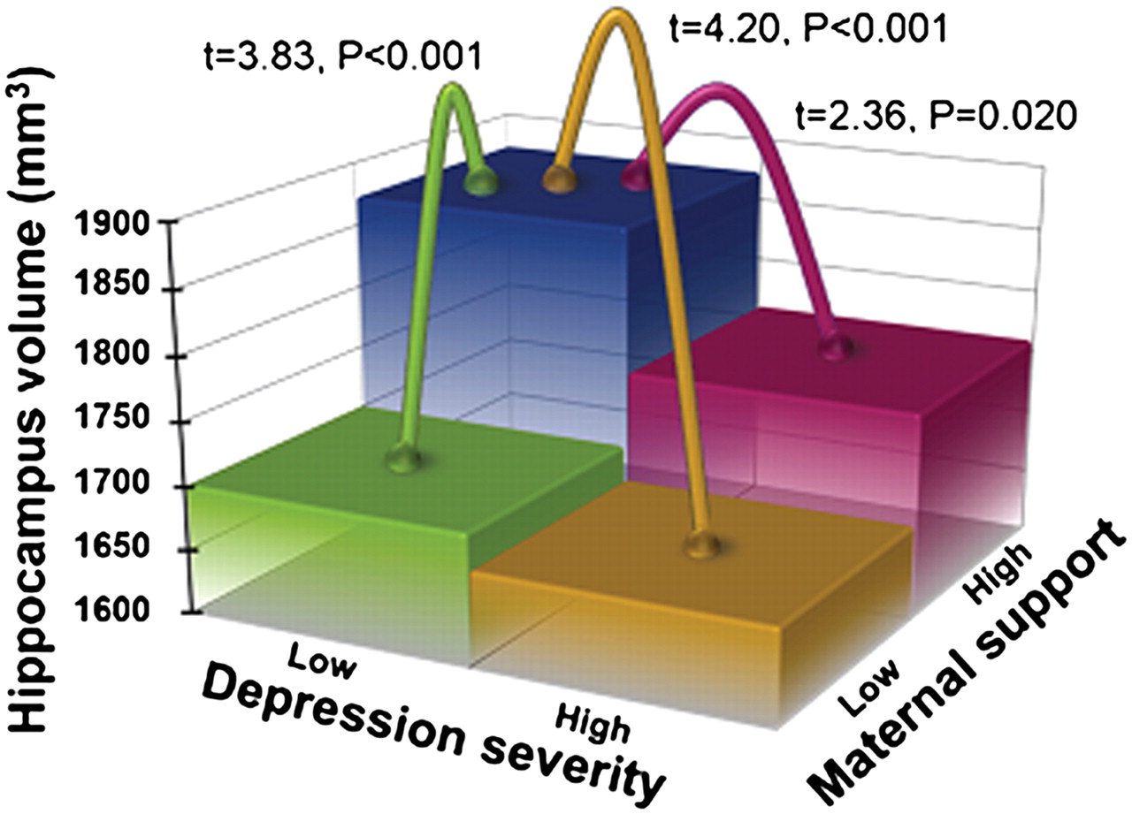
Hippocampus Volume by Preschool Depression Severity and Maternal Support
Luby J L et al. PNAS 2012;109:2854-2859
©2012 by National Academy of Sciences
Luby JL, Barch DM, Belden A, et al. Maternal support in early childhood predicts larger hippocampal volumes at school age. PNAS. 2012; 109(8): 2854-2859. doi: 10.1073/pnas.1118003109
Notes:
A study by Joan Luby and colleagues looked at hippocampus volume by preschool depression severity and maternal support. The findings suggest that nurturing a child early in life may help in the development of a larger hippocampus, as indicated in the Blue Box. Where the child experienced low depression with high maternal support the hippocampus volume is greatest. And, the yellow box shows how high depression and low maternal support create the lowest hippocampus volume. In the study children of nurturing mothers had hippocampal volumes 10 percent larger than children whose mothers were not so nurturing. Note how much of a difference support made even in “low severity depression” situations. Parenting matters!
One of the implications of these studies is that toxic stress to an individual may have a two-generation effect via epigenetic mechanisms.

Slide 21
Key Concept 3
Developmental Neuroscience
Brain architecture is experience-dependent
Ecology influences how brain architecture is formed and remodeled
Diminishing cellular plasticity limits remediation
Notes:
Brain Architecture is experience-dependent (individual connections or “synapses” and complex circuits of connections or “pathways” are both dependent upon activity)
Ecology (environment/experience) influences how brain architecture is formed and remodeled (plasticity)
Diminishing cellular plasticity limits remediation
Early childhood adversity -> vicious cycle of stress
Potentially permanent alterations in brain architecture and functioning

Slide 22
5 Principles of Brain Development
Experience dependent
Cumulative
Integrated
Dynamic
Asynchronous
Garner A, Saul R. Thinking Developmentally. Itasca, IL: American Academy of Pediatrics; 2018.
Notes:
These 5 principles best describe brain development:
Experiences create the connections in the brain by changing the number of neurons and neuronal connections, and the speed of neuronal connections.
Synapses serve as the building blocks of neuronal pathways, then those pathways serve as the foundation for complex functions – everything builds upon each other to create cumulative growth.
The brain is like a spiderweb, with each set of skills or deficits impact everything else in the brain’s development and growth.
The brain’s plasticity means that it is ever changing, adapting to the environment and learning rapidly during the early years. But as children grow older, the plasticity declines making learning more difficult.
The structures in the brain don’t grow at the same rate, so growth occurs in different areas of the brain at different times. The brain progresses from the back to the front and parallels the developmental progression of the child.
Think about how stress comes into play when thinking about these five principles. Given this information, when stress becomes toxic, how does the brain respond?

Slide 23
Plasticity
Plasticity refers to the brain’s unique ability to literally “rewire” itself in response to experience
Experience influences not only the foundational architecture, but the on-going connectivity and functionality
Two different types of plasticity…
Garner A, Saul R. Thinking Developmentally. Itasca, IL: American Academy of Pediatrics; 2018.
Notes:
Brain plasticity is essentially the changes in the brain that occur in response to the environment. Brain plasticity or this “rewiring” is the greatest during sensitive periods in a child’s life – the first 1,000 days are a period of great brain plasticity as we discussed in the first session.
There are two different types of plasticity…

Slide 24
Plasticity
Synaptic Plasticity
    Variation in the STRENGTH of individual connections
  “a single person goes from a whisper to a shout”
  Lifelong (how old dogs learn new tricks)
Cellular Plasticity
  Variations in the NUMBER (or COUNT) of connections
  “from one person shouting to a stadium shouting”
  Declines dramatically with age (waning by age 5)
Garner A, Saul R. Thinking Developmentally. Itasca, IL: American Academy of Pediatrics; 2018.
Notes:
These connections impact a child’s executive function and can make a significant difference in how children are able to take in and use information and experiences to learn and grow, as well as their ability to manage their own thinking and emotions.

Slide 25
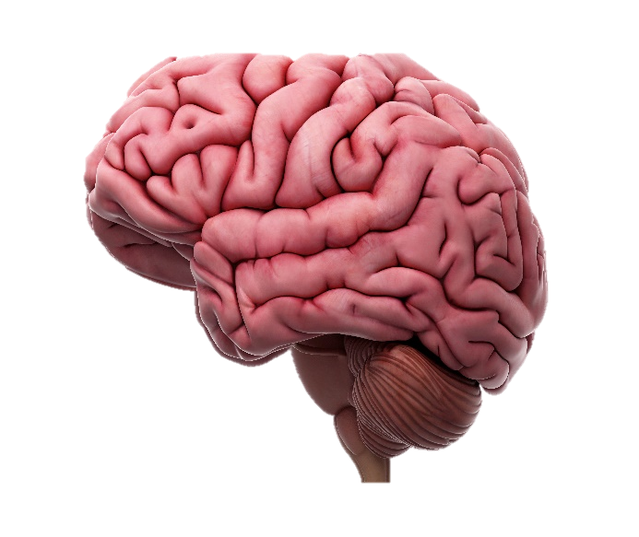
Differential Maturation
The Brake – PFC (with some hippocampal help)
Frontal lobes:
Abstract thought, reasoning, judgment, planning,
impulse and affect regulation, consequences
Parietal Lobe:
Integration of sensory
data and movement
Temporal lobe (outside):
Processing sound
and language
Occipital Lobe:
Visual processing
Limbic System (inside):
Emotions and impulsivity
Cerebellum:
Smooth movements
Coordination
+ The Gas Pedal + Amygdala
Brain Stem & Cranial Nerves:
Vital functions
Swallowing
Adapted from: Garner A, Saul R. Thinking Developmentally. Itasca, IL:
American Academy of Pediatrics; 2018. p.44
Notes:
The brain can be impaired in many ways when exposed to stressful experiences without protective buffers. Toxic stress has been shown to alter the size and neuronal architecture of the prefrontal cortex or PFC. This leads to less abstract thought, reasoning, planning, and impulse control. Conversely, the limbic system (the amygdala) predominates, with emotions and impulsivity becoming more prominent without a PFC to counter them.
These changes can create a weak foundation for later learning, behaviors and health.
Consider sharing Brain Architecture: https://developingchild.harvard.edu/science/key-concepts/brain-architecture/ (1:57)

Slide 26
Impact of Early Stress
TOXIC STRESS
CHILDHOOD STRESS
Hyper-responsive stress response; calm/coping
Chronic “fight or flight;” cortisol / norepinephrine
Changes in Brain Architecture
Garner A, Saul R. Thinking Developmentally. Itasca, IL: American Academy of Pediatrics; 2018.
Notes:
The vicious cycle of early toxic stress creates changes in brain architecture which impacts behaviors that create toxic stress. It must be broken in early childhood to make a significant difference in how children’s brains grow and develop. Remember that there are positive and tolerable forms of stress that a child experiences, and that the kinds of protective factors, particularly through positive, nurturing relationships can break the cycle of toxic stress.
Drs. Andrew Garner and Robert Saul also talk about a freeze or affiliate response which can occur during this cycle of early stress. They write that the freeze response is like the “deer in the headlights” response where there is no reaction, but rather muscle groups become tonic and the heart rate slows. Additionally, the affiliate response is what they call the “tend and befriend” reaction – a time when oxytocin is released to promote pro-social perceptions, thoughts, and behaviors. (Thinking Developmentally, Pg. 16)
Note to the trainer: consider sharing Toxic Stress: https://developingchild.harvard.edu/science/key-concepts/toxic-stress/ (1:52)
Source: Garner, A. and Saul, R. (2018). Thinking Developmentally. Itasca, IL: American Academy of Pediatrics.

Slide 27
Critical Concept 4
What can you do to
make it better?
Notes:
What can you do to translate what we know about toxic stress into practice? There is plenty that you already do, and there is evidence for other practices that will also help. Most importantly, you can help build an environment of wellness.

Slide 28

Development is a Dance Between Nature and Nurture
What you can do:
  Apply an ecobiodevelopmental framework
  Recognize adverse psychosocial factors
  Collaborate with families and social service providers
  Conduct developmental and behavioral monitoring and screening
Notes:
Remember development is a dance between nature and nurture. Apply an ecobiodevelopmental framework and recognize that adverse psychosocial factors (poverty, domestic violence, parental mental illness or substance use and addiction) are no less biological than lead poisoning or poor nutrition.
Collaborate with families and local service providers to improve the early childhood ecology, both to improve life-course trajectories and to address the biologic mediators underlying disparities in health and education. We’ll talk more about 2-generation solutions in the fourth module.
Stay focused on the dance during the early years by regularly conducting developmental and behavioral monitoring and screening. You may already use developmental screening tools in your practice with patients or clients and their families, but make sure you integrate mental health screening and assessment tools. To find some tools that may work for you, review the following resources:
Mental Health Screening and Assessment Tools for Primary Care: https://www.aap.org/en-us/advocacy-and-policy/aap-health-initiatives/Mental-Health/Documents/MH_ScreeningChart.pdf
Birth to 5: Watch Me Thrive! A Primary Care Provider’s Guide for Developmental and Behavioral Screening: https://www.acf.hhs.gov/sites/default/files/ecd/pcp_screening_guide_march2014.pdf
Birth to 5: Watch Me Thrive! A Behavioral Health Provider’s Guide for Developmental and Behavioral Screening: https://www.acf.hhs.gov/sites/default/files/ecd/behavioral_health_guide_march2014.pdf
If your audience includes other types of professionals, visit Watch Me Thrive’s home page to find useful tools for them: https://www.acf.hhs.gov/ecd/child-health-development/watch-me-thrive
Note to trainer: either link to or have hard copies available of each of these tools so that attendees can review them.

Slide 29
Early Connections Form the Foundation
What you can do:
  Encourage social-emotional skills
  Talk about the 5 Rs of early education
  Help families recognize social and developmental milestones
Notes:
Brain development is cumulative in that early, simple connections and circuits form the foundation for more complex pathways and behaviors. Much like muscles, connections and circuits that are used frequently become stronger and more efficient over time (“neurons that fire together, wire together”). However, those connections and circuits that are not utilized are pruned and eliminated (“if you don’t use it, you lose it”).
Pediatricians and public health professionals need to assist families in recognizing and encouraging rudimentary yet foundational skills as they emerge. For example, the social smile at 6 weeks sets the stage for cooing conversations, which in turn leads to babbling and, eventually, spoken language.
Note to the trainer: consider sharing the video “Learn the Signs. Act Early” One Doctor’s Story. https://youtu.be/6AZDse_c9nA
Also share these resources from Learn the Signs. Act Early:
CDC’s Learn the Signs. Act Early for Healthcare Providers: https://www.cdc.gov/ncbddd/actearly/pdf/LTSAE_Physician_Pager-508.pdf
CDC’s Free Milestone Tracker App Poster: https://www.cdc.gov/ncbddd/actearly/powerpoint/Milestone-Tracker-App-Slide.pptx
AAP’s Tips to Promote Social-Emotional Health Among Young Children: https://www.aap.org/en-us/Documents/SE-Tips-2016.pdf
Early Education – The 5 R’s: https://www.aap.org/en-us/advocacy-and-policy/aap-health-initiatives/EBCD/Pages/Five.aspx
Also consider reviewing the following research:
Mendelsohn, A., Brockmeyer Cates, C., Weisleder, A., Berkule Johnson, S., Seery, A., Canfield, C., Huberman, H., and Dreyer, B. (2018). Reading Aloud, Play, and Social-Emotional Development. Pediatrics. 141(5) Retrieved from: http://pediatrics.aappublications.org/content/pediatrics/141/5/e20173393.full.pdf
Hutton, J., Horowitz-Kraus, T., Mendelsohn, A., DeWitt, T., Holland, S. (2015). Home Reading Environment and Brain Activation in Children Listening to Stories. Pediatrics. 136(3) Retrieved from http://pediatrics.aappublications.org/content/136/3/466
Scharf, R. (2016) School Readiness. Pediatrics in Review. 37(11). Retrieved from http://pedsinreview.aappublications.org/content/37/11/501?sso=1&sso_redirect_count=1&nfstatus=401&nftoken=00000000-0000-0000-0000-000000000000&nfstatusdescription=ERROR%3a+No+local+token

Slide 30
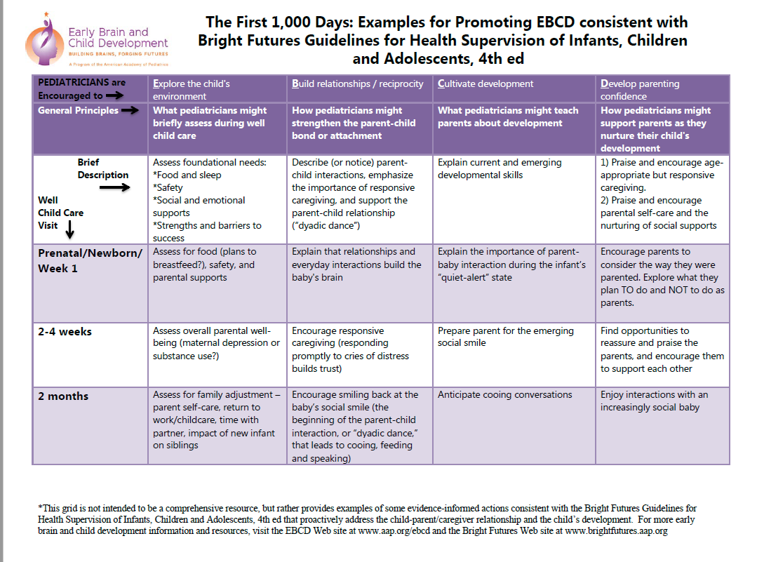
Promoting EBCD
The First 1000 Days: Examples for Promoting EBCD Consistent with Bright Futures Guidelines for Health Supervision of Infants, Children and Adolescents, 4th ed. https://www.aap.org/en-us/advocacy-and-policy/aap-health-initiatives/EBCD/Documents/EBCD_Well_Child_Grid.pdf , Accessed August 28, 2018
Notes:
Here is a great example of a resource from the American Academy of Pediatrics on strategies you can use to promote early brain and child development during the first 1,000 days of a child’s life. This tool offers you concreate strategies by age and kind of support you can give.
Note to the trainer: consider handing out: https://www.aap.org/en-us/advocacy-and-policy/aap-health-initiatives/EBCD/Documents/EBCD_Well_Child_Grid.pdf

Slide 31
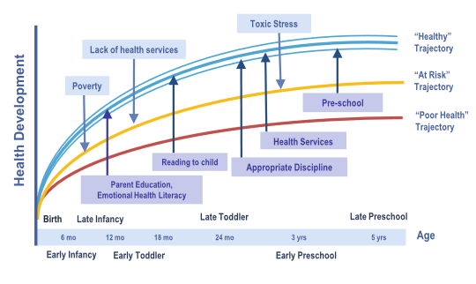
Strategies to Improve Developmental Trajectories
PROTECTIVE INTERVENTIONS
Anticipatory Guidance
Additional Strategies for ‘At Risk’ Families
High Quality ECE
Language Stimulation
Parent Responsiveness
Additional Strategies for ‘Poor Health’ Families
Home visiting
Specialized Services
Source: Halfon N, Larson K, Lu M, Tullis E, Russ S. Lifecourse Health Development: Past, Present and Future. Matern Child Health J. 2014; 18(2): 344-365. doi: 10.1007/s10995-013-1346-2.
Notes:
Note to the trainer: This slide is animated so you will want to be sure to click on the slide at the appropriate intervals to reveal the animations.
This is graphic is known as the Life Course model which was developed by Neal Halfon, MD, MPH, who leads the Life Course Research Network. This slide demonstrates some of the things that can be done to improve developmental trajectories through age 5. Remember that adversity will push down upon ALL these curves, so we can’t ignore the child who is currently “doing well”.
In Thinking Developmentally, Drs. Andrew Garner and Robert Saul explain that affiliative childhood experiences, these arrows pushing upward, have been associated with lifelong outcomes as these children become adults.
Note in particular that each of these activities connect to protective factors that support positive relationships – parent responsiveness, reading to children, language simulation, appropriate discipline are all related to the connection between a child and their family. High quality early childhood education/child care and preschool, health services, anticipatory guidance, home visiting, specialized services are about the relationships or connections available to a family within their community. Making connections for families to these important services increases their ability to support their child and diminish the negative impacts of stress in their lives.

Slide 32
Brain Plasticity Declines With Age
What you can do:
  Work with families and child care providers to ensure that brain’s wiring is right the first time
  Advocate for a public health approach to toxic stress
  Help families to provide safe, stable relationships
  Assist families in regulating stress
Garner A, Saul R. Thinking Developmentally. Itasca, IL: American Academy of Pediatrics; 2018.
Notes:
Brain plasticity declines with age. Plasticity, or the ability of the brain to rewire itself in response to changes in the environment, is waning by the time children begin kindergarten.
Pediatricians and public health professionals should work with families and early educators to ensure that the brain’s wiring is right the first time. Remediation, while possible, is much more difficult.
Pediatricians and public health professionals share with families that children are biologically predisposed to more physiologic stress, and that the critical brain structures that modulate this stress mature later. Young children need safe, stable, and nurturing relationships to assist them in regulating their stress.
Pediatricians and public health professionals promote a public health approach to address toxic stress, including 1) “common messaging” to prevent or minimize toxic stress, 2) screening families and children for common precipitants of toxic stress (poverty, domestic violence, parental mental illness or substance use and addiction), and 3) collaborating with local resources to address the consequences of toxic stress.

Slide 33
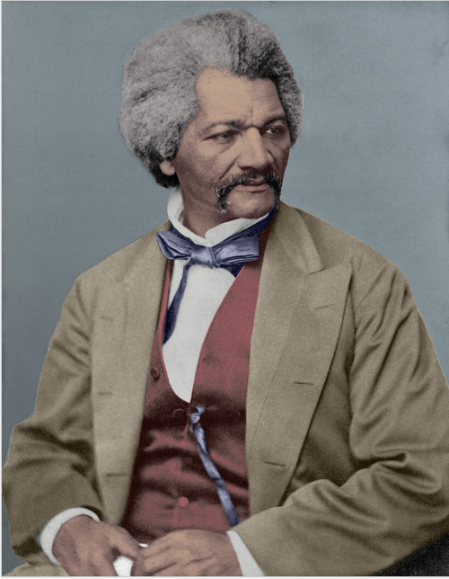
Conclusion:
It is easier to build strong children than to repair broken men.
Frederick Douglass

Slide 34

Questions?

