Slide 1
Early Brain and Child Development Advocacy: An Opportunity to Change Childhood Outcomes
Name of Presenter
Material developed by the American Academy of Pediatrics
Revised: August 2018
Notes:
This is the fifth module in the Early Brain and Child Development training and education series.

Slide 2
Objectives
Identify factors that determine health
Describe the importance of early childhood influences on life course trajectories and current theories of change
Define the public health approach to early brain and child development
Articulate strategies to improve a child’s life course through advocacy
Notes:
We’ve talked through brain development and the many factors that promote optimal development for young children in modules 1 through 3, then we’ve discussed how to engage families and use a two-generation approach to services. Now let’s explore what determines a child’s health from a public health perspective and how we, as professionals, can work together to ensure the best outcomes for young children and their families.

Slide 3
What Determines Health?
Building Adult Capabilities to Improve Child Outcomes: A Theory of Change
http://developingchild.harvard.edu/resources/multimedia/videos/theory_of_change/
Building Adult Capabilities to Improve Child Outcomes. Center on the Developing Child at Harvard University Website. https://developingchild.harvard.edu/resources/building-adult-capabilities-to-improve-child-outcomes-a-theory-of-change/. Accessed on July 18, 2018.
Notes:
Here is an introductory video to help you understand the broader perspective of how a theory of change drives public health activities to promote early brain and child development.
Note to the trainer: Select the link to share the video (5:19 minutes)

Slide 4
The Roots of Children’s Health and Well-being
Notes:
As the video shows, the health and well being of children -- from the physical to the emotional -- has profound and powerful influences far beyond clinical walls. It reaches families and communities and policies that surround children. All of these can be key to a child’s health and well-being.
We know the depth of the social determinants of health, the power of early influences and experiences. This knowledge calls on us to rethink our model and our role – In many ways our practices and system are still set up to be “reactive” and disease based as opposed to PROACTIVE and health promotion/ health building focused.
This is a very exciting time, never before have we known with so much clarity - that a paradigm shift is urgent!

Slide 5
Bronfenbrenner’s Socioecological Model
Macrosystem:
Economic system, laws, history, culture, social conditions, attitudes
Macrosystem =
societal and cultural values
Exosystem:
Extended family, parents work environment, social services, mass media, local politics
Exosystem =
society/indirect environment
Chronosystems= Changes over time, history
Mesosytem =
Community
Mesosytems:
Relationships between those in microsystem
Microsystems = Relationships
Microsystems:
Family, peers, child care, neighborhood
Individual Child
Child:
age, health, behaviors
Adapted from: Bronfenbrenner, U. (1994). Ecological models of human development. Readings on the Development of Children, 2(1), 37-43.
Notes:
Urie Bronfenbrenner’s socioecological model emphasizes the context of all of our work. Children and family are at the center of all of the work we do, but we have many partners in the services we deliver and we are guided by the policies and perceptions of society as a whole. Therefore, building relationships within the community and making yourself heard by the broader public can help you drive positive policies and initiatives for young children.

Slide 6
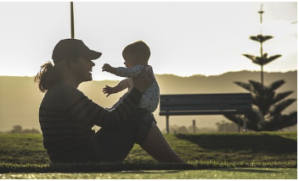
”Development, it turns out, occurs through this process of progressively more complex exchange between a child and somebody else – especially somebody who’s crazy about that child”
- Urie Bronfenbrenner
Urie Bronfenbrenner. Quoted in Childhood, Robert H. Wozniak (1991). A viewer's guide produced in collaboration with Thirteen WNET.

Slide 7
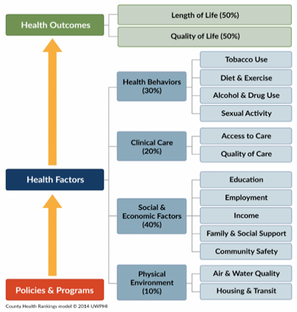
What Determines Health?
Source: University of Wisconsin Population Health Institute. County Health Rankings & Roadmaps 2018. www.countyhealthrankings.org.. Accessed July 18, 2018.
Notes:
Here is one example of how health is built through an interplay of many factors. A model from the County Health Rankings & Roadmaps program, a collaboration between the Robert Wood Johnson Foundation and the University of Wisconsin Population Health Institute show that 80% of health is influenced by care outside of hospitals, clinics or medical providers’ offices. As shown in this figure, social and economic factors, the physical environment and health behaviors collectively influence health outcomes to a wider extent. This graphic reinforces the need for collaboration across sectors to promote and build healthy families.
7

Slide 8
Shaping the Capacity of the Brain
The interactive influences of genes and experiences shape the architecture of the developing brain
Brains are built from the bottom up
nurturing relationships build more capable and resilient brains
Notes:
We also know that that the interactive influences of genes and experience literally shape the architecture of the developing brain and the active ingredient is the “serve and return” nature of children’s engagement in relationships with their parents and other caregivers in their family and community.
Both brain architecture and developing abilities are built from the bottom up with simple circuits and skills providing scaffolding for more advanced circuits and skills over time. This shaping of the brain (especially in the first 1000 days) can have a profound affect on health outcomes later in life.

Slide 9
Early Childhood Programs and Services
Key role in helping to create better health outcomes
Home visiting programs
Positive parenting programs
Quality early education/child care
Early intervention programs
WIC
Medicaid
Notes:
As noted earlier, 80% of health is influenced by non-hospital or clinical care; social and economic factors, the physical environment and health behaviors influence health outcomes.
Programs such as, Medicaid, WIC, quality early education/child care, positive parenting programs, early intervention programs and home visiting (MIECHV) offer ways to mitigate or lessen many of the social, economic, and environmental factors that can alter life-course trajectories. Many of these programs (i.e. positive parenting programs and home visiting) help build strong parent child relationships.
These programs provide a means to improve the environments of children and families and provide a buffer that can ensure that children are healthy and ready to learn despite adverse childhood experiences.

Slide 10
Definitions
Population health is: “the health outcomes of a group of individuals, including the distribution of such outcomes within the group.”
- Institute of Medicine, 2012, Pg. 19
Public health is: “fulfilling society’s interest in assuring conditions in which people can be healthy.”
- Institute of Medicine, 2003, pg. 411
Institute of Medicine. Primary Care and Public Health: Exploring Integration to Improve Population Health. Washington, DC: The National Academies Press; 2012:19. https://doi.org/10.17226/13381. Accessed July 18, 2018.
Institute of Medicine. The Future of the Public's Health in the 21st Century. Washington, DC: The National Academies Press; 2003:411. https://doi.org/10.17226/10548. Accessed July 18, 2018.
Notes:
As we delve into the kinds of activities you can engage in, it’s important to make sure we are all on the same page about definitions.
Note to the trainer: Confirm with the audience that they understand the definitions and the differences between them.
Source: Institute of Medicine. 2012. Primary Care and Public Health: Exploring Integration to Improve Population Health. Washington, DC: The National Academies Press. https://doi.org/10.17226/13381.
Institute of Medicine. 2003. The Future of the Public's Health in the 21st Century. Washington, DC: The National Academies Press. https://doi.org/10.17226/10548.

Slide 11
How Early Experience Gets Into the Body: A Biodevelopmental Framework
Foundations for Healthy Development
Lifelong Outcomes
Gene-environment interaction
Cumulative effects
Biological embedding
Physical adaptations & disruptions
Health Related Behaviors
Physical & Mental Health
Educational Achievement
Economic Productivity
Relationships
Physical, Chemical and Built Environment
Nutrition
Positive early influences = typically healthy and adaptive
Adverse early influences = dysfunctional, maladaptive, poor health
Adapted from: Shonkoff, J. Building a New Biodevelopmental Framework to Guide the Future of Early Childhood Policy. Child Development, January/February 2010, Volume 81, Number 1, Pages 357–367 https://steinhardt.nyu.edu/scmsAdmin/media/users/eez206/srb_conference/Building_a_New_Biodevelopmental_Framework_-_J__Shonkoff.pdf. Accessed August 28, 2018
Notes:
Investing in the early years matters because physiological responses to early experiences, in turn, affect adult outcomes in educational achievement and economic productivity; health-related behaviors that are either enhancing (e.g., nutritious diets, frequent exercise) or threatening (e.g., smoking, alcohol abuse, illicit substance use, other risk-taking behaviors); and physical and mental health.
When early influences have been positive, physiological systems are typically healthy and adaptive. When influences have been adverse, systems may be dysfunctional and can lead to impaired learning, maladaptive behavior, illness, disability, and a shortened lifespan.
In other words, children who live in health-promoting environments and have positive early experiences tend to go on to complete more years of school and have higher-paying jobs, live healthier lifestyles, and live longer, healthier lives. Children who experience significant adversity early in life without consistent support from caring adults are more likely to drop out of school earlier, earn less, depend more on public assistance, adopt a range of unhealthy behaviors, and live shorter and less healthy lives.
Citation: Shonkoff, J.P., Boyce, W.T. & McEwen, B.S. (2009). Neuroscience, molecular biology, and the childhood roots of health disparities: Building a new framework for health promotion and disease prevention. JAMA, 301, 2252-2259.

Slide 12
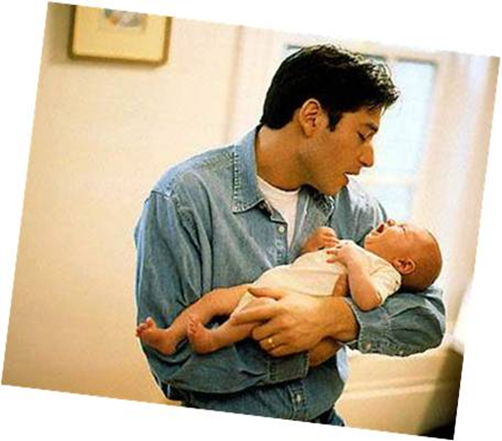
What Are We Building?
We’re in the “building health and developmental assurance” business…..
Physical health
Developmental health
Relational health
Notes:
Remember, we are in the futures business, the future of children and families.
Please remember, relational health includes attachment and social emotional bonding.

Slide 13
Conceptual Framework Guiding Early Childhood Policy and Practice
Healthy Developmental Trajectory
Significant Adversity
Can counter adversity
Supportive Relationships
Stimulating Experiences
Health-Promoting Environments
Impaired Health and Development
Adapted from: Shonkoff JP. Translating the Biology of Adversity Into More Effective Policy and Practice. Presented at Pediatric Academic Societies Annual Meeting; May 6, 2013; Washington, DC. https://www.aap.org/en-us/advocacy-and-policy/aap-health-initiatives/EBCD/Documents/Shonkoff_PAS_Plenary.pdf Accessed August 28, 2018
Notes:
This is a key point – our theory of change. This is currently the state of the field. Adversity impedes healthy development. To counter that, we are building supportive relationships, stimulating experiences, health-promoting environments and therefore better brains.

Slide 14
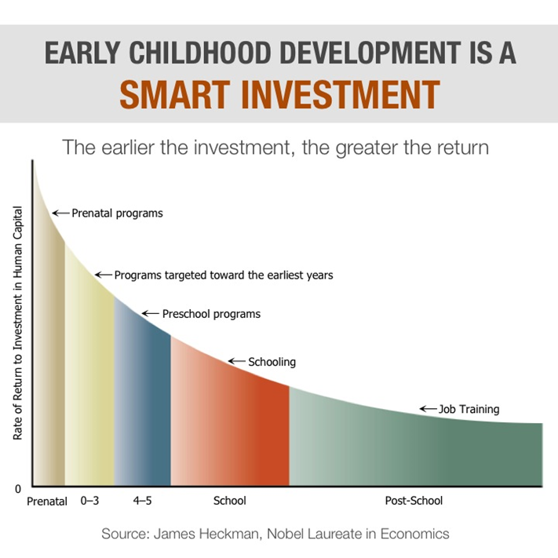
Returns on Dollars Invested in Early Childhood
Source: The Heckman Equation, downloadable toolkit: Social Media Content: Early Investments and Return on Investment for ECE/Childcare https://heckmanequation.org/resource/social-posts-early-investments-and-return-on-investment-for-ece-childcare/, Accessed August 28, 2018
Notes:
This graph illustrates some of the work and research by University of Chicago professor (and Nobel Laureate in Economics) James J. Heckman. He is an expert in the economics of human development. His groundbreaking work with a consortium of economists, developmental psychologists, sociologists, statisticians and neuroscientists has proven that the quality of early childhood development has a great impact on health, and economic and social outcomes for individuals and society at large. Early investment in high quality experiences for children from birth to age five helps develop and sustain healthy brains. This is not to imply that there is *no* return on investment later on, but that the best rate of return is earlier.
This slide, mentioned in an earlier module (module 3), bears repeating as this data supports investing in early childhood programs and is important to achieving the goal of improving and changing child outcomes.
Note to the trainer:
Consider sharing the video: Medical Compliance Starts at Birth, available at: https://heckmanequation.org/resource/medical-compliance-starts-at-birth-2/ (2:00 min).
Also, consider sharing the Heckman Equation Health Research Kit: https://heckmanequation.org/resource/health-research-toolkit/
Source: www.heckmanequation.org

Slide 15
Benefits of High-Quality Early Education and Child Care – Early Outcomes
Educational
–Lower rate of special education and grade retention
–Increased high school completion
–Higher test scores
Social-Emotional
–Fewer behavior problems
–More self-control
–Improved peer relations
Child well-being
–Less child maltreatment and neglect
Donoghue EA, AAP Council on Early Childhood. Quality Early Education and Child Care from Birth to Kindergarten. Pediatrics. 2017; 140: e20171488. doi: 10.1542/peds.2017-1488.
Notes:
Studies from such landmark programs as Perry Preschool, Abecedarian Project and the Chicago Child-Parent Centers show the importance of quality early education and child care.
James Heckman and Jack Shonkoff, from the Proceedings of National Academy of Sciences, 2006, stated:
“The most effective strategy for strengthening the future workforce, both economically and neurobiologically, and improving its quality of life is to invest in the environment of disadvantaged children during the early childhood years.”
There is a 13% Return on Investment for quality early education and child care from birth through age 5.
See also the AAP Policy Statement, Quality Education and Child Care From Birth to Kindergarten, revised in 2017, at: http://pediatrics.aappublications.org/content/140/2/e20171488

Slide 16
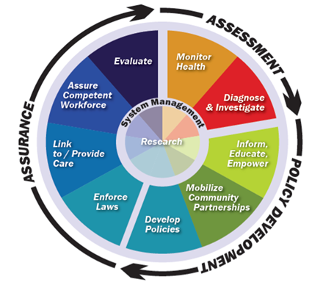
10 Essential Public Health Services
The Public Health System & the 10 Essential Public Health Services. Centers for Disease Control and Prevention Website. https://www.cdc.gov/stltpublichealth/publichealthservices/essentialhealthservices.html. Updated September 20, 2017. Accessed July 18, 2018.
Notes:
“The Future of Public Health” compiled by the National Academy of Medicine described 3 core functions of public health with 10 essential services. This graphic encapsulates these ideas. The core functions are the arrows at the edge of the graphic (assessment, policy development, assurance). The 10 essential services are the pieces of the pie.
Pediatricians are on the front lines of assessment (including monitoring health and diagnosing conditions). The medical home model embraced by pediatrics includes many elements of assurance; the essential service of “linking families with resources or providing care” is another example. The AAP, both locally and nationally, allows pediatricians an organized way to also be able to significantly impact policy.
Public health and pediatricians partner in these activities, sharing information, addressing these issues, and guiding each others’ work. When pediatricians become engaged in community efforts and advisory groups, they reach beyond their offices to impact population health as partners with public health professionals.
Source: Kuo, A., Thomas, P., Chilton, L., and Mascola, L. (2018). Pediatricians and Public Health: Optimizing the Health and Well-Being of the Nation’s Children. Pediatrics. Retreived from: http://pediatrics.aappublications.org/content/early/2018/01/18/peds.2017-3848

Slide 17
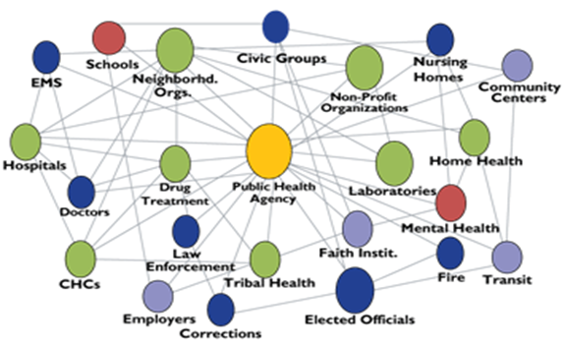
The Public Health System
The Public Health System & the 10 Essential Public Health Services. Centers for Disease Control and Prevention Website. https://www.cdc.gov/stltpublichealth/publichealthservices/essentialhealthservices.html. Updated September 20, 2017. Accessed July 18, 2018.
Notes:
The public health system, including all public, private, and voluntary public health organizations, supports the health and well-being of the populations they serve. Partnerships with these organizations is key to success in public health and population health advocacy work.

Slide 18
Trusted and Effective Messengers
Pediatricians are most trusted source of information for mothers of young children
Mothers ask physicians about health issues, nutrition and diet, and parenting.
Pediatrician advice is more fully followed than other sources.
Top 10 Information Sources for Moms (2008)
Pediatricians (58%)
Friends and family (55%)
Evening news (39%)
Internet searches (38%)
Physician office (37%)
Web sites (33%)
Parenting books (32%)
Morning TV talk shows (31%)
Newspaper articles (28%)
Magazine articles (25%)
Bailey, M. (2008, September 18). New survey reveals moms’ media habits. Marketing to Moms Coalition and Current Lifestyle Marketing. (Non-peer reviewed research report). https://www.cdc.gov/healthcommunication/pdf/thisjustin/tji_18_200912.pdf, Accessed August 28, 2018)
The role of health information sources in decision-making among Hispanic mothers during their children’s first 1000 days of life
Shaniece Criss, Jennifer A. Woo Baidal, Roberta E. Goldman, Meghan Perkins, Courtney Cunningham, Elsie M. Taveras. Matern Child Health J. 2015 Nov; 19(11): 2536–2543. doi: 10.1007/s10995-015-1774-2
Notes:
How can you improve a child’s life? As this slide indicates you are uniquely positioned to make a profound impact in many ways.
First, It is clear that you hold a unique trust by families, public and policy makers. Doctors who take care of children are repeatedly cited as society’s most trusted messengers. This allows you to be uniquely effective in supporting parents and cultivating relationships around early childhood systems that enhance Early Brain and Child Development.
From Capitol Hill to state capitols to local policy makers- you are heard in a unique way and bring a specific credibility. This is confirmed by polls, by historic impact and by individual experiences and feedback from the public.

Slide 19
Possible Public Health Activities
Stay aware of reporting requirements
Make use of public health resources
Access and use public health data
Identify opportunities to collaborate
Serve as advisors to community health organizations
Promote population-based approaches
Educate others about public health and population health
Kuo AA, Thomas PA, Chilton LA, Mascola L, Council on Community Pediatrics, Section on Epidemiology, Public Health, and Evidence. Pediatricians and Public Health: Optimizing the Health and Well-Being of the Nation's Children. Pediatrics. 2018; 141(2): e20173848. doi: 10.1542/peds.2017-3848.
Notes:
There are lots of things you can do to engage in public health activities.
When thinking about reporting requirements, note which communicable diseases are required to report.
Public health resources include home visiting, WIC, lead environmental assessments, etc.
There are specific types of public health data that may be relevant to you including newborn screening, lead, flu surveillance, other reportable diseases
Collaborate for child care, immunizations, nutrition, and communicable disease.
Organizations like Head Start, MIECHV, and early intervention look to pediatricians and public health professionals to serve as advisors and support their mission in improving outcomes for young children and their families.
Looking to the bigger picture, thinking beyond the office walls is important and doable. Advocating for education, environmental, and family services that improve the overall health and wellness of children and families is a critical piece of the work.
Finally, helping others in the community learn about public health and population health, the strategies you use, and the ways to assess, assure, and promote policy.

Slide 20
Connections Between Public Health and the Medical Home
​"We are all pieces of the population health puzzle," she said. "Collaboration is essential to solve the puzzle, create effective solutions to the challenges we collectively face, and optimize the health of our children and our communities.​"​​
Lillianne Lewis, MD, MPH, FAAP
Prevention and Public Health Special Interest Group, co-chair (2018)
AAP Section on Epidemiology, Public Health and Evidence​
Notes:
Note to the trainer:
Download and share the following scenario from Gerri Mattson, MD, MSPH, FAAP, AAP Prevention and Public Health Special Interest Group, co-chair (2018). Quoted is Lillianne Lewis, MD, MPH, FAAP, AAP Prevention and Public Health Special Interest Group, co-chair (2018), a public health pediatrician with the child health clinic at Wake County Health and Human Services in Raleigh, NC.
Available at https://www.aap.org/en-us/aap-voices/Pages/Pediatricians-and-Public-Health.aspx

Slide 21
Partnerships Between Pediatricians & Public Health
Current Collaborations
Epidemic response and emergency preparedness
Immunization endeavors, including education, administration, and tracking through registries
Lead poisoning prevention
Newborn screening
Perinatal hepatitis B prevention
Kuo AA, Thomas PA, Chilton LA, Mascola L, Council on Community Pediatrics, Section on Epidemiology, Public Health, and Evidence. Pediatricians and Public Health: Optimizing the Health and Well-Being of the Nation's Children. Pediatrics. 2018; 141(2): e20173848. doi: 10.1542/peds.2017-3848.
Notes:
The pediatric community has a long and distinguished history of partnering with public health at the community level to support healthy child development. This slide and the next provide some examples.
Newborn screening includes screening for metabolic conditions, hearing, and critical congenital heart defects.
Source: Source: Kuo, A., Thomas, P., Chilton, L., and Mascola, L. (2018). Pediatricians and Public Health: Optimizing the Health and Well-Being of the Nation’s Children. Pediatrics. Retreived from: http://pediatrics.aappublications.org/content/early/2018/01/18/peds.2017-3848

Slide 22
Partnerships Between Pediatricians & Public Health
Current collaborations
Promotion and adoption of healthy lifestyle behaviors
Protecting the health of travelers
Recognition of the health needs of children who are immigrants, refugees, and migrants
Recognition and reporting of new illness and outbreaks by pediatricians
Substance use prevention and reduction, including tobacco, alcohol, and illicit drugs
Kuo AA, Thomas PA, Chilton LA, Mascola L, Council on Community Pediatrics, Section on Epidemiology, Public Health, and Evidence. Pediatricians and Public Health: Optimizing the Health and Well-Being of the Nation's Children. Pediatrics. 2018; 141(2): e20173848. doi: 10.1542/peds.2017-3848.
Notes:
Remember that these are examples – there are other opportunities that are not included.
Source: Source: Kuo, A., Thomas, P., Chilton, L., and Mascola, L. (2018). Pediatricians and Public Health: Optimizing the Health and Well-Being of the Nation’s Children. Pediatrics. Retreived from: http://pediatrics.aappublications.org/content/early/2018/01/18/peds.2017-3848

Slide 23
Partnerships Between Pediatricians & Public Health
Threats that Require Collaborations
Environmental health concerns, including climate disruption, air quality, water safety, environmental toxins, and natural disasters
Food safety
Vaccine hesitancy and/or refusal
Communicable diseases
Obesity epidemic
Supports for immigrant, refugee, and migrant families
Children with special health care needs
Health epidemics (for example, Zika)
Kuo AA, Thomas PA, Chilton LA, Mascola L, Council on Community Pediatrics, Section on Epidemiology, Public Health, and Evidence. Pediatricians and Public Health: Optimizing the Health and Well-Being of the Nation's Children. Pediatrics. 2018; 141(2): e20173848. doi: 10.1542/peds.2017-3848.
Notes:
And there are now even more threats that require these kinds of collaborations if we are going to successfully address them. This slide and the next slide list some of the issues that families face and that need collaboration to successfully address.
Once again, these are examples – there are other threats (or opportunities) that are not included.

Slide 24
Partnerships Between Pediatricians & Public Health
Threats that Require Collaborations
Adverse childhood experiences resulting in toxic stress, including poverty, social isolation, immigration, and violence
Health care access, especially for underserved groups (eg, children of undocumented immigrants)
Injury prevention (including gun violence), education, regulation, and anticipatory guidance
Substance use and addiction (including tobacco use, opioids, alcohol, and prescription and illicit drugs)
Kuo AA, Thomas PA, Chilton LA, Mascola L, Council on Community Pediatrics, Section on Epidemiology, Public Health, and Evidence. Pediatricians and Public Health: Optimizing the Health and Well-Being of the Nation's Children. Pediatrics. 2018; 141(2): e20173848. doi: 10.1542/peds.2017-3848.
Notes:
When we think about health care access, don’t forget the supports of infant and early childhood mental health professionals.

Slide 25
How Can You Improve a Child’s Life? Be an Advocate!
Advocacy means speaking out on your patient's behalf, whether for one child or many in your practice or community
It involves many of the skills you use every day and
Putting a human face on an issue
Source: Advocacy Training Modules. American Academy of Pediatrics Website. https://www.aap.org/en-us/advocacy-and-policy/aap-health-initiatives/CPTI/Pages/Advocacy-Training-Modules.aspx?. Accessed on July 18, 2018.
Notes:
How can you improve a child’s life?
Be an advocate
Advocacy means speaking out on your patient’s behalf. It assumes that there is a problem that needs to be changed and a way to effect change. At its core, advocacy is about speaking out on behalf of children’s health and well-being, whether it is for one child or for systematic solutions that benefit many children.
Advocacy uses the same skills you use when working with patients, hospital administrators or insurance companies. By working together more can be accomplished than when working alone.
Remember being a decision-maker does not automatically make someone an expert in children’s health. Decision-makers need to hear from people, including you, in order to learn about how the decisions they make affect children’s health.
By telling your story and sharing your experiences you can help decision-makers put a human face on an issue.
Share AAP’s advocacy guide: https://www.aap.org/en-us/advocacy-and-policy/state-advocacy/Documents/AdvocacyGuide.pdf

Slide 26
How Can You Improve a Child’s Life by Advocating for EBCD?
Share your stories
Spread the message that investing in early childhood is more effective and less costly than addressing programs later in life
Advocacy Training Modules. American Academy of Pediatrics Website. https://www.aap.org/en-us/advocacy-and-policy/aap-health-initiatives/CPTI/Pages/Advocacy-Training-Modules.aspx?. Accessed on July 18, 2018.
Notes:
Share your stories, think back about what lead you to be a pediatrician, often it stems from wanting to make a difference In the lives of children.
The children that you have made a difference to, sharing your stories, is the heart of advocacy.
For example, as pediatrician you don’t want to see:
another child with a brain injury because of not being in car seat
a child missing immunizations because of lack of insurance
a child being behind academically before they even walk in the door to kindergarten because early interventions or having quality early child care were not available
These stories give you power and influence to drive change.
Source: AAP Advocacy Guide Training Modules

Slide 27
Spread the Word About These 5 Key Numbers
More than 1 million new neural connections per second
18 months: age at which disparities in vocabulary begin to appear
90-100% change of developmental delays when children experience 6-7 risk factors
3:1 odds of adult heart disease after 7-8 adverse childhood experiences
$4-$9 in return for every dollar invested in early childhood programs
Five Numbers to Remember about Early Childhood Development. Center on the Developing Child at Harvard University Website. https://developingchild.harvard.edu/resources/five-numbers-to-remember-about-early-childhood-development/. Accessed on July 18, 2018.
Notes:
For Bullet 3, please note that more than 90% of young children with 6 or more psychosocial risks have developmental delay by age 3 (source: Barth et al)
For Bullet 5, there are a number of different studies. This rate of return is based on the three most rigorous long-term studies of early childhood programs (Perry Preschool, Abecedarian Project, and Nurse Family Partnership) which found a range of returns between $4 and $9 for every dollar invested in early learning programs for low-income children. As another example, the return of investment for high-quality, birth-to-five early childhood education is 13% per year according to Heckman (see https://heckmanequation.org/)
What these numbers tell us:
Getting things right the first time is easier and more effective than trying to fix them later.
Early childhood matters because experiences early in life can have a lasting impact on later learning, behavior, and health.
Highly specialized interventions are needed as early as possible for children experiencing toxic stress.
Early life experiences actually get under the skin and into the body, with lifelong effects on adult physical and mental health.
All of society benefits from investments in early childhood programs.
Note to the trainer: Share the handout, Five Numbers to Remember about Early Childhood Development, available at: https://developingchild.harvard.edu/resources/five-numbers-to-remember-about-early-childhood-development/

Slide 28
Crafting Your Message to Spread the Word
Your Message should be
A core statement of why your issue is important
Consistent and responsive
Easily understood
Convincing
Advocacy Training Modules. American Academy of Pediatrics Website. https://www.aap.org/en-us/advocacy-and-policy/aap-health-initiatives/CPTI/Pages/Advocacy-Training-Modules.aspx?. Accessed on July 18, 2018.
Notes:
Two important things to keep in mind when communicating to advance your issue are your message and how you deliver your message.
Your message is the core statement of why your issue is important (think back to the 5 key numbers on the early slide and the story these numbers tell).
Remember it is best that your message avoid technical jargon and language that makes the message too complicated. Use language that you would use when talking to your patient’s family and connect the message to your audience’s self-interest.

Slide 29
How to Deliver Your Message
Combine your message with personal stories to illustrate the importance of and to put a human face on the issue
Connect your message to what is happening locally
Highlight solutions and inform others about how they can help bring about a solution
Advocacy Training Modules. American Academy of Pediatrics Website. https://www.aap.org/en-us/advocacy-and-policy/aap-health-initiatives/CPTI/Pages/Advocacy-Training-Modules.aspx?. Accessed on July 18, 2018.

Slide 30
How Can You Improve a Child’s Life Through Advocacy?
Mitigate and try to prevent toxic stress
Promote positive parenting and supportive relationships for families
Increase opportunities for environments that support healthy development
Enhancing developmental activities
Coordinate medical home with early childhood programs
Screen at recommended times and as concern arises
Refer for evidence based interventions when indicated
Address paid family leave
Advocacy Training Modules. American Academy of Pediatrics Website. https://www.aap.org/en-us/advocacy-and-policy/aap-health-initiatives/CPTI/Pages/Advocacy-Training-Modules.aspx?. Accessed on July 18, 2018.
Notes:
Your EBCD advocacy effects can help:
Minimize toxic stress (socioeconomic distress, substance abuse, maltreatment, maternal depression, adverse childhood experiences)
Promote positive parenting and supportive relationships for families (social capital, home visitors, relational monitoring) to buffer adversity’s effects when it does exist.
Support an environment for healthy development (avoidance of environmental toxins, optimal nutrition, early literacy promotion, media impacts, prevent catastrophic disease)
Develop and enhance early childhood education activities such as Reach Out and Read, face time, interpersonal relationships, quality child care and preschool programs, positive parenting
Help with Early Childhood coordination with medical homes (medical homes, Early Childhood Coordinating Systems grants, home visiting, etc.)
Screen for families at risk and refer to other community-based services (dev. delay, substance abuse, social capital
Addressing paid family leave to support families in developing family bonds after a child’s birth

Slide 31
Advocating for EBCD – Capturing Brief Opportunities
In 5 – 15 minutes you can:
Check with your AAP chapter to sign up for any state advocacy email updates
Watch for AAP Federal Advocacy Action Network (FAAN) alerts to weigh-in on federal bills affecting children
Talk to parents about the importance of groups or organizations that advocate on behalf of children’s health
In 30 – 60 minutes you can:
Do a Internet search for local advocacy organizations and read about ways to get involved
Visit aap.org/stateadvocacy to view the latest resources on a range of issues
Set up a table outside of grand rounds with information on EBCD
Source Advocacy Training Modules. American Academy of Pediatrics Website. https://www.aap.org/en-us/advocacy-and-policy/aap-health-initiatives/CPTI/Pages/Advocacy-Training-Modules.aspx?. Accessed on July 18, 2018.

Slide 32
Promote the Five R’s of Early Childhood Education
Reading together – daily
Rhyming, playing and cuddling
Routines – help children know what to expect of us and what is expected of them
Rewards for everyday successes – praise is a powerful reward
Relationships – reciprocal and nurturing are the foundation of healthy child development
High PC, Committee on Early Childhood, Adoption, and Dependent Care, Council on School Health. School Readiness. Pediatrics. 2008; 121; e1008-e1015. doi: 10.1542/peds.2008-0079.
Notes:
Creating the right conditions for early childhood development is likely to be more effective and less costly at a later age
What else can you do? Help promote the Five R’s of early childhood by speaking to parents and others about the importance of the 5Rs. Promoting the 5R’s is direct individual advocacy when working with families. Additionally, your work on the 5R’s is community and policy advocacy when you promote programs that support reading such as Reach Out and Read and other programs in your state. Examples include Motheread; Talk, Read, and Sing Together Every Day; Too Small to Fail; Books Build Connections; and Dolly Parton’s Imagination Library.
Note to the trainer: Consider sharing these links:
Reach Out and Read: http://www.reachoutandread.org
Motheread: http://www.motheread.org
Talk, Read, and Sing Together Every Day: https://www.ed.gov/early-learning/talk-read-sing
Too Small to Fail: http://toosmall.org
Books Build Connections: https://www.aap.org/en-us/literacy/Pages/default.aspx
Dolly Parton’s Imagination Library: https://imaginationlibrary.com

Slide 33
Other Advocacy Opportunities
Carry the urgent message of EBCD
Advocate for either level or expanded state funding
Advocate for and participate in local efforts to mitigate or treat the consequences of toxic stress
Join, develop, or lead partnerships
Notes:
Carry the urgent message of EBCD to legislators, policymakers and public: an
eco-bio-developmental framework explains why early and sustained investments
in families with children makes sense ethically, economically, and biologically.
Advocate for either level or expanded state funding for essential EC programs such as Home Visiting, Quality Child Care, Child Care Vouchers, Reach Out and Read, Universal Preschool – as these are economic investments for education readiness and workforce development
Advocate for (and participate in!) local efforts including early childhood advisory groups to mitigate or treat the consequences of toxic stress (e.g., Early Childhood Advisory Councils, Traumatic Stress Networks, the recruitment of early childhood mental health professionals and collaborations with them)
Join, develop or lead partnerships between the business community and state advocacy groups that focus on Workforce Development, Economic Investment, and Kindergarten Readiness agendas (Ready Nation, etc.)

Slide 34
Asset Mapping
Map out the assets in your community
Contact Head Start and Early Head Start partners to request community assessment reports
National Library of Medicine and the Centers for Disease Control and Prevention as resources
Talk with state and local health departments, community partners, and families about resources
Identify partners
What gaps or challenges can you address?
Notes:
Remember Asset or Community Mapping from Module 4? Return to your asset map to identify where your partners in public health are and what types of gaps or challenges you may need to address.
There is tremendous value in exploring your local community resources and doing an “asset map” of what services and strengths are available.
You may want to develop an asset map around a particular issue area such as services for maternal mental health prior to implementing a maternal depression screening protocol.
Or develop an asset map around a variety of early childhood supports in a given location. The path to reaching out and identifying services will expand your clinical toolbox by allowing you to link families with the range of services and strengths in a community.
It will also open doors to the relationships and roles you can play in the community. It can also helps grow your set of partners with whom to work on a common vision for children. You can learn more about asset mapping or just start the process with the single step of identifying strengths and services in your community that support your goal.
Head Start and Early Head Start programs are required to conduct regular community assessment and pull all of the information together in community assessment reports. Partner with these programs to gain access to the information they have captured. You may also be a partner with them in the future.
The National Library of Medicine manages a website with resources about electronic mapping resources. Visit https://communityhealthmaps.nlm.nih.gov to learn more about what is available to you. Additionally the Centers for Disease Control and Prevention offers a wide range of maps about community public health services.
Additionally, UCLA Center for Health Policy Research offers an excellent resource on Asset Mapping that may be helpful to use when you are beginning the process: http://healthpolicy.ucla.edu/programs/health-data/trainings/Documents/tw_cba20.pdf
To really augment the information you gain from your asset map, talking with partners and families about the resources they accessed can fill out your map with the kind of detail about which referrals to make and who to partner with.

Slide 35
Advocacy in Action: Flint, MI
https://www.tedmed.com/talks/show?id=627338
Hanna-Attisha M. Mona Hanna-Attisha: Flint's fight for America's children. Presented at TEDMED2016; November 30, 2016; Palm Springs, California. https://www.tedmed.com/talks/show?id=627338. Accessed July 18, 2018.
Notes:
Take a moment to see how advocacy in action can happen by watching Dr. Mona Hanna-Attisha talk about her work in Flint, MI.
As you watch, consider what kinds of public health needs impact early brain and child development in your community and what kinds of partnerships and activities can you do to help resolve them?

Slide 36
What Are We Building?
Strong Communities
Healthy Economy
Successful Parenting of Next Generation
Educational Achievement
Economic Productivity
Responsible Citizenship
Lifelong Health
Healthy Child Development
Graphic adapted from: Three Core Concepts in Early Development. Center on the Developing Child at Harvard University. https://developingchild.harvard.edu/resources/three-core-concepts-in-early-development/. Accessed July 26, 2018.
Notes:
Your relationship building, and advocacy is an important part of the mortar of creating the strong foundation necessary for building brains and forging futures.
There are many compelling resources to be a champion for early brain and child development, all built on the goal of building healthy brains and future.

Slide 37
Questions?

