Slide 1
How Schools, Pediatricians, and Families Can Work Together to Prevent and Manage Infectious Diseases
Learning Burst
This project is supported by the Healthy Schools Branch, School Response Unit at the Centers for Disease Control and Prevention (CDC). Its contents are solely the responsibility of the American Academy of Pediatrics and do not necessarily represent the official views of the Centers for Disease Control and Prevention of the Department of Health and Human Services.
Notes:
Welcome to this Learning Burst on How Schools, Pediatricians, and Families Can Work Together to Prevent and Manage Infectious Diseases.
This resource was developed by the American Academy of Pediatrics through support by the Healthy Schools Branch, School Response Unit at the Centers for Disease Control and Prevention (CDC). Its contents are solely the responsibility of the American Academy of Pediatrics and do not necessarily represent the official views of the Centers for Disease Control and Prevention of the Department of Health and Human Services.
This learning burst is intended to provide basic information about forming partnerships to prevent and manage infectious diseases in schools.

Slide 2
Learning Outcomes
By the end of this learning burst, participants will be able to:
Identify levels of community engagement and support needed to improve student health and wellness.
Communicate with families to promote infectious disease prevention and vaccine confidence.
List potential partners to work with to address managing infectious diseases.
Notes:
By the end of this learning burst, participants will be able to:
Identify levels of community engagement and support needed to improve student health and wellness.
Communicate with families to promote infectious disease prevention and vaccine confidence.
List potential partners to work with to address managing infectious diseases.

Slide 3
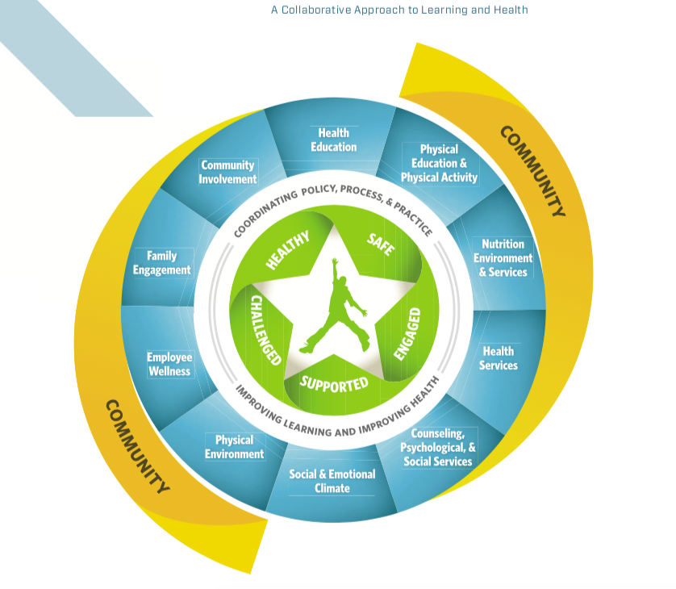
Whole School, Whole Community, Whole Child (WSCC) Model
The WSCC model has 10 components:
Physical education and physical activity
Nutrition environment and services
Health education
Social and emotional climate
Physical environment
Health services
Counseling, psychological and social services
Employee wellness
Community involvement
Family engagement
https://www.cdc.gov/healthyschools/wscc/index.htm
Notes:
The Whole School, Whole Community, Whole Child, or WSCC model is a framework created by the Centers for Disease Control and Prevention (CDC) for addressing health in schools. The WSCC model is student-centered and emphasizes the role of the community in supporting the school, the connections between health and academic achievement, and the importance of evidence-based school policies and practices.
The WSCC model has 10 components. Today we will focus on 3 of them to explore the role they play in helping to prevent and manage infectious diseases within the school community - Health Services, Community Involvement, and Family Engagement.

Slide 4
Partnering With and Within Schools
Every school and school district is unique
Need to understand how schools work
Superintendent is like the CEO
Principal is the key decision maker/gatekeeper
Remember that for schools, primary priority is education
Educational and health cultures differ, as do their priorities
https://www.nasbe.org/how-schools-work-and-how-to-work-with-schools/
Notes:
When partnering with and within schools, it is important to understand that every school and school district is unique. Some important things to understand are:
How your school works
The superintendent is like the CEO
The principal is the key decision maker/gatekeeper
For schools, primary priority is education. When advocating for change, it is important to tie outcomes to the benefit or impact that they will have on education and learning.
Educational and health cultures differ, as do their priorities. You may need to adapt your strategies or goals as you assess the culture and how to meet the unique needs/goals of your school/district.

Slide 5
Partnering With and Within School Districts
Establish personal relationships
School district leadership
With other schools
Identify champions
Establish common goals
Connect your goals to teaching, learning, and academic achievement
Notes:
Some key strategies to partnering with and within school districts include:
Establishing personal relationships within your school/district including with leadership and with other schools. These partnerships can help you to learn from one another and ally on shared goals.
Identify champions to advocate for your goals. Consider a school health professional or school representative who can speak firsthand on an effective strategy and how it has made an impact.
Establish a common goal with and within your school/district. In terms of infectious disease management, keeping students, the adults who care for them, and school professionals healthy and in schools is a goal that most everyone can relate to.
Connect your goals to teaching, learning, and academic achievement to make the case for why new strategies, policy changes, or investments in infrastructure would benefit your school/district.

Slide 6
Health Services
School Nurses
School-Based Health Centers
School Physician
Community Pediatricians
Health Department
Are there others in your community who could partner in helping to prevent and manage infectious diseases in your school?
Notes:
As illustrated in the WSCC model, Health Services play a key role in the framework to help keep students and communities healthy. Health service providers include:
School Nurses
School-Based Health Centers
School Physician
Community Pediatricians
Health Department
Are there other health service providers available in your community who could partner in helping to prevent and manage infectious diseases in your school?

Slide 7
School Nurses
Keep kids healthy and in school
Assist students in finding primary care/medical home
Chronic condition management
Coordinate with the medical home, families, and community
And so much more!
Notes:
School nurses play a vital role in helping to prevent and manage infectious diseases in schools, and they can be a powerful asset in advancing and implementing your plans. Their work helps to keep children healthy and in schools.
Often they can assist students and their families in finding a primary care provider if they do not already have an established relationship.
They help students to manage their chronic conditions while in schools.
They coordinate with a students’ medical home, family, and community services to help keep them healthy.

Slide 8
Partnering with Pediatricians/Medical Home
Keep an updated list of pediatricians in your community
Identify a key contact in the practice
Partner in the care of children with chronic conditions
Reach out about children you are concerned about
Be a liaison to teachers and other staff
If you have a school physician, ask them to help build relationships with community providers
Notes:
It is important for schools to partner with pediatricians and pediatric health care providers in their community. Ways you can organize this include:
Keep an updated list of pediatricians in your community
Identify a key contact in the practice
Partner in the care of children with chronic conditions
Reach out about children you are concerned about
Be a liaison to other teachers and other staff
If you have a school physician, ask them to help build relationships with community providers.

Slide 9
School-Based Health Centers (SBHC)
Benefits
Accessible
Convenient
Integrated
Enhances health services
Less missed class time
Equity:
Financial
Transportation
Work schedules
Types of SBHCs
School-based
School-linked
Mobile
Telehealth
May also offer:
Mental health
Oral health
Sexual health
Notes:
If available, school-based health centers are a valuable asset in supporting the health and well being of students.
Benefits include accessible and convenient services integrated in the school. This helps to enhance the school’s health services and results in less missed class time for students to receive health services outside of the school setting.
SBHCs might be school-based, school-linked, mobile, or available via telehealth.
SBHCs also enhance equitable access to health services by minimizing the financial constrains of families, the need for transportation to attend services, and the disruption to parent/caregiver work schedules to take children to services. They may also offer services to support mental, oral and/or sexual health.

Slide 10
Family Engagement
Ask families what they need
Invite them into the school
Involve them in decision making
Address barriers
Transportation
Language
Work schedules
What are ways you have worked to engage families?
Notes:
A key element of the WSCC model is meaningful engagement of families. The model states that:
“Family and community involvement in schools is important to the learning, development, and health of students. When schools engage families in meaningful ways to improve student health and learning, families can support and reinforce healthy behaviors in multiple settings—at home, in school, in out-of-school programs, and in the community.” – CDC WSCC
Ways that you can approach family engagement include:
Ask families what they need
Invite them into the school
Involve them in decision making
Address barriers
Transportation
Language
Work schedules
What are ways you have worked to engage families?

Slide 11
Family Engagement
Communicate using a variety of methods
Use of school newsletter, web pages, social media, blogs, etc.
Inform and encourage youth, parents, and community members to attend advisory board meetings
Offer materials in other languages for youth and families
Offer consistent health messages from schools and community organizations to families
Translate resources created
https://www.cdc.gov/healthyyouth/protective/pdf/parent_engagement_strategies.pdf
Notes:
Think through an engagement plan that communicates with families and youth in a variety of ways.
Use a variety of outlets like school newsletter, web pages, social media, blogs, etc.
Inform and encourage youth, parents, and community members to attend advisory board meetings
Offer materials in other languages for youth and families
Offer consistent health messages from schools and community organization to families
Make sure messages are translated into the languages used in your community.
Additional tips and strategies can be found in the CDC report title “Parent Engagement – Strategies for Involving Parents in School Health” available at https://www.cdc.gov/healthyyouth/protective/pdf/parent_engagement_strategies.pdf.

Slide 12
Family Engagement: Vaccines
Ask permission to discuss
Listen, listen, listen
Consider framing of the message
Consistent messaging
School nurses/SBHC
Community partners
Be creative and flexible
https://www.frameworksinstitute.org/publication/reframing-the-conversation-about-child-and-adolescent-vaccinations/
Notes:
Thoughtful planning should also be involved when considering how to communicate the value and importance of vaccines to families.
Some tips include:
Ask permission to discuss
Listen, listen, listen
Consider framing of the message
Consistent messaging
School nurses/SBHC
Community partners
Be creative and flexible
Additional strategies can be found in the brief titled “Reframing the Conversation about Child and Adolescent Vaccinations” available at https://www.frameworksinstitute.org/publication/reframing-the-conversation-about-child-and-adolescent-vaccinations/

Slide 13
Community Involvement
Consider involvement and partnerships within your community including:
Pediatricians and Primary Care
Public Health Departments
Social Service Organizations
Universities/Colleges
Hospitals
Park Districts
Who do you partner with in your community?
Notes:
As highlighted in the WSCC model, community involvement plays a key role in advancing the health and well being of children.
As you are thinking about infectious disease management in your community, consider involvement and partnerships within your community including:
Pediatricians and Primary Care
Public Health Departments
Social Service Organizations
Universities/Colleges
Hospitals
Park Districts
Who do you partner with in your community?

Slide 14
School Health Advisory Councils (SHAC)
SHAC could be district-wide or within a school and could include:
School nurses
School physicians
SBHC providers
School staff/administration
Community
Families
Students
Notes:
As we think through building partnerships to help advance the health and well being of students as well as prevent and manage infectious diseases in our school community, we might consider forming a School Health Advisory Council (SHAC). SHACs are a wonderful resource to encourage engagement, receive feedback, address issues, and form plans for how to best serve the school community.
SHACs could be district-wide or within an individual school and could include:
School nurses
School physicians
SBHC providers
School staff/administration
Community
Families
Students

Slide 15
Recap
Every school and school district is unique.
Find common priorities and goals with and within your school and/or district.
Develop relationships and two-way communication with all partners.
Be creative and flexible.
Partner, partner, partner!
Notes:
Let’s recap some of the key messages we have discussed today.
Every school and school district is unique.
Find common priorities and goals with and within your school and/or district.
Develop relationships and two-way communication with all partners.
Be creative and flexible.
Partner, partner, partner!

Slide 16
Case Scenario(s)
Notes:
[Use this slide to share a local case scenario related to topic.]

Slide 17
Develop a list of partners you are already working with.
Are there any partnerships missing from your list?
Develop a list of partnerships you would like to establish.
Contact potential new partners and set up a meeting to discuss collaboration and how to best communicate.
Notes:
What is next:
Develop a list of partners you are already working with.
Are there any partnerships missing from your list?
Develop a list of partnerships you would like to establish.
Contact potential new partners and set up a meeting to discuss collaboration and how to best communicate.

Slide 18
Resources
American Academy of Pediatrics:
School-Based Health Centers and Pediatric Practice. Pediatrics. 2021, 148 (4)
School Health Resources
Managing Infectious Diseases in Schools
Reframing the Conversation about Child and Adolescent Vaccinations
Centers for Disease Control and Prevention (CDC):
Parent Engagement: Strategies for Involving Parents in School Health
Whole School, Whole Community, Whole Child (WSCC)
National Association of State Boards of Education (NASBE) – How Schools Work and How to Work with Schools
School Based Health Alliance
Notes:
Here is a list of articles and useful resources related to forming partnerships to prevent and manage infectious diseases in school settings.

Slide 19
Additional Questions
Contact Agency
Contact Person and Title
Contact Email Address
Contact Phone Number
Notes:
[Use this slide to customize contact information]
If there are further questions, please feel free to reach out to XXX.

