Slide 1
Strategies to Manage Infectious Diseases in K-12 School Settings
Learning Burst
This project is supported by the Healthy Schools Branch, School Response Unit at the Centers for Disease Control and Prevention (CDC). Its contents are solely the responsibility of the American Academy of Pediatrics and do not necessarily represent the official views of the Centers for Disease Control and Prevention of the Department of Health and Human Services.
Notes:
Welcome to this Learning Burst on Strategies to Manage Infectious Diseases in K-12 Schools Settings.
This resource was developed by the American Academy of Pediatrics through support by the Healthy Schools Branch, School Response Unit at the Centers for Disease Control and Prevention (CDC). Its contents are solely the responsibility of the American Academy of Pediatrics and do not necessarily represent the official views of the Centers for Disease Control and Prevention of the Department of Health and Human Services.
This learning burst is intended to provide basic information and practical strategies to prevent and manage infectious diseases in schools.

Slide 2
Learning Outcomes
By the end of this learning burst, participants will be able to:
Identify the most prevalent infectious disease concerns facing school communities.
Describe infectious disease prevention strategies.
Learn strategies for communicating with families and promoting vaccine confidence.
Notes:
By the end of this learning burst, participants will be able to:
Identify the most prevalent infectious disease concerns facing school communities.
Describe infectious disease prevention strategies.
Learn strategies for communicating with families and promoting vaccine confidence.

Slide 3
Why Managing Infectious Diseases Matters
Healthier students are proven better learners.
Children rely on adult caregivers to incorporate and teach them routines and behaviors to help prevent the spread of infectious diseases in schools and at home.
Many preventive strategies are simple, safe, and effective.
Goal: Keeping children and the adults who care for them healthy.
Notes:
As we will discuss during today’s session, keeping children and the adults who care for them healthy is a goal of educators, families, public health officials, and health professionals.
Healthier students are proven to be better learners.
Children learn best when they can attend school in-person. They rely on adult caregivers to incorporate and teach them routines and behaviors to help prevent the spread of infectious diseases including influenza (flu), respiratory syncytial virus (RSV), and COVID-19 in schools and at home.
Many preventive strategies are simple, safe, and effective, allowing you to guard against a variety of potentially serious illnesses.

Slide 4
Infectious Diseases in Schools
Schools are a common place where diseases are rapidly spread into communities
Children from different families spend many hours together in close contact.
Children are less likely to be immune (they are susceptible) to new infections.
Children frequently touch each other and surfaces when playing or interacting.
Children may not be as good at covering coughs or sneezes, washing hands, or refraining from scratching themselves.
Children and adults who work in schools may spread illness to other people in their family.
Notes:
Because of the mixing of students and staff, schools are a common place where diseases are rapidly spread into communities, even to high-risk individuals like grandparents and spouses who may not visit the school setting.
Children from different families spend many hours together in close contact.
Children are less likely to be immune (they are susceptible) to new infections.
Children frequently touch each other and surfaces when playing or interacting.
Children may not be as good at covering coughs or sneezes, washing hands, or refraining from scratching themselves.
Children and adults who work in schools may spread illness to other people in their family.

Slide 5
Infectious Diseases in Schools
Primary means of transmission:
Fomites (touching contaminated surfaces)
Respiratory (shared air, droplets from sneeze or cough)
Contact (touching infectious lesions or body fluids)
Ingestion (consuming contaminated food or drinks)
Having sick people stay home goes a long way to preventing infection!
Notes:
There are several ways that infectious diseases are transmitted in schools:
Fomites (touching contaminated surfaces)
Respiratory (shared air, droplets from sneeze or cough)
Contact (touching infectious lesions or body fluids)
Ingestion (consuming contaminated food or drinks)
Having sick people stay home goes a long way to preventing infection!

Slide 6
Prevention Strategies
Encourage all children and families to:
Get sufficient sleep
Eat nutritious meals
Practice good oral hygiene
Get enough physical activity to keep their bodies healthy
Be an advocate and remind parents about getting their children, and themselves, vaccinated.
Recommend vaccinations to all staff.
Notes:
There are a variety of practical prevention strategies that you can implement and education your school community about.
Encourage all children and families to:
get sufficient sleep
eat nutritious meals
practice good oral hygiene
get enough physical activity to keep their bodies healthy
Be an advocate and remind parents about getting their children, and themselves, vaccinated.
Recommend vaccinations to all staff.

Slide 7
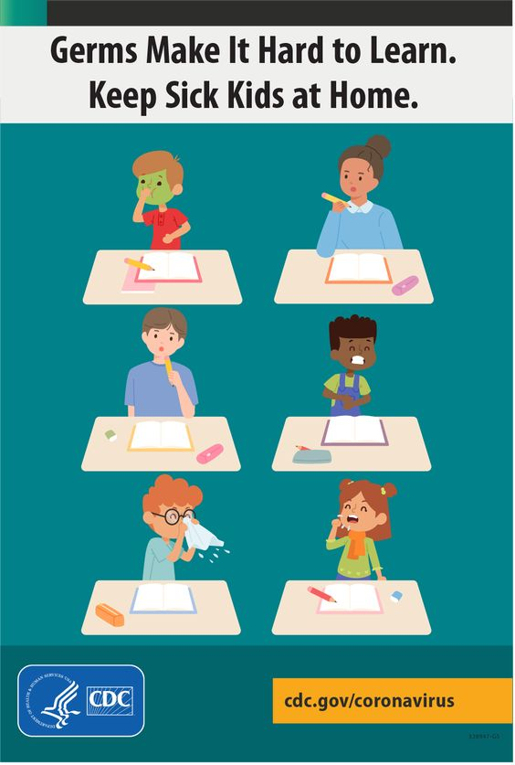
Prevention Strategies
Excuse a child from class if the child has a fever, vomiting, or other symptoms like cough, sore throat, sneezing, or runny nose that prevent them from participating in activities and require extra care.
Have clear attendance rules for students and staff.
Have an emergency plan in place for seasonal viruses and pandemics to help prepare your school community and minimize disruptions to learning.
Notes:
Additional prevention strategies include:
Excuse a child from class if the child has a fever, vomiting, or other symptoms like cough, sore throat, sneezing, or runny nose that prevent them from participating in activities and require extra care.
Have an emergency plan in place for seasonal viruses and pandemics to help prepare your school community and minimize disruptions to learning.

Slide 8
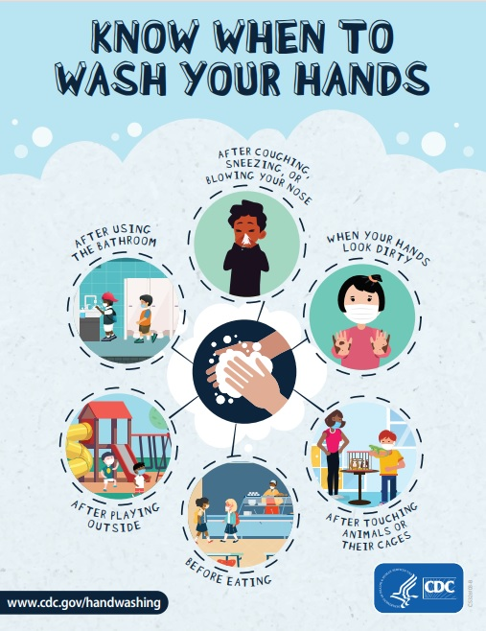
Classroom Infection Prevention and Control Methods
Encourage frequent hand washing to prevent the spread of germs and viruses.
Clean, sanitize, and disinfect surfaces.
Teach children to cough and sneeze in their elbows or into a tissue, then clean hands.
Make sure rooms are well-ventilated.
Handle food safely.
Create a school environment where mask wearing is normal and welcome.
Notes:
There are a variety of Classroom Infection Prevention and Control Methods that your school can employ.
Encourage frequent hand washing to prevent the spread of germs and viruses.
Clean, sanitize, and disinfect surfaces.
Teach children to cough and sneeze in their elbows or into a tissue. They should clean hands afterwards.
Make sure rooms are well-ventilated.
Handle food safely.
Create a school environment where mask wearing is normal and welcome. Consider making masks available to students and school professionals who wish to wear one.

Slide 9
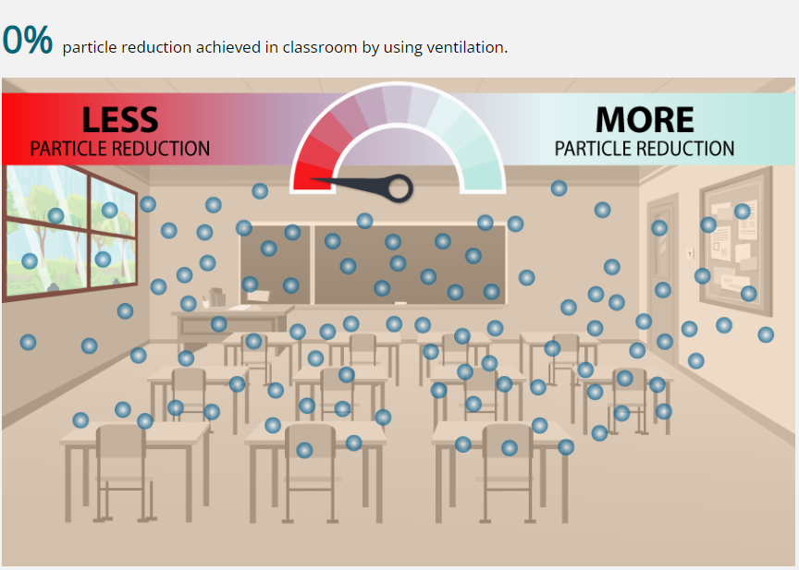
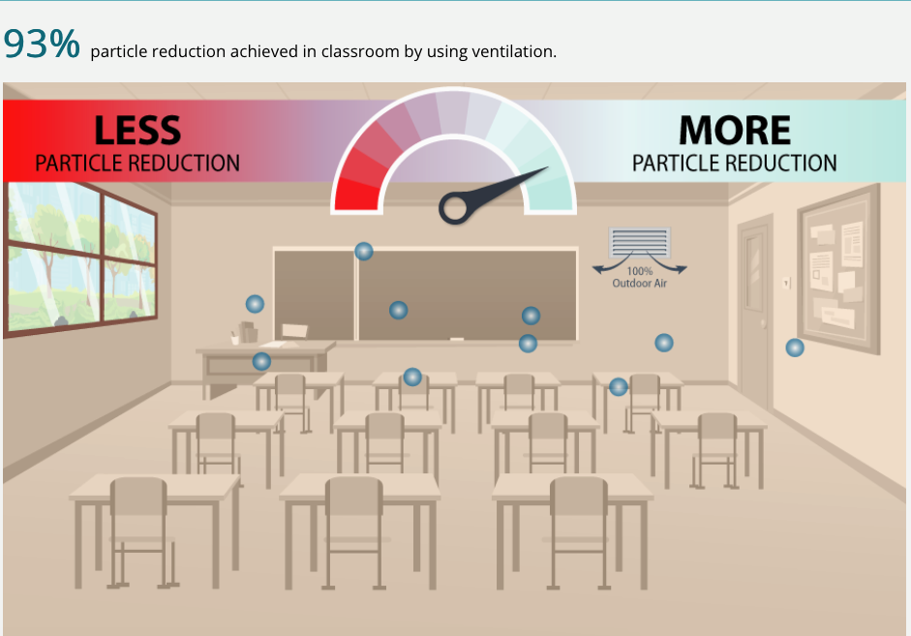
Ventilation Plays an Important Role in Healthy School Environments
CDC: Interactive School Ventilation Tool https://www.cdc.gov/coronavirus/2019-ncov/community/schools-childcare/interactive-ventilation-tool.html
Notes:
Small particles that people breathe out can contain virus particles. Proper ventilation can help prevent virus transmission in schools.
Some tips for good ventilation in schools include:
Make sure the ventilation systems are clean, serviced regularly, and meeting code requirements.
Set the HVAC fan control from “Auto” to “On” to ensure there is a continuous air filtration and distribution.
Use outdoor air (not recycled) when possible.
The CDC: Interactive School Ventilation Tool is a useful resource to help see how implementing different ventilation strategies could help improve air quality in your school. https://www.cdc.gov/coronavirus/2019-ncov/community/schools-childcare/interactive-ventilation-tool.html

Slide 10
Framing Discussions about Vaccines
Talk about the benefits of vaccination for the common good.
Talk about improving vaccination access as a preventive public health measure.
Focus on how vaccines are beneficial to child and adolescent long-term health and wellbeing.
Use a computer updates metaphor to explain how the immune system improves its performance through vaccination.
Use a literacy metaphor to explain how the immune system learns how to respond to viruses through vaccination.
https://www.frameworksinstitute.org/publication/reframing-the-conversation-about-child-and-adolescent-vaccinations/
Notes:
The American Academy of Pediatrics, in partnership with FrameWorks Institute, commissioned a study concluding in five evidence-based recommendations for communicating about vaccinations, The purpose of this brief is to equip physicians, advocates, and public health communicators with the strategies necessary to effectively build understanding of and support for child and adolescent vaccinations. The recommendations are outlined on this slide and include:
Talk about the benefits of vaccination for the common good.
Talk about improving vaccination access as a preventive public health measure.
Focus on how vaccines are beneficial to child and adolescent long-term health and wellbeing.
Use a computer updates metaphor to explain how the immune system improves its performance through vaccination.
Use a literacy metaphor to explain how the immune system learns how to respond to viruses through vaccination.

Slide 11
Case Scenario(s)
Notes:
[Use this slide to share a local case scenario related to topic.]

Slide 12
Recap
Keeping children and the adults who care for them healthy is the goal.
Infection prevention strategies including hand washing, vaccination, and school exclusion, when necessary, help keep students and staff in the learning environment.
Ventilation is a win for everyone.
Have a plan and know it can be implemented.
Notes:
Let’s review what we learned about managing infectious diseases in schools.
Above all else, keeping children and the adults who care for them healthy is the goal.
Infection prevention strategies including hand washing, vaccination, and school exclusion, when necessary, help keep students and staff in the learning environment.
Ventilation is a win for everyone.
Have a plan for preventing and managing infectious diseases and know how it can be implemented.

Slide 13
Review the school’s current infectious disease prevention strategies/policies.
Identify where improvements can be made.
Identify who to contact to discuss improvements.
Set up a meeting!
Notes:
What are your next steps?
Review your school’s current infectious disease prevention strategies/policies.
Identify where improvements could me made.
Identify who to contact to discuss improvements.
Set up a meeting to make recommendations.

Slide 14
Resources
American Academy of Pediatrics (AAP):
School Health Resources
Managing Infectious Diseases in Schools
Managing Infectious Diseases in Child Care and Schools, 6th Edition
Centers for Disease Control & Prevention (CDC):
Infection Control
Healthy Schools
School Preparedness
HealthyChildren.org Resources for Parents:
Immunizations
Disease Prevention
Conditions
Notes:
Here is a list of articles and useful resources on the prevention and management of infectious diseases in school settings.

Slide 15
Additional Questions
Contact Agency
Contact Person and Title
Contact Email Address
Contact Phone Number
Notes:
[Use this slide to customize contact information]
If there are further questions, please feel free to reach out to XXX.

