Slide 1
The National Center for a System of Services for CYSHCN Title V Virtual Cafes Ask the Experts: Medical Home NPM Friday March 8, 2024m 12-1pm CT/1-2pm ET
The National Center for a System of Services for CYSHCN is supported by the Health Resources and Services Administration (HRSA) of the U.S. Department of Health and Human Services (HHS) as part of an award totaling $1,500,000 with no funding from nongovernmental sources. The information or content are those of the author(s) and do not necessarily represent the official views of, nor an endorsement, by HRSA, HHS or the U.S. Government.
Notes:
Welcome to our 2nd virtual café for title v programs hosted by the ….
I’m Janine….
HRSA…

Slide 2
Housekeeping
All participants have been muted
Utilize chat box to share comments, questions, or relevant resources
Utilize hand raising feature during discussion portion
Rename yourself to include your name and state
Direct chat AAP staff with technical issues
Notes:
Janine

Slide 3
Session Objectives
Describe how the medical home universal performance measure is measured in the National Survey of Children’s Health, including the composite measures and its five components.
Understand how Title V population health activities to advance medical home align with/advance the Blueprint for Change strategies.
Notes:
Janine

Slide 4
Session Agenda
Introduction
National Center for a System of Services for CYSHCN
Why Medical Home? Why does this matter for advancing the Blueprint for Change?
Overview of Medical Home NPM and Q&A
Discussion/Peer Sharing
Closing/Evaluation Poll
Notes:
Janine

Slide 5
National Center for a System of Services for CYSHCN (aka Blueprint National Center)
Goal: To advance and strengthen the system of services for CYSHCN and their families/caregivers at the community, state, and national levels by leading the field to promote health care and other supports that are integrated, family-centered, evidence-informed, and culturally responsive.
What We Do
One-on-one technical assistance
Tools
Training
Strategies
Connections to peers and experts
Notes:
The National Center is a group of organizations working collaboratively to support state Title V programs and their allies in their efforts to advance the Blueprint for Change. We provide one-on-one technical assistance, tools, training, strategies, expert and peer connections to improve equity, access, quality of life, and financing in the systems that serve children and youth with special health care needs (CYSHCN) so they can flourish throughout the lifespan

Slide 6
Ask the Experts: Medical Home NPM
Presented by:
Dennis Z. Kuo, MD, MHS, FAAP, University of Rochester Medical Center/Golisano Children’s Hospital
Keriann Uesugi, PhD, MPH, Division of State and Community Health, MCHB
Notes:
Janine

Slide 7
Why Medical Home Matters
Care that is accessible, family-centered, continuous, comprehensive, coordinated, compassionate, culturally effective
Standard of care for all children, including CYSHCN
Key driver of comprehensive system of services for CYSHCN
New universal National Performance Measure (NPM) for Title V Programs
Focus on access and quality of primary and preventive care
Intended to drive improvement in CYSHCN systems of care National Outcome Measure (NOM)
NPM is derived from lived experience reported by families
https://www.aap.org/en/practice-management/medical-home/medical-home-overview/what-is-medical-home
Notes:
Speaker: Dennis

Slide 8
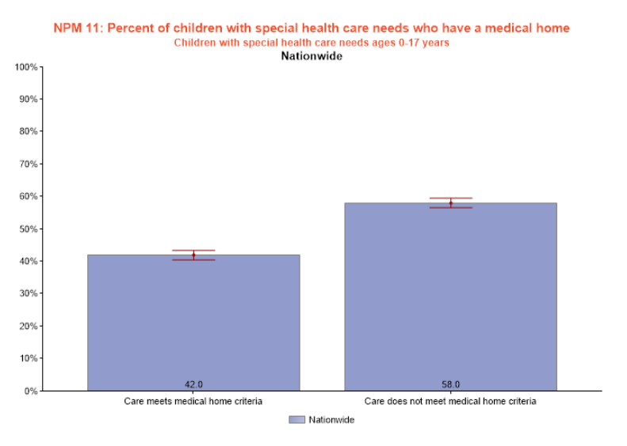
Notes:
Speaker: Dennis
Let’s look at the data. This is from the 2020-2021 NSCH, showing that less than half of CYSHCN receive care in a medical home.
It’s important to remember that NSCH data is based on parent responses.
The Data Resource Center for Child and Adolescent Health has an interactive data query application that allows you to look at data by NPM, NPM, and by each of the components that make up the medical home NPM. You can search nationally and by your state, and filter the data by populations such as CYSHCN.

Slide 9
Population Health
Population health
Intends to improve health and wellbeing of an entire group or subgroup.
Strategies occur at the policy or systems level and are measurable over time.
Designed to improve health equity and often focus on social and environmental factors.
Medical Home is not a building or a place; it extends beyond the walls of a clinical practice, including partnerships with specialists, families, and community resources – and thus is a population health strategy.
Notes:
Dennis

Slide 10
Population Health and Medical Home
Example population health strategies around medical home:
Practice transformation to support population health and targeted case management
Community referral system for families and providers
Statewide registry to track screening and provide feedback to providers across sectors
Language access and cultural responsiveness across sectors
Workforce development to navigate sectors and support the comprehensive care of the medical home
Notes:
Dennis

Slide 11
Connection to the Blueprint for Change
Medical Home Implementation Advances the Blueprint for Change
A Title V program supports access to non-emergency medical transportation through Medicaid for CYSHCN medical appointments.
Blueprint: Access to care, financing, equity
Medical home: Accessible, family-centered, coordinated
A Title V program provides training for pediatric providers on disability justice and anti-ableism.
Blueprint: Access to care, equity, quality of life
Medical home: culturally effective, accessible, compassionate, family centered
Notes:
Speaker: Dennis
(after this slide – Keriann will share her slides for her portion)

Slide 12
Discussion Questions
If you have been choosing medical home as an NPM for your state:
What strategies can you share and how do they align with the Blueprint (health equity, access, financing, QoL)?
What challenges have you encountered?
If you will be choosing medical home as an NPM for the first time, what challenges do you anticipate and/or what questions do you have as you embark on this work?
Notes:
Janine

Slide 13
Discussion Questions
Family centered care is an important component of the medical home measure. How have your states integrated the expertise of families/caregivers into your medical home efforts, or how might you plan to do so in the future?
What tools/resources might be helpful to your state as you consider implementing strategies around medical home?
Notes:
Janine

Slide 14
Any other questions?
Notes:
Janine

Slide 15
Contact us!
Blueprint4CYSHCN@aap.org
National Center for a System of Services for CYSHCN Web site
Subscribe to the National Center for a system of services for CYSHCN listserv to get access to valuable resources, event notifications, and so much more!
Notes:
Janine

Slide 16
Virtual Café Evaluation Survey
Notes:
https://www.surveymonkey.com/r/2024BlueprintVirtualCafe2

