Slide 1
The National Center for a System of Services for CYSHCN Title V Virtual Cafes Friday February 23rd 12-1pm CT/1-2pm ET
The National Center for a System of Services for CYSHCN is supported by the Health Resources and Services Administration (HRSA) of the U.S. Department of Health and Human Services (HHS) as part of an award totaling $1,500,000 with no funding from nongovernmental sources. The information or content are those of the author(s) and do not necessarily represent the official views of, nor an endorsement, by HRSA, HHS or the U.S. Government.

Slide 2
Housekeeping
All participants have been muted
Utilize chat box to share comments, questions, or relevant resources
Utilize hand raising feature during discussion portion
Rename yourself to include your name and state
Direct chat AAP staff with technical issues

Slide 3
Agenda
Introduction to the Blueprint National Center and Virtual Café
Overview of the National Survey of Children’s Health (NSCH)
Accessing the NSCH data on the Data Resource Center website
Completing the well-functioning system of services worksheet
State Spotlight: Illinois Title V’s Ebonie Zielinski
Discussion and Q&A
Evaluation Survey

Slide 4
Blueprint for Change and the National Center for a System of Services for CYSHCN
A National Framework for a System of Services for CYSHCN
Federal vision to advance the system of services for CYSHCN over the next 15 years.
Four critical areas: health equity, quality of life/well-being, financing, access
Blueprint goal in plain language: Every child gets the services they need, so that they can play, go to school, and grow up to become a healthy adult. (And so grown-ups and siblings can thrive too.)
Focuses on measuring what matters to families
Blueprint National Center Consortium
American Academy of Pediatrics (lead)
Family Voices
Got Transition
Boston University/Catalyst Center

Slide 5
National Center for a System of Services for CYSHCN (aka Blueprint National Center)
Goal: To advance and strengthen the system of services for CYSHCN and their families/caregivers at the community, state, and national levels by leading the field to promote health care and other supports that are integrated, family-centered, evidence-informed, and culturally responsive.
What We Do
One-on-one technical assistance
Tools
Training
Strategies
Connections to peers and experts

Slide 6
Title V Virtual Cafés
Series of 1-hour virtual cafes hosted by the Blueprint National Center
Virtual cafe objectives
Addressing the needs of Title V CYSHCN programs related to advancing the Blueprint for Change
Providing a space for peer-to-peer sharing/learning/networking
Connection to the Blueprint National Center
Let us know what you want to get out of these virtual cafes!

Slide 7
Integrating the Blueprint Into Your Needs Assessment | Part 1: Understanding How to Use NSCH Data
Presented by Got Transition
Samhita Ilango, MSPH and Peggy McManus, MHS
silango@thenationalalliance.org
mmcmanus@thenationalalliance.org

Slide 8
NSCH Overview
The National Survey of Children’s Health (NSCH) is a national, parent-reported survey funded and directed by the Health Resources and Services Administration’s Maternal and Child Health Bureau (HRSA MCHB)
It is designed to produce national and state-level data on the physical and emotional health of children 0-17 years old in the US
It collects information related to the health and well-being of children, including access to and use of health care, family interactions, parental health, school and after-school experiences, and neighborhood characteristics
It provides estimates for 19 Title V Maternal and Child Health Services Block Grant National Outcome and Performance Measures, and data for each state’s Title V needs assessment

Slide 9
NSCH Overview – Frequency
Since 2016, the NSCH has been an annual survey.
The survey supports national estimates every year and state-level estimates by combining 2 or 3 years of data.
Before 2016, the survey was conducted every 4 years.
For the 2022 survey, data were collected from July 2022 to January 2023.

Slide 10
NSCH Overview – Survey Participants
In 2022, a sample of approximately 360,000 addresses was selected from the Census Master Address File
Households were randomly contacted by mail to identify those with one or more children under 18 years old.
Number of surveys completed in 2022:
Approximately 125,000 households were screened for age-eligible children in sampled addresses
67,269 children reported on completed screeners
54,103 child-level topical questionnaires completed (state ranges from 688 to 4,724)
13,016 of topical questionnaires completed on CSHCN
Survey data were weighted to represent the population of non-institutionalized children ages 0-17 who live in housing units nationally and in each state.

Slide 11
NSCH Overview – Data Collection
Households received a mailed invitation asking an adult in the household who is familiar with the child’s health and health care (usually a parent) to complete a short screener questionnaire (via web or paper).
If a child (or children) was reported to live in the household, participants who chose to respond online were immediately directed to a more detailed, age-specific topical questionnaire for one randomly selected child
Participants also had an option to complete a paper version of the screener and topical questionnaire.
Telephone questionnaire assistance was available to complete the survey over the phone.
The NSCH screener and topical questionnaires were available in both English and in Spanish.

Slide 12
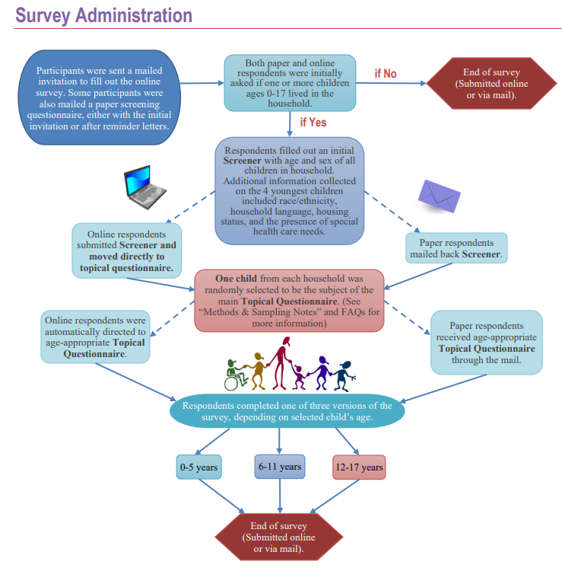
Source: https://www.childhealthdata.org/docs/default-source/nsch-docs/2022-nsch-sampling-and-administration_cahmi.pdf
Notes:
Source: https://www.childhealthdata.org/docs/default-source/nsch-docs/2022-nsch-sampling-and-administration_cahmi.pdf

Slide 13
NSCH Overview - Screener
A screener instrument identifies households with children.
The screener questionnaire included a series of health questions (next slide) used to determine whether each eligible child could be classified as having a special health care need. One eligible child from each completed screener questionnaire was subsampled.
When subsampling CSHCN were oversampled (at 80%)
The Screener data file must be used to estimate the proportion of households with CSHCN and the prevalence estimates at the state and national levels.

Slide 14
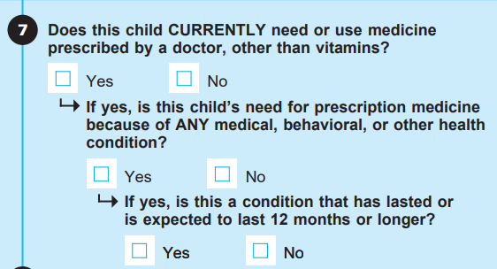
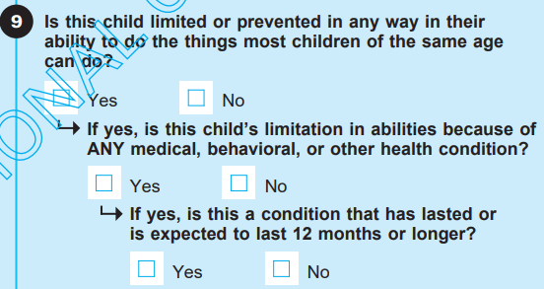
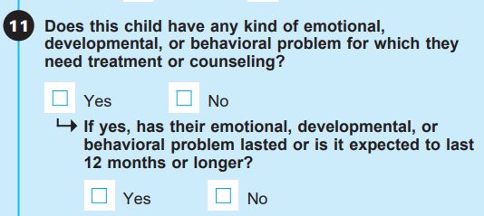
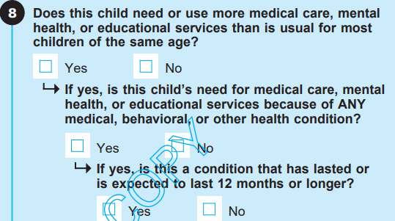
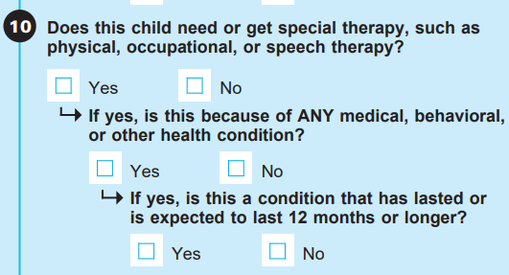
In order for a child to meet CSHCN Screener criteria for having a special health care need, all three parts of at least one screener question (or in the case of question 5, the two parts) must be answered “YES”
Source: https://www.census.gov/content/dam/Census/programs-surveys/nsch/tech-documentation/questionnaires/2022/NSCH-S1.pdf
Notes:
In order for a child to meet CSHCN Screener criteria for having a special health care need, all three parts of at least one screener question (or in the case of question 5, the two parts) must be answered “YES” Source: https://www.census.gov/content/dam/Census/programs-surveys/nsch/tech-documentation/questionnaires/2022/NSCH-S1.pdf

Slide 15
DRC Website
The Data Resource Center takes the results from the NSCH and makes them easily accessible to parents, researchers, community health providers and anyone interested in maternal and child health
Data on this site are for the nation and each of the 50 states plus the District of Columbia.
On the site, state and national data can be further refined to assess differences by race/ethnicity, income, type of health insurance, and a variety of other important demographic and health status characteristics

Slide 16
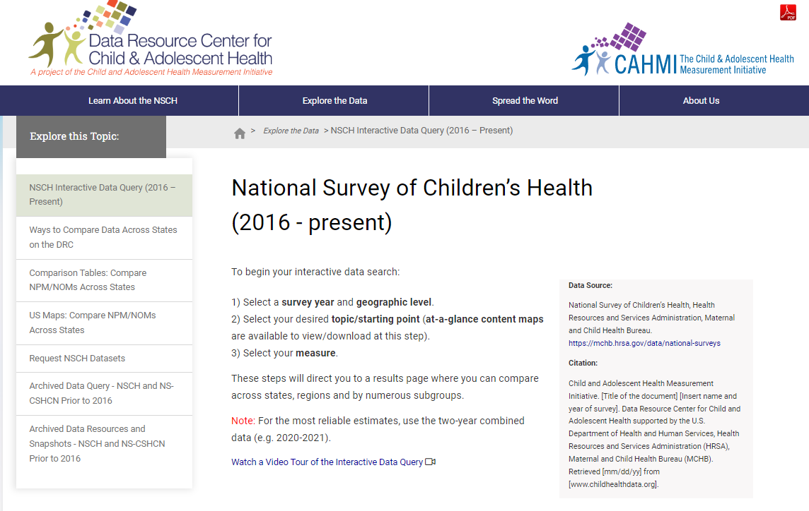
DRC Website – childhealthdata.org
The DRC can be contacted at: info@cahmi.org
Source: childhealthdata.org
Notes:
Source: childhealthdata.org

Slide 17
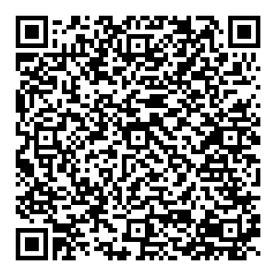
Completing the Worksheet: Aligning your work with the Blueprint for Change for CYSHCN
Source: https://www.aap.org/en/patient-care/national-center-for-a-system-of-services-for-children-and-youth-with-special-health-care-needs/aligning-your-work-with-the-blueprint-for-change-for-cyshcn/
Notes:
Worksheet: https://www.aap.org/en/patient-care/national-center-for-a-system-of-services-for-children-and-youth-with-special-health-care-needs/aligning-your-work-with-the-blueprint-for-change-for-cyshcn/

Slide 18
State Spotlight – Illinois Title V
Dr. Ebonie Zielinski is the Assistant Director of Research and Practice Initiatives for the Division of Specialized Care for Children, Illinois' Title V CYSHCN program. Ebonie's role is to increase the efficacy of population health strategies and programs across the state for CYSHCN while increasing the voices of CYSHCN and their families, especially those from marginalized populations.
Contact Ebonie: ewrigh6@uic.edu

Slide 19
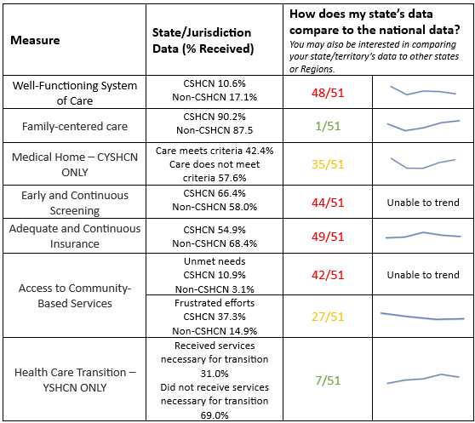
Illinois Title V Results – System of Services Data Table

Slide 20
Discussion Questions
Have states looked at NSCH data in their thinking about the Blueprint?
What are some examples of how you are using/planning to use NSCH data to identify gaps and opportunities for CYSHCN related to Blueprint domains?
How are states blending the work with their CYSHCN National Performance Measures with the overlay of the Blueprint domains?
What are some specific TA needs you have with using the NSCH?

Slide 21
Any other questions?

Slide 22
Virtual Café Evaluation Survey
Notes:
https://www.surveymonkey.com/r/2024BlueprintVirtualCafes

