Slide 2
Case #1: Dennis
Setting: Continuity Clinic
You are conducting a well-child visit for a 6-year-old male you have seen once before, Dennis. When you ask where Dennis is attending 1st grade and his mother immediately becomes distressed.
She tells you he has previously been “kicked out” of 2 classrooms for fighting. In the exam room, she frequently criticizes Dennis as she relays the history of his problems and periodically gives orders to him in an angry tone of voice.

Slide 3
Case #1: Dennis
Have you seen a child like this before?
If so what did you do?
What could be going on?
Is this common?

Slide 4
Goals & Objectives
Goal: | Utilize evidence-based approaches to engage patients and families in managing mental health concerns
Objective 1: | Explain the importance of addressing mental health concerns in children and adolescents and the rationale for doing so in primary care.
Objective 2: | Discuss strategies to integrate mental health into primary care for each stage of a child’s emotional development.

Slide 5
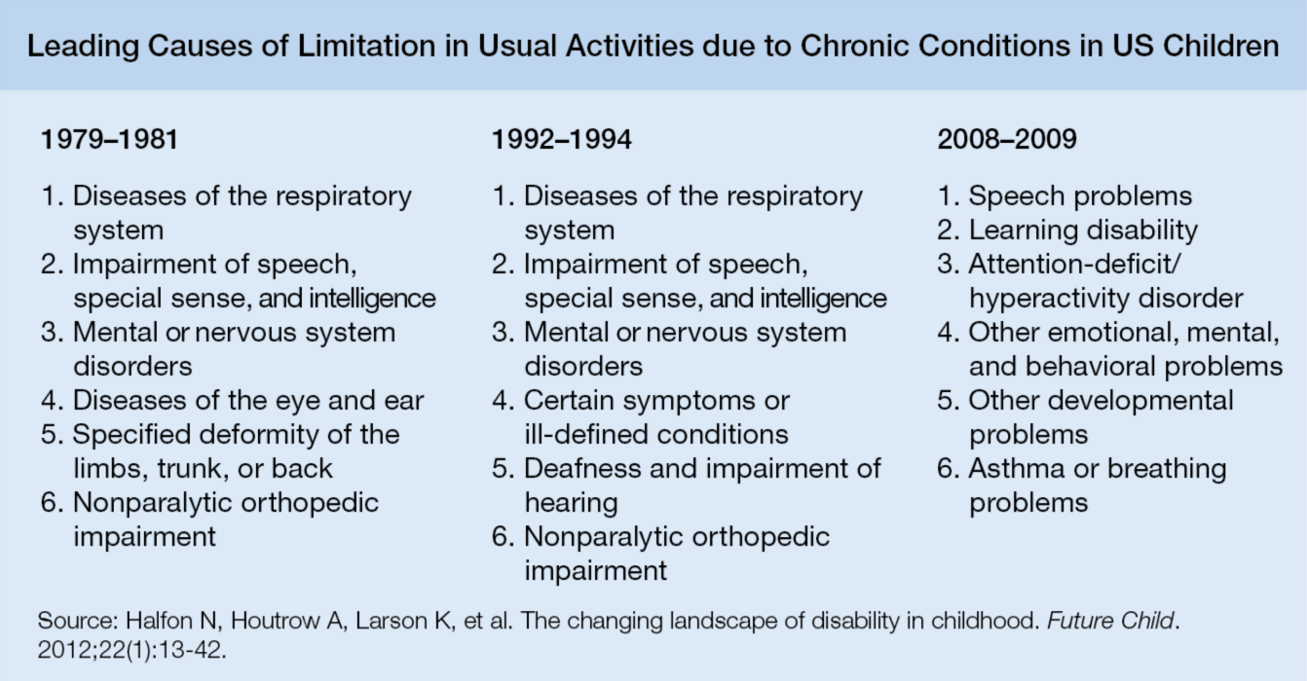
From: Chronic Mental Health Issues in Children Now Loom Larger Than Physical Problems
JAMA. 2012;308(3):223-225. doi:10.1001/jama.2012.6951
Figure Legend:
For the first time in more than 30 years, mental health conditions have displaced physical illnesses as the top 5 disabilities in US children. Nearly 8% of children have an activity-limiting disability.
Date of download: 8/13/2013
Copyright © 2012 American Medical Association. All rights reserved.

Slide 6
Barriers to care for children with mental health concerns

Slide 7
Barriers to Care for Children With Mental Health Concerns
While 1 in 5 children suffer from a diagnosable mental health disorder, only 21% of affected children actually receive needed treatment
In addition to children with diagnosable disorders, many children in the US have mental health symptoms that do not rise to the level of a disorder
2006 study estimated need for 30,000 child psychiatrists in US, but only 6,300 in practice
Average wait time for families to see a developmental pediatric specialist is 14.5 weeks, 7.5 weeks for child and adolescent psychiatry
Enhancing Pediatric Mental Health Care: Report from the American Academy of Pediatrics Task Force on Mental Health, 2010, Supplement 3; Thomas, 2006; www.aap.org/mentalhealth

Slide 8
The “Primary Care Advantage”
Longitudinal, trusting relationship
Family centeredness
Unique opportunities for prevention & anticipatory guidance
Understanding of common social-emotional & learning issues in context of development
Experience in coordinating with specialists in the care of children with special health care needs
The Future of Pediatrics: Mental Health Competencies for Pediatric Primary Care, PEDIATRICS, 124(1), July 2009.
Notes:
8

Slide 9
What mental health care can be provided in a medical home?

Slide 10
Mental Health Care in the Medical Home
Prevention and health promotion
Screening, risk assessment
Early intervention
Recognition
Plan a diagnostic assessment
Treatment
Alliance building
Management, co-management, community service provider referral

Slide 11
Review of Dennis’ First Year of Life
You look back at the well baby notes from Dennis’ 6 month visit. The provider noted Dennis to have excessive irritability with difficult in calming.
Mom would complain about his inability to sleep through the night. The pediatrician also noted that Dennis did not seem to brighten when mom engaged him or quiets with her soothing.

Slide 12
Identifying Mental Health Concerns in Primary Care: Early Infancy
Stage of Development & Developmental Tasks | Prevention/Health Promotion | Early Identification
Secure attachment Emotional regulation Appropriate conduct | Ask and counsel about temperament and sensory processing Observe maternal-child interaction and assess quality of attachment Ask about psychosocial risk factors and a family history of mental health or substance abuse problems | Screening of Child: Ages & Stages Questionnaire: Social-Emotional Screening of Environment Edinburgh Postpartum Depression Scale Parent Health Questionnaire Abuse Assessment Screen Multidimensional Scale of Perceived Social Support Caregiver Strain Questionnaire Bright Futures Surveillance Questions Consider dyadic therapy if there is a disruption in attachment or maternal depression
Bright Futures, 3rd edition; Strategies To Support the Integration of Mental Health Care into Pediatric Primary Care, NIHCM report, 2009

Slide 13
Symptoms in Infancy of Challenges to Emotional Well-Being
Poor eye contact
Lack of smiling or brightening on seeing parent
Lack of vocalizations
Not quieting with parent’s voice
Not turning to sound of parent
Lack of mouthing objects
Dysregulation in sleep
Sad or somber facial expression
Excessive irritability with difficult in calming

Slide 14
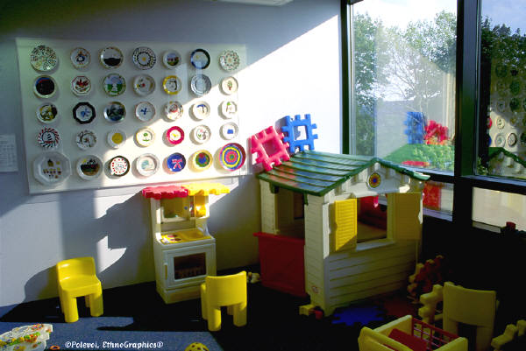
Additional Chart Review
Looking back through your notes from Dennis’ 4 year-old visit you remember his mother had told you he had been “kicked out” of 2 child care centers for fighting.
Your notes also indicate that during the visit Dennis’ mother criticized Dennis as she relayed the history of his problems and periodically gave him orders to him in an angry tone of voice.

Slide 15
Identifying Mental Health Concerns in Primary Care: Early Childhood (12 months to 4 years)
Stage of Development & Developmental Tasks | Prevention/Health Promotion | Early Identification
Secure attachment Emotional regulation Appropriate conduct | Ask about how the child behaves, identify strengths Ask about how the child plays & acts around other children Anticipatory guidance on discipline, praise, & role modeling good behavior | General Psychosocial: Early Childhood Screening Assessment Ages & Stages Questionnaire: Social-Emotional Modified Checklist for Autism in Toddlers Mental Health Assessment Child Behavior Checklist Behavior Assessment System for Children Spence Children’s Anxiety Scale Brief Infant Toddler Social Emotional Assessment Caregiver-Teach Report Form Identify behavioral concerns in the home and child care setting using behavioral checklists.
Bright Futures, 3rd edition; Strategies To Support the Integration of Mental Health Care into Pediatric Primary Care, NIHCM report, 2009

Slide 16
Other Potential Behavioral Concerns That Dennis May Exhibit During This Time
Bedtime struggles
Feeding difficulty (picky eaters)
Resistance to toileting
Excessive temper tantrums
Chronic aggression
Difficulty in forming friendships
Excessive anxiety
Excessive activity and impulsivity

Slide 17
Identifying Mental Health Concerns in Primary Care: Middle Childhood: Dennis at age 6 (5 to 10 years)
Stage of Development & Developmental Tasks | Prevention/Health Promotion | Early Identification
Learning reading, writing, & math Attending and behaving appropriately in school Empathy Getting along with peers Self-efficacy | Conduct surveillance and targeted screening for behavioral concerns using checklists Identify protective factors Screen for bullying Education on substance use & abuse | General Psychosocial: Pediatric Symptom Checklist Strengths and Difficulties Questionnaire Mental Health Assessment SDQ Impact Scale Adapted-SAD PERSONS Child Behavior Checklist Vanderbilt Diagnostic Rating Scales Short Mood and Feelings Questionnaire SCARED – Self-Report for Childhood Anxiety Related Emotional Disorders *This is NOT a comprehensive list. For a list of screening and assessment tools: www.aap.org/mentalhealth/screeningchart
Bright Futures, 3rd edition; Strategies To Support the Integration of Mental Health Care into Pediatric Primary Care, NIHCM report, 2009

Slide 18
What if Dennis First Presented With These Concerns in Middle Childhood?
Learning disabilities and ADHD
Anxiety disorders
Mood disorder
Early substance use
Conduct disturbances
Notes:
18

Slide 19
Case #1: Back to Dennis
Setting: Continuity Clinic
You are conducting a well-child visit for a 6-year-old male you have seen once before, Dennis. When you ask where Dennis is attending 1st grade and his mother immediately becomes distressed.
She tells you he has previously been “kicked out” of 2 classrooms for fighting. In the exam room, she frequently criticizes Dennis as she relays the history of his problems and periodically gives orders to him in an angry tone of voice.

Slide 20
Back to Dennis at Age 6: Assessment of His Aggression
What do you want to know?

Slide 21
Back to Dennis at Age 6: Assessment of His Aggression
Detailed history about the behavior in question
Developmental/Health Status
Temperament and Sensory Processing
Family-Child Interactions
Other Environmental Influences

Slide 22
Back to Dennis at Age 6: Assessment of His Aggression
Detailed history about the behavior in question
Kicking other children
Developmental/Health Status
No physical issues, mild expressive language delay
Temperament
Often impulsive, difficulty sleeping when at his grandmother’s or father’s house
Family-Child Interactions
History of maternal depression, occasionally spanked
Other Environmental Influences
No domestic violence, but gangs are prevalent in neighborhood

Slide 23
Early Identification – Diagnostic Assessment
Identify strengths (eg, mother’s help-seeking, child’s physical health, extended family involvement…)
Administer ASQ-SE or other screening tools
List of screening & assessment tools: www.aap.org/mentalhealth/screeningchart
Explore positive findings, behavioral triggers.
Screen for social stressors / maternal depression
Notes:
23

Slide 24
Discuss Therapy
1st step is building a therapeutic relationship using common factors
Follow up appointment to discuss results from further diagnostic assessment and behavioral counseling
Consider referral for play therapy or family counseling after further assessment performed
Co-management strategies
Notes:
24

Slide 25
Traditional Approach
Surveillance / Screening
Diagnose
Refer
OR
Treat
Treat or Co-Treat
Monitor
Response

Slide 26
Common Factors Approach
Surveillance / Screening
Collaborate with family to define problem
Establish initial plan
Monitor response
Continue to support Family
Resolution
Diagnose
OR
Refer
Treat
Treat or Co-Treat
Monitor
Response

Slide 27
Take-Home Message
Pediatric mental health concerns are prevalent and need to be addressed in the medical home
Promotion, prevention, early identification, treatment
A common factors approach can help facilitate this process
Monitor each stage of a child’s emotional development in the exam room with history taking, health promotion, observation, and screening tools
Notes:
27

Slide 29
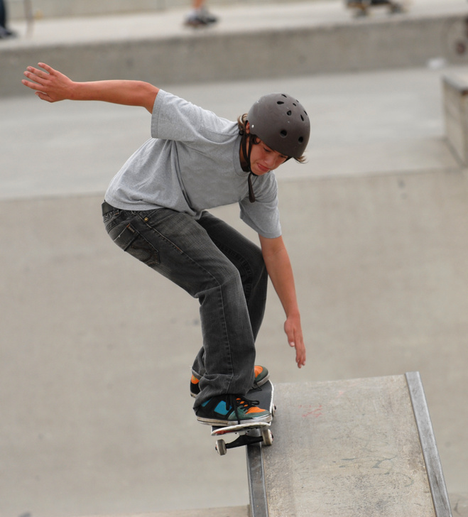
Case #2: Jake
Jake is a 15-year-old male diagnosed with asthma as a preschooler. He has maintained excellent control of his intermittent asthma symptoms through the use of albuterol as needed. He has managed his exercise-induced symptoms by pretreating before physical activity, including PE class.
In the last month, Jake has been experiencing more asthma symptoms. His mother was called at work today to pick him up from school due to wheezing. She has brought Jake to your clinic. He is your next patient.

Slide 30
Visit With Jake & His Mother
Upon entering the room, you observe Jake and his mother sitting side-by-side but angled away from each other.
The mother interrupts your attempts to ask Jake questions directly. She states that she doesn’t believe he is taking his albuterol as he is supposed to and is now missing PE class because of shortness of breath.
Jake rolls his eyes, moans, and turns further away from his mother and begins playing on his cell phone.

Slide 31
Visit With Jake & His Mother
What goal(s) do you have for this visit?

Slide 32
Goals & Objectives
Goal: | Utilize evidence-based approaches to engage patients and families in managing mental health concerns
Objective 1: | Summarize the importance of establishing alliance (physician-patient-family) as a platform for providing mental health care in the medical home.
Objective 2: | Incorporate the common factors approach as a tool for facilitating communication with families about mental health concerns and other pediatric issues.

Slide 33
Identifying Mental Health Concerns in Primary Care: Adolescence (11 to 21 years)
Stage of Development & Developmental Tasks | Prevention/Health Promotion | Early Identification
Healthy physical development Intellectual development & critical thinking skills Self-esteem Positive relationships with peers & family Attachment to social institutes | Ask about: stress & coping mechanisms mood & worries Relationships at home & with peers Smoking, alcohol, & drug usage (including misuse of prescription drugs) | Surveillance & General Psychosocial: HEADSSS Pediatric Symptom Checklist Strengths and Difficulties Questionnaire CRAFFT Mental Health Assessment Child Behavior Checklist Children’s Revised Impact of Event Scale SCARED – Self-Report for Childhood Anxiety Related Emotional Disorders Patient Health Questionnaire for Adolescents Short Mood and Feelings Questionnaire *This is NOT a comprehensive list. For a list of screening and assessment tools: www.aap.org/mentalhealth/screeningchart
Bright Futures, 3rd edition; Strategies To Support the Integration of Mental Health Care into Pediatric Primary Care, NIHCM report, 2009

Slide 34
Establishing Alliance
Advice alone is not enough
< 50% of psychosocial concerns disclosed
< 50% of mental health referrals kept
< 50% of children who start mental health treatment finish

Slide 35
Establishing Alliance
Step 1: Assure all parties feel heard and understood
Step 2: Seek agreement on a working formulation of the problem
Step 3: Establish a plan and offer advice after obtaining permission to do so

Slide 36
Common Factors Approach:
Tools for Alliance Building
H | Hope
E | Empathy
L² | Language Loyalty
P³ | Permission Partnership Plan

Slide 37
Common Factors Review
H | Hope: for improvement, identify strengths
E | Empathy: listen attentively
L² | Language: use family’s language, check understanding Loyalty: express support and commitment
P³ | Permission: ask permission to explore sensitive subjects, offer advice Partnership: identify and overcome barriers Plan: establish plan or at least a first step family can do

Slide 38
Alliance Building & Common Factors Case #2: Jake
Step 1: Assuring Jake and his mother both feel heard and understood
Incorporating Hope, Empathy, Language and Loyalty, how would you begin approaching this situation?
What would you say next?

Slide 39
Alliance Building & Common Factors Case #2: Jake
Step 1: Assuring Jake and his mother both feel heard and understood
Construct an open-ended question for Jake to begin exploring his concerns and thoughts about his mother’s accusation.

Slide 40
Alliance Building & Common Factors Case #2: Jake
In addition to using open-ended questions, you can also help the patient and his mother feel heard and understood by:
Asking, “Anything Else?”
Playing back the story
Asking for clarification and priorities
“Which one of those is hardest?”
“Pick one of those to start with”
Expressing empathy and hope

Slide 41
Alliance Building & Common Factors Case #2: Jake
Step 2: Seek agreement on a working formulation of the problem
Keep in mind that:
Jake and his mother are likely to have different priorities
The family’s priorities are not the same as yours

Slide 42
Alliance Building & Common Factors Case #2: Jake
Step 2: Seek agreement on a working formulation of the problem
Incorporating H-E-L-P, describe an approach for reaching an understanding of the mother’s perspective.

Slide 43
Alliance Building & Common Factors Case #2: Jake
When trying to formulate an understanding of the problem, it is helpful to appreciate the severity of the signs, behaviors, and impact on function. Possible questions to explore this include:
“Do the difficulties you mentioned bother you (teen) or your child (younger child)?
“How much?”
“How much do they interfere with life?”
At home
With friends
In school
In other activities

Slide 44
Alliance Building & Common Factors Case #2: Jake
Step 3: Establish a plan & offer advice after obtaining permission to do so
In preparation for offering advice, it is helpful to summarize your thinking about the concerns to the family and check for agreement. Additional information may need to be gathered if perspectives differ. Once an agreed upon perspective is established, clarify if the family still agrees that this is something they want to do something about.
Construct a question to ask the mother for permission to give advice.
Construct a question to ask Jake for permission to give advice.

Slide 45
Alliance Building & Common Factors Case #2: Jake
Step 3: Establish a plan & offer advice after obtaining permission to do so
Once the family and teen have agreed:
Ask for their ideas
Offer advice as a set of choices, including their ideas as appropriate
Frame advice as short and long term plans
Ask about barriers to implementing plans

Slide 46
Common Factors Approach
Surveillance / Screening
Collaborate with family to define problem
Establish initial plan
Monitor response
Continue to support Family
Resolution
Diagnose
OR
Refer
Treat
Treat or Co-Treat
Monitor
Response

Slide 47
Common Factors Approach:
Tools for Alliance Building
H | Hope
E | Empathy
L² | Language Loyalty
P³ | Permission Partnership Plan

