Slide 2
Goals & Objectives
Goal: | Recognize and manage in the primary care setting children and youth with mild to moderate anxiety
Objective 1: | Appreciate that anxiety symptoms and disorders commonly present in primary care and may represent typical behavior, a primary anxiety concern, and/or be secondary to other conditions or events
Objective 2: | Know and recognize the common symptoms and clinical findings in children and youth that suggest anxiety at different developmental stages
Objective 3: | Utilize a common factors approach to assess and manage children and youth with anxiety

Slide 3
Anxiety: Brief Review
Anxiety is influenced by genetic & environment
Common and unusual events
Occasionally medications and medical disorders
Anxiety is common and can be adaptive
Mild levels can be protective and facilitate task completion
Anxiety disorders occur when anxiety interferes with functioning and/or causes distress
6% to 20% childhood prevalence

Slide 4
Anxiety: Brief Review
Anxiety changes with age and developmental stage
Toddler/Preschool: separation, strangers, imaginary creatures
Early School Age: separation, being alone, physical harm to self or parents
Late elementary to middle school: performance, health or harm, social
Adolescence: Performance, social, not fitting in with peers

Slide 5
Anxiety Management
Intervention strategies
Express hope that the child will learn to adapt (common factors)
Reduce stress, but don’t avoid developmentally appropriate activities
Gradually increase exposure to feared objects or experiences
Imagining exposure, tolerating brief exposure, increasing exposure time
Getting closer to a feared object
Rewards often helpful to motivate child

Slide 6
Anxiety Management
Teach anxiety symptom management strategies
Cognitive
Understand biological response to fear/anxiety
Develop helpful thoughts instead of fear inducing thoughts
Distraction and/or relaxation
Bubbles / deep breathing
Progressive muscle relaxation
Give child control
Fixed choices
Super powers
Psychopharmacological interventions (not discussed in this module)

Slide 7
Anxiety Management
Refer when anxiety…
Causes severe impairment or moderate impairment in multiple settings
Occurs after a severe psychosocial stressor
Occurs in context of marital discord, or parental psychopathology/severe family stressors
Is not improving despite intervention in primary care

Slide 8
Common Factors Review
H | Hope: for improvement, identify strengths
E | Empathy: listen attentively
L² | Language: use family’s language, check understanding Loyalty: express support and commitment
P³ | Permission: ask permission to explore sensitive subjects, offer advice Partnership: identify and overcome barriers Plan: establish plan or at least a first step family can do

Slide 9
Case #1
You are seeing Ben, a 3 ½-year-old boy, whose parents come in together due to concerns about his tantrums when dropped off at child care. He is a healthy child who you last saw for his 3 year well-child visit. During that visit there were no concerns raised about his behavior or development (he passed his 3-year-old developmental screen), but his mother had expressed concern about how Ben would do in child care now that she was going back to work. The parents were able to meet with you without Ben present.

Slide 10
Case #1 | Video #1
While watching this video, think about the following questions:
What does the pediatrician do well in approaching this case?
What could the pediatrician have done differently or better?
Note how the pediatrician discourages discussion of parental concerns

Slide 11
Click here to play video from Internet: https://www.youtube.com/v/tSnF2NAy3ns

Slide 12
Pediatrician Responses That Discouraged Discussion
Ignored the problem, changed subject
Changed the problem
After little exploration, minimized the problem or reframed to detract from legitimacy or importance
Overly authoritative response
Confident, simplistic and often scripted advice
Powerless to help
Ambiguous advice or acknowledged inability to help without offering additional resources

Slide 13
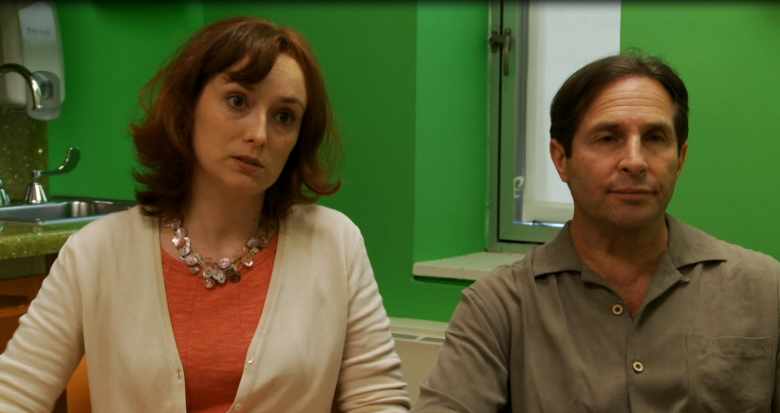
Case #1: Discussion of Video #1
What additional history would you want to obtain?
Using a common factors approach, how might you approach this situation differently?

Slide 14
Case #1 | Video #2
While watching this video, think about the following questions:
What aspects of this case are typical for a child with separation anxiety? What aspects are unusual?
How did the pediatrician use a common factors approach?
Notice how the common factors approach can help to elicit additional history important in understanding the situation

Slide 15
Click here to play video from Internet: https://www.youtube.com/v/ElniRiDgRyQ

Slide 16
Case #1: Potential Barriers to Intervention
Child Factors
Parent Factors
School/Community Factors

Slide 17
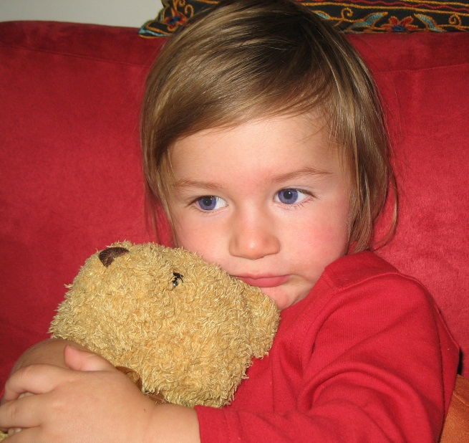
What are some potential management strategies to address this child’s separation anxiety?

Slide 19
Case #2
You are seeing Maria, an 11 year-old girl for a well-child visit and school physical. You last saw her for her 10-year well-child visit. She has no chronic medical problems and has been growing and developing well. She comes to your office with her mother. You discover she is having frequent episodes of abdominal pain.

Slide 20
Case #2 | Video #1
While watching this video, think about the following questions:
What does the pediatrician do well in approaching this case?
How did the pediatrician use a common factors approach to obtain the history?
What are possible causes of this child’s symptoms?

Slide 21
Click here to play video from Internet: https://www.youtube.com/v/MQ1lUNHXXh4

Slide 22
Case #2: Key History Reviewed
School nurse calls Maria’s mother about 3 times per week and her mother picks her up from school. Pain typically occurs before math class.
Pain is perumbilical, crampy, and seems to improve after she gets home and rests.
Additional family stressors
Mother is missing work, father is traveling for business.
Maria is growing and gaining weight appropriately and the physical exam is unremarkable.
What additional history would you like to obtain?

Slide 23
Case #2 | Video #2
While watching this video, think about the following questions:
How did the physician use a common factors approach to develop next steps?
What factors were typical for a child with school avoidance? What factors were unusual?
What are possible long-term sequelae if school avoidance is not successfully addressed?

Slide 24
Click here to play video from Internet: https://www.youtube.com/v/8WGpS2SALb4

Slide 25
Common Factors Approach Demonstrated
Hope: | “If we work together I think we can figure this out”
Language: | Discusses medical & psychological factors together
Permission: | Defines the 2 goals for the visit

Slide 26
Common Factors Approach Demonstrated
Partnership: | Develops partnership with parent Addressing her concern about her job Develops partnership with Maria Asking her to be a detective Making it her job to complete the diary

Slide 27
What are some additional management strategies that may have been reasonable to address this child’s school avoidance?

