Slide 1
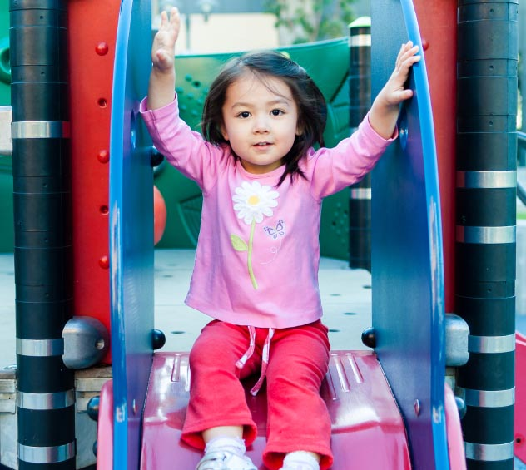
Keeping Children Safe From Injuries in Early Care and Education Settings
Playground Safety
Notes:
Today’s topic is part of an ongoing series on Injury Prevention in early care and education settings. Today we will be talking about playground safety, a very important topic for early care and education providers when it comes to keeping children safe during play time. Children spend a lot of outdoor time on the playground, and while injuries on the playground are very common, they are also predictable and preventable.
The information in this module is consistent with the Standards established in the American Academy of Pediatrics (AAP), American Public Health Association (APHA), Maternal and Child Health Bureau (MCHB) publication Caring For Our Children: National Health and Safety Performance Standards; Guidelines for Early Care and Education Programs, 3rd Edition. This resource can be accessed online at http://cfoc.nrckids.org or purchased at http://shop.aap.org/.
The other modules in this series that you may be interested in include Fire and Burn (Red), Transportation Safety (Yellow), Medication Safety (Blue), and Helmet Safety (Purple).
Sources
ASTM International’s Safe Playground Equipment: http://www.astm.org
Caring for Our Children: http://cfoc.nrckids.org
Centers for Disease Control and Prevention: http://www.cdc.gov
Consumer Product Safety Commission: http://www.cpsc.gov
National Program for Playground Safety: http://www.playgroundsafety.org
National Recreation and Park Association’s Certified Playground Safety Inspectors: http://www.nrpa.org/CPSI
Safe Kids Worldwide: http://www.safekids.org
US Play Coalition: http://usplaycoalition.clemson.edu

Slide 2

Keeping Children Safe From Injuries in Early Care and Education Settings
Welcome
Date
Location
PRESENTER INFORMATION HERE
Notes:
Welcome everyone and thank participants for coming.
Introduce yourself.
Connect with participants and get an idea of who they are.
If the group is small enough, ask participants to introduce themselves, tell where they work, and describe their type of early care and education facility and their role.
Alternatively, ask participants to raise their hands if they are center directors, early care and education workers, Head Start providers, family child care providers, parents, grandparents, etc.

Slide 3

Learning Objectives
Identify the #1 cause of playground injuries
Understand the importance of active supervision
Understand the dos and don'ts for playground surfaces
Identify at least 1 place to get more information about playground safety
Notes:
Review the learning objectives with the participants.
By the end of today’s lecture, you will be able to:
Identify the #1 cause of playground injuries
Understand the importance of active supervision to reduce injuries (especially around monkey bars, swings, and slides)
Understand the dos and don’ts for playground surfaces and explain why
Identify at least 1 place to get more information about playground safety
Design note: There is no participant manual. The slides will be used to create the participant handout (without speaker notes). The learning objectives should be on the screen so participants can refer to them.

Slide 4
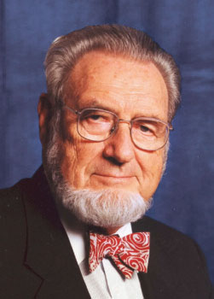
“If a disease were killing our children in the proportions that injuries are, people would be outraged and demand that this killer be stopped.”
C. Everett Koop, MD
Former US Surgeon General
Notes:
C. Everett Koop helped raise injury prevention as a public health issue.

Slide 5
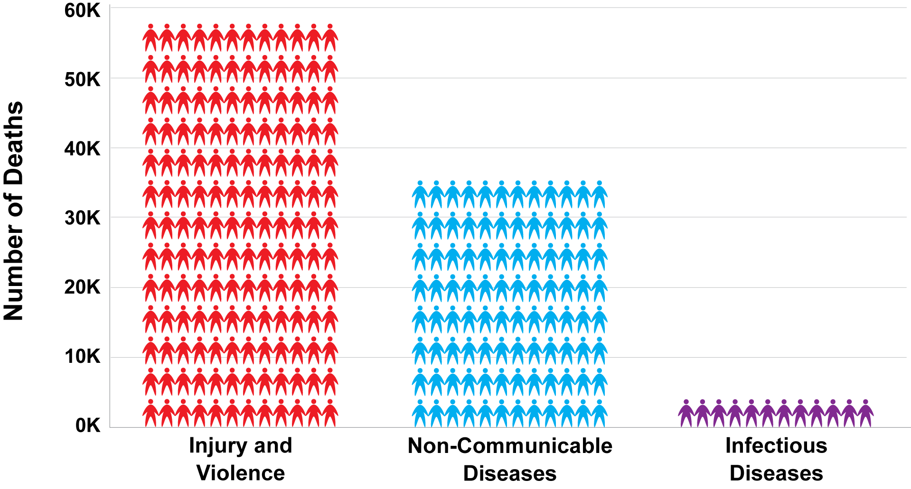
Injury Deaths Compared to Other Leading Causes of Death
(Ages 1–44, United States, 2013)
Notes:
When it comes to public health, many people focus on diseases. But the fact is that more people die each year from injury and violence than from diseases. In fact, the number one cause of death and disability among children alone in the United States is from injuries. Most injuries are preventable AND predictable.
Source
Centers for Disease Control and Prevention. Injury Prevention and Control. 2015. (http://www.cdc.gov/injury/overview/leading_cod.html)

Slide 6
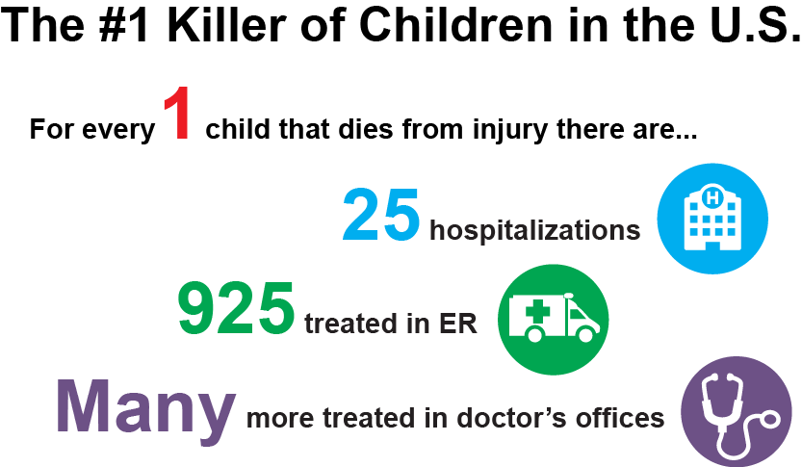
Injury
Notes:
More than 9,000 children die each year from injuries, which is equal to 150 school buses all loaded with children.
However, injury deaths are only part of the tragic story. Each year, millions of children are injured and have to live with these injuries for a period of time; sometimes their injuries have a lifelong effect.
With a fatal injury, family, friends, coworkers, employers, and other members of the child’s community feel the loss. With a nonfatal injury, family members must often care for the injured child, which can cause stress, time away from work, and lost income.
Injuries to children can result in major expenses, including medical costs for the injured child and loss of wages for the parent/caregiver.
The consequences of these fatal and nonfatal injuries to children have a physical and emotional cost to the individual and our society. An injury affects more than just the injured child—it affects many others involved in the child’s life. The community also feels the cost burden of child injuries, as does the state and the nation.
For children, even minor injuries cause pain and may limit their activities. Major injuries may involve hospitalizations, emergency room visits, and multiple doctors’ visits. Sometimes the injury can lead to one or more of the following: physical limitations, stress, depression, constant pain, and a major change in their lifestyle or quality of life.
Source
Centers for Disease Control and Prevention, Vital Signs 2012. (http://www.cdc.gov/VitalSigns/pdf/2012-04-vitalsigns.pdf)

Slide 7
Injuries Among Children
Leading cause of death and disability
  10% of injuries in preschoolers happen in early care and education settings
Not accidents
  Preventable and predictable
Notes:
Injuries are the main cause of death and disability among children in the United States. Ten percent of those injuries in young children (preschool, ages 0-5) happens in the early care and education setting.
Injuries are NOT accidents, as that implies or suggests that they occur randomly and could not be prevented. But we know that is not true, because we know that most common injuries among children are preventable and predictable.
Source
Hashikawa AN, Newton MF, Cunningham RM, Stevens MW. Unintentional injuries in child care centers in the United States: A systematic review. Journal of Child Health Care. 2015 Mar;19(1):93-105. doi: 10.1177/1367493513501020. Epub 2013 Oct 3.

Slide 8


Safe Kids USA
Notes:
Show the video Imagine a World Where Every Kid is a Safe Kid – Help each child reach their full potential by reducing preventable injuries.
http://www.safekids.org/video/imagine-world-where-every-kid-safe-kid

Slide 9

Caring For Our Children Standards
Caring for Our Children: National Health and Safety Performance Standards—Guidelines for Early Care and Education Programs (CFOC)
3rd edition
Available at http://cfoc.nrckids.org
(free download and purchase
options)
Notes:
Caring for Our Children contains standards for injury prevention and safety practices.

Slide 10
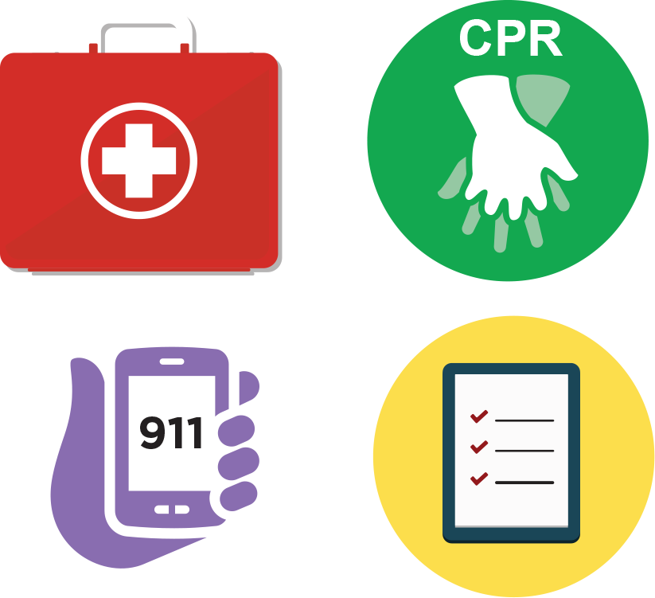
Injuries
Pediatric first aid kit
Pediatric CPR and first aid training
Communication device for emergencies (911)
Document and notify parents and state licensing agency
Report serious injuries to appropriate authorities
Notes:
Pediatric First Aid kits should be stocked and available in each location where children are cared for. This includes a transportable first aid kit that can go with the children on a walk or in a vehicle.
Pediatric First Aid and CPR training
You are most likely to need first aid skills, therefore, all staff members that have contact with children should be current on training for first aid.
At least 1 staff member currently certified in CPR should be present at all times.
Communication device
Emergencies can happen quickly. Each staff member should have a way to call for help. This is especially important when children are taken away from the facility to a playground, for a walk, or on a field trip.
Document and notify parents
In the event of an injury, a report should be completed and filed. Parents should be notified immediately of an injury or illness of their child.
Require that child care providers report any serious injuries or deaths of children occurring in child care to a designated state, territorial, or tribal entity.
Source
Child Care and Development Fund, Section 98.42 – Enforcement of licensing and health and safety requirements. (b)(4)

Slide 11

The Early Care and Education Provider
Relationship with family and child
Model safety for children and families
Notes:
Why is your role as a early care and education provider so important?
Children spend a lot of time in the early care and education setting. In fact, some children spend more awake hours there than they do at home. Children depend on caregivers to provide a safe environment away from home.
As a provider, and because of your relationship with the family and child, you are the perfect person to focus on safety. You have the chance to not only keep the children safe, but to find ways to teach them about how they can prevent injuries. This can be done by modeling and explaining safe behaviors in a way that is appropriate for the age and developmental level of the children in your care.
Explain to participants the importance of role modeling. Adults often underestimate their impact with role modeling. Children will follow your example. Always practice safe behavior. The effectiveness of health and safety education is enhanced when shared between the caregiver/teacher and the parents/guardians.
Source
CFOC Standard 2.4.1.2 – Staff modeling of healthy and safe behavior and health and safety education activities. (http://cfoc.nrckids.org/StandardView/2.4.1.2)

Slide 12


The problem

Slide 13
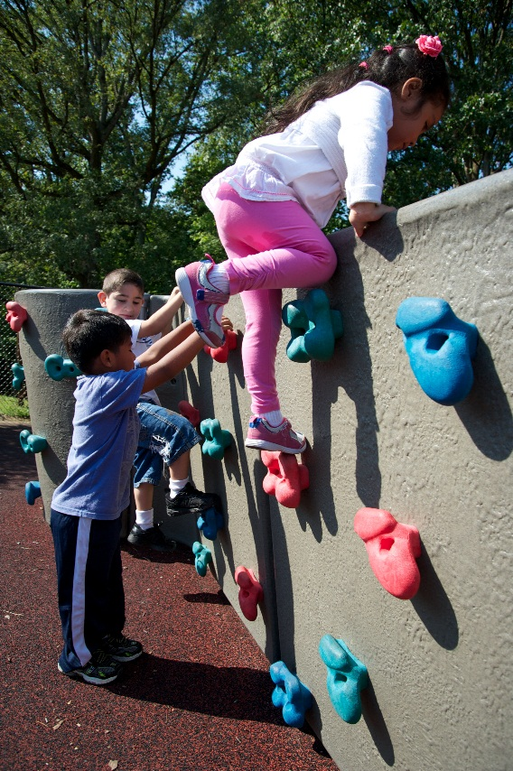
Playground Injuries
200,000 children injured yearly
#1 cause of injury: FALLS
Half of injuries = lack of proper supervision
Children and risk:
  Developmental variations
  Test skills & abilities
  Unaware of dangers
Notes:
Every year, 200,000 children will go to an emergency room for a playground injury.
Falls are the most common cause of playground injury (79%):
Almost half of playground injuries happen because no adult is watching the children
Children are at different developmental stages, both physically and emotionally
Children are curious and like to test their skills and abilities, especially around playground equipment
Young children do not have the ability to judge what is safe or not safe and may not realize that it’s dangerous to run in front of a swing where they could be hit
Sources
Tinsworth D, McDonald J. Special Study: Injuries and Deaths Associated with Children’s Playground Equipment. 2001. Washington, DC: Consumer Product Safety Commission. (http://www.cpsc.gov//PageFiles/108601/playgrnd.pdf)
Hashikawa AN, Newton MF, Cunningham RM, Stevens MW. Unintentional injuries in child care centers in the United States: A systematic review. Journal of Child Health Care. 2015 Mar;19(1):93-105. doi: 10.1177/1367493513501020. Epub 2013 Oct 3.
American Academy of Orthopaedic Surgeons. Playground Safety Guide. 2015. (http://orthoinfo.aaos.org/topic.cfm?topic=A00313)
Safe Kids Worldwide. Safe Kids Coalitions in the United States. 2015. (http://www.safekids.org/safe-kids-coalitions-united-states?content_item_id=342&folder_id=177)

Slide 14
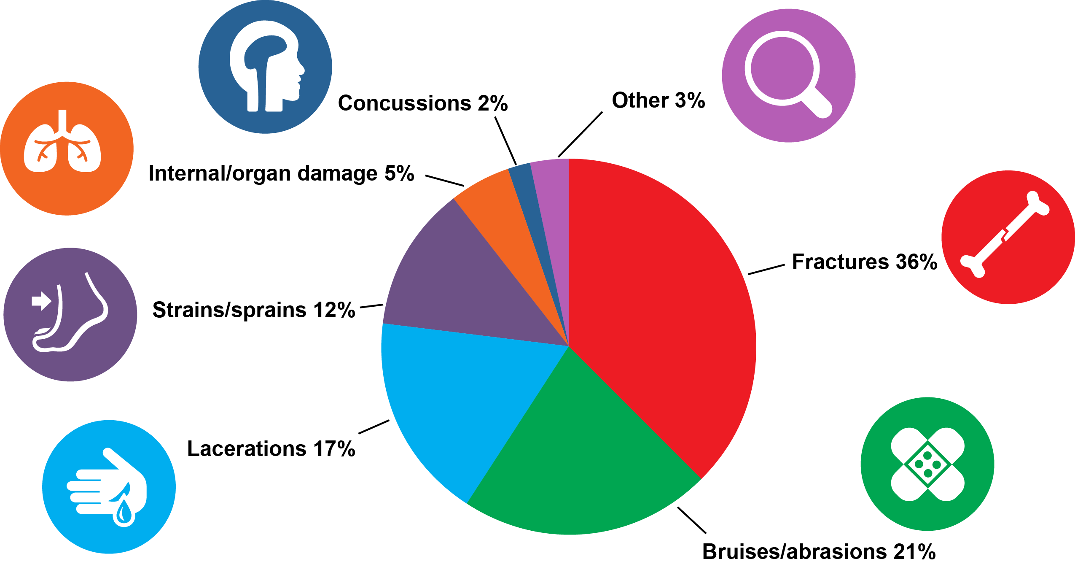
Common Playground Injuries
Notes:
Let’s take a closer look at the some playground injuries based on data for preschool and elementary school children.
Over a third of these injuries are in children between 0-5 years of age
Bone fractures and bruises/cuts are the most common injury among children
Among reported incidents with known ages, the 0-4 age group accounts for 54% of the data
Other common injuries include:
Lacerations (17%)
Strains/sprains (12%)
Internal/organ damage (5%)
Concussions (2%)
Other (3%)
Sources
Consumer Product Safety Commission. National Electronic Injury Surveillance System Database. May 2009. (http://www.cpsc.gov//PageFiles/106637/2009highlights.pdf)
Safe Kids Worldwide. Safe Kids Coalitions in the United States. 2015. (http://www.safekids.org/safe-kids-coalitions-united-states?content_item_id=342&folder_id=177)

Slide 15
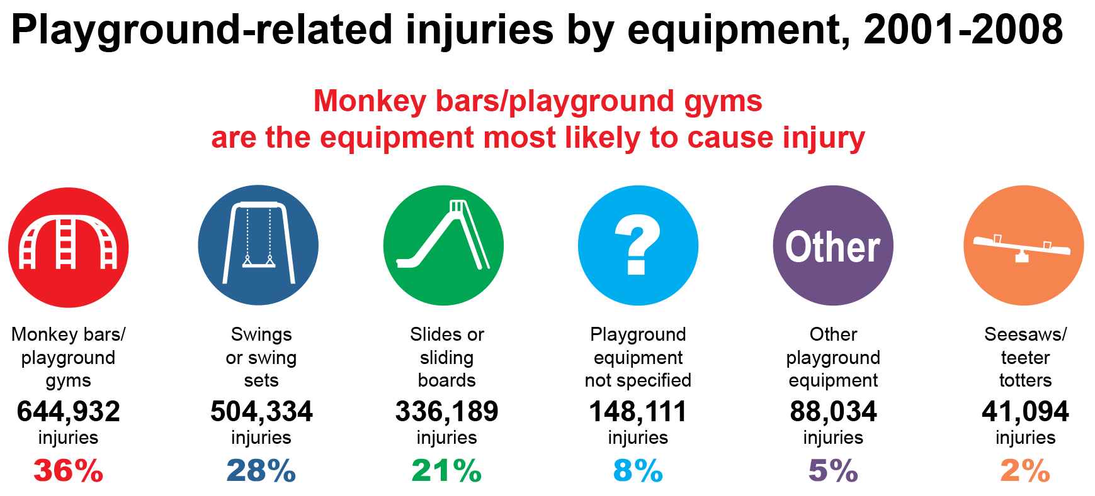
Common Playground Equipment
Notes:
When it comes to the type of equipment that is most likely to cause an injury, monkey bars, swings, and slides are at the top of the list.
It’s important to let early care and education workers know where children are most likely to get hurt so they can provide additional supervision and focus in those areas.
For monkey bars, lowering the bar should be considered, if it’s an option.
Note to Presenter:
The Consumer Product Safety Commission (CPSC) public Playground Safety Handbook is a great free resource with specific recommendations, especially if the audience has specific questions; however, this amount of detail is not recommended to include in the presentation routinely. Some examples:
Monkey bars: For toddlers, the maximum fall height for free standing and composite climbing structures should be 32 inches (pg. 25).
Free-standing arch and flexible climbers: Not recommended for toddlers and preschool children (pg. 27).
Horizontal (overhead) ladders: Four-year-olds are generally the youngest children able to use upper body devices like these; therefore, horizontal ladders should not be used on playgrounds intended for toddlers and 3-year-olds. (pg. 28)
Sources
National Program for Playground Safety. Injuries. 2009. (http://playgroundsafety.org/research/injuries)
The CPSC public Playground Safety Handbook (https://www.cpsc.gov//PageFiles/122149/325.pdf)

Slide 16
equipment

Slide 17
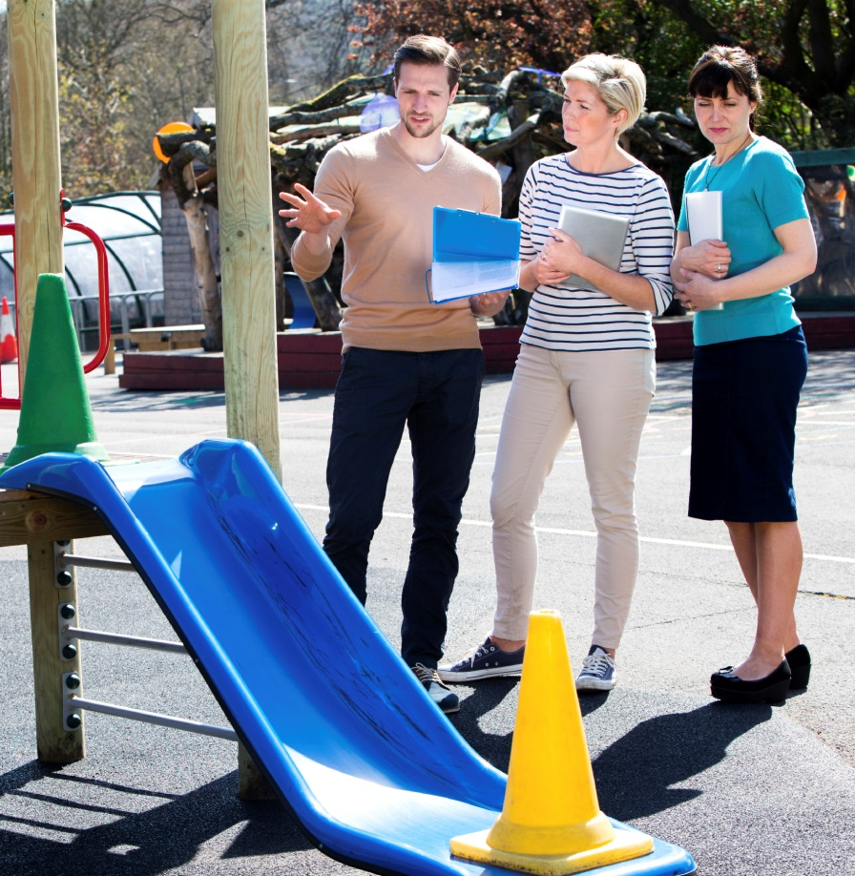
Certified Playground Safety Inspectors (CPSIs)
Training: National Recreation and Park Association (NRPA)
  Locate a CPSI at www.nrpa.org
Looking for hazards = preventing injuries
New playground installs
Yearly inspections
Notes:
Certified Playground Safety Inspectors (CPSIs) must attend a training and get certified from the National Recreation and Park Association in association with the National Playground Safety Institute. You can locate a CPSI at www.nrpa.org. Because CPSIs’ training is beyond that of most early care and education providers, getting a professional inspection to find playground dangers before a child is injured is worth it.
Child care health consultants are health professionals with experience helping early care and education settings develop their best practices. Sometimes your child care health consultant has completed the NPSI training and are certified CPSIs. If not, check the NPSI Web site for an inspector.
CPSIs should do an inspection of new playground installs. Playgrounds that are already in place should be inspected at least once a year by a CPSI or local regulatory agency and when there are changes to the equipment.
It is important to emphasize that early care and education providers are not expected to have the knowledge level of a CPSI and should use local resources, including local parks and recreation departments or other local regulatory agencies, for assistance with playground safety concerns. These local experts will also be familiar with any local or state requirements.
For example, programs can learn from the inspectors what hazards to look for that may cause injury, such as surfacing materials shifting or part of the play structure becoming loose that may create a pinching hazard after repetitive use; these are things that programs can add to their daily inspection checklists.
Also remember to budget for playground inspections and necessary repairs.
Source
CFOC Standard 6.2.1.1 – Play equipment requirements. (http://cfoc.nrckids.org/StandardView/6.2.1.1)

Slide 18
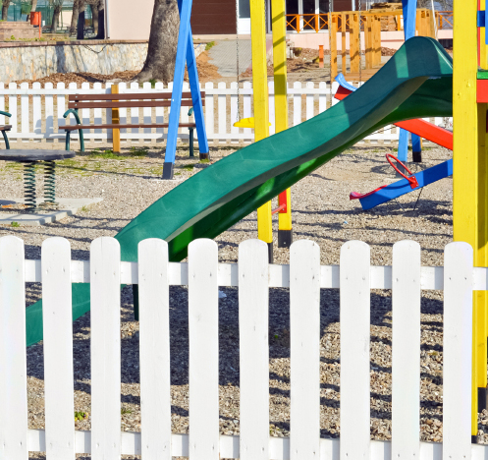
Play Space and Equipment
All areas visible at all times
No access to standing water
Shade
Accessible to all
Properly spaced and arranged
Equipment:
  Separate play areas
  Appropriate for age
Notes:
Playgrounds should be laid out to allow caregivers to keep track of children as they move throughout the playground environment. Visual barriers should be minimized as much as possible.
Early care and education providers should position themselves so that they can see the children at play and the children can see the teacher. Position yourself near high use or potentially dangerous areas, such as swings.
Locate play areas away from standing water or other areas with water (eg, swimming pool without a fence, ditches, ponds, or canals).
Provide shade for metal equipment (especially slides) and play space. Children should have shaded areas outside where they can play, not just on playgrounds. Trees, buildings and other structures are good choices for shaded areas. Shade also prevents sunburn or burning from hot ground surfaces. Time children’s outdoor play to avoid (or at least limit) the most intense sun exposure, which is between 10am and 4pm.
Provide play equipment that is accessible to all (Americans with Disabilities Act).
Injuries from falls are more likely to occur when equipment spacing is inadequate. All equipment should be arranged so that children playing on one piece of equipment will not interfere with children playing on or running to another piece of equipment. All equipment should be arranged to facilitate proper supervision by sight and sound. Collisions between children utilizing different pieces of equipment occur more often when equipment is inappropriately placed.
When it comes to playground equipment, it is not a one size fits all for every child. Play structures are not only designed differently for different ages, but for different developmental skills at these ages. Size and height of the equipment are important to reducing injuries. Separate play areas for children in different age groups is very important. There are differences in the physical development and abilities among children and possible injuries are very predictable (younger children on bigger equipment are likely to get hurt). Younger and smaller children should be on equipment that is for their size and easy to play on. Equipment for older children should be away from where the smaller children play because there may be things the younger children will not be able to do. All fixed play equipment should have a minimum of six feet use zone (clearance space) from walkways, buildings, and other structures that are not used as part of play activities. For fixed play equipment only used by children six months to twenty-three months of age, a minimum three-foot use zone is required.
For playgrounds intended to serve children of all ages, the layout of pathways and the landscaping of the playground should show the distinct areas for the different age groups. The areas should be separated at least by a buffer zone, which could be an area with shrubs or benches. This separation and buffer zone will reduce the chance of injury from older, more active children running through areas filled with younger children with generally slower movement and reaction times.
(Note: We know that best practice would be to have a fully accessible playground with shade. Not all early care and education providers are able to provide shade or a fully ADA playground, therefore, this should be discussed as to how to provide an acceptable level of both.)
Sources
CFOC Standard 6.1.0.5 – Visibility of outdoor play area. (http://cfoc.nrckids.org/StandardView/6.1.0.5)
CFOC Standard 6.1.0.6 – Location of play areas near bodies of water. (http://cfoc.nrckids.org/StandardView/6.1.0.6)
CFOC Standard 6.1.0.7 – Shading of play area. (http://cfoc.nrckids.org/StandardView/6.1.0.7)
CFOC Standard 6.1.0.1 – Size and location of outdoor play area. (http://cfoc.nrckids.org/StandardView/6.1.0.1)
CFOC Standard 6.2.2.2 - Arrangement of play equipment. (http://cfoc.nrckids.org/StandardView/6.2.2.2)
CFOC Standard 6.2.2 - Use Zones and Clearance Requirements. (http://cfoc.nrckids.org/StandardView/6.2.2)
Consumer Products Safety Commission. Public Playground Safety Handbook (page 6). (https://www.cpsc.gov/PageFiles/122149/325.pdf)

Slide 19
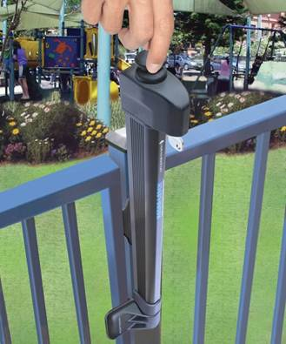
Secured Space
Goal: keep child in the space
  Prevent getting over, under, or through
Design: discourage climbing
Layer of protection
Self-closing/self-latching
Notes:
Fences help protect and keep children in an area where they can be watched by an adult. They can prevent a child from leaving outdoor play areas and help keep children safe from injuries. Even though fences are not childproof, they do make the area safer for children who may walk away from the group.
The fence and gate should be built so that it’s not easy for children to climb (fence posts on outside of fence).
Early care and education programs and providers need to know and comply with local codes, if applicable, regarding fence height. Teachers should not rely on fences to keep children safe and need to actively supervise the children at all times.
Gates should have latches that close and lock by themselves. The latches should be high enough so children cannot reach and open them.
Source
CFOC Standard 6.1.0.8 – Enclosures for outdoor play areas. (http://cfoc.nrckids.org/StandardView/6.1.0.8)

Slide 20
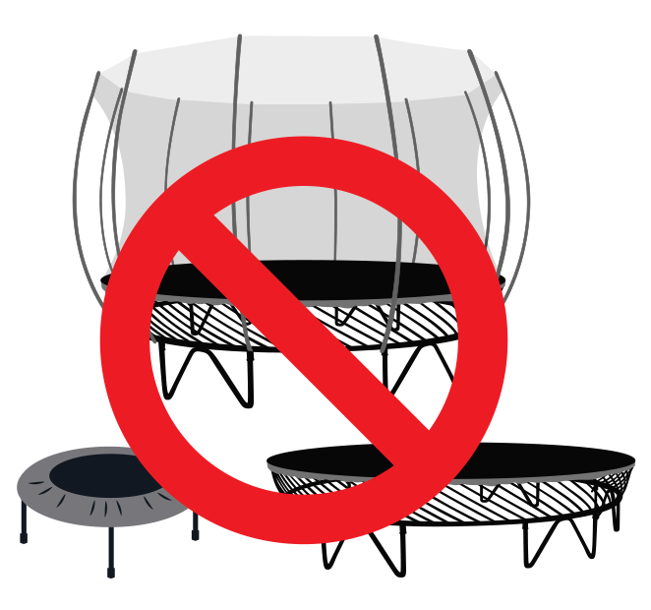
Trampolines/Mini Trampolines
American Academy of Pediatrics does NOT recommend use
Not playground equipment
Injuries are very common
Insurance coverage may be denied
Notes:
The AAP, the American Academy of Orthopedic Surgeons, and the Consumer Product Safety Commission, DO NOT recommend using trampolines, including mini trampolines, for children.
Trampolines are not playground equipment and injuries on trampolines are very common.
Children 5 years and younger appear to be at increased risk of fractures and dislocations from trampoline-related injuries.
Enclosures and padding have not been shown to decrease the number of injuries.
There have been times when insurance companies have refused to give or to continue insurance to the family child care providers or early care and education center where a trampoline was found.
(Note: Trampolines are regulated in many states by licensing requirements. Early care and education providers should be familiar with their licensing requirements, know the dangers, and that they are not recommended.)
Sources
CFOC Standard 6.2.4.4 – Trampolines. (http://cfoc.nrckids.org/StandardView/6.2.4.4)
Safe Kids Worldwide. Playground Safety Tips. 2013. (http://www.safekids.org/sites/default/files/documents/playground_safety_tips.pdf)
American Academy of Pediatrics. (http://pediatrics.aappublications.org/content/130/4/774)

Slide 21

Play Area Inspection
Daily and monthly safety checks
  file and document
Equipment:
  Anchored
  No missing or broken pieces, sharp edges, parts sticking out
  No signs of wear and tear
Surface:
  No tripping dangers
  Proper coverage
Notes:
Daily safety checks should be conducted to identify any new potential hazards, which should be addressed immediately. Broken equipment/toys should be removed until it can be repaired or replaced.
Checking the equipment every month to make sure it’s safe will give you the chance to see if there’s anything that needs to be fixed. A staff member can be assigned to check all the playground equipment to make sure it’s safe for the children. Staff members should also look at the equipment when the children are playing on it to find any issues and get them fixed as soon as possible.
These observations should be documented and filed.
When inspecting playground equipment, here are some things to look for to help ensure a safe play area for children:
Equipment should be attached to the ground and anchored so it doesn’t tip, turn over, slide, or move in any way.
None of the pieces of equipment should have sharp edges, pieces that stick out, or weak areas that could break. Sharp pieces could cause children to get scratches, cuts, bumps or bruises.
All openings in pieces of play equipment should be designed too large for a child’s head to get stuck in and too small for a child’s body to fit into, in order to prevent entrapment and strangulation. Any parts that stick out and may catch a child’s clothing are prohibited. Other smaller openings may cause entrapment of a child’s fingers. A CPSI can help identify these dangers.
The wood, metal, or plastic should be in good shape : No gaps, holes, cracks, broken or missing parts, rust, chipping or peeling paint, cracks or splinters, or rough surfaces.
The surfacing area should be inspected for hazards that may include rocks, tree stumps or roots, uneven ground, or concrete anchoring that was under the surface but is now showing.
Surfacing should also be inspected for proper coverage, which we will cover next.
Safety Checklist
The National Program for Playground Safety has developed a report card to evaluate the safety of an early care and education playground.
Sources
CFOC Standard 6.2.5.1 – Inspection of indoor and outdoor play areas and equipment. (http://cfoc.nrckids.org/StandardView/6.2.5.1)
CFOC Standard 6.2.1.4 – Installation of play equipment. (http://cfoc.nrckids.org/StandardView/6.2.1.4)
CFOC Standard 6.2.1.8 – Material defects and edges on play equipment. (http://cfoc.nrckids.org/StandardView/6.2.1.8)
CFOC Standard 6.2.1.9 - Entrapment of Hazards of Play Equipment. (http://cfoc.nrckids.org/StandardView/6.2.1.9)
Safe Kids Worldwide. Playground Safety Tips. 2013. (http://www.safekids.org/sites/default/files/documents/playground_safety_tips.pdf)
National Recreation and Park Association. The Dirty Dozen: 12 Playground Hazards. (http://www.nrpa.org/uploadedFiles/nrpa.org/Professional_Development/Certification/CPSI/Dirty-Dozen-Playground-Hazards.pdf)

Slide 22

Surfacing
3 out of 4 playground injuries = falls
Not acceptable:
  Asphalt, cement, dirt, and grass
Shock-absorbing:
  Stationary
  Loose fill
Notes:
The kind of surfacing on a playground is important to prevent injuries because falls are the number one cause of playground injuries.
Equipment that can be climbed on should not be near hard surfaces like asphalt, concrete, dirt, grass, or floors covered by carpet or gym mats because it is not safe for climbing equipment.
All pieces of playground equipment should be placed over and surrounded by a shock-absorbing (softer) surface. This material may be either attached to the ground or loose-fill type.
Check your state licensing regulations, as some states have specific requirements for surfacing.
Surfacing does not prevent all injuries, but can help to make them less severe.
Follow playground manufacturer’s recommendations regarding installation, maintenance, and replacement of equipment as well as the type and depth of surface materials selected.
Loose-fill materials will degrade and compress over time so will need to be refilled regularly and maintained. Loose-fill does not provide access for wheel chairs.
Source
CFOC Standard 6.2.3.1 – Prohibited surfaces for placing climbing equipment. (http://cfoc.nrckids.org/StandardView/6.2.3.1)

Slide 23
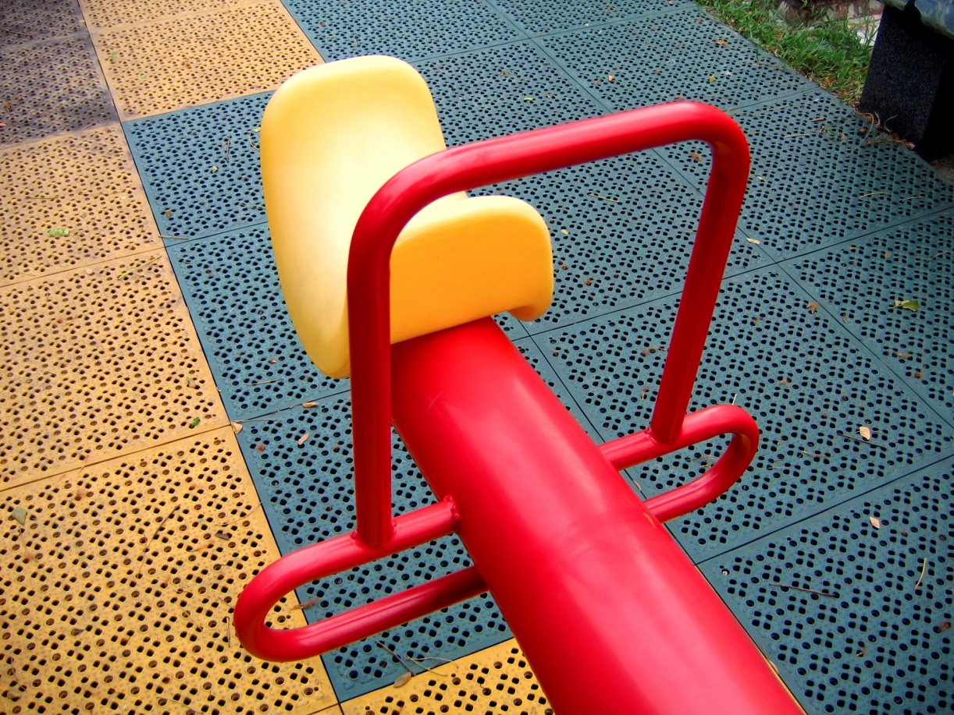
Stationary: Shock Absorbing
Rubber mats
Tiles
Poured-in-place
Notes:
Optional Discussion
What are the pros and cons of the listed shock-absorbing surfaces?
PROS
Meets the ADA standards for children with disabilities
Minimum maintenance and care
Allows for creative design of the area
Provides fall height protection
Softer on the feet when standing for a long period of time
CONS
Rubbery surface can cause shoes to stick, resulting in tripping
Can cause “rug burn” type abrasions

Slide 24
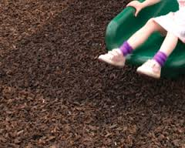
Loose-Fill Material: Shock Absorbing
Wood chips, mulch, and sand:
  Caution: choking hazards
  Maintenance
  Depth: at least 12 inches
  Area: at least 6 feet in all directions
    Swings: 2 times height of top bar
Notes:
Shock-absorbing loose-fill surfaces (those that are softer and make falls less painful) include wood chips or mulch, pea gravel, and sand. However, when sand gets wet it is less shock absorbing, and gets very hard when temperatures drop below freezing.
Some surface materials are not considered safe for infants and toddlers because of choking hazards (eg, pea gravel and wood chip nuggets)
Wood chips, mulch, and other loose materials that are used to make the ground softer should be checked often to make sure that it is deep enough and has not moved. This is very important for under swings and at the end of slides. Wood chips or mulch should be put back into place or added if there are bare spaces, so that it is equal on all playground areas.
Pea gravel is another material option, but it is a choking hazard for children under the age of 3.
Loose playground surface material should be at least 12 inches deep and go out from the playground equipment 6 feet in all directions, sometimes even farther. For bigger equipment, like swings, the material will have to go out 2 times farther than the height of the bar that holds the swings in front and back of the swing. For example, it the swing bar is 10 feet high, the material should go 20 feet out from the swings in all directions.
Optional Discussion
What are the pros and cons of the listed shock-absorbing surfaces?
Sources
CFOC Standard 6.2.5.2 – Inspection of play area surfacing. (http://cfoc.nrckids.org/StandardView/6.2.5.2)
CFOC Appendix Z – Depth required for shock-absorbing surfacing materials for use under play equipment (reprinted from CPSC Public Playground Safety Handbook). (http://cfoc.nrckids.org/WebFiles/AppendicesUpload/AppendixZ.pdf)

Slide 25
ENVIRONMENT

Slide 26

Outdoor hazards
Insects
  Inspect areas before use
Plants
  Remove unknown plants
  Children should not eat berries, mushrooms, or other vegetation
Sun
Weather conditions
Notes:
INSECTS
Facilities should prevent pest infestations by ensuring sanitary conditions. This can be done by eliminating pest breeding areas, filling in cracks and crevices; holes in walls, floors, ceilings and water leads; repairing water damage; and removing clutter and rubbish on the premises.
Facilities should avoid the use of sprays and other pesticide formulations.
Pesticide Use: If physical intervention fails to prevent pest infestations, facility managers should ensure that targeted (rather than broadcast) applications of pesticides are made, beginning with the products that pose the least exposure hazard first, and always using a pesticide applicator who has the licenses or certifications required by state and local laws.
Child care staff should ask to see the license of the pest management professional and should be certain that the individual who applies the toxic chemicals has personally been trained and preferably, individually licensed (ie, not working in the capacity of a technician being supervised by a licensed pest management professional).
Integrated Pest Management is a way to control pests in the least toxic way. A curriculum is available for early education and child care programs through the California Child Care Health Program – http://www.ucsfchilcarehealth.org/html/pandr/trainingcurrmain.htm.
Notification should be given to parents/guardians and staff before using pesticides, to determine if any child or staff member is sensitive to the product. A member of the child care staff should directly observe the application to be sure that toxic chemicals are not applied on surfaces with which children or staff may come in contact.
PLANTS
Poisonous or potentially harmful plants are prohibited in any part of a child care facility that is accessible to children. All plants not known to be nontoxic should be identified and checked by name with the local poison center (1-800-222-1222) to determine safe use.
All outdoor plants and their leaves, fruit, and stems should be considered potentially toxic. Cuttings, trimmings, and leaves from potentially harmful plants must be disposed of safely so children do not have access to them.
For toxic, frequently ingested products and plants, see the American Academy of Pediatrics’ (AAP) Handbook of Common Poisonings in Children. (http://www.aap.org)
SUN
Younger children are more likely to get sunburn because their skin is not fully developed and can be damaged even as early as the first summer of life. (http://pediatrics.aappublications.org/content/128/1/92.full)
Children cannot be outside without being in the sun, but they need to be protected from getting too much sun. People who had very bad sunburns when they were children are more likely to get skin cancer later in life.
The first step to prevent the chances of getting skin cancer is to protect children early on in their life from getting too much sun and teach them how to be safe in the sun. The amount of time children are out in the sun should be limited, especially during the hours of 10am and 4pm when the sun is the strongest.
Children should be protected from the sun with sunscreen and hats, as well as by shaded areas on the playground.
WEATHER CONDITIONS
Supervising adults should check the air quality index (AQI) each day and use the information to determine whether all or only certain children should be allowed to play outdoors. Children need protection from air pollution. Air pollution can contribute to acute asthma attacks in sensitive children.
Warm temps are likely to increase the need for access to water to keep active children hydrated.
Children need protection from adverse weather and its effects. Wind chill conditions at or below minus 15ºF as well as heat index at or above 90ºF, as defined by the National Weather Service, pose significant risks for children. Children have greater surface area to body mass ratio than adults. Therefore, children do not adapt to extremes of temperature as effectively as adults when exposed.
Sources
CFOC Standard 3.1.3.2 - Playing Outdoors. (http://cfoc.nrckids.org/StandardView.cfm?StdNum=3.1.3.2&=+)
CFOC Standard 3.1.3.3 - Protection from Air Pollution While Children Are Outside. (http://cfoc.nrckids.org/StandardView/3.1.3.3)
Environmental Protection Agency. Sunwise Kids. 2014: Chapter 6. (http://www.epa.gov/sunwise/kids/index.html)
healthychildren.org, American Academy of Pediatrics. Safety and Prevention: Sun Safety. 2015. (http://www.healthychildren.org/english/safety-prevention/at-play/pages/Sun-Safety.aspx)

Slide 27
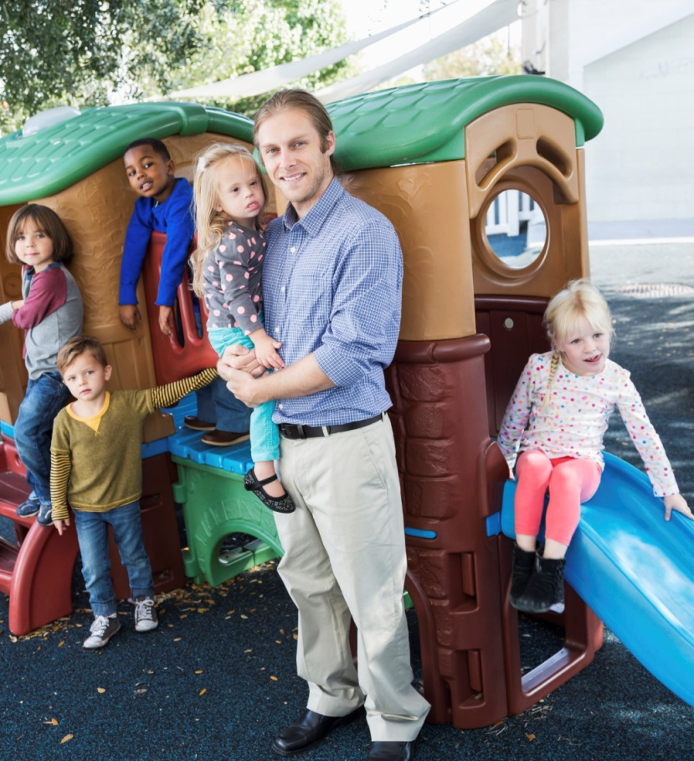
Active supervision
No substitute for supervision
Half of injuries = lack of proper supervision
More active = more supervision
Notes:
Making the playground area safe for children is important, but cannot replace the safety and security of having adult supervision. Almost half of playground-related injuries are due to improper supervision.
Children are more active in the outdoor learning/play areas than they are inside and need to be watched more carefully outside.
Discussion
Discuss the need to have a supervision strategy so that all children are being observed by at least one designated adult at all times. Keep in mind that because monkey bars, swings, and slides are the most likely to cause injuries, more supervision in these areas is needed.
Sources
CFOC Standard 2.2 – Supervision and Discipline. (http://cfoc.nrckids.org/StandardView/2.2)
Safe Kids Worldwide. Playground Safety Tips. 2013. (http://www.safekids.org/sites/default/files/documents/playground_safety_tips.pdf)

Slide 28

Six Active Supervision Strategies
Set Up the Environment
  Keep small spaces clutter-free
  Clear play space for big spaces
Notes:
Now we are going to review the six active supervision strategies that will keep children safe on the playground. These strategies are from the National Center on Early Childhood Health and Wellness at the Office of Head Start.
1. Set up the environment
Staff set up the environment so that they can supervise children at all times. Choose equipment that is age and developmentally appropriate; set up all areas to they are visible to supervising adults (ie, no “blind spots”).

Slide 29
Six Active Supervision Strategies
2. Position Staff
  Always be able to see and hear children at all times
  Make sure there are clear paths to where children are playing
Notes:
2. Position Staff
Early care and education staff should:
Make sure they can see the children at play and the children can see them at all times.
Carefully plan where they will position themselves in the environment to prevent children from harm.
Place themselves so that they can see and hear all of the children on the playground.
Make sure there are always clear paths to where children are playing so they can react quickly when necessary.
Stay close to children who may need additional support.

Slide 30

Active Supervision Strategies
3. Scan and Count
  Continually scan environment
  Regularly count children (name to face)
  Same caregiver/child ratio indoors and outdoors
Notes:
3. Scan and Count
Caregivers/teachers should regularly count children (name to face and whenever leaving one area and arriving at another), going indoors or outdoors, to confirm that each child is safe at all times. Also, they must be able to state (and account for) the number of children in their care at all times. The ratio of caregivers/teachers to the number of children should be the same indoors as it is outdoors. They continually scan the entire environment to know where everyone is and what they are doing. They count the children frequently. This is especially important during transitions, when children are moving from one location to another.

Slide 31
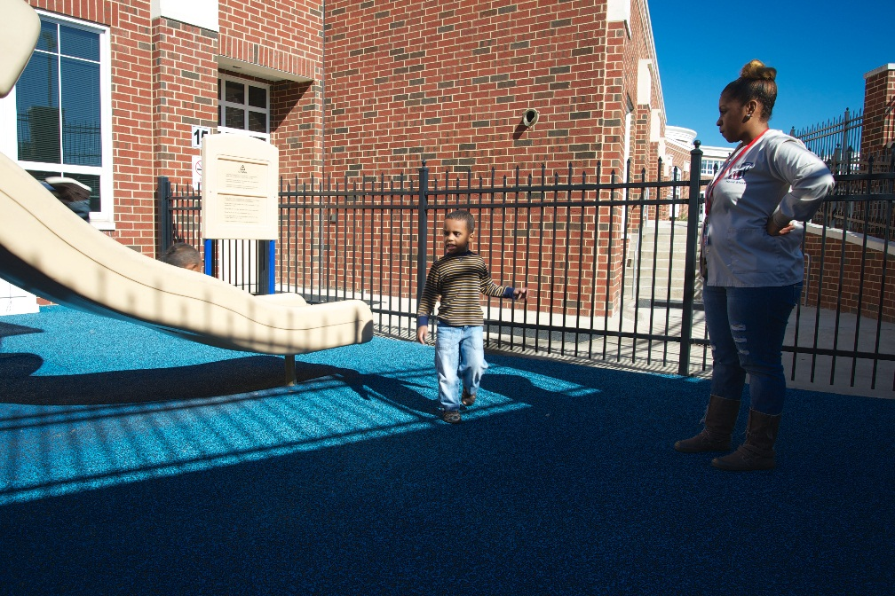
Active Supervision Strategies
Listen
  For sounds or absence
  of sounds
Notes:
4. Listen
Specific sounds or the absence of sounds may signify reason for concern. Staff who are listening closely to children immediately identify signs of potential danger. Programs that think systemically implement additional strategies to safeguard children.

Slide 32
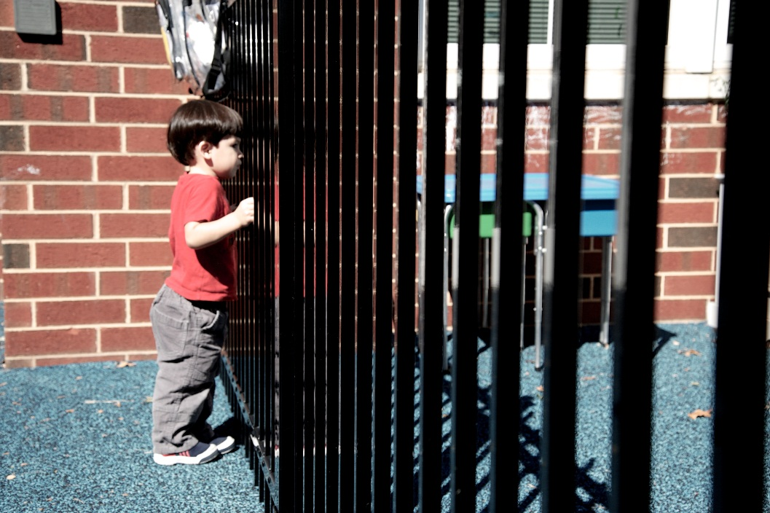
Active Supervision Strategies
5. Anticipate Child’s Behavior
  Know each child’s interests and skills
  Know when child might wander or get upset
Notes:
5. Anticipate Children’s Behavior
Staff use what they know about each child’s individual interests and skills to predict what he/she will do. They create challenges that children are ready for and support them in succeeding. But they also recognize when children might wander, get upset, or take a dangerous risk. Information from the daily health check (eg, illness, allergies, lack of sleep or food, etc.) informs staff’s observations and helps them anticipate children’s behavior. Staff who know what to expect are better able to protect children from harm.
Discussion
Discuss the need to have a supervision strategy so that all children are being observed by at least one designated adult at all times.
Sources
Safe Kids Worldwide. Playground Safety Tips. 2013. (http://www.safekids.org/sites/default/files/documents/playground_safety_tips.pdf)
National Centers on Health: 6 Strategies to keep children safe – active supervision – National Center on Early Childhood Health and Wellness
Tip sheet (https://eclkc.ohs.acf.hhs.gov/hslc/tta-system/health/docs/active-supervision-handout.pdf)
Poster (https://eclkc.ohs.acf.hhs.gov/hslc/tta-system/health/docs/active-supervision-poster.pdf)
Additional Materials (https://eclkc.ohs.acf.hhs.gov/hslc/tta-system/health/safety-injury-prevention/safe-healthy-environments/active-supervision.html)

Slide 33
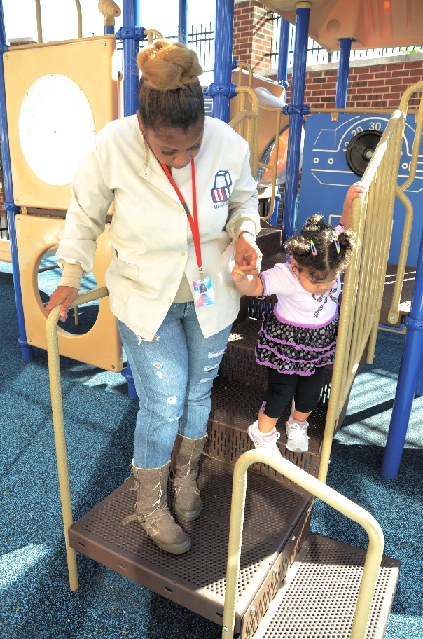
Active Supervision Strategies
Engage and Redirect
  Offer support to children
  Get involved if needed
Notes:
6. Engage and Redirect
Staff use active supervision skills to know when to offer children support. Staff wait until children are unable to solve problems on their own to get involved. They may offer different levels of assistance or redirection depending on each individual child’s needs.
Discussion
Discuss the need to have a supervision strategy so that all children are being observed by at least one designated adult at all times.
Sources
Safe Kids Worldwide. Playground Safety Tips. 2013. (http://www.safekids.org/sites/default/files/documents/playground_safety_tips.pdf)
National Centers on Health: 6 Strategies to keep children safe – active supervision – National Center on Early Childhood Health and Wellness
Tip sheet (https://eclkc.ohs.acf.hhs.gov/hslc/tta-system/health/docs/active-supervision-handout.pdf)
Poster (https://eclkc.ohs.acf.hhs.gov/hslc/tta-system/health/docs/active-supervision-poster.pdf)
Additional Materials (https://eclkc.ohs.acf.hhs.gov/hslc/tta-system/health/safety-injury-prevention/safe-healthy-environments/active-supervision.html)

Slide 34
TEACHING KIDS

Slide 35
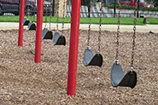
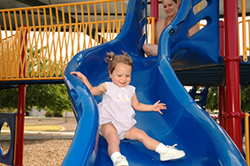
Playground Rules
No shoving, pushing or crowding
Swing:
  Sit
  One at a time
  Keep clear (people and things)
Slide:
  Feet first
  One at a time
  Down, not up
Notes:
Children should learn the rules on the playground to help prevent injuries. Early care and education providers need to have clear rules for the playground, teach and reteach these rules to the children they care for, and always enforce the rules. General rules include no pushing, shoving, or crowding.
Rules for playing on the swing:
Children should always sit. This prevents falls to the ground.
Only 1 child should be on the swing at a time.
Children should not be near children who are swinging on the swings because they can get hurt. It is important to show children how far back and forward swings move when in use. Children need to be reminded that that when swings are in use, they move. They do not stay in the same position. Therefore they need to keep their heads up and a safe distance as to not make contact with the swinger.
Area around the swings should be kept clear of movable hazards like trikes, toys, rocks and groups of children.
Rules for playing on a slide:
Feet first. This could prevent a possible head injury.
One at a time. More than one child on the slide can cause injury.
Always go down the slide, never up.
If someone is going down the slide while someone is coming up, injuries can happen.
Source
More for Kids. Playground Injuries: Statistics and Prevention. 2015. (http://safety.more4kids.info/178/playground-injuries/)

Slide 36
Strangulation Hazards
Avoid:
Scarves
Clothes with drawstrings
Bike helmet straps
Notes:
Another safety issue that caregivers need to be aware of is strangulation. Caregivers need to make sure children are not wearing clothing or other items that could be dangerous on the playground.
For example:
No scarves (unless they are worn for customary or religious reasons) or clothing with drawstrings that are longer than 3 inches outside the garment.
Remove bike helmets. Parents and caregivers may think that bike helmets help protect a child’s head if he or she falls; however, straps can get caught in equipment. Helmets should not be worn when they are playing on the playground.
CFOC Standard 3.4.6.1 – Strangulation Hazards. (http://cfoc.nrckids.org/StandardView.cfm?StdNum=3.4.6.1&=+)

Slide 37
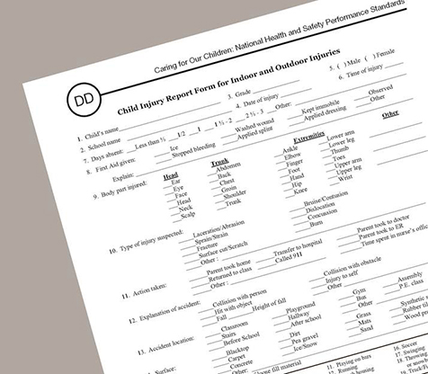
Document All Injuries
Prevent future injuries:
  Review past reports
  Look for patterns
  Figure out the causes
Notes:
All playground injuries should be documented (as with any injury) using the Child Injury Report Form for Indoor and Outdoor Injuries. This form can be found in Appendix DD of Caring for Our Children. You can also use the injury report form required by the state licensing entity for your program.
For Head Start Programs: You can also use the CFOC Incident Report Form, Appendix CC, which sometimes works better for early care and education programs, as it has language that aligns with injuries in early care and education programs.
Injury reports are important because they can be used to look for patterns of injuries and figure out the causes, so that the same injuries don‘t happen over and over again.
Sources
CFOC Appendix CC – Incident Report Form. (http://cfoc.nrckids.org/WebFiles/AppendicesUpload/AppendixCC.pdf)
CFOC Appendix DD – Child Injury Report Form for Indoor and Outdoor Injuries. (http://cfoc.nrckids.org/WebFiles/AppendicesUpload/AppendixDD.pdf)

Slide 38

Discussion
Describe something you’ve learned during this session that you can implement today to prevent children you care for from being injured while playing on a playground.
Notes:
Encourage participants to volunteer responses.

Slide 39

Summary
Falls - #1 cause of injury
  Check equipment
  Teach children safe play
  Document injuries
Use active supervision
Install shock absorbing surfaces
Use local resources/experts
Notes:
Help participants remember the main points of the session by reviewing the summary and answering any remaining questions.
Falls are the most common cause of playground injuries. Fractures, bruises, and abrasions are the most common injuries.
The safest surfaces for playgrounds are surfaces that help absorb the impact of a child falling.
Adult supervision is key to keeping children safe from injury at the playground. Lack of supervision is associated with nearly half of all playground injuries. Make sure all adults who are supervising children on the playground know how to effectively supervise children and know which children they are to watch.
Monthly safety checks of all equipment provide an opportunity to notice wear and tear that require maintenance. Safety checks help prevent an injury before it has a chance to happen.
Children need rules to play safely. Teach children these rules and consistently enforce them.
All injuries should be documented. Look for patterns, investigate causes, and implement preventive measures.
Local resources are available to help you. Locate a local Certified Playground Safety Inspector in your area, your community’s parks and recreation department, the local Safe Kids Coalition, and other community groups.

Slide 40
Resources
Early Childhood Learning and Knowledge Center (ECLKC): Administration for Children and Families. Health and Human Services
Consumer Product Safety Commission: www.cpsc.gov or www.recalls.gov
ASTM International: www.astm.org
Injury Free Coalition for Kids: www.injuryfree.org
Caring for Our Children, 3rd edition: http://cfoc.nrckids.org
Notes:
Early Childhood Learning and Knowledge Center - safety and injury prevention resources for children in Head Start programs
The Consumer Product Safety Commission offers a free subscription e-mail service for product recall notices.
The ASTM International is an international standards organization that develops and publishes voluntary consensus technical standards for a wide range of materials, products, systems, and services.
The Injury Free Coalition for Kids is one of the most effective injury prevention programs for children.
Caring For Our Children provides the standards that early education and child care settings should be following and implementing in their centers.

Slide 41
Resources
National Recreation and Park Association (www.nrpa.org)
  Certified Playground Safety Inspector
Safe Kids Worldwide: www.safekids.org
  Coalitions across the United States
National Program for Playground Safety: www.playgroundsafety.org
  Online safety courses available
Notes:
A Certified Playground Safety Inspector can be used for guidance in assisting with outdoor play areas. To locate a local inspector, check the National Recreation and Park Association registry.
Safe Kids Worldwide has coalitions across the United States that advocate for the prevention of injuries to children. Visit the Web site to find a local group.
The National Program for Playground Safety has several interactive online courses covering a variety of topics on developing and maintaining safe and appropriate outdoor play environments for children.

Slide 42
Acknowledgements
This curriculum has been developed by the American Academy of Pediatrics (AAP). The authors and contributors are expert authorities in the field of pediatrics.
The recommendations in this curriculum do not indicate an exclusive course of treatment or serve as a standard of medical care. Variations, taking into account individual circumstances, may be appropriate.
Listing of resources does not imply an endorsement by the AAP. The AAP is not responsible for the content of resources mentioned in this curriculum.
Web site addresses are as current as possible, but may change at any time.
Support for the Heathy Futures curricula has been provided through funding from Johnson & Johnson Consumer Inc.

Slide 43
Acknowledgements
  Project Advisor
  Andrew N. Hashikawa, MD, MS, FAAP
  AAP Early Childhood Champion (Michigan)
  University of Michigan Injury Center
  (Assistant Professor)
  Curriculum Content Consultant
  Amy Teddy – Child Safety & Injury Prevention Expert (University of Michigan)
  Steering Committee
  Danette Glassy, MD, FAAP
  AAP Council on Early Childhood Member
  Nancy Topping-Tailby, MSW, LICSW
  National Center on Early Childhood Health & Wellness
  Susan Pollack, MD, FAAP
  AAP Committee, Section, Council Reviewers
  Council on Early Childhood
  Council on Injury, Violence, and Poison Prevention
  Disaster Preparedness Advisory Council
  University of Michigan Contributors/Reviewers
  Allison Effron, MD
  Tiffany Munzer, MD

Slide 44
Copyright Information
Copyright©2016 American Academy of Pediatrics. All rights reserved. Specific permission is granted to duplicate this curriculum for distribution to child care providers for educational, noncommercial purposes.

