Slide 1
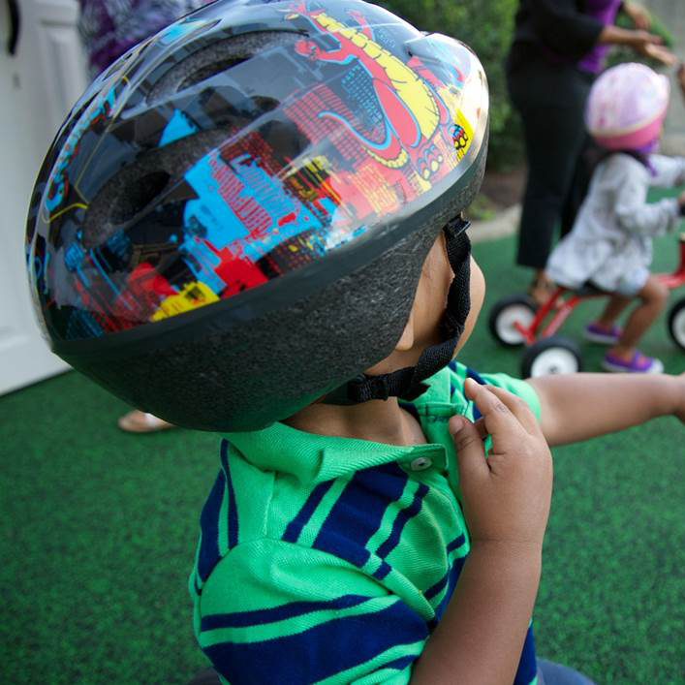
Keeping Children Safe in Early Care and Education Settings
Helmet Safety
Notes:
Today’s topic is part of an ongoing series on Injury Prevention in early care and education settings. Today we will be talking about Helmet Safety.
Other modules that you may be interested in include Transportation Safety (Yellow), Playground Safety (Green), Medication Safety (Blue), and Fire and Burn Prevention (Red).
The information in this module is consistent with the Standards established in the American Academy of Pediatrics (AAP), American Public Health Association (APHA), National Resource Center for Health and Safety in Child Care and Early Education, and the Maternal and Child Health Bureau (MCHB) publication Caring for Our Children: National Health and Safety Performance Standards—Guidelines for Early Care and Education Programs, 3rd Edition. The MCHB resource can be accessed online at http://cfoc.nrckids.org or purchased at http://shop.aap.org/.

Slide 2

Keeping Children Safe From Injuries in Early Care and Education Settings
Welcome
Date
Location
PRESENTER INFORMATION HERE
Notes:
Welcome everyone and thank participants for coming.
Introduce yourself.
Connect with participants and get an idea of who they are.
If the group is small enough, ask participants to introduce themselves, tell where they work, and describe their type of early care and education facility and their role.
Alternatively, ask participants to raise their hands if they are center directors, early care and education workers, Head Start providers, family child care providers, parents, grandparents, etc.

Slide 3
Learning Objectives
Understand the risks associated with use of wheeled toys by young children
State when helmets should be used
Explain how to check proper helmet fit
State at least 2 concepts to teach children about wheeled toy safety
Notes:
Review learning objectives with participants.
By the end of today’s lecture, you will be able to:
Understand the risks associated with use of wheeled toys by young children
State when helmets should be used
Explain how to check proper helmet fit
State at least 2 concepts to teach children about wheeled toy safety
Design note: There is no participant manual. The slides will be used to create the participant handout (without speaker notes). The learning objectives need to be on the screen so participants can refer to them.

Slide 4
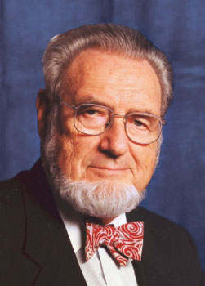
“If a disease were killing our children in the proportions that injuries are, people would be outraged and demand that this killer be stopped.”
C. Everett Koop, MD
Former US Surgeon General
Notes:
C. Everett Koop helped raise injury prevention as a public health issue.

Slide 5
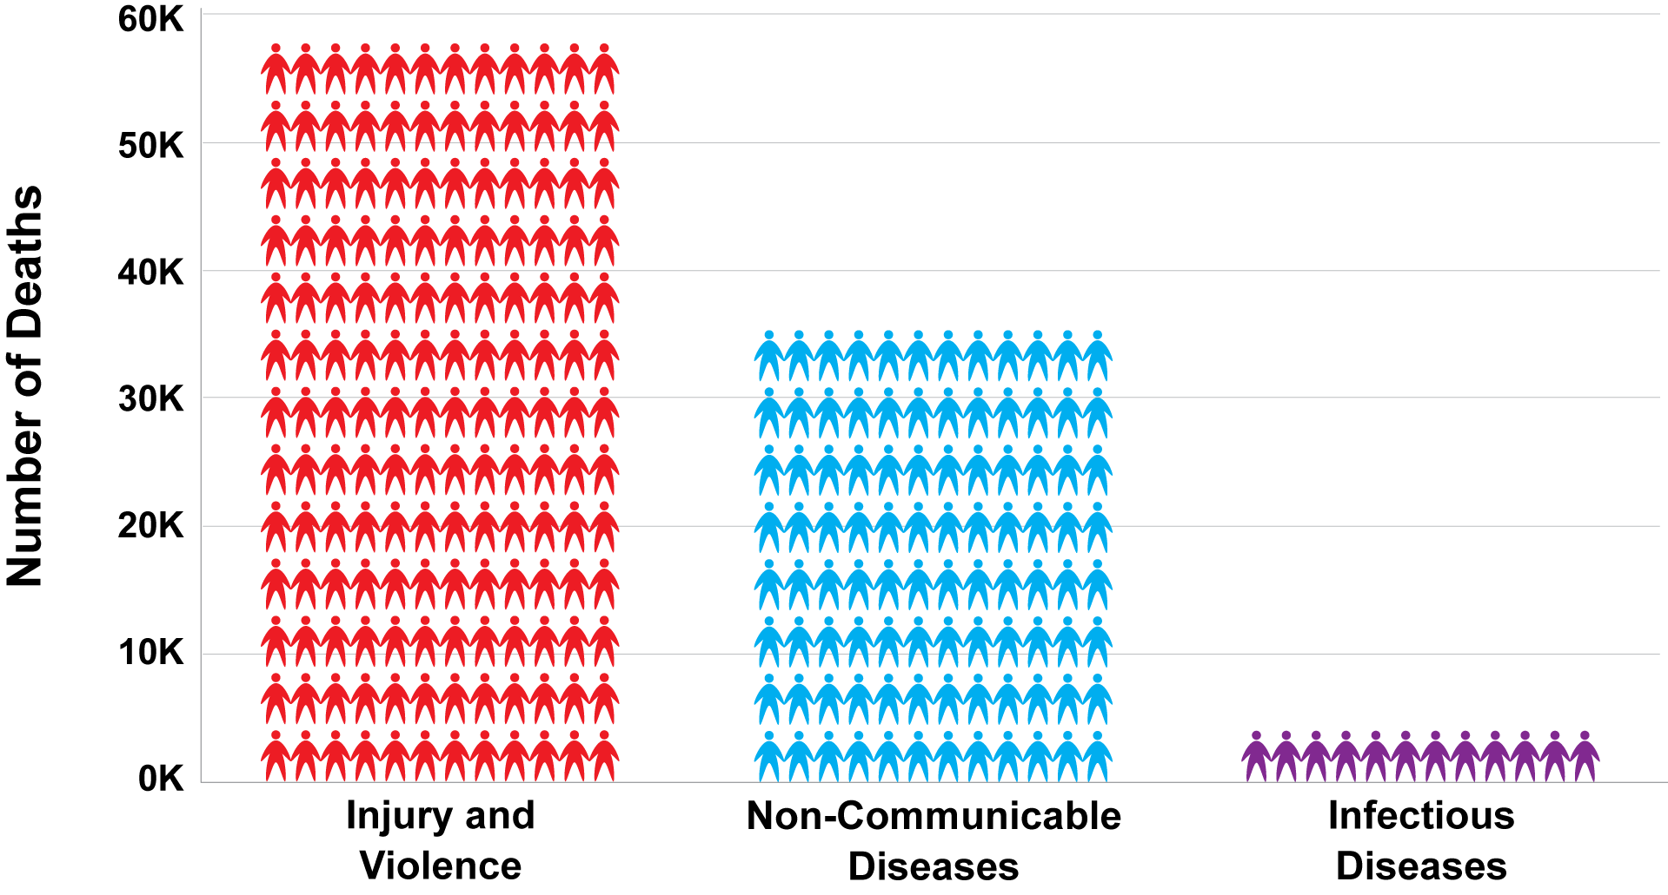
Injury Deaths Compared to Other Leading Causes of Death
(Ages 1–44, United States, 2013)
Notes:
When it comes to public health, many people focus on diseases. But the fact is that more people die each year from injury and violence than from diseases. In fact, the number one cause of death and disability among children alone in the United States is from injuries. Most injuries are preventable AND predictable.
Source
Centers for Disease Control and Prevention. Injury Prevention and Control. 2015. (http://www.cdc.gov/injury/overview/leading_cod.html)

Slide 6
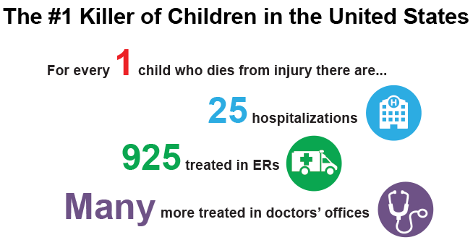
Injury
Notes:
More than 9,000 children die each year from injuries, which is equal to 150 school buses all loaded with children.
However, injury deaths are only part of the tragic story. Each year, millions of children are injured and have to live with these injuries for a period of time; sometimes their injuries have a lifelong effect.
With a fatal injury, family, friends, coworkers, employers, and other members of the child’s community feel the loss. With a nonfatal injury, family members must often care for the injured child, which can cause stress, time away from work, and lost income.
Injuries to children can result in major expenses, including medical costs for the injured child and loss of wages for the parent/caregiver.
The consequences of these fatal and nonfatal injuries to children have a physical and emotional cost to the individual and our society. An injury affects more than just the injured child—it affects many others involved in the child’s life. The community also feels the cost burden of child injuries, as does the state and the nation.
For children, even minor injuries cause pain and may limit their activities. Major injuries may involve hospitalizations, emergency room visits, and multiple doctors’ visits. Sometimes the injury can lead to one or more of the following: physical limitations, stress, depression, constant pain, and a major change in their lifestyle or quality of life.
Source
Centers for Disease Control and Prevention, Vital Signs 2012

Slide 7
Injuries Among Children
Leading cause of death and disability
  10% of injuries in preschoolers happen in early care and education settings
Not accidents
  Preventable and predictable
Notes:
Injuries are the main cause of death and disability among children in the United States. Ten percent of those injuries in young children (preschool ages 0-5) happens in the early care and education setting.
Injuries are NOT accidents, as that implies or suggests that they occur randomly and could not be prevented. But we know that is not true, because we know that most common injuries among children are preventable and predictable.
Source
Hashikawa AN, Newton MF, Cunningham RM, Stevens MW. Unintentional injuries in child care centers in the United States: A systematic review. Journal of Child Health Care. 2015 Mar;19(1):93-105. doi: 10.1177/1367493513501020. Epub 2013 Oct 3.

Slide 8


Imagine
Notes:
Show the video Imagine a World Where Every Kid Is a Safe Kid. Help each child reach his or her full potential by reducing preventable injuries.
http://www.safekids.org/video/imagine-world-where-every-kid-safe-kid

Slide 9

Caring for Our Children Standards
Caring for Our Children: National Health and Safety Performance Standards—Guidelines for Early Care and Education Programs (CFOC)
3rd edition
Available at http://cfoc.nrckids.org
(free download and purchase
options)
Notes:
Caring for Our Children contains standards for injury prevention and safety practices.

Slide 10
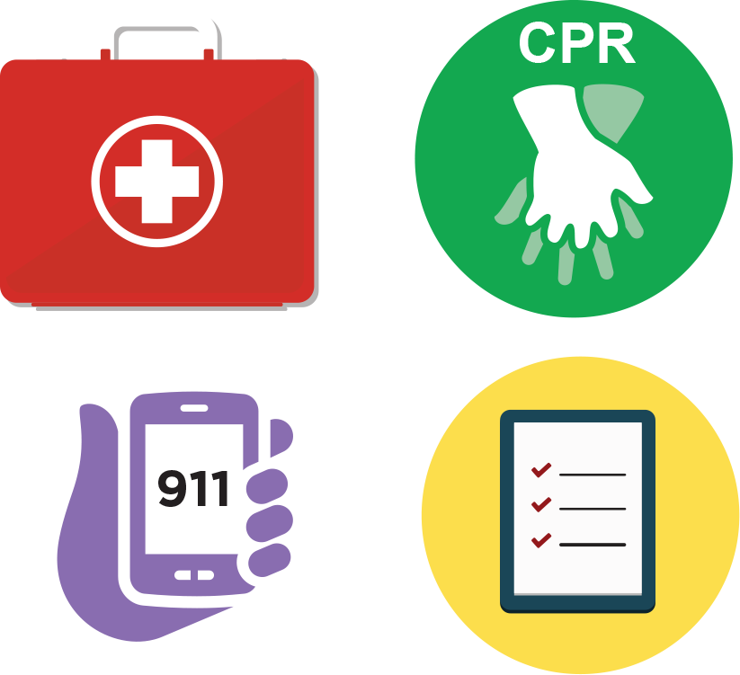
Injuries
Pediatric first aid kit
Pediatric CPR and first aid training
Communication device for emergencies (911)
Document and notify parents and state licensing agency
Report serious injuries to appropriate authorities
Notes:
Pediatric First Aid kits should be stocked and available in each location where children are cared for. This includes a transportable first aid kit that can go with the children for a walk or in a vehicle.
Pediatric First Aid and CPR training
You are most likely to need first aid skills, therefore, all staff members that have contact with children should be current on training for first aid.
At least 1 staff member currently certified in CPR should be present at all times.
Communication device
Emergencies can happen quickly. Each staff member should have a way to call for help. This is especially important when children are taken away from the facility to a playground, for a walk, or on a field trip.
Document and notify parents
In the event of an injury a report should be completed and filed. Parents should be notified immediately of an injury or illness of their child.
Require that child care providers report any serious injuries or deaths of children occurring in child care to a designated state, territorial, or tribal entity.
Source
Child Care and Development Fund, Section 98.42 – Enforcement of licensing and health and safety requirements. (b)(4)

Slide 11

The Early Care and Education Provider
Relationship with family and child
Model safety for children and families
Notes:
Why is your role as a early care and education provider so important?
Children spend a lot of time in the early care and education setting. In fact, some children spend more awake hours there than they do at home. Children depend on caregivers to provide a safe environment away from home.
As a provider, and because of your relationship with the family and child, you are the perfect person to focus on safety. You have the chance to not only keep the children safe, but to find ways to teach them about how they can prevent injuries. This can be done by modeling and explaining safe behaviors in a way that is appropriate for the age and developmental level of the children in your care.
Explain to participants the importance of role modeling. Adults often underestimate their impact with role modeling. Children will follow your example. Always practice safe behavior. The effectiveness of health and safety education is enhanced when shared between the caregiver/teacher and the parents/guardians.
Source
CFOC Standard 2.4.1.2 – Staff modeling of healthy and safe behavior and health and safety education activities. (http://cfoc.nrckids.org/StandardView/2.4.1.2)

Slide 12


The problem

Slide 13
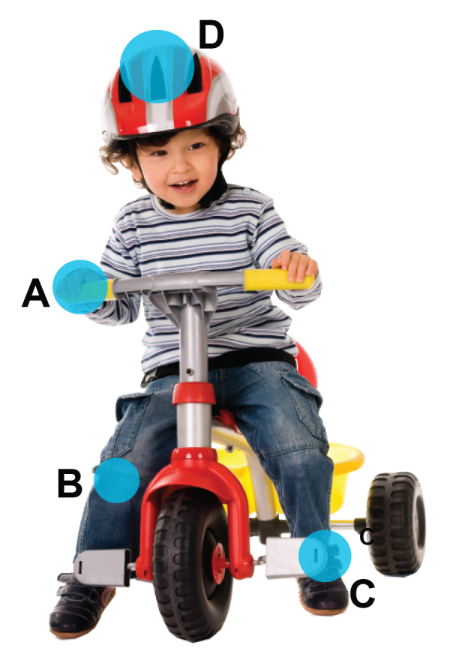
Tricycle-Related Injuries
Among tricycle-related injuries, the ____ is the most commonly injured body part.
hand
knee
ankle
head
Notes:
Activity Quiz
For all of the activity quizzes, present the question and ask participants what they think the correct answer is.
As you read each response, have participants raise their hands if they think that response is the correct answer. After participants have responded, discuss the important points of the topic.

Slide 14
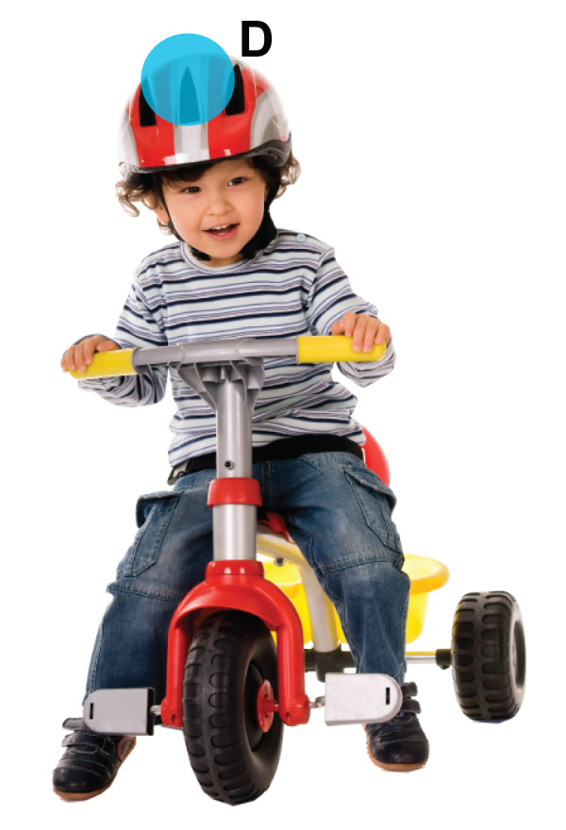
Tricycle-Related Injuries
Among tricycle-related injuries, the head
is the most commonly injured body part.
hand
knee
ankle
head
Notes:
Activity Quiz
The head is the most commonly injured region of the body and the most common region to endure internal damage.

Slide 15
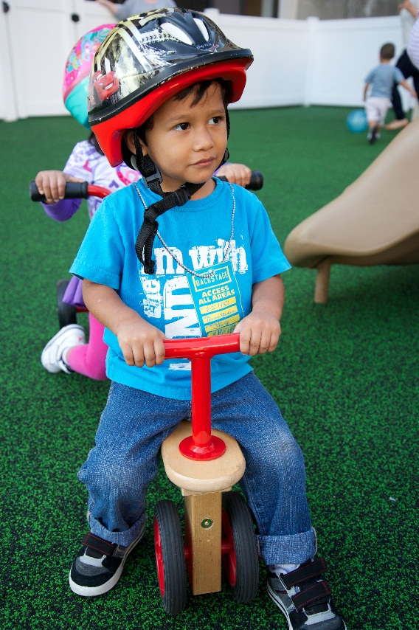
Wheeled Toys
Helmets: most effective safety device to prevent injury
Wheeled toys (eg, bicycles/tricycles, skates): leading cause of head injuries for children
600 children injured per day
Only ½ of children wear helmets
Notes:
Helmets are the single most effective safety device available to reduce head injury and death from bicycle crashes and accidents related to other wheeled equipment.
Wheeled activities that are not motorized include bicycles and tricycles, rollerblades, skates, and skateboards. The American Academy of Pediatrics (AAP) does not recommend skateboard use in the early learning population. For more information, visit
http://pediatrics.aappublications.org/content/109/3/542.ful?sid=922f9431-8927-44d6-8c26-6171ff74b84a
Each month, 3 out of 4 children in the United States ride a bicycle.
Approximately 55% of children don’t always wear a helmet while bicycling.
Apart from cars, bicycles are tied to more childhood injuries than any other consumer product.
Helmet use is the single most effective way to reduce bicycle-related fatalities.
Helmets reduce the risk of head injury by at least 45%, brain injury by 33%, facial injury by 27%, and fatal injury by 29%. One study suggests that helmet use can reduce the risk of head injury by 85% and severe brain injury by 88%.
More injuries are associated with non-motorized scooters among children younger than age 15 than any other toy.
Source
Safe Kids Worldwide at http://www.safekids.org/sites/default/files/documents/skw_bike_fact_sheet_feb_2015.pdf

Slide 16
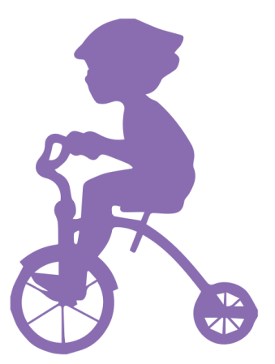
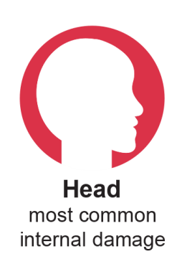
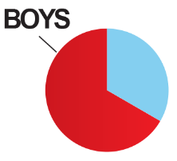
2015 Study: Tricycle Injuries
2012: Most common cause of
toy-related deaths
~5,000 tricycle-related injuries
per year
The head is the most frequently injured body part
  Most likely part to endure internal organ damage
Notes:
According to the Consumer Product Safety Commission, tricycles have remained the second most common cause of reported toy-related deaths among children younger than age 15 in the United States from calendar years 2005 to 2009. In 2012, tricycle accidents were the most common cause of reported toy-related deaths in children.
From 2012 to 2013, a 2-year period, there were more than 9,000 tricycle-related injuries. This equates to approximately 5,000 injuries each year.
An estimated 9,340 tricycle-related injuries were treated in US emergency departments from 2012 to 2013. Two-year-olds had the highest frequency of injuries (2,847). Boys accounted for 63.6% of all injuries. Children between ages 1 and 2 represented 51.9% of all injuries (4,847).
Researchers estimated the total included 2,767 injuries to the head, 767 at the elbow, 1,880 accidents damaging the face, 954 hurting the mouth, and 483 harming the lower arms.
On average, the injured children were approximately 3-years-old, and patients between ages 1 and 2 represented slightly more than half of the cases.
Boys accounted for almost two-thirds of the accidents.
An indication that safety is important even on short rides or trips that don’t extend beyond the yard or driveway is that approximately 72% of the injuries happened at home.
Source
Bandzar S, Vats A, Gupta S, Atallah H, Pitts SR. Tricycle injuries presenting to US emergency departments, 2012–2013. Pediatrics. October 2015;36(4). (http://pediatrics.aappublications.org/content/pediatrics/early/2015/09/08/peds.2014-3632.full.pdf)

Slide 17
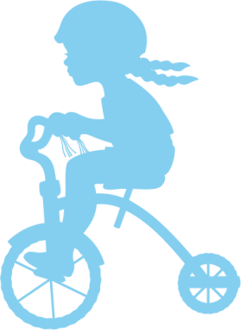

2015 Study: Tricycle Injuries
Most common
  Type: Lacerations
    3 to 5-year-olds: internal organ damage
  Body part: Head
  Fracture: Elbow
Notes:
Lacerations were the most common type of injury.
Internal organ damage was the most common type of injury in 3- to 5-year-olds.
Contusions were the most common type of injury in 1- to 7-year-olds.
The head was the most commonly injured region of the body and the most common region to endure internal damage.
The elbows were the most commonly fractured body part.
The upper extremity was more frequently fractured than the lower extremity.
Source
Livescience study – available at http://www.livescience.com/52160-tricycle-accidents-children-injuries.html

Slide 18
American Academy of Pediatrics
Tricycles
  Age 3: Balance and coordination to ride
  Low to ground + big wheels = safest
Supervision: Away from pools
and streets
Older than age 1 + riding wheeled toys = helmet
Notes:
In the early care and education setting, all riders should wear properly fitting helmets when riding toys (such as tricycles) and wheeled equipment (such as scooters).
Approved helmets should meet the standards of the US Consumer Product Safety Commission (CPSC). The standards sticker should be located on the bike helmet. Helmets should be removed once children are no longer using wheeled riding toys or wheeled equipment.
The American Academy of Pediatrics says most children don’t have the balance or coordination to ride a tricycle until approximately age 3.
Tricycles that are low to the ground, with big wheels, are safest, and helmets should be worn, the AAP says. Proper supervision is advised, including keeping little cyclists away from pools and streets. This is where most deaths occur involving tricycles.
Sources
CFOC Standard 6.4.2.1 - Riding Toys with Wheels and Wheeled Equipment. (http://cfoc.nrckids.org/StandardView/6.4.2.1)
CFOC Standard 6.4.2.2 – Helmets. (http://cfoc.nrckids.org/StandardView/6.4.2.2)

Slide 19
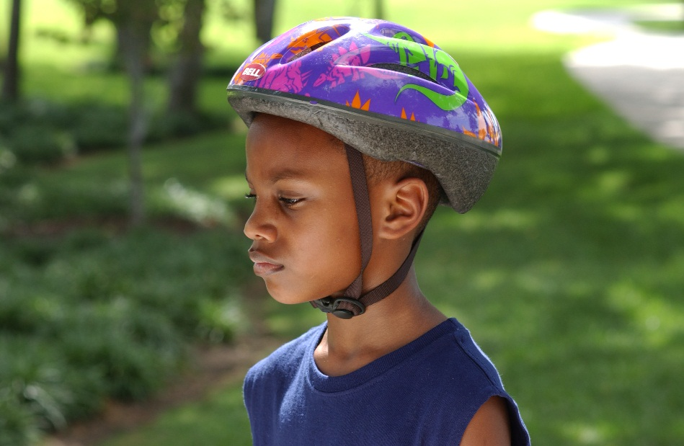
Helmet
Most effective way to reduce injury
Recommended: Older than age 1
Remove after use
  Strangulation risk
    Playground equipment
    Climbing trees
    Worn incorrectly
Notes:
Helmets are the single most effective safety device available to reduce head injury and death from bicycle crashes and accidents related to other wheeled equipment.
Helmets should be REMOVED once children are no longer using wheeled riding toys or wheeled equipment.
Helmets can be a potential strangulation hazard if they are worn for other activities such as playing on playground equipment or climbing trees.
Helmets can be a potential strangulation hazard if they are worn incorrectly.
Babies younger than 1 year have relatively weak neck structures. Infants are just learning to sit unsupported and have not developed sufficient bone mass and muscle tone to enable them to sit with their backs straight. Having infants sitting in a slumped or curled position for prolonged periods can be dangerous. Having infants younger than 1 wear a bike helmet can strain their neck muscles and can be harmful.
All children ages 1 and older should wear properly fitted and approved helmets while riding toys with wheels or using any wheeled equipment.

Slide 20
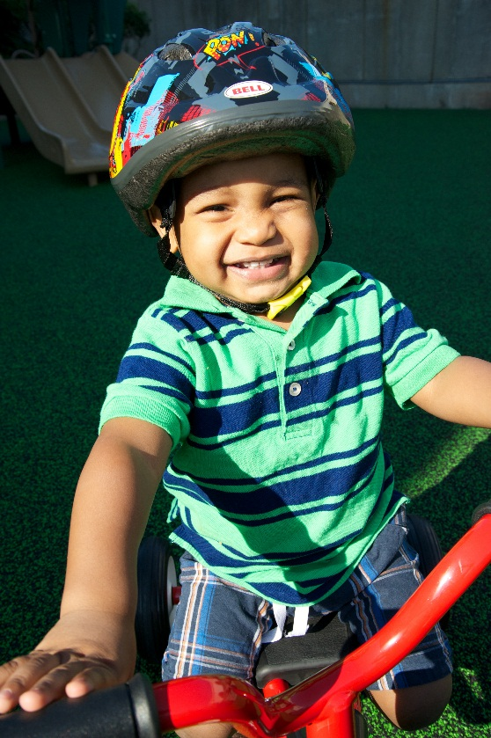
Wearing a Helmet
A child should wear a helmet when riding any wheeled toys
  Bicycles
  Tricycles
  Scooters
  Training skates
*Skateboards are NOT recommended for young children
Notes:
Helmets should be worn even for short trips.
The AAP does NOT recommend skateboard use by young children.

Slide 21
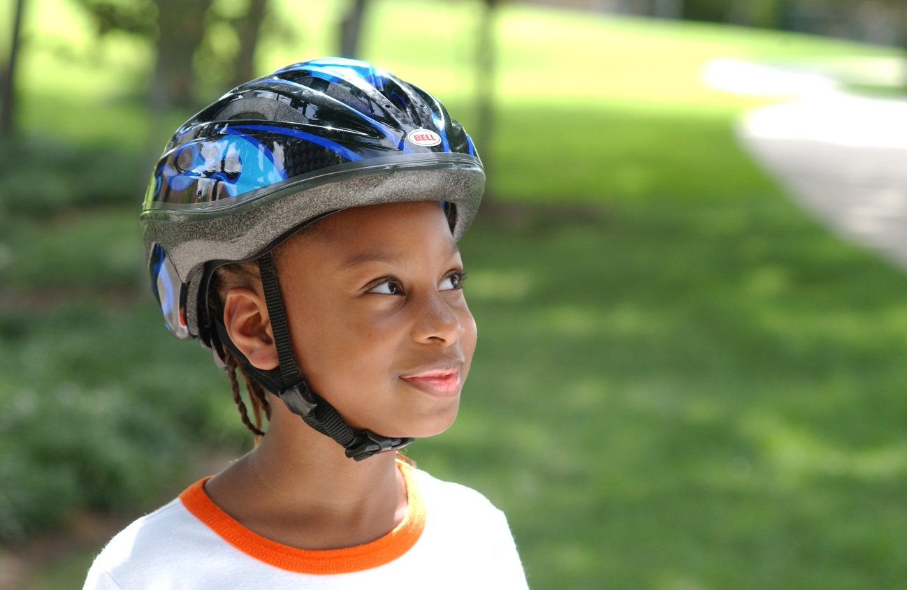
Fit Test: Eyes
Eyes
  No more than 2 fingers above eyebrows
Notes:
Adjust the Straps
Eyes: The child should be able to see the front edge of the helmet.
Sources
Safe Kids Worldwide. Does Your Bicycle Helmet Fit Properly? (http://www.safekids.org/sites/default/files/documents/Helmet%20Fit%20Test%202013.pdf)
Safe Kids Worldwide. Bike Helmet Fit Test. (http://www.safekids.org/video/bike-helmet-fit-test)

Slide 22
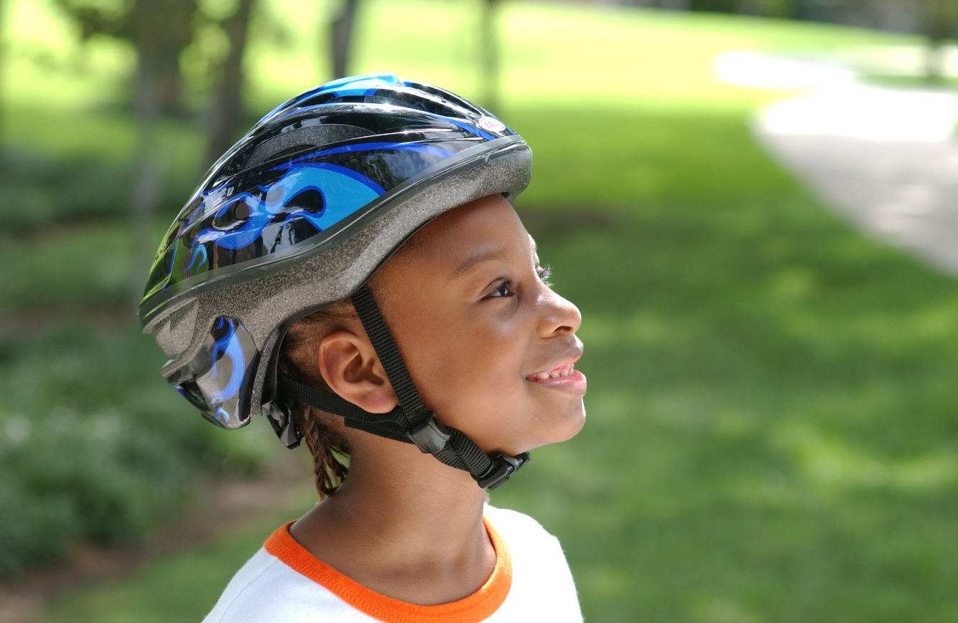
Fit Test: Ears
Ears
  Straps should form
  a V under ears
Notes:
Adjust the Straps
Ears: The sliders should be moved up to just under the ear lobes.
Sources
Safe Kids Worldwide. Does Your Bicycle Helmet Fit Properly? (http://www.safekids.org/sites/default/files/documents/Helmet%20Fit%20Test%202013.pdf)
Safe Kids Worldwide. Bike Helmet Fit Test. (http://www.safekids.org/video/bike-helmet-fit-test)

Slide 23
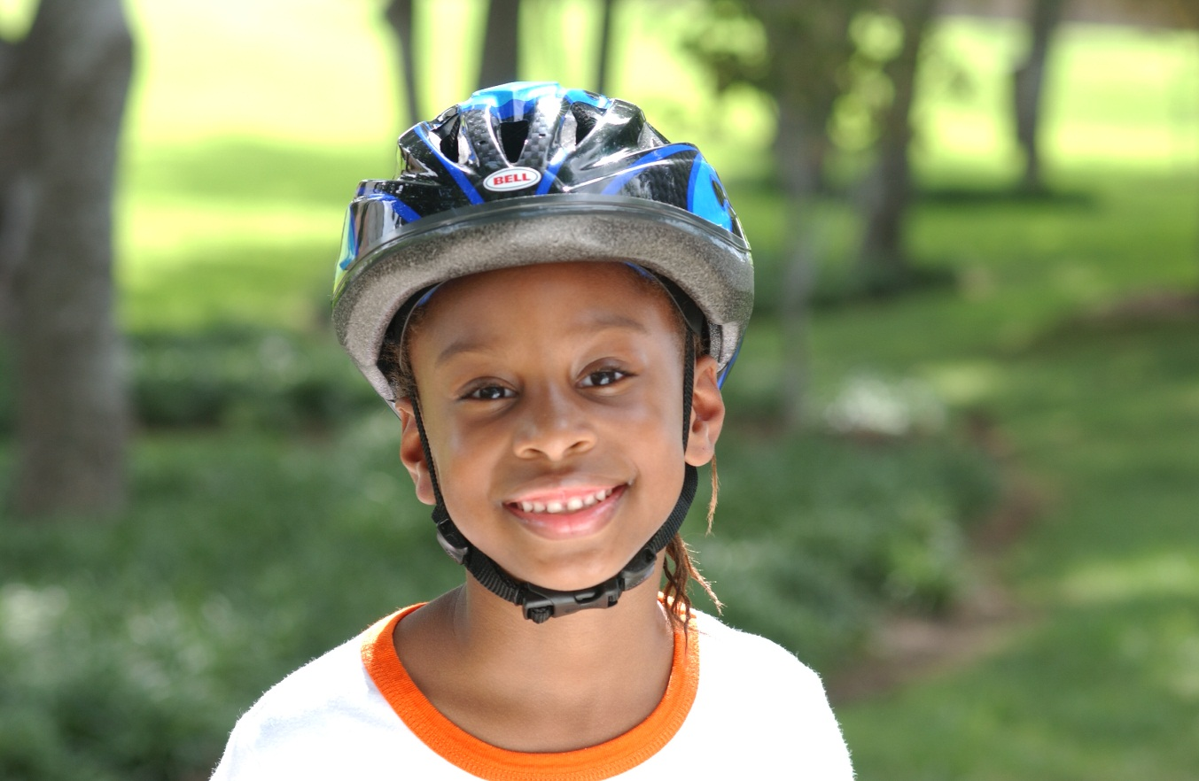
Fit Test: Mouth
Mouth
  No more than 1‒2 fingers between chin and strap (buckled)
Notes:
Adjust the Straps
Mouth: The chin strap should fit snugly enough that opening the mouth widely will move the helmet.
Sources
Safe Kids Worldwide. Does Your Bicycle Helmet Fit Properly? (http://www.safekids.org/sites/default/files/documents/Helmet%20Fit%20Test%202013.pdf)
Safe Kids Worldwide. Bike Helmet Fit Test. (http://www.safekids.org/video/bike-helmet-fit-test)

Slide 24
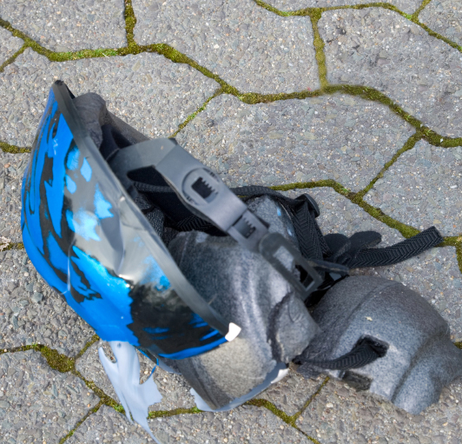
When to Replace
Crashed
Cracked
Broken straps
Recommended by manufacturer
Notes:
Bike helmets should be replaced if they have been involved in a crash, the helmet is cracked, the straps are broken, the helmet can no longer be worn properly, or according to recommendations by the manufacturer.

Slide 25
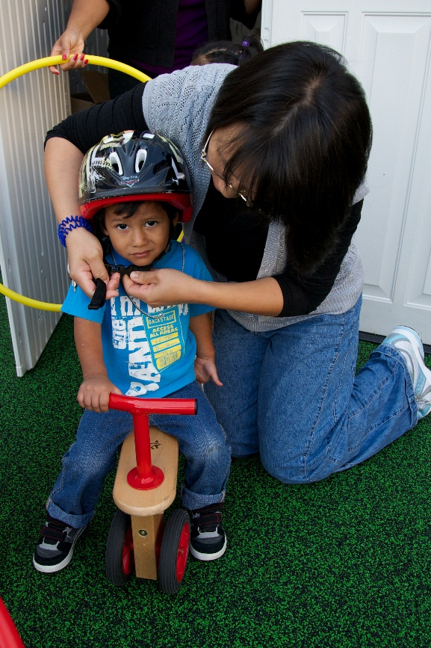
Cleaning
Brain injury vs head lice
Best practice: Use own helmet
  If shared: Clean between users (mild detergent)
  Can use surgical hats
Notes:
Concern regarding the spreading of head lice in sharing helmets should not override the practice of using helmets. The prevention of a potential brain injury heavily outweighs a possible case of head lice.
While it is best practice for each child to have his or her own helmet, this may not be possible. If helmets need to be shared, it is recommended that the helmets be cleaned between users.
Wiping the lining with a damp cloth (with mild detergent) should remove any head lice, nits, or fungal spores. Another option is to use surgical hats under the helmet.

Slide 26
Teaching kids AND FAMILIES

Slide 27
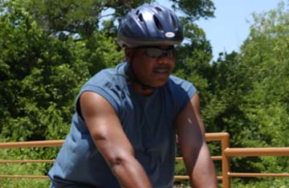
Wheel Safety
Role model
Wear helmets
  Start habit early
Stay alert
Notes:
Role Model and Teach Good Behavior (Safe Kids Bike Safety Tips)
Children learn by watching the adults around them! It's important for early care and education workers and parents to model safe behavior.
Wear a Helmet
Early care and education workers should also wear helmets when using bicycles or other wheeled equipment. A child who rides with companions wearing helmets or adults in general is more likely to wear a helmet.
Start the habit of putting on a helmet when children are young so that you do not have to work to correct the behavior later in life!
Stay Alert
No matter where you ride, teach children to stay alert and watch for cars and trucks and for what might be ahead.

Slide 28
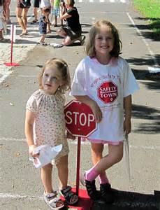
Rules of the Road: Simulating Safety
Set up pretend “roads” (chalk) and stop signs/signals:
Teach kids to stay to the right
Use sidewalks
Cross at intersections
Stop at lights and stop signs
Stop: Look left, right, and left again
Notes:
Teach children street safety when using a bicycle. This can be done at the center or home in the driveway or parking lot using pretend roads (chalk) and play stop signs or signals.
Remind children to:
Make eye contact with drivers. Bikers should make sure drivers are paying attention and are going to stop before they cross the street.
Ride on the right side of the road, with traffic, not against it. Stay as far to the right as possible. Use sidewalks whenever possible.
Always cross at intersections. Look back and yield to traffic coming from behind before turning left.
Use appropriate hand signals when turning and obey traffic signals, stopping at all stop signs and stoplights.
Stop and look left, right, and left again before entering a street or crossing an intersection.
Source
Safety Town Model. (http://www.a2schools.org/Page/5004)

Slide 29
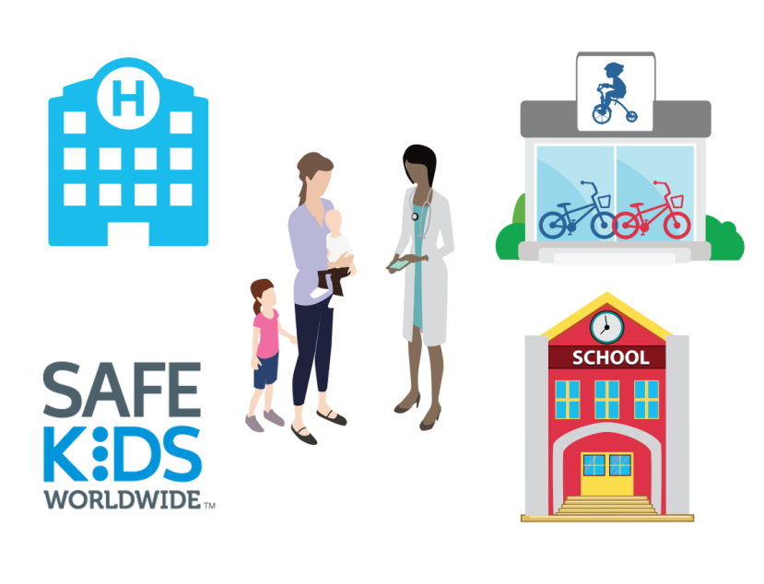
Develop Policies and Know Local Resources
Use best practices
Work with local experts
Pediatrician
Safe Kids Coalition
Bike shops or clubs
Schools
Find discounted or free helmets
Notes:
Use best practices to develop policies for your center. You can use the best practices presented in this module to develop policies.
You can work with a pediatrician, Head Start health manager, or a child care health consultant if you need help or have questions. Work with local experts.
Take advantage of discounted or free helmets for your center. Visit Helmets.org, which has information on free helmets (http://www.bhsi.org/cheapies.htm).

Slide 30
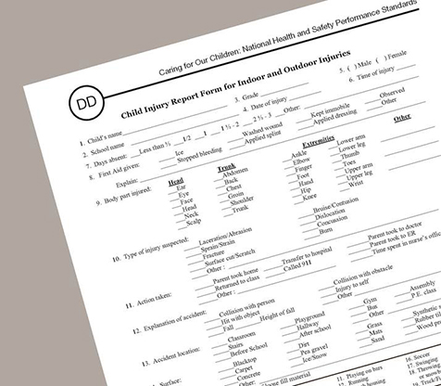
Document All Injuries
Prevent future injuries:
  Review past reports
  Look for patterns
  Figure out the causes
Notes:
All playground injuries should be documented (as with any injury) using the Child Injury Report Form for Indoor and Outdoor Injuries. This form can be found in Appendix DD of Caring for Our Children or you can use the injury report form required by your state licensing entity or your program.
For Head Start Programs: You can also use the CFOC Incident Report Form, Appendix CC, which sometimes works better for early care and education programs, as it has language that aligns with injuries in early care and education programs.
Injury reports are important because they can be used to look for patterns of injuries and figure out the causes, so that the same injuries don‘t happen over and over again.
Sources
CFOC Appendix CC – Incident Report Form. (http://cfoc.nrckids.org/WebFiles/AppendicesUpload/AppendixCC.pdf)
CFOC Appendix DD – Child Injury Report Form for Indoor and Outdoor Injuries. (http://cfoc.nrckids.org/WebFiles/AppendicesUpload/AppendixDD.pdf)

Slide 31
Summary
Wheeled toys: Leading cause of head injury
Helmet use with any wheeled equipment
Helmet fit: Eyes, ears, mouth
Role model and teach children about helmet safety
Notes:
Source
CFOC Standard 6.4.2.1 – Riding toys with wheels and wheeled equipment. (http://cfoc.nrckids.org/StandardView/6.4.2.1)

Slide 32
Resources
American Academy of Pediatrics:
http://www.healthychildren.org
Safe Kids Worldwide—A global organization dedicated to preventing injuries in children:
http://www.safekids.org
Centers for Disease Control and Prevention:
http://www.cdc.gov/motorvehiclesafety
Children’s Safety Network (CSN)—A national resource center for the prevention of childhood injuries and violence:
http://www.childrenssafetynetwork.org
Consumer Product Safety Commission:
https://www.cpsc.gov/

Slide 33
Acknowledgments
This curriculum has been developed by the American Academy of Pediatrics (AAP). The authors and contributors are expert authorities in the field of pediatrics.
The recommendations in this curriculum do not indicate an exclusive course of treatment or serve as a standard of medical care. Variations, taking into account individual circumstances, may be appropriate.
Listing of resources does not imply an endorsement by the AAP. The AAP is not responsible for the content of resources mentioned in this curriculum.
Website addresses are as current as possible but may change at any time.
Support for the Heathy Futures curricula has been provided through funding from Johnson & Johnson Consumer Inc.

Slide 34
Acknowledgments
  Project Advisor
  Andrew N. Hashikawa, MD, MS, FAAP –
  AAP Early Childhood Champion (Michigan)
  University of Michigan Injury Center
  (Assistant Professor)
  Curriculum Content Consultant
  Amy Teddy – Child Safety & Injury Prevention Expert (University of Michigan)
  Steering Committee
  Danette Glassy, MD, FAAP
  AAP Council on Early Childhood Member
  Nancy Topping-Tailby, MSW, LICSW
  National Center on Early Childhood Health & Wellness
  Susan Pollack, MD, FAAP
  AAP Committee, Section, Council Reviewers
  Council on Early Childhood
  Council on Injury, Violence, and Poison Prevention
  Disaster Preparedness Advisory Council
  University of Michigan Contributor/Reviewer
  Aviva Alpert, MD

Slide 35
Copyright Information
Copyright©2016 American Academy of Pediatrics. All rights reserved. Specific permission is granted to duplicate this curriculum for distribution to child care providers for educational, noncommercial purposes.

